Slide 1
java secure chat application
By : Ekhlas Isleem & Shaimaa Iqtefan
To : Dr. Ahmad Abdalaal

Slide 2
INTRODUCTION
Nowadays, while the popularity of chat applications increases, this popularity brings some security problems with it, providing an alternative to telephone and email conversations. A variety of encrypting methods are suggested and applied between server and client to minimize the increasing security problems in companies
People of all ages log into messenger service or chat rooms to spend time chatting persons. The aim of this project is to develop a client server java chat application with security in mind. The use of Encryption and decryption algorithm forms part of this project where by messages exchanged between client and server are encrypted and decrypted with a symmetric key to provide security , privacy and confidentiality of messages sent.

Slide 3
Objective :
To develop a client server java chat application that will enable instant messaging between host computers on a network.
To provide security of information (messages) by performing an encryption and decryption scheme due to which the messages together with the key is transferred in a cipher text format over the network rather than plain text so as to disallow intruder’s attempt.
A time has been added to ensure that the message arrives at the correct time

Slide 4
Why Should You Use a Team Chat App?
There are so many ways to talk to your team, from email and social networks. Even SMS could work.
Team chat is similar, but its main benefit is that it keeps all your company’s communications in one place, making it easier for everyone to talk together with group or private chats. No more searching for a team member’s email address; everyone’s a tap away, even from your phone.

Slide 5
APPLIED SECURITY ELEMENTS
Users of the chat application might be attacked over the internet, since there is no protection such as encryption or decryption for instant messaging sending as plain text between source and target. By stealing the identities of people who chat each other, the content of the message could change and thus, leads to undesired results. In this study, many security measures have been applied to protect the users from cyber-attacks such as changing the content of the message or deleting it

Slide 6
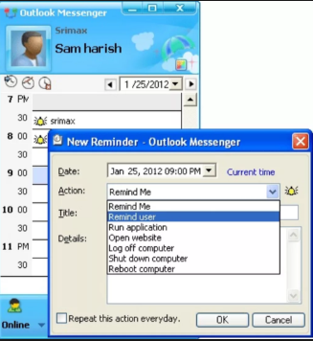
The related applications:
Outlook LAN Messenger
It is instant messaging software designed for use within Small, Medium and Corporate Office's Local Area Network. This Intranet Messenger is an ideal replacement for internet messengers in companies that creates private and secure messaging, and improve internal communications, business productivity and relationships with colleagues inside the company.

Slide 7
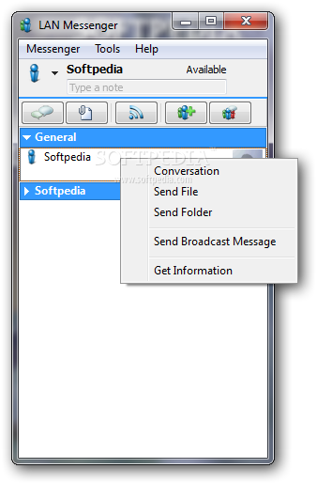
Cont…
LAN messenger Portable
LAN Messenger portable is a free peer-to-peer and open source cross-platform instant messaging application for communication over a local network. It does not require a server to establish connection.LAN messenger portable was developed by Microsoft and released in October 2003. A number of useful features including event notifications, file transfer and message logging are provided.

Slide 8
Security
This secured chat application model has some steps has been developed.
The server must be available all the time
At the first step, client identify himself to the server.
The second step is called connection where client connects to chat room and record its name in chat list .
In the third step which is called as secure message exchange (encrypted messaging). Messages written by clients are sent to server cryptically through symmetric encryption method (AES),DES,RC2,3DES .

Slide 9
Facts…
The server distribute a common key for clients , and create a new one every time
The message from client will be encrypted and when the reciever receive it, it will be decrypted, then display for client.
Client can send a message to everyone online or a private message to a particular person
The project display the date and time of sending and receiving the message at both parties to check the time of sending the message
The client must be online, so that he can communicate with others, And if one client is eliminated and became offline, he will be deleted from chat list
There are many cryptographic algorithms that can be used. Supports Arabic and English encryption

Slide 10
Messages types :
To server :
Connection msg
Key request
To other clients :
Normal message

Slide 11
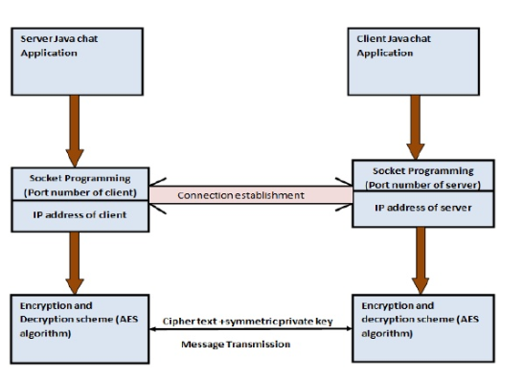

Slide 12
Risks (Disadvantages) :
Hardware of both server and client workstations can be wiped out and there can be impromptu shutdown whiles the application is still running
There may be occurrences of exception java run time errors that will disable the application from working if there is no java run time environment installed on the host computer.
There can be undesirable system behavior if for instance an invalid port number is inputted in one of the application modules.

Slide 13
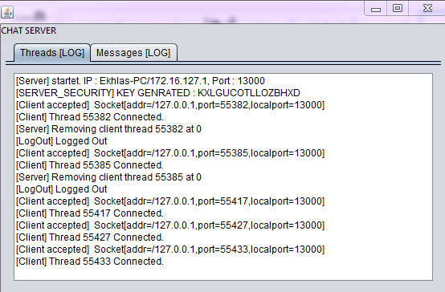

Slide 14
