Slide 1


The Chang School
of Continuing
Education
Recommendation System Based on Website Clickstream Data
Data Analytics, Big Data, and Predictive Analytics
Capstone Project , December 1, 2015
Dr. Hamidreza Chinaei
Project Supervisor
Shaimaa Soltan
Ryerson Student
-1-

Slide 2
The Chang School
of Continuing
Education
Problem Definition:
You have an attractive website layout. Though, your website bounce rate is high.
How could you improve your website layout to give you less bounce rate and increase your conversion?
Why using Recommender Systems?
Value for the customer
– Help me explore the space of options
– Discover new things
Clickstream
Product Profile
Recommender
Value for the provider
–unique personalized service for the customer
– Increase trust and customer loyalty
– Increase sales, click trough rates, conversion etc.
– Opportunities for promotion, persuasion
User Profile
-2-

Slide 3
The Chang School
of Continuing
Education
Dataset Description:
How we get data for our system?
Explicit Data
feedback & demographic data
User Profile from (CRM)
Product Profile from (CMS)
Fig. 1. Number of User Sessions per Product Category
Implicit Data (Website log files)
user do not know that you are capturing this data like Clickstream Data
We have in total 427811 records, with 16234 Unique Visitors and 14 Product Category. During a period of 15 days .
Feature engineering : Visit Duration, and Visit Day, Age, Number of visits….
https://s3.amazonaws.com/hw-sandbox/tutorial8/RefineDemoData.zip
-3-
Notes:
Basically, we have three types of data at our end as follows:
Website log files: containing information such as URL, timestamp, IP address, geocoded IP address, and user ID (SWIDs).
CRM (Customer Relationship Management): user data listing SWIDs (Software User IDs), along with date of birth and gender.
CMS (Content Management System): data that maps product categories to website URLs.

Slide 4
The Chang School
of Continuing
Education
Techniques used in literature:
Uncovering Large Groups of Active Malicious Accounts in Online Social Networks.
  clusters user accounts according to the similarity of their actions and uncovers large groups of malicious accounts
Multi-Stage Malicious Click Detection on Large Scale Web Advertising Data
First Stag was, Rule-based filtering.
Second Filtering stage was Classification-based filtering. Traffic click and Normal User Click
Third filtering stage was Clustering-based filtering.
-4-
Notes:
First paper we get a lot of ideas about how to do feature engineering.

Slide 5
The Chang School
of Continuing
Education
Methodology: Collaborative system
Feature Engineering & Exploratory Data Analysis (EDA)
Exploratory Data Analysis (EDA)
Features Engineering
Clickstream Filter
Stage One filtering
Stage Two Filtering
Build Recommendation Model
Build Scoring matrix
Build Discount Matrix
Products Pairs
 | Country | Age | Gender
Users set 1 | 4 * 100 | 3 * 10 | 1 * 1
Users set 2 | 1 * 100 | 4 * 10 | 1 * 1
…….
Filtered Clickstream Data
Age, Gender, and Country
Age, Gender,
and Country
# visits
# visits(class)
/ # visits
Product List | Discount
Prod. 1 | 0
Prod. 2 | 3 %
Prod. 3 | 12 %
Scoring Matrix
Users Classifications
Discount Matrix
User Profile
-5-

Slide 6
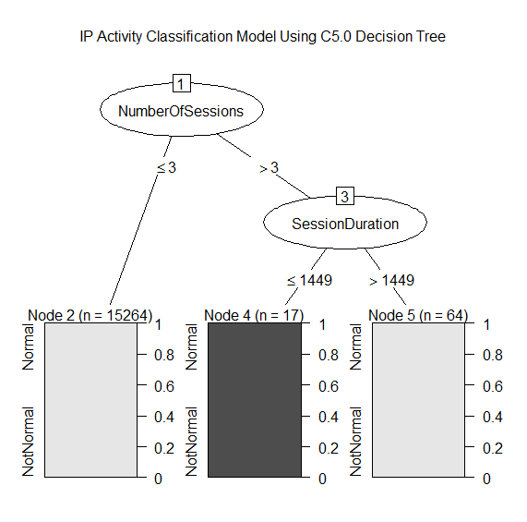
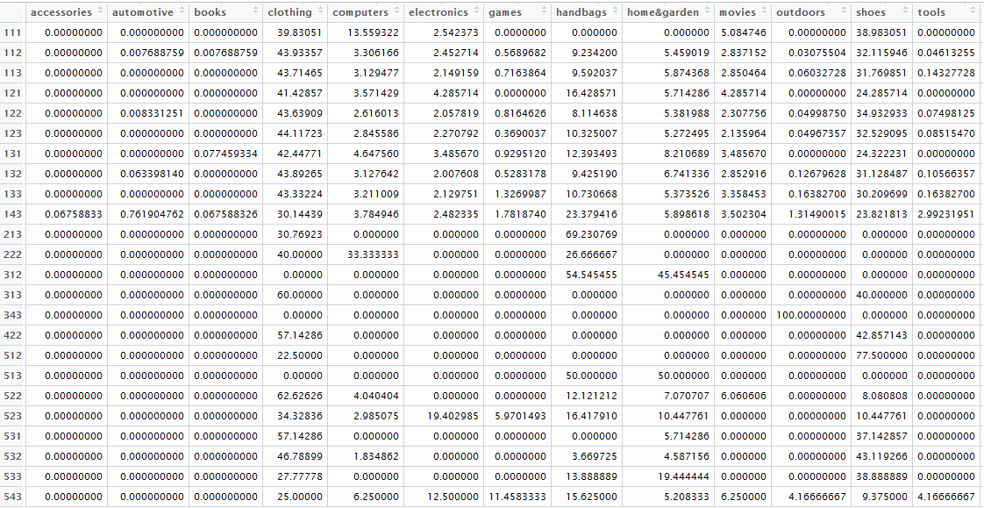
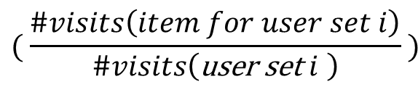
The Chang School
of Continuing
Education
Results and Discussion :
Items
User Sets
Fig. 3. Product / service Scoring Matrix
$$( \frac{\#visits\left(item for user set i\right)}{\#visits\left(\text{user} \text{set} i \right)} )$$
Fig. 2. IP Activity Classification Model Decision Tree
Scoring Matrix
Pros. : Reduce Sparsity
Cons. : Cold start, popularity bias
-6-

Slide 7
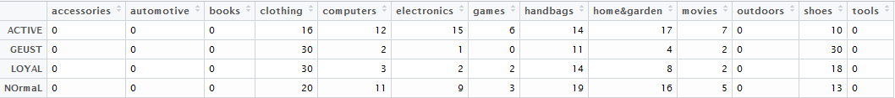
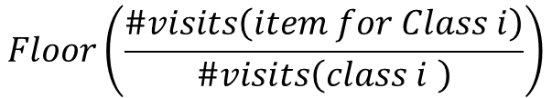
The Chang School
of Continuing
Education
Results and Discussion :
Items
$$Floor\left(\frac{\#visits\left(item for Class i\right)}{\#visits\left(class i \right)}\right)$$
User Classifications
> Product List('173.255.176.213')
[1] "Welcome To our website You are a GUEST USER "
[1] "Product List"
[1] "--------------------"
[1] "clothing --> 0% Discount"
[1] "shoes --> 0% Discount"
[1] "handbags --> 0% Discount"
[1] "home&garden --> 30% Discount"
[1] "movies --> 2% Discount"
[1] "computers --> 1% Discount"
[1] "electronics --> 0% Discount"
[1] "games --> 11% Discount"
[1] "tools --> 4% Discount"
[1] "outdoors --> 2% Discount"
[1] "accessories --> 0% Discount"
[1] "automotive --> 30% Discount"
[1] "books --> 0% Discount"
Fig. 4. Visitors Discount Matrix
> Product List('67.224.130.63')
[1] "Welcome To our website You are a Normal USER "
[1] "Product List"
[1] "--------------------"
[1] "clothing --> 0% Discount"
[1] "electronics --> 0% Discount"
[1] "handbags --> 0% Discount"
[1] "shoes --> 20% Discount"
[1] "games --> 12% Discount"
[1] "home&garden --> 9% Discount"
[1] "movies --> 3% Discount"
[1] "computers --> 19% Discount"
[1] "tools --> 16% Discount"
[1] "outdoors --> 5% Discount"
[1] "accessories --> 0% Discount"
[1] "automotive --> 12% Discount"
[1] "books --> 0% Discount"
-7-

Slide 8
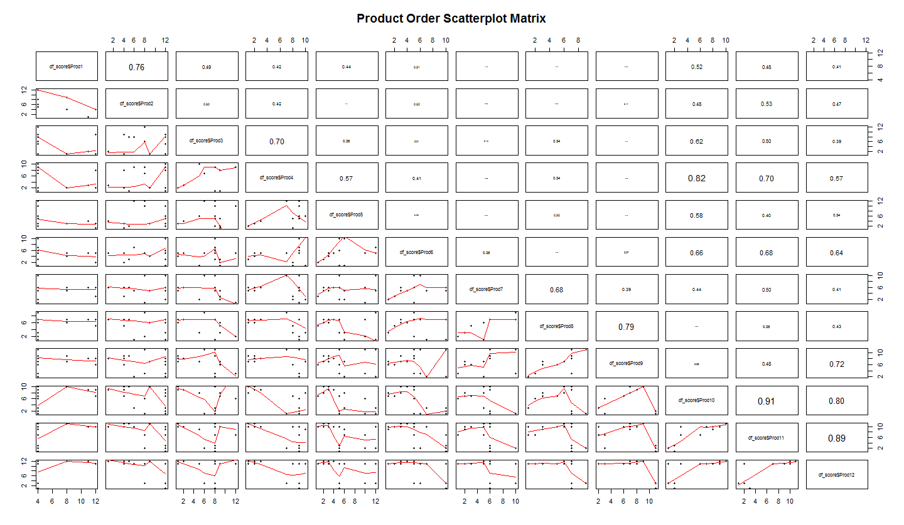
The Chang School
of Continuing
Education
Results and Discussion :
Evaluation :
Offline evaluation : we are not going to provide exact user behaviour but we will simulate user behaviour using existing user dataset and try to evaluate our system
Fig. 5. Product Index Order Scatterplot and Correlation Matrix
Algorithm | Accuracy for predicting First Item
KNN | 99.9984 %
SVM | 77.74 %
-8-

Slide 9
The Chang School
of Continuing
Education
Thank You
-9-

