Slide 1
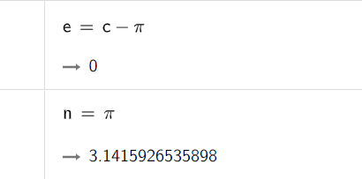


Pi value with interval integration
$$\int_{−10.38119222696}^{2}{\frac{1}{x^{2}+x+1}= π}$$

Slide 2
