Slide 1
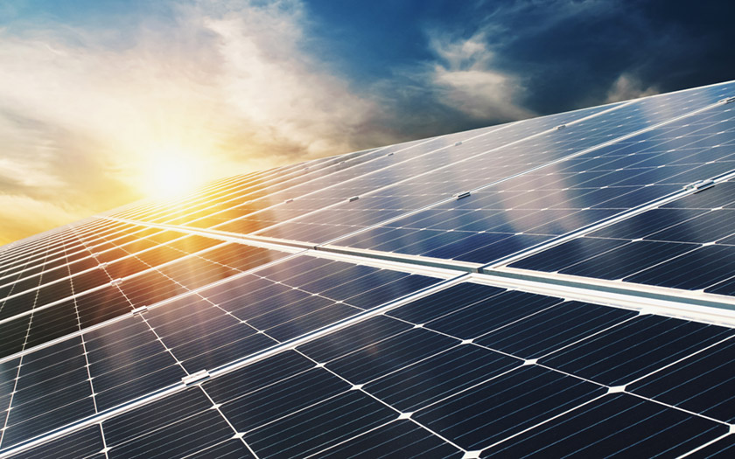
Solar Energy
Group (1) – App 4. - EAR

Slide 2
Solar energy

Slide 3
Solar Energy
Solar energy is the energy radiating from the sun that is usually converted into thermal or electricity. Solar energy is one of the sufficient renewable energy sources available, and the United States of America owns part of the richest solar power resources in the whole world.

Slide 4
How dose solar energy work?
The PV process works through the following broad steps :
The solar cells absorb the silicon photovoltaic (PV) from the solar radiation.
When sunlight interacts with the silicon cell, the electrons begin to move, causing an electric current to flow.
The wires pick up and feed this direct current (DC) into a solar inverter to be converted into alternating current (AC)

Slide 5
Advantages and Disadvantages of Solar Energy
Advantages:
Disadvantages:
Renewable and Safe Energy Source
Reduces Electricity Bills
Diverse Applications
Low Maintenance Costs
High Cost
Weather-Dependent
Solar Energy Storage IS Expensive
Uses a Lot of Space

Slide 6
The secant method

Slide 7

The secant method
the best way to apply for solar-energy collection by solve the equation for the geometrical concentration factor, which is the secant method.
The secant method is using the secant line for solving a nonlinear equation is a known iterative process.
$$x_{n+1}= x_{n}−f\left(x_{n}\right)\left[\frac{x_{n}− x_{n−1}}{f\left(x_{n}\right)−f(x_{n−1})}\right]$$
Where n and n-1 are two guesses, let n+1 be the current iterate and n the previous iterate.

Slide 8
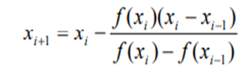
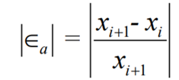
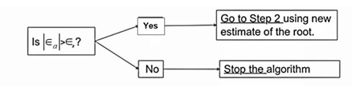
Secant Method Algorithm:
Secant's method algorithm consists of three short steps:
The first step: use the given two initial guesses, xi-1, and xi, to calculate the estimate of the next value's root, xi+1.
The second step: find the absolute relative approximate error.
The third step: compare the absolute relative approximate error with the pre-specified error tolerance.

Slide 9
Advantages and Disadvantages of Secant's Method:
Advantages:
When it is converges, it will converge faster.
Does not need to bracket the root.
Does not need to evaluate the derivative of the function.
Disadvantages:
It may or may not converge.
It need to two initial guesses not like the newton's method.

Slide 10
Problem description

Slide 11
Problem description
Our problem focuses on the concentration (C) and the rim angle(A) of a solar-energy collector. These two highly affect the application and the output. In our application, they are multiple parameters related to nanotechnology and physics, such as the solar collector's Diameter(D), the height(H), and lastly, the fractional coverage of the field(F). By changing the input parameters, we end up with different outcomes until the user gets to the desired solution. We are looking for an instance where the rim angle (A) is 0.

Slide 12
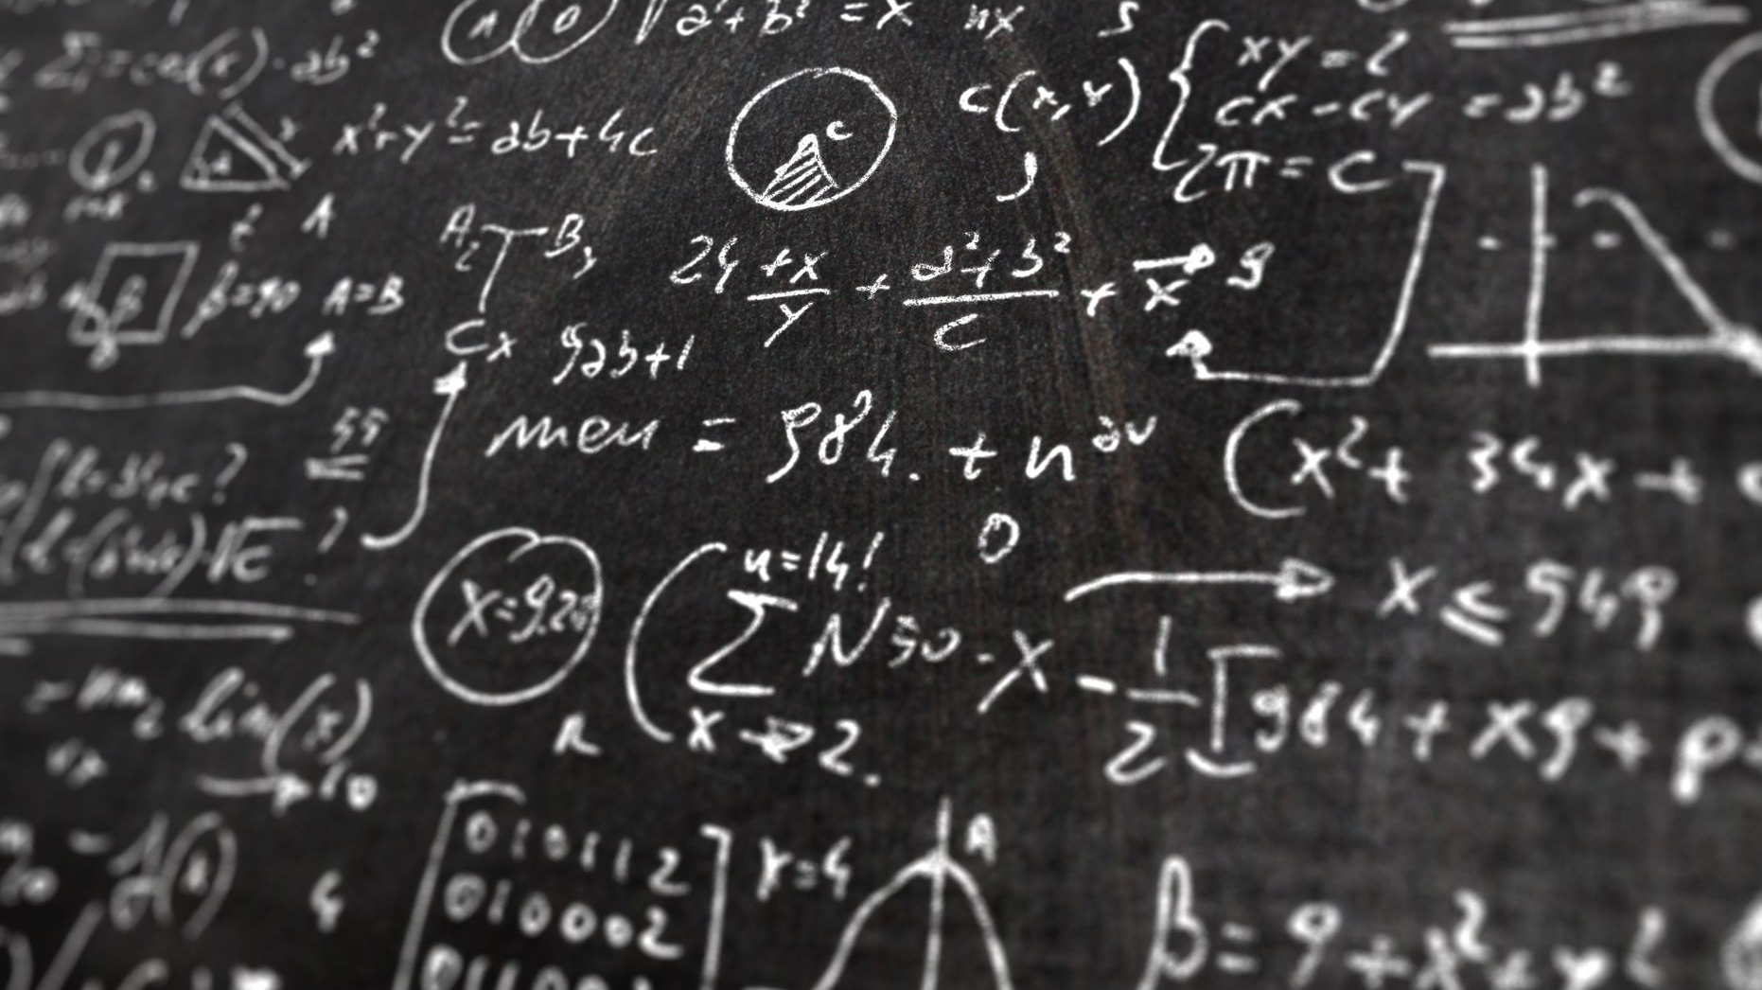
Ultimately, we get the root of the function benefiting from our numerical analysis study; we decided to use the secant method as our method of choice.

Slide 13
Solution

Slide 14
Solution
find the optimal angle of the collector by using code on MATLAB. This program designed to find the Rim Angle of the solar energy collector and let the user prespecified the other parameters.

Slide 15

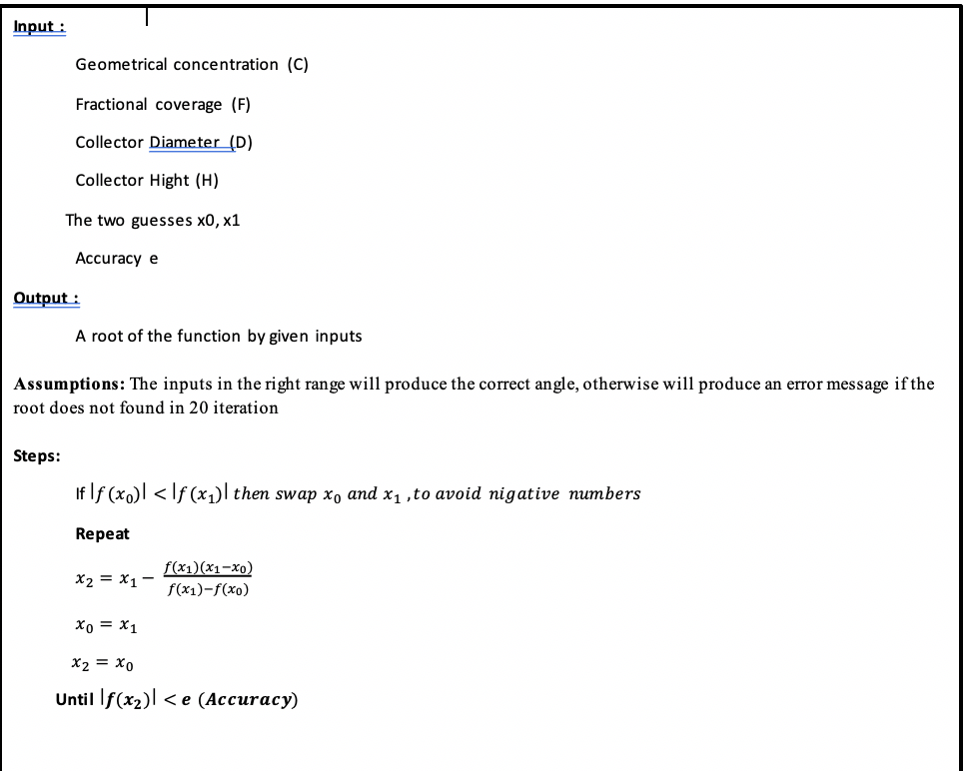
Solution

Slide 16
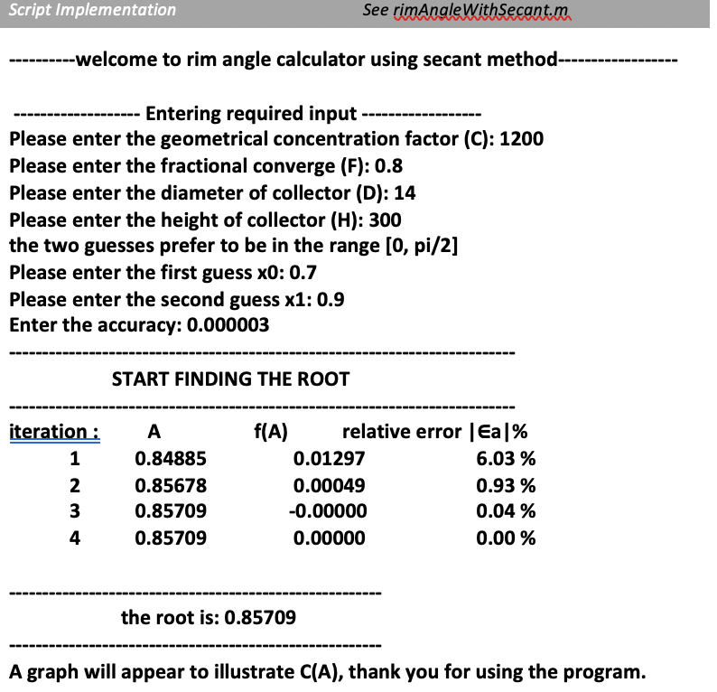
Solution

Slide 17
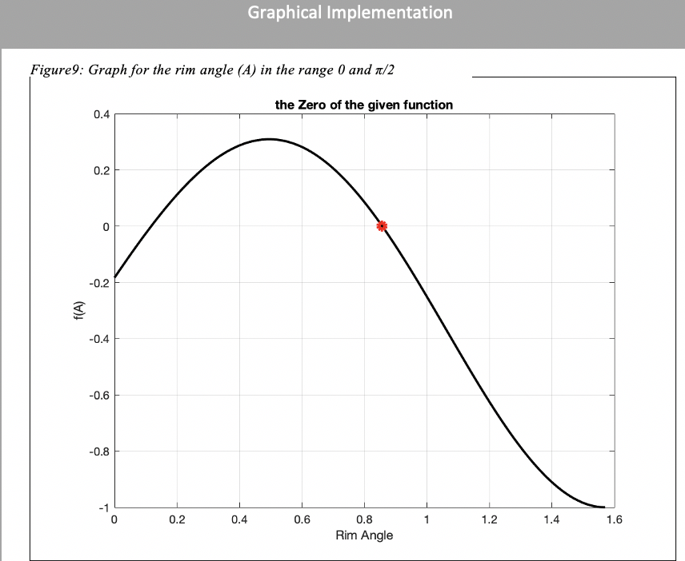
Solution Graph

Slide 18
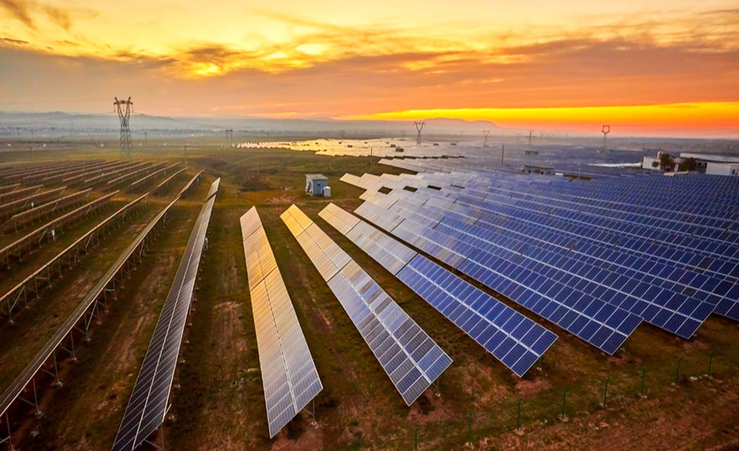
Thank you..
Group 1:
Khadija Balfagih 1914895
Randa Nahhas 1906161
Tahani Abdullah 1906666
Razan Ali 1917170
Asma Alaidrous 1914941
Shaimaa Bashammakh 1914892

