Slide 1


AI-Powered Multi-Agent LMS Assistant For Students, Teachers, and Admins
COMP8420 Major Project – Presentation Group Members: Shaimon Rahman (48226459) Md Nadim Yeasin (48343110)

Slide 2
Problem & Motivation
Problem:
Modern LMS platforms (e.g., iLearn) cause information overload for students and increased workload for staff. Finding accurate, timely info is difficult for all users.
Motivation:
We propose developing an AI-powered assistant that streamlines LMS interaction, automates routine queries, and supports different user roles (students, teachers, admins) with advanced NLP.

Slide 3
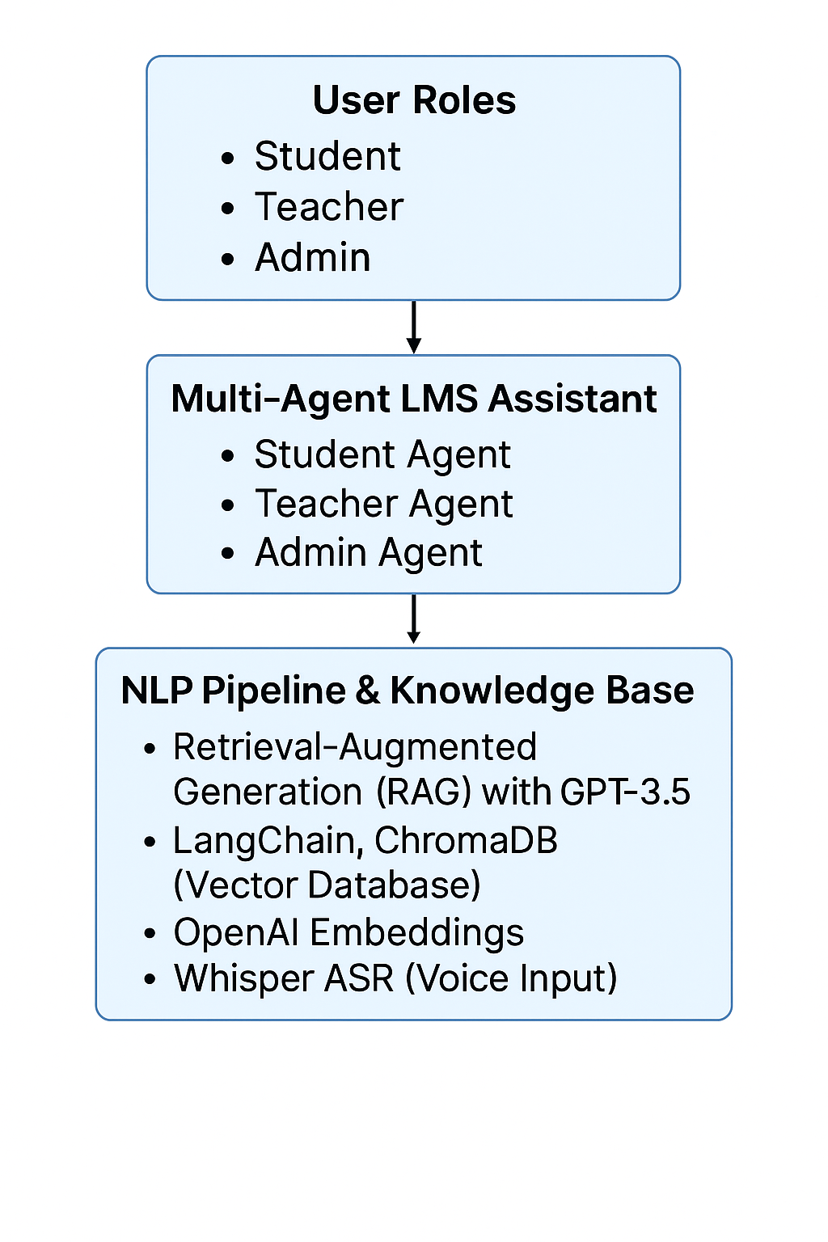
Proposed System Architecture & NLP Technologies

Slide 4
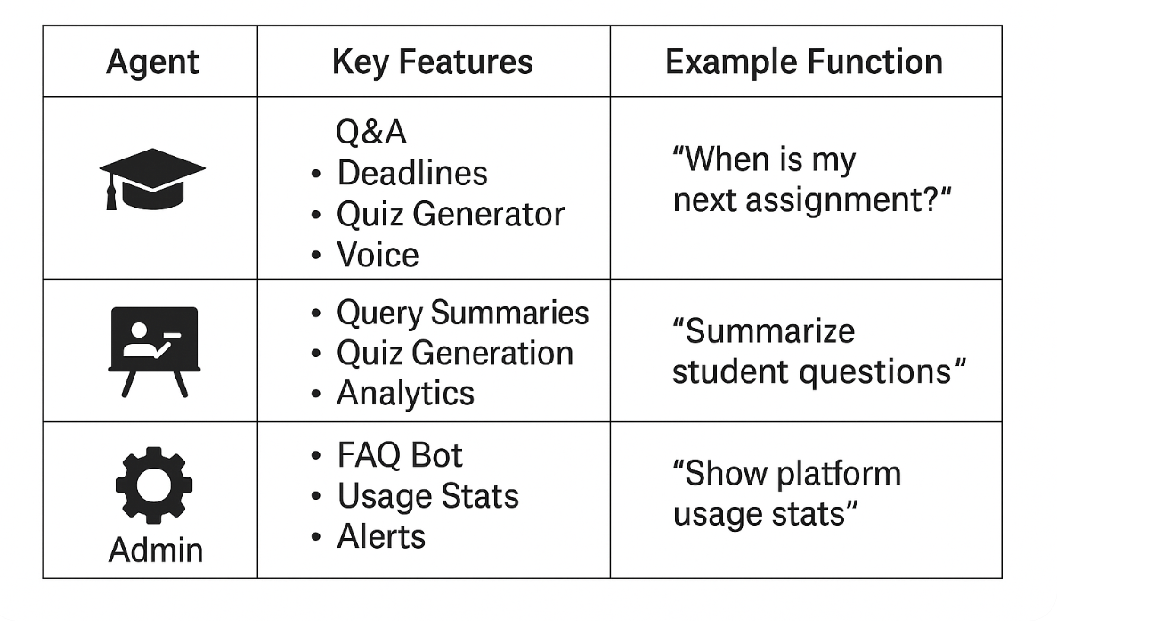
Planned Features: Role-Specific Agents

Slide 5
Evaluation Plan
We will evaluate our system using:
Precision@k for information retrieval
BLEU and Cosine Similarity for answer quality
Response time (efficiency)
We plan to compare user experience between our assistant using Retrieval-Augmented Generation (RAG) and a version without RAG.
Logs will be analyzed to understand agent usage and areas for improvement

Slide 6
Anticipated Impact
Reduces cognitive load and manual work for students, teachers, and admins
Supports all user roles with tailored NLP agents
Easily adaptable to other educational platforms
Demonstrates industry-aligned use of RAG, LLMs, multi-agent design, and evaluation best practices

Slide 7
Thank You & Questions
Thank you for your attention! We’re happy to answer any questions.
(Presented by Shaimon Rahman & Md Nadim Yeasin )

