Slide 1


AI-Powered Multi-Agent LMS Assistant For Students, Teachers, and Admins
COMP8420 Major Project – Presentation Group Members: Shaimon Rahman (48226459) Md Nadim Yeasin (48343110)

Slide 2
Problem & Motivation
Problem:
Modern LMS platforms (e.g., iLearn) cause information overload for students and increased workload for staff. Finding accurate, timely info is difficult for all users.
Motivation:
We propose developing an AI-powered assistant that streamlines LMS interaction, automates routine queries, and supports different user roles (students, teachers, admins) with advanced NLP.

Slide 3
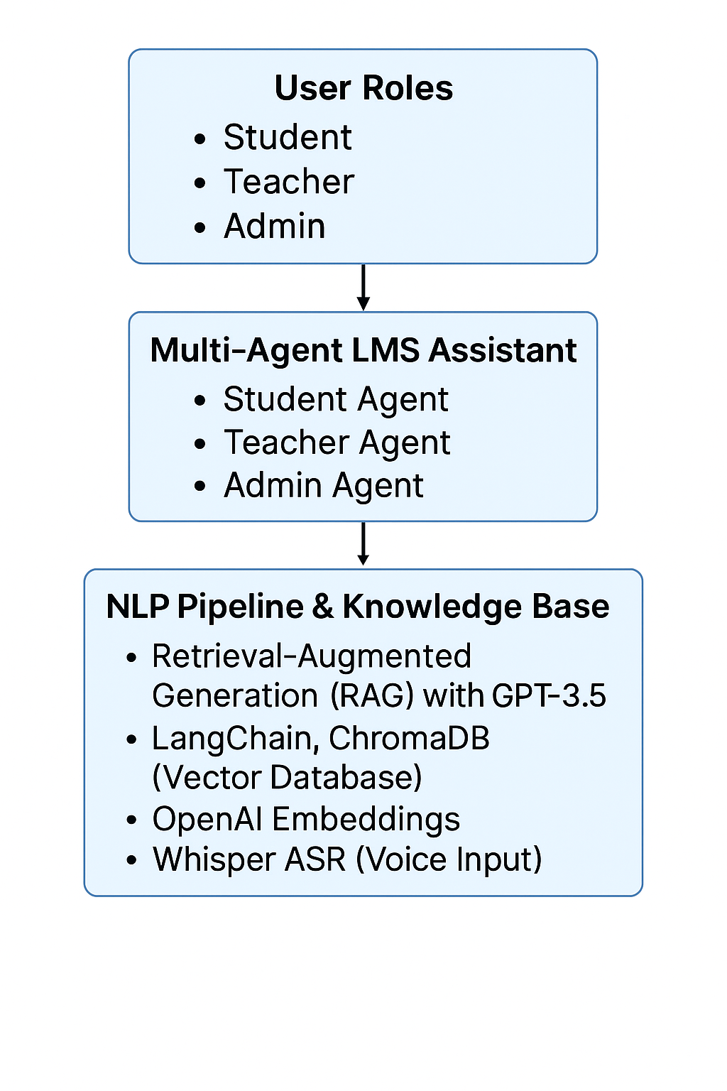
Proposed System Architecture & NLP Technologies

Slide 4
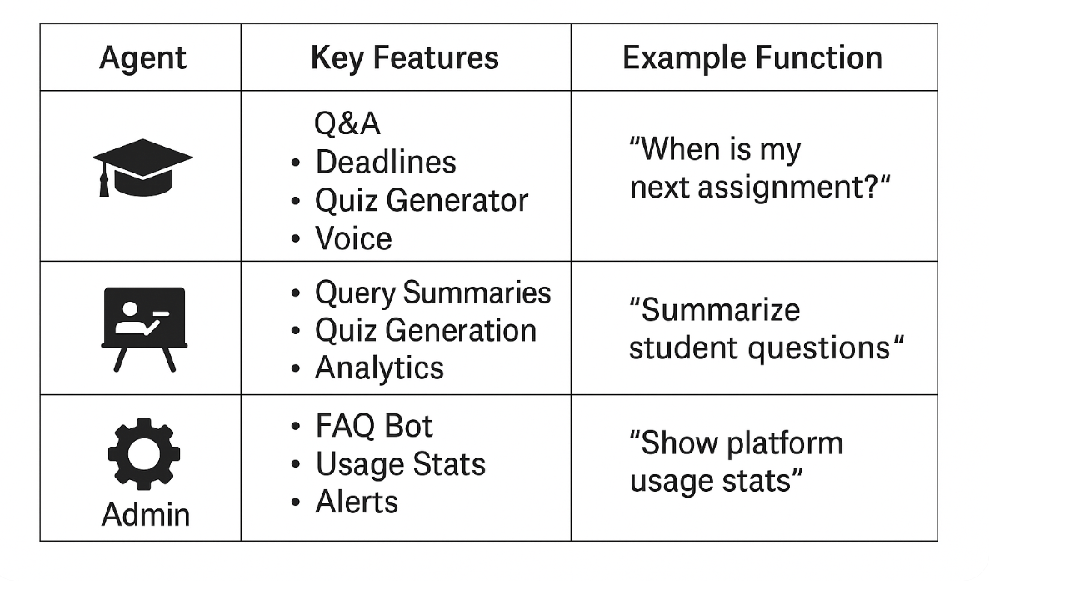
Planned Features: Role-Specific Agents

Slide 5
Evaluation Plan
We will evaluate our system using:
Precision@k for information retrieval
BLEU and Cosine Similarity for answer quality
Response time (efficiency)
We plan to compare user experience with and without our assistant
Logs will be analyzed to understand agent usage and areas for improvement

Slide 6
Anticipated Impact
Reduces cognitive load and manual work for students, teachers, and admins
Supports all user roles with tailored NLP agents
Easily adaptable to other educational platforms
Demonstrates industry-aligned use of RAG, LLMs, multi-agent design, and evaluation best practices

Slide 7
Thank You & Questions
Thank you for your attention! We’re happy to answer any questions.
(Presented by Shaimon Rahman & Md Nadim Yeasin )

