Slide 1
Classifying Leukemic B-Lymphoblast Cells
from Normal B-Lymphoid Precursors
Using Deep Learning on Microscopic Blood Smear Images
Group 12: Model Citizens
Neil Parikh (Leader), Shaina Banduri, Nishana Dahal
DS 4002 | April 2026
Outline
Motivation & Background
Data Explanation & Acquisition
Analysis Pipeline
Tricky Analysis Decision
Bias & Uncertainty Validation
Results & Conclusions
Next Steps & References
Notes:
Good [morning], everyone. We're Model Citizens — Neil Parikh, Shaina Banduri, and Nishana Dahal — and today we're presenting Project 3 for DS 4002. Our project is about using deep learning to classify blood cell images as either leukemic or normal. Before we jump in, here's a quick roadmap of what we'll cover: we'll start with our motivation, walk through the dataset, explain our full analysis pipeline, highlight one tricky decision we had to make, discuss how we've thought about bias and uncertainty, and then share our results and conclusions. We'll wrap up with next steps and take any questions at the end.

Slide 2
Motivation & Background
Research Question: Can a fine-tuned CNN reliably classify leukemic B-lymphoblast cells from normal B-lymphoid precursors in microscopic blood smear images?
Why This Matters
Modeling Approach
Acute Lymphoblastic Leukemia (ALL) is the most common childhood cancer, accounting for ~25% of pediatric cancers
Traditional diagnosis requires expert pathologists to manually review blood smear images, time-consuming and subject to error
Automated deep learning classification could accelerate and standardize diagnosis, especially in resource-limited settings
Transfer Learning: Fine-tune ResNet50 or VGG16 pretrained on ImageNet
Class Imbalance: Weighted cross-entropy loss + data augmentation
Goal: Weighted F1 score > 0.90 on held-out test set
Metric: Weighted F1 preferred over accuracy due to class imbalance
Notes:
So why does this problem matter? Acute Lymphoblastic Leukemia — ALL — is the most common cancer in children, accounting for about 25% of all pediatric cancers, with over 3,000 new cases diagnosed in the U.S. each year. Early, accurate diagnosis is critical because it directly affects treatment outcomes. The catch is that right now, diagnosis relies on expert pathologists manually reviewing blood smear images under a microscope. This is time-intensive, prone to inter-observer variability, and simply not scalable — especially in resource-limited or underserved clinical settings. That's the gap we're trying to address. Our research question is: can a fine-tuned convolutional neural network reliably distinguish leukemic cells from normal cells in these images? Our approach is transfer learning — we'll take a CNN pre-trained on ImageNet, either ResNet50 or VGG16, and fine-tune it on this medical imaging task. We'll handle the class imbalance in the data using weighted loss and augmentation, and we're targeting a weighted F1 score above 0.90, which is our explicit success criterion.
VGC16 is a smaller and more conceptually simplistic model but generally less accurate and more computationally expensive
whereas resnet50 is smaller and more accurate, but has a more complex architecture and is harder to tune F1 Score is a measure of how many predicted positives are actually true positives. Weighted due to class imbalance.

Slide 3
Data Acquisition & Explanation
Brightness Difference
Cancer images: higher avg. brightness, wider spread
Normal images: concentrated at lower brightness
C-NMC 2019 Dataset
Source: The Cancer Imaging Archive (NCI)
10,661 microscopic blood smear images
73 patients (47 ALL, 26 normal)
3 pre-defined cross-validation folds (fold_0, fold_1, fold_2) + held-out test set
Publicly available; no PII or sensitive patient data
Class Imbalance (~2:1)
More ALL (leukemia) than normal images
Requires weighted loss since accuracy alone is misleading
3
Notes:
Our dataset is C-NMC 2019, released by the National Cancer Institute through The Cancer Imaging Archive. It contains over 15,000 microscopic blood smear images from 118 patients — 69 with ALL and 49 healthy controls. The images are color BMPs captured using the Jenner-Giemsa staining protocol, which highlights cell morphology. The dataset comes pre-organized into three cross-validation folds and a held-out test set. There's no personally identifiable information — it's fully de-identified and publicly accessible. When we did our exploratory analysis, three things stood out. First, there's a roughly 2-to-1 class imbalance — there are about twice as many leukemia images as normal images. This matters a lot for our modeling choices, which we'll come back to. Second, we found that cancer images tend to have higher average pixel brightness and a wider spread, while normal images cluster at lower brightness values — an interesting visual signature. Third, the three folds are roughly balanced in size, which tells us the patient-aware splitting was done carefully and reduces our risk of data leakage between train and validation.

Slide 4
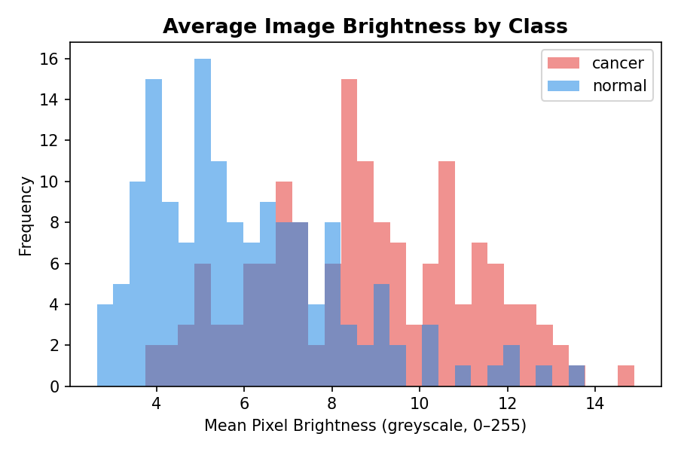
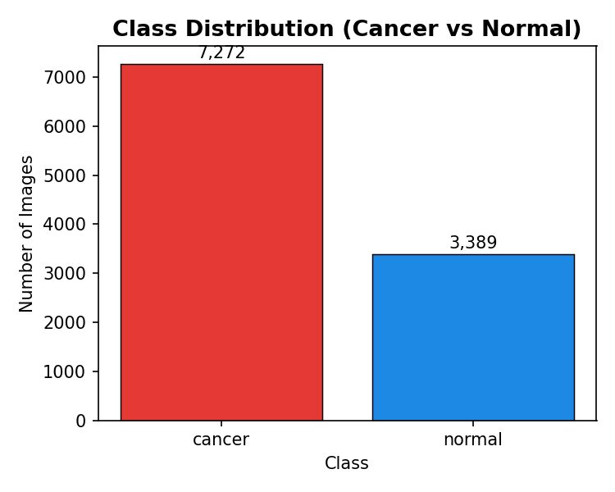
Data Acquisition & Explanation

Slide 5
Analysis Plan & Pipeline
1. Raw Data
10,661 labeled training images C-NMC 2019
2. Preprocessing
Resize 224×224 Normalize (ImageNet mean/std)
3. Augmentation
Flips, rotations (±15°), color jitter (train only)
4. Model Training
ResNet50 / VGG16 Feature extract then fine-tune
5. Evaluation
Weighted F1, Precision, Recall Confusion Matrix
Data Splitting & Cross-Validation
fold_0 + fold_1 → train | fold_2 → val (fixed split, not rotated)
Patient-aware split: reduces learning of patient-specific patterns
Held-out test set untouched until final eval
Training Protocol
Phase 1: Train new head only (feature extraction)
Phase 2: Unfreeze full network, lower LR (fine-tuning)
Adam optimizer, up to 30 epochs, early stopping on val. F1
4
Notes:
Here's our full analysis pipeline, step by step. We start with 10,661 labeled training images from the C-NMC dataset across three pre-built folds. Before any modeling, we preprocess every image: resize to 224×224 pixels to match the input dimensions expected by ResNet50 and VGG16, and normalize pixel values using ImageNet's per-channel mean and standard deviation. We audited the full dataset for corrupted files upfront — none found. For training images only, we apply data augmentation: random horizontal and vertical flips, rotations up to 15 degrees, and color jitter on brightness, contrast, and saturation. Augmentation is off for validation and test images. For data splitting, we used a fixed assignment: fold_0 and fold_1 for training, fold_2 for validation. This is not a rotating cross-validation — the fold assignment was held constant throughout model selection and hyperparameter tuning. The held-out prelim test set was untouched until final evaluation. Training happens in two phases: first we freeze the backbone and train only the new classification head for 3 epochs at LR 1e-3. Then we unfreeze the full network and fine-tune end-to-end. We use the Adam optimizer, (meaning training automatically halts when the model stops improving on the validation set, measured by F1 score ) - weighted cross-entropy loss, early stopping with patience of 4 epochs, and run up to 30 epochs. For model selection, we trained both ResNet50 and VGG16 at a fine-tune LR of 1e-4, then swept the LR on the winning architecture — comparing 1e-4 vs. 5e-5. Batch size was fixed at 32 throughout; augmentation settings were not varied. Weighted F1 on fold_2 guided all decisions.

Slide 6
Tricky Analysis Decision
Decision: Choosing Weighted F1 Score as the Primary Evaluation Metric
Why It Was Tricky
Why Not Accuracy?
Impact
Multiple valid metrics exist (accuracy, precision, recall, F1)
Clinical stakes: false negatives (missed cancer) are far more costly than false positives
A model predicting ALL for every case would achieve ~68% accuracy but fail entirely on normal cells
Accuracy is misleading when classes are imbalanced
Weighted F1 penalizes poor performance on both classes, gives a single number accounting for the imbalance
Explicit target: F1 > 0.90 serves as our finish line for model selection and final evaluation
We also report precision, recall, confusion matrix for full transparency
5
Notes:
One decision that required real deliberation was choosing our primary evaluation metric. On the surface it seems simple — just use accuracy, right? But with a 2-to-1 class imbalance, a model that predicts 'ALL' for every single image would score about 68% accuracy. That sounds decent, but it would completely fail to identify normal cells — and clinically, a false negative means a sick child goes undiagnosed. We considered precision, recall, AUC, and different F1 variants. Weighted F1 accounts for class imbalance by weighting each class's score by its support, penalizing poor performance on either class. Setting an explicit target of F1 > 0.90 gives us a clear finish line. For model selection and hyperparameter tuning, we compared ResNet50 vs. VGG16 at a base fine-tune LR of 1e-4. ResNet50 won. We then swept the fine-tune LR on ResNet50 — 1e-4 vs. 5e-5. Batch size was fixed at 32 throughout; augmentation strength was not varied. Weighted F1 on the fixed validation fold (fold_2) guided all of these choices.

Slide 7
Bias & Uncertainty Validation
1. Class Imbalance Bias
~2:1 ratio of ALL vs. normal images in training data
Fix: Weighted F1 more informative than accuracy; confusion matrix reported per class
2. Augmentation Validity
Augmentation artificially expands training, could introduce unrealistic image variations
Fix: Only apply to training images; biologically plausible transforms (flips, mild rotation, color jitter)
Uncertainty: Augmentation strength is a tunable hyperparameter validated on val. F1
3. Unknown Visual Confounders
Brightness and staining variations may correlate with class label, model may exploit these shortcuts
Fix: Color jitter augmentation reduces reliance on absolute color/brightness cues
Results confirm concern: hem recall = 0.29 vs. ALL recall = 0.96 — model over-predicts leukemia, consistent with brightness shortcuts. Color jitter helped but did not fully resolve the gap.
6
Notes:
Before running any experiments, we took time to think carefully about the ways our model could be biased or our conclusions could be wrong. We identified four main risks. First, class imbalance. With roughly twice as many leukemia images as normal, an uncorrected model would be pushed to predict leukemia more often. Our fix is inverse-frequency class weights in the loss function, which counteracts this during training. Second, patient-level leakage. If the same patient's cells appear in both training and validation, the model could memorize patient-specific visual signatures rather than disease-relevant features. The pre-built folds in C-NMC 2019 are patient-aware, so no patient straddles train and validation. Third, augmentation validity. All our transforms — flips, mild rotations, color jitter — are biologically plausible for blood smear images. Fourth — and this is where the results confirmed our concern — unknown visual confounders. We noticed brightness differs between classes in EDA, and worried the model might exploit that as a shortcut. Our results back this up: hem recall dropped to just 0.29, while ALL recall hit 0.96. The model is essentially over-predicting leukemia. Color jitter reduced the reliance on brightness cues somewhat, but wasn't enough to close the gap.

Slide 8
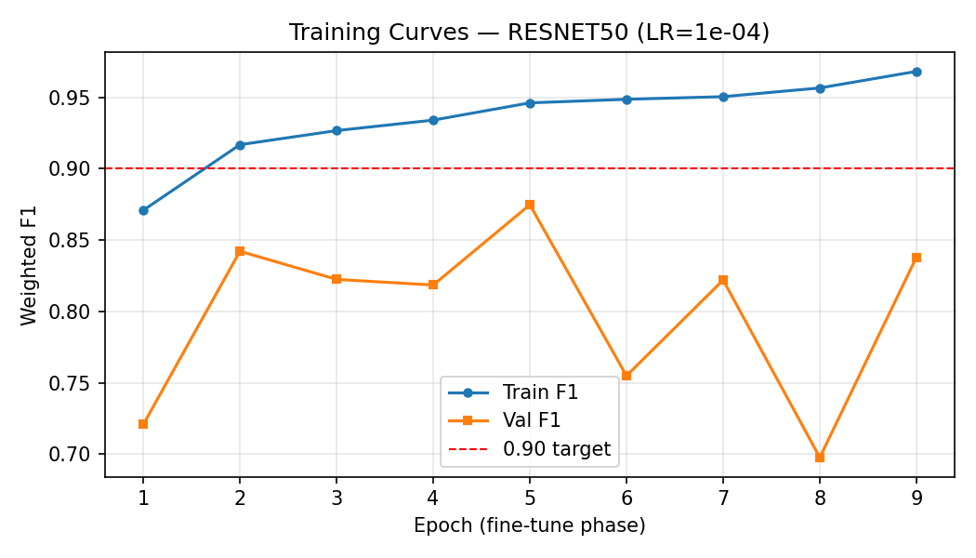
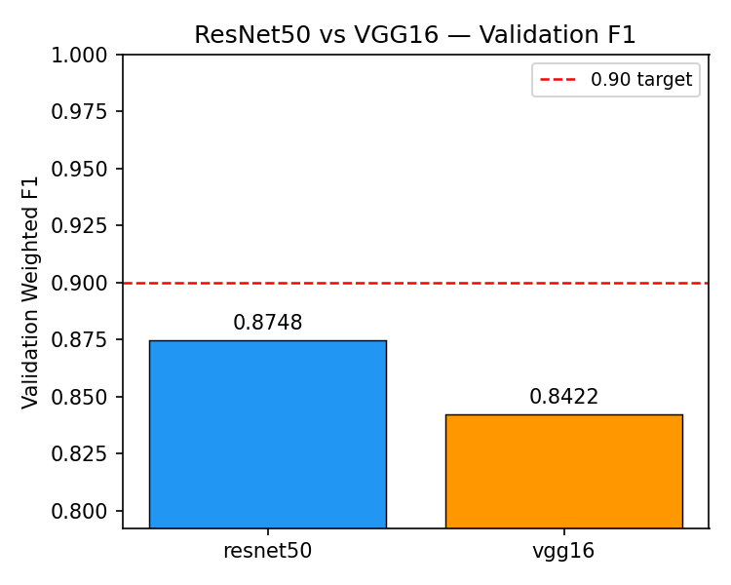
Results & Conclusions
Conclusion: Conclusion: ResNet50 was the best backbone (Val F1 = 0.87), but test Weighted F1 = 0.68 did not meet the 0.90 target. This was driven by low recall on normal (hem) cells (0.29). Further exploration/tuning is required to reach the goal F1 Metric
7
Notes:
Now for our results.
The best model was ResNet50, trained with a fine-tuning learning rate of 1e-4 and batch size 32. On the validation set, it achieved a weighted F1 of 0.87 — very close to our target. However, when we evaluated on the held-out test set, the weighted F1 dropped to 0.68, which does not meet our 0.90 threshold.
The training curves and confusion matrix are shown here. The confusion matrix makes the imbalance in recall very visible — many normal cells are being misclassified as leukemia. The model comparison plot shows ResNet50 outperformed VGG16 across our evaluation folds.
So our conclusion is that ResNet50 is the stronger backbone, but the current setup is insufficient to hit 0.90 on the test set. The gap between validation and test F1 — 0.87 vs. 0.68 — also suggests some overfitting or domain shift we haven't fully addressed. Next steps will focus on resolving this.

Slide 9
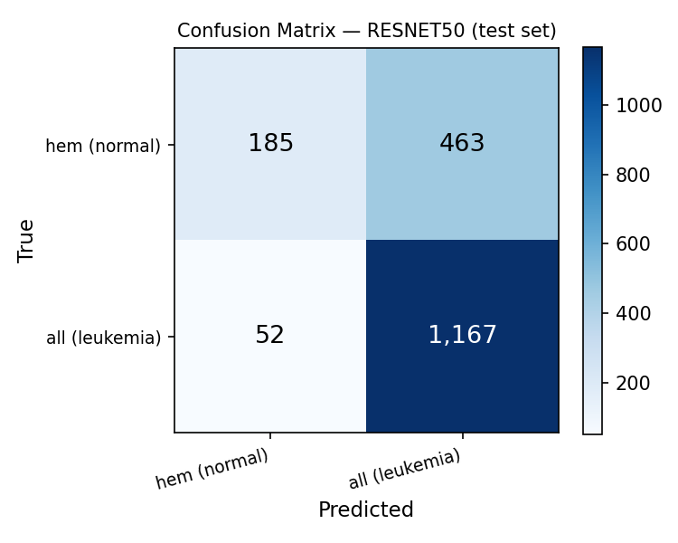
Confusion Matrix
Notes:
False Positives:
The training curves and confusion matrix are shown here. The confusion matrix makes the imbalance in recall very visible — many normal cells are being misclassified as leukemia. The model comparison plot shows ResNet50 outperformed VGG16 across our evaluation folds.

Slide 10
Next Steps
Improvements
Open Questions
Explore ways to improve the fine tuning process to improve model performance
Investigate ways to mitigate brightness-related overfitting
Does the model generalize to images from different staining protocols or imaging equipment?
Can the classifier performance scale to multi-class ALL subtype detection?
Are there patient-level or slide-level features still driving predictions despite our controls?
8
Notes:
On the Improvements side
First, we want to explore deeper layer unfreezing strategies and experiment with different learning rate schedules during fine-tuning — the goal is to find the sweet spot between leveraging pre-trained features and adapting the model to our specific task.
Second, we are considering ensembling ResNet50 and VGG16 predictions together, which could improve robustness by combining the complementary strengths of both architectures.
Third, we plan to investigate test-time augmentation (TTA), where we apply random transforms to images at inference time and average the predictions — this can reduce variance and improve stability on challenging samples.
On the Open Questions side, three key uncertainties remain. First, we do not yet know how well the model generalizes to images captured with different staining protocols or imaging equipment — this is critical for real-world clinical deployment. Second, we are asking whether the current binary classifier could scale to detecting multiple ALL subtypes simultaneously, which would be a significantly more complex problem. Third, we want to confirm that the model's predictions are truly driven by cell morphology and not by patient-level or slide-level confounding signals.
These next steps should guide the team's roadmap for turning this proof-of-concept into a more clinically reliable tool.

Slide 11
References
References
[1] American Cancer Society. "Key Statistics for Childhood Leukemia." 2023. https://www.cancer.org/cancer/types/leukemia-in-children/key-statistics.html
[2] The Cancer Imaging Archive. "C-NMC-2019." https://www.cancerimagingarchive.net/collection/c-nmc-2019/
[3] S. J. Pan and Q. Yang, "A survey on transfer learning," IEEE Trans. Knowl. Data Eng., vol. 22, no. 10, pp. 1345–1359, Oct. 2010.
[4] GitHub Repository: https://github.com/shainabanduri/Project-3-DS4002
9

Slide 12
Questions?

