Slide 1
Principal Component Regression
A Biased Regression Technique

Slide 2
Multicollinearity
Two or more explanatory variables in a regression model are highly correlated
Causes inflated standard errors on the regression coefficients
Can potentially switch the expected sign of a regression coefficient

Slide 3
Dealing w/ Multicollinearity
Exclude redundant independent variables
Redefine variables
For polynomial regression, center the independent variables
Use biased regression techniques
Principal Component Regression
Ridge Regression (Later)

Slide 4
Biased Regression Techniques
Biased regression techniques intentionally bias the estimation of the regression coefficients.
Although these methods produce estimates that are biased, they tend to have more precision than OLS estimates in the presence of multicollinearity.

Slide 5

Biased Regression Techniques

Slide 6
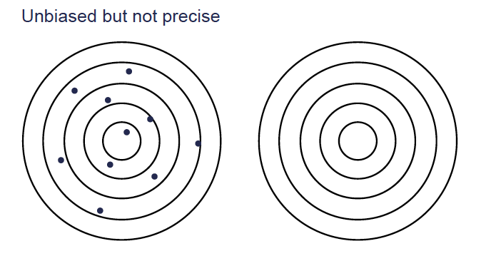
Biased Regression Techniques

Slide 7
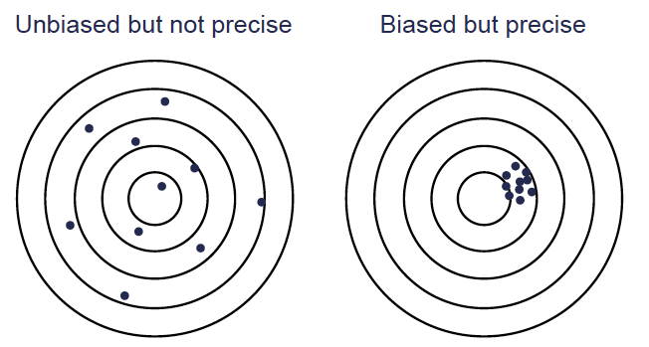
Biased Regression Techniques

Slide 8
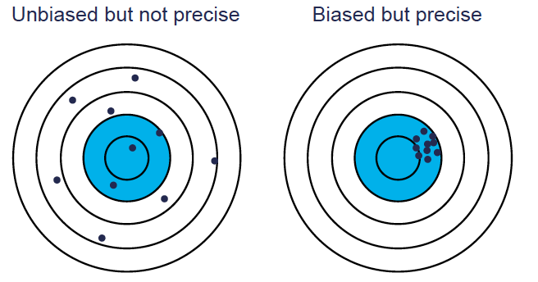
Biased Regression Techniques

Slide 9
Principal Component Regression

Slide 10
Principal Components
Multicollinearity is a problem where variables are highly correlated.
Any collection of variables can be recreated as set of orthogonal predictor variables that are a linear combination of the original variables.
The orthogonal predictor variables are the principal components.

Slide 11
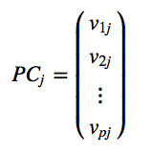
Principal Components
Recall that principal components are simply linear combinations of original variables.
The coefficients of that linear combination are typically reflected in a vector:

Slide 12
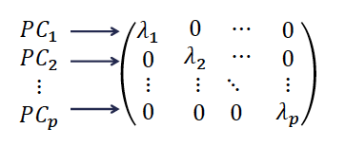
Principal Components
Covariance Matrix of PCs looks like the following:

Slide 13
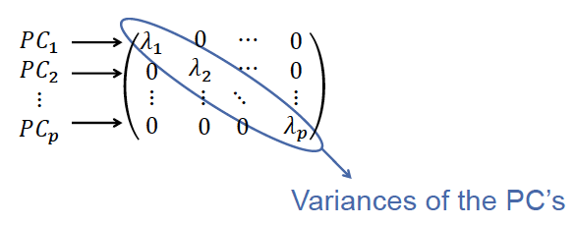
Principal Components
Covariance Matrix of PCs looks like the following:
If the value of 𝜆_{j} = 0, then the corresponding PC has no variance (a.k.a. a constant).

Slide 14
Principal Components Regression
By omitting any PC with 𝜆_{j} close to 0, we essentially create an approximation of our data which has no multicollinearity in the regression model.
WHAT IS THE PROBLEM IF WE DO NOT OMIT ANY PRINCIPAL COMPONENTS FROM OUR ANALYSIS?

Slide 15
Example – French Economy
We are going to examine data from the French economy reported by Malinvaud (1968).
Variables:
Imports
Domestic Production
Stock Formation
Domestic Consumption
All measured in billions of French francs between 1949 and 1966.

Slide 16
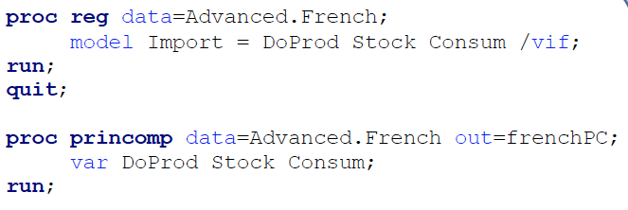
Example – French Economy

Slide 17
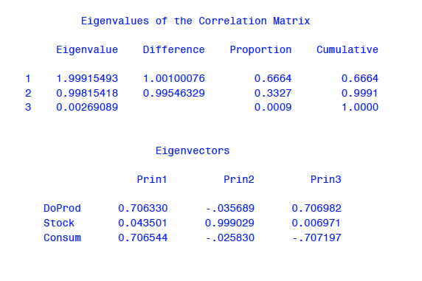
Example – French Economy

Slide 18
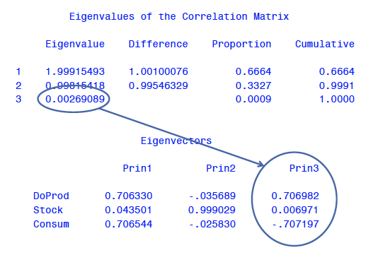
Example – French Economy

Slide 19

Example – French Economy
Now there is a “new” set of variables (the PC’s) that are orthogonal to each other, which eliminates multicollinearity concerns.
As long as you remove those that are nearly constant!
Principal Components Regression (PCR) Model:

Slide 20
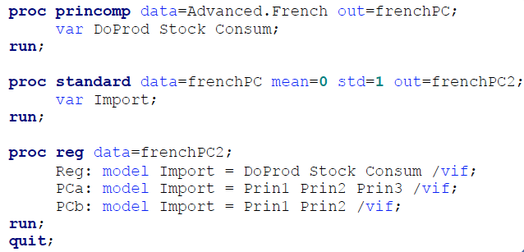
Example – French Economy

Slide 21
Example – French Economy

Slide 22
Example – French Economy
PCR model:
What is the problem with the new variables and coefficients 𝛼₁, … , 𝛼_{k} ?
INTERPRETATION!

Slide 23

Principal Components Regression
Since the PC’s are simply functions of the original variables, they can be replaced with the linear combinations.

Slide 24
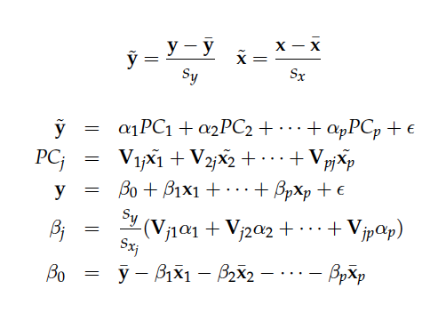
The Replacement Math

Slide 25

Automatic Replacement via PROC PLS

Slide 26
Cautions
May not always work
May have trouble explaining variability in the response variable
Never blindly drop PCs!
Outliers / influential observations can severely distort the principal components because they alter the covariance matrix.

