Slide 1
Network Analysis
Dr. Shaina Race
Institute for Advanced Analytics
Spring 2017

Slide 2
Network Centrality
Measuring Influence in a Network

Slide 3
Centrality
Centrality is a measure of how importance a vertex is to a graph.
There are many ways to define importance.
Common measures of centrality:
Degree Centrality
Betweenness Centrality
Closeness Centrality
Eigenvector Centrality
Usually normalized in [0,1] for comparison across networks

Slide 4
Degree Centrality
Node with highest degree is most important
Measures the exposure of vertex to others in network
Degree centrality for vertex v is C_{D}(v) = d_{v} /(n-1)
d_{v}=degree of vertex v
n=number of vertices in network
Max value is 1 (if vertex is connected to all other vertices).
Local measure: can be deceiving (see example)

Slide 5
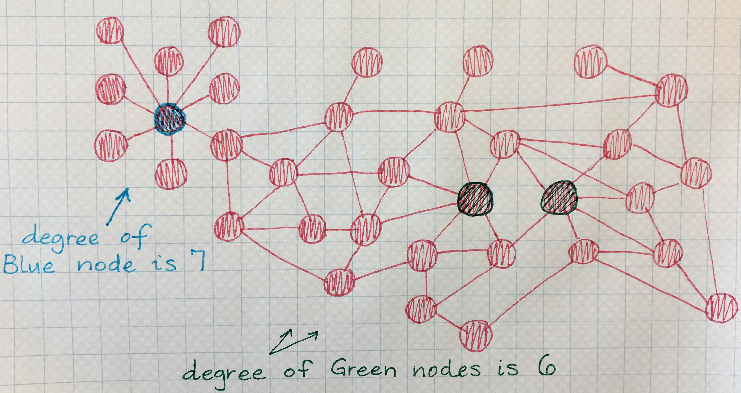
Deceptive Degree Centrality

Slide 6
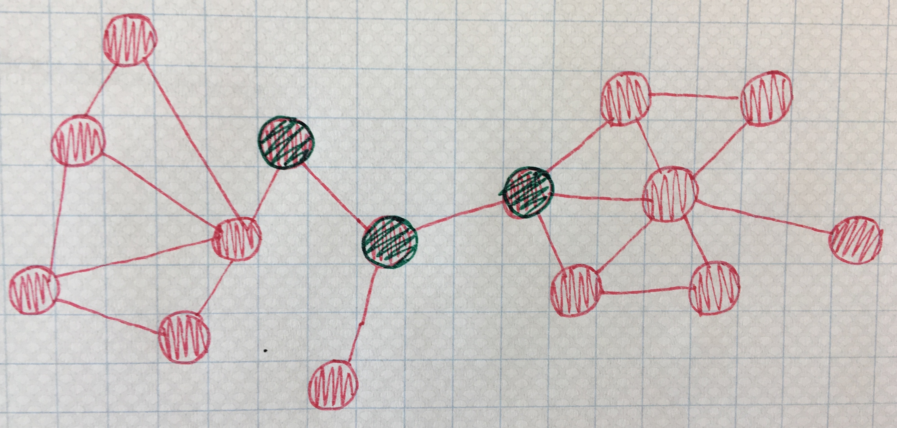
Betweenness Centrality
you’ll have to go through us!

Slide 7
Betweenness Centrality
Sum of proportions of shortest paths between 2 nodes that pass through the node of interest.
Measures control of a node on communication between other nodes.
δ_{ij}=number of shortest paths between nodes i and j
δ_{ij}(v)=number of shortest paths between i and j that go through node u
Can also consider edge betweenness centrality using paths that include a given edge.

Slide 8
Betweenness Centrality
Note: Be sure to use Brandes’ Algorithm to compute betweenness! Developed in 2001, O(mn) for unweighted graphs and O(n²logn+mn) for unweighted graphs

Slide 9
Betweenness Centrality
Normalize each value by the maximum possible centrality score = the number of pairs of nodes excluding the given node.
For directed graph, normalize by (n-1)(n-2)
For undirected graph, normalize by (n-1)(n-2)/2
Normalization allows for comparison across networks.

Slide 10
Closeness Centrality
Measures how quickly information will spread from one node to all other nodes.
Node is important if close to all other nodes.
Farness defined as the sum of distances to all other nodes. Closeness is then the inverse of farness.

Slide 11
Closeness Centrality
Normalize by maximum possible score, which would be 1/(n-1) when the node is connected to all others.
i.e. multiply by (n-1) to normalize.
Only defined for connected graphs

Slide 12
Comparing 3 Centralities
The centrality measures should be correlated.
If not, that might mean something interesting.
 | Low Degree | Low Closeness | Low Betweenness
High Degree |  | In cluster far from rest of network | Connections are redundant. Communication bypasses node
High Closeness | Key player, tied to important, active alternatives |  | Prob. multiple paths in network. Near many, just like everyone else
High Betweenness | A few edges are crucial for network flow | RARE. Node monopolizes ties from few to many

Slide 13
Eigenvector Centrality
Would you rather have influence over the Provost and the Chancellor or all of the university’s graduate TAs?
The previous definitions of centrality have a problem: They don’t take into account the importance of your contacts.
Previous measures don’t necessarily measure influence.

Slide 14
Eigenvector Centrality
What if each node’s centrality was the sum of the centralities of the nodes to which it is connected?
Let x be the vector of centralities.
Let A be a binary adjacency matrix.
Then, Ax = x

Slide 15
Eigenvector Centrality
x=Ax
Of course, this may not always be possible, so we’ll add in a normalizing constant, λ:
Ax= λx
Look familiar??

Slide 16
Eigenvector Centrality
But which eigenvalue??
We want the centralities to be positive.
The first eigenvector of an adjacency matrix is guaranteed to have all positive elements.
(Perron-Frobenius Theorem of Nonnegative Matrices)
Google’s PageRank is a variant of eigenvector centrality, using the hyperlink structure of the net.
See original HITS algorithm

Slide 17
Centralization of Network
How much variation in centrality scores?
How central is maximum centrality compared to others?
$$0<Centralization<1$$
All nodes have the same centrality
One node has maximal centrality, all other nodes have minimal centrality

Slide 18
Centralization of Network
Freeman’s formula for degree centralization:
Can be adopted for other types of centrality just by changing denominator and centrality function.
Notes:
Max degree is n-1 : one node connected to all other nodes (star). In that case, all other nodes have degree 1. So the max-c(i) = (n-1)-1 = n-2 for all nodes, of which there are (n-1) so add up (n-2) (n-1) times gives you the denominator ➔ centralization of 1.
If all the nodes have max ➔ centralization is 0

Slide 19
Calculating Centrality Scores in Gephi
Try: Filtering + Rerunning measures.

