Slide 1
Network Analysis
Dr. Shaina Race
Institute for Advanced Analytics
Spring 2018

Slide 2
Descriptives of Network Structure
Components, Cliques, Bridges, Brokers

Slide 3
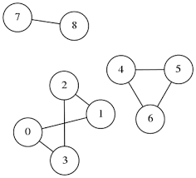
Connected Components
A graph is connected if every node can be reached from every other node
(no separate pieces)
A component of a graph is a collection of nodes which are connected themselves but disconnected from the rest of the graph.

Slide 4
Connected Components (in Directed Networks)
Strongly Connected: Nodes connected by directed path
Weakly Connected: Nodes connected by edges regardless of direction

Slide 5
Pop Quiz
If a network has more than one connected component, what does that say about it’s adjacency matrix?

Slide 6
Solution
Component 1
Component 2
Component 3
Component 1
Component 2
It’s ”block diagonal”
Component 3

Slide 7
Bridges and Brokers
A bridge is an edge whose removal disconnects the network.
A broker is a node whose removal disconnects the network.
Important players in the “small world effect.”
http://www4.ncsu.edu/~slrace/facebook.html

Slide 8
Cliques (aka Complete Graphs)
A clique is a group of three or more nodes among which all possible edges exist. Each node in a clique is connected to every other node in that clique.
triangle

Slide 9
N-Cliques
Large cliques hard to find. Relax the definition to a group of nodes separated by a distance ≤ n
2-clique: group of nodes such that each is either directly connected to or shares at least one neighbor with every other node.

Slide 10
Nodal Degree
weighted/unweighted, directed/undirected
and distribution across a network.

Slide 11
Nodal Degree
The degree of a node measures the connectedness of that node in the network.
For a binary graph, it is simply the number of edges connected to that node.
degree = 2
degree = 1
degree = 2
degree = 3
degree = 2
degree = 2

Slide 12
Nodal Degree
For a weighted graph, it is the sum of the weights of edges connected to that node.
degree = 8
degree = 2
degree = 22
degree = 26
degree = 5
degree = 19

Slide 13
Nodal Degree
For a directed graph, we calculate both an in-degree and an out-degree.
in-deg = 2
out-deg = 1
in-deg = 0
out-deg = 1
in-deg = 1
out-deg = 2
in-deg = 3
out-deg = 1
in-deg = 1
out-deg = 0
in-deg = 1
out-deg = 2

Slide 14
Nodal Degree
Nodal degrees are sums of rows and/or columns of the corresponding adjacency matrix.
0 1 0 0 0 0
0 0 1 0 0 0
0 0 0 1 0 0
0 0 1 0 1 1
0 0 0 1 0 1
0 0 0 1 1 0

Slide 15
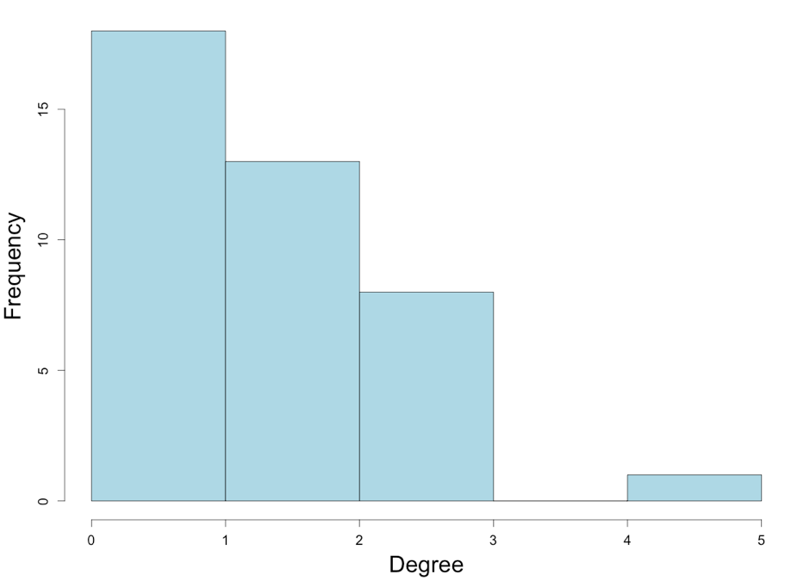
Degree Distribution
It’s common to look at the distribution of degrees in a network.
Usually many nodes with low degree and few with high degree.

Slide 16
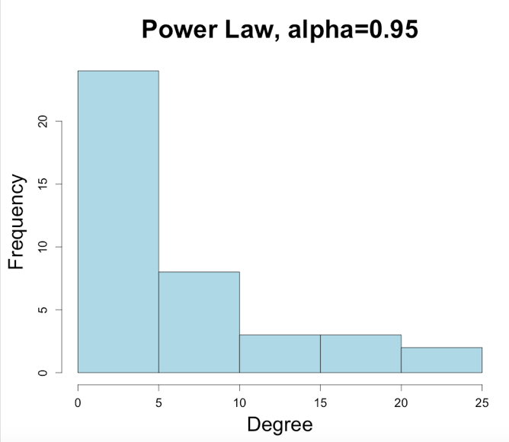
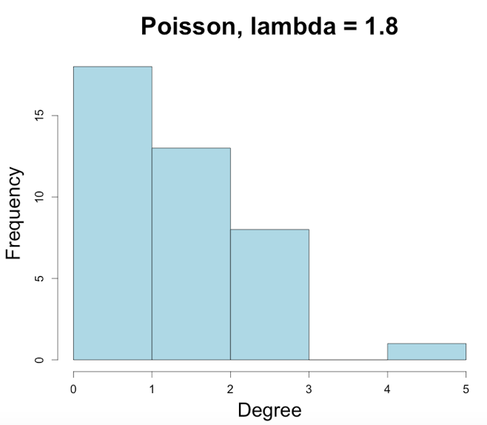
Degree Distributions
It’s known that most networks follow natural patterns when it comes to degree distribution.
Two most common distributions:

Slide 17
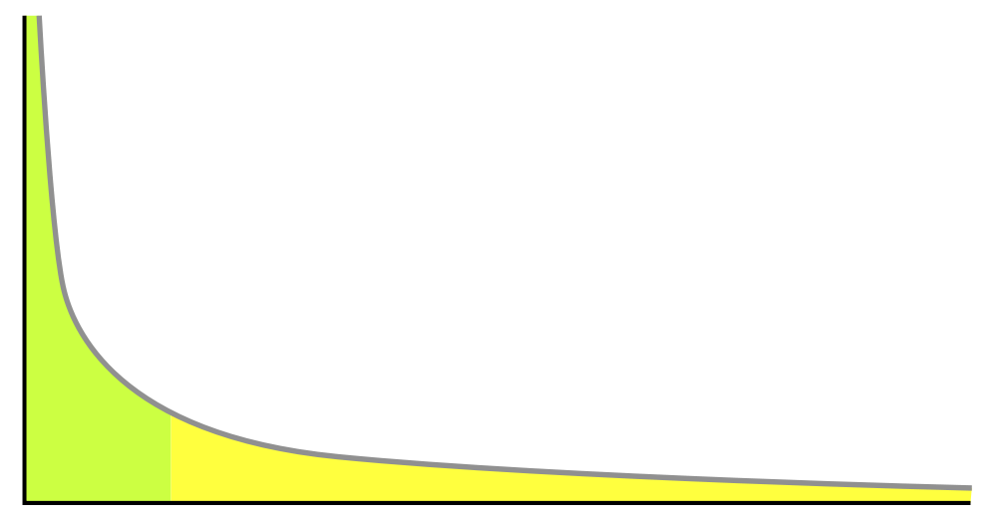
Power Law
The degree distribution appears as a power law: a relationship where one quantity varies as a power of another.
Long tail
On a log-log scale, relationship looks linear.

Slide 18
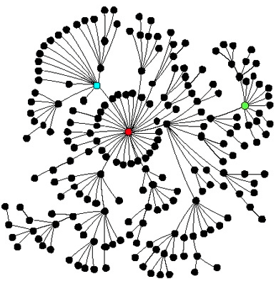
Power Law Graphs aka Scale Free Networks
Power law graphs contain a few hubs (highly connected nodes) but the majority of nodes in the network have low degree.

Slide 19
Power Law Graphs aka Scale Free Networks
Properties
Robust to random breakdown
Vulnerable to targeted attacks
Viruses can persist even at low transmission rates
Real World Examples
Email Networks
World Wide Web
Intranets
Diseases with short transmission window
Needle Sharing
Sexual Contacts

Slide 20
Other Descriptives
Density, Shortest Paths, Eccentricity, Clustering Coefficients

Slide 21
Density of Graph
The density of a graph measures how interconnected the nodes are.
Simply the proportion of possible edges that actually exist in the graph.
Let E be the number of edges in the graph, N the number of vertices. The density, Δ, is then:
For undirected graphs
For directed graphs

Slide 22
Density of Graph
Several ways to consider density for a weighted graph depending on application.
Some use average strength of edges.

Slide 23
Shortest Paths (Geodesic Distances)
The geodesic or graph distance between two vertices is the length of the shortest path from one vertex to the other.
For directed graph, must be a directed path

Slide 24
Diameter/Eccentricity
Graph Diameter: Largest Geodesic Distance in the whole network
Eccentricity of a node: Distance to furthest node from that node.

Slide 25
Clustering Coefficient
The clustering coefficient of a node is a measure of the extent to which its neighbors are also neighbors of each other.
Measures Transitivity: if A is connected to B and B is connected to C what is the probability that A is connected to C?
Ratio of number edges existing between neighbors to those that could possibly exist.

Slide 26
Clustering Coefficient

Slide 27
Clustering Coefficients for Entire Network
Measure the transitivity of the entire network – does the transitive property hold most of the time?
A
?
C
B

Slide 28
Clustering Coefficients for Entire Network
Network Average Clustering Coefficient: Simply average the clustering coefficient for each node.
Global Clustering Coefficient:
Connected triple is 3 vertices joined by 2 edges.
Each triangle makes 3 connected triple.

Slide 29
Fun Links
www.socilab.com
www.theyrule.net

