Slide 1
Network Analysis
Dr. Shaina Race
Institute for Advanced Analytics
Spring 2017

Slide 2
Hypothesis Testing for Networks

Slide 3
Individual Level Hypotheses
Does the social capital of legislators predict success of the bills they sponsor?
Does organizational connectedness predict speed of promotion?
Does out-degree in an advice network predict learning?

Slide 4
Problems
Observations not independent!
If I have a high centrality, yours may go up by association
My connectedness/connections influence yours
Undirected networks force reciprocal links
Social connections have other limiting factors: time, money, freedom, happenstance.

Slide 5
Problems
Often not a random sample.
How useful would a random sample be if we’re interested in relationships?
Snowball sampling
=> Population distribution of variables unknown
Because of #1 & #2, cannot compute significance through traditional tests.
Can compute correlations and statistics but cannot speak to their statistical significance.

Slide 6
Solution
Permutation Tests
Simulate the null hypothesis: No association/difference
Take one column of data and shuffle (permute) it randomly
Calculate the statistic of interest on the shuffled data.
Repeat many times
Get distribution of values you might expect to find if there were no association/difference
See where the value from the original observed data falls in that distribution

Slide 7
Example
Trust network from an organization.
Ask employees questions on team feedback “I trust this individual to operate effectively and efficiently with minimal guidance”
Want to know if an individual’s trustworthiness is related tenure with company.
Hypothesis: In-Degree is correlated with tenure. (observed r=0.39)

Slide 8
Example
Hypothesis: In-Degree is correlated with tenure. (observed r=0.39)
A p-value is the probability we got that result if there is truly no relationship.
So simulate what it looks like when there is truly no relationship!
Degree Tenure
1 2
2 1
4 2
5 3
… …

Slide 9
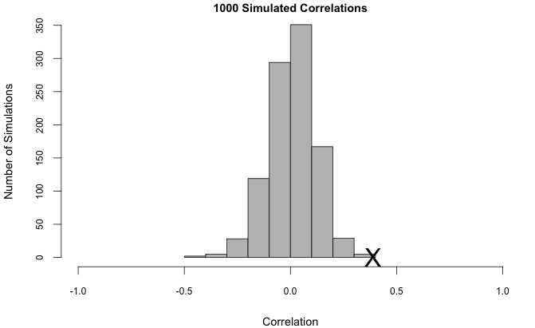
Example
1 simulation had correlation ≥ 0.39
=> p-value is 0.001

Slide 10
Dyad Level Hypothesis
Does homework group membership correlate with outside social interactions?
Do people with strong social bonds tend to have many friends in common?
Challenge: Correlating two adjacency matrices or comparing network statistics (which are based on two adjacency matrices)

Slide 11
Problems
All the same problems listed previously.
Solution #1: Turn the adjacency matrices into vectors. Simulate as before by randomly permuting one of the vectors.
Problem with Solution #1: Randomly permuting one of the vectors does not handle the full range of dependencies between dyads.
Notes:
Fundamentally changing the structure of the data.

Slide 12
Solution
QAP Approach
Randomly permute rows AND columns of one matrix using the same permutation.
In essence, this just re-labels the nodes in one matrix
Then compare the permuted matrix with second matrix, record statistic of interest, and repeat many times
Compute proportion of trials that produced a result equal to or stronger than the one found. This is your p-value.

Slide 13
Network Level Hypothesis
Is the density of a trust network in a practicum group associated with better performance?
Is the clusterability of high-school social network associated with higher incidence of fights?

Slide 14
No Problem!
As long as the individual networks are selected randomly from the population of networks, we can use traditional statistical tests.

Slide 15
Network Autocorrelation (Ordinal/Continuous)
Mixing dyadic and individual variables.
one variable is the network, another is for each node/individual
Example:
Friendship network in organization. Individual variable is attitude toward the firm (ordinal). Is attitude contagious?
If so, friends should have similar attitudes
Nodes 2 links away should be more similar than those 5 links away.
Notes:
Compute a matrix of similarities/differences. |x_i – x_j| for instance. see if this correlates with network distance (geodesic distance)

Slide 16
Network Autocorrelation (Ordinal/Continuous)
Solution:
Create a similarity measure for attitude (like absolute difference)
See if it correlates with network distance.

Slide 17
Example: Autocorrelation
F
E
1
2
Difference in Attitude
Network Distance
D
B
3
4
A B C D E F
A B C D E F
A
B
C
D
E
F
0 | 1 | 0 | 2 | 3 | 4
1 | 0 | 1 | 1 | 2 | 3
0 | 1 | 0 | 2 | 3 | 4
2 | 1 | 2 | 0 | 1 | 2
3 | 2 | 3 | 1 | 0 | 1
4 | 3 | 4 | 2 | 1 | 0
0 | 1 | 1 | 2 | 2 | 3
1 | 0 | 1 | 1 | 1 | 2
1 | 1 | 0 | 2 | 2 | 3
2 | 1 | 2 | 0 | 2 | 3
2 | 1 | 2 | 2 | 0 | 1
3 | 2 | 3 | 3 | 1 | 0
5
5
C
A
If matrices are symmetric, only compare half of values

Slide 18
Network Autocorrelation (Categorical)
Examples:
Are you more likely to respond to someone’s post if that person is of the same gender?
Do individuals in the same cohort communicate more/less frequently than individuals in different cohorts?

Slide 19
Network Autocorrelation (Categorical)
Solution: Statistically, are the differences in means between matrix blocks greater than you would expect by chance? Shuffle the Categorical variable (QAP approach).
Connections within Blue Cohort
0 | 1 | 0 | 2 | 3 | 4
1 | 0 | 1 | 1 | 2 | 3
0 | 1 | 0 | 2 | 3 | 4
2 | 1 | 2 | 0 | 1 | 2
3 | 2 | 3 | 1 | 0 | 1
4 | 3 | 4 | 2 | 1 | 0
Connections within Orange Cohort

Slide 20
Network Regression
If we have many structural (dyadic) variables, we might want to consider something like a MLR.
Example:
y_{ij}= # of projects individual i asked individual j for help
x_{ij}¹= knowledge: does ind. i know talents of ind. j?
x_{ij}²= trust : does ind. i trust ind. j?
x_{ij}³= access: can ind. i access ind. j?
x_{ij}⁴= friendship: are ind. i and ind. j friendly?
Problem:
Still no p-values (no independence). Must still use permutations/simulations to discover p-values for each relationship…gets time consuming.

Slide 21
Fortune Interactive Consulting
71 Consultants
Most projects are brought in by the consultants themselves (some by sales/support staff)
Each project has 1 or 2 leads, managing a team of 3 or 6 individuals respectively.
Each lead is responsible for creating a team of 3 other consultants to handle the project.
Encouraged to work with many different consultants, not always draft same team
(They had been worried that newly hired consultants were not being utilized.)
Some accusations of preferential treatment based on mutual interests

Slide 22
Fortune Interactive Consulting
Projects can range in duration from 1 month to 24 months
Consultants have at most 4 projects ongoing at any given time.
Data
Edge variable: Reported trust in ability between consultants
Node variables:
Gender
Company Tenure
College Football Team Preference
College Basketball Team Preference
Number of Past Project Leads

Slide 23
Fortune Interactive Consulting
Questions:
Is there any relationship between whether consultants report trust in one another and whether they have the same college football preference?
Is there any relationship between whether consultants will invite one another to join a project and whether they have the same college football preference?
Can we determine factors that contribute to this network structure? Are mutual interests in sports driving professional relationships?

