Slide 1
Network Analysis
Dr. Shaina Race
Institute for Advanced Analytics
Spring 2018

Slide 2
Course Overview
Visualization/Terminology basics
Descriptive Statistics
Measures of Influence/Importance in a network
Community Detection (clustering)
Hypothesis Testing on networks

Slide 3
Questions this course might answer
Who is the most important or influential person in this network?
Is there any community structure or clustering apparent? Who is forming social groups? Who is NOT fitting in with the community structure?
Are MSA students who come from similar backgrounds more likely to connect socially?
What is driving the social atmosphere in our organization? What factors explain the network?

Slide 4
Introduction to Network Data
Graphs, Nodes, Edges

Slide 5
What is a graph/network?

Slide 6
What is a graph/network?
Collection of Entities
i.e. Nodes/Vertices/Actors/Sites
Ex: individuals, organizations, places, objects
A structural variable that measures some relationship between dyads/pairs
i.e. Edges/Arcs/Links/Ties/Relations
Friendship, distance, similarity, trade, management

Slide 7
Graph Diagram (Binary Graph)
Edges are binary variables indicating presence/absence of relationship

Slide 8
Graph Diagram (Directed Binary Graph)
Edges are binary variables indicating presence/absence of directed relationship. (Ex: “is the son/daughter of…”)

Slide 9
Graph Diagram (Weighted Graph)
Edges are ordinal or continuous variables indicating strength of relationship (Ex: “$ amount of trade between”)

Slide 10
Examples of Networks
Social
Personal affinity (friendship, respect, trust)
Interaction (phone records, email records, etc)
Organizational (managerial networks, organizational maps)
Affiliation (links to social events, clubs, or organizations)
Genealogy (family trees, kinship)
Financial/Political
Trade networks
Business transactions, lending
Transportation/Logistics
Manufacturing, warehousing, and retail networks
Highway and road systems

Slide 11
Pop Quiz
Are the following networks weighted or unweighted?
A graph that links people together if they have the same birthday
A graph that links people together by the number of mutual friends they have
Is the following network directed or undirected?
A network that shows how universities transfer students to other universities

Slide 12
Statistical Considerations for Network data
Sampling, Independence

Slide 13
Sampling
Suppose you’re studying a massive network.
How do you collect data to support your analysis?

Slide 14
Snowball sampling
Data often collected via snowball sampling.
Select few individuals
Follow their ties/links to new individuals
Follow ties/links of new individuals
…Not so random...
Advantages
Great for hidden populations
Or when trust needed to collect info
Disadvantages
Bias! towards initial set of individuals.
Potential for inaccurate referrals
Most imp: Doesn’t tell you about true population distribution.

Slide 15
Independence
What independence??

Slide 16
Network Visualization
One of the primary types of network analyses!

Slide 17
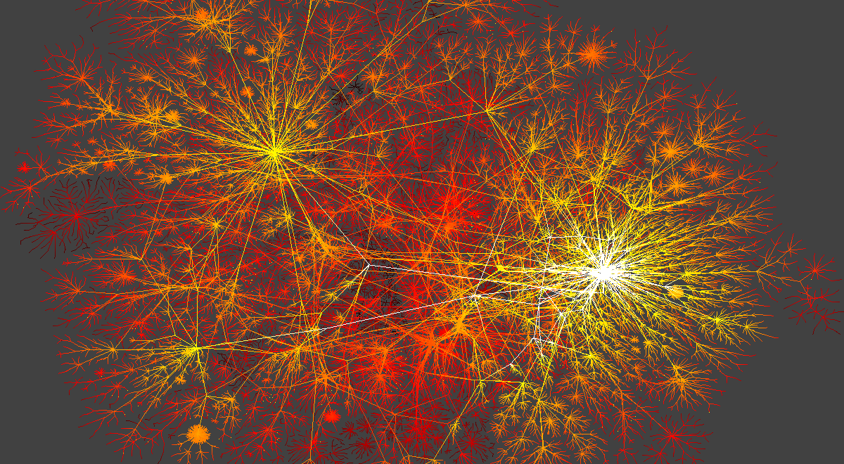
Sample of The Internet

Slide 18
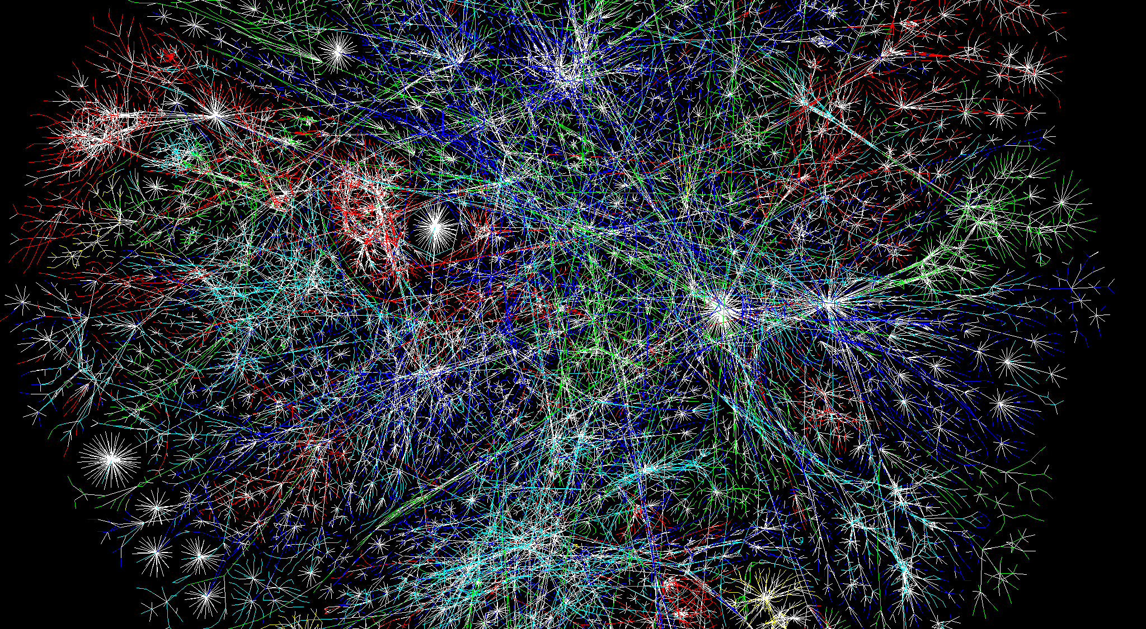
Sample of The Internet

Slide 19
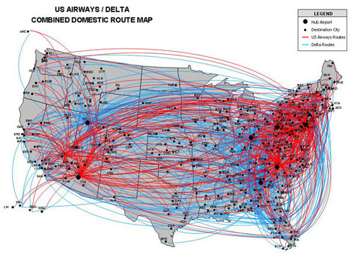
Air Transportation

Slide 20
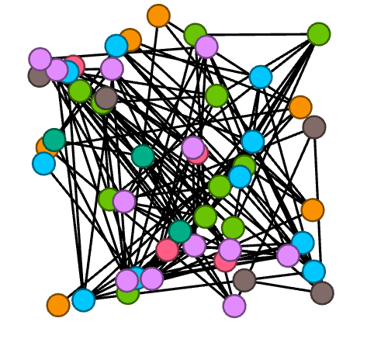
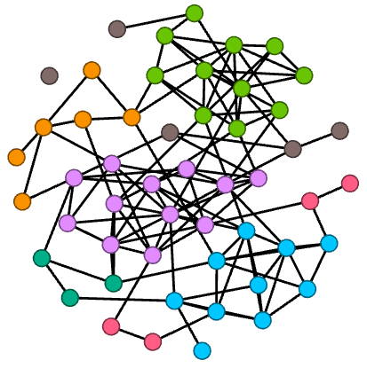
Layout is important!
vs.

Slide 21
Considerations for Network Layout
Edge lengths
Edge crossings
Node-edge overlap
vs.
vs.
vs.

Slide 22
Force-Directed Graph Drawing
Family of algorithms designed to layout graphs
Some attractive force is placed on adjacent vertices while a repulsive force placed on all vertices. Then the energy of the system is minimized.
Examples in action:
http://www4.ncsu.edu/~slrace/FINetwork.html
http://www4.ncsu.edu/~slrace/facebook.html

Slide 23
Force-Directed Graph Drawing
Advantages
Quality
Versatility
Simplicity
Disadvantages
Long Run-time ~ O(n³) (Problem for large graphs)
Standard algorithm: Hundreds-Thousand nodes
Barnes-Hut Simulation O(n log(n)): ~100K nodes
Multi-level approaches: ~million of nodes
Some algorithms find poor local minima
Rarely do algorithms factor in the weights of edges

Slide 24
Other Graph Drawings
Multidimensional Scaling

Slide 25
Other Graph Drawings
Multidimensional Scaling
Class of methods to best represent pairwise distances in 2-space.
The distances between points in the resulting 2-dimensional approximation are as close as possible to the distances between points in the original space.
Gives (x,y) coordinates based on the SVD/PCA of a similarity matrix
For a network, the distance between 2 nodes is the length of shortest path between them.

Slide 26
Visualization Software
Gephi – Most popular (as of late)
R
igraph
network
networkD3
Python
networkX

Slide 27
Data Formats
Edgelists, Adjacency Matrices, Lists of Neighbors

Slide 28
Graph Data Formats
Many possible formats (.gml,.csv,.gephi, etc)
Many include built-in ways to include individual variables (e.g. gender, age)
Node table
Node attributes
All have some way to list edges (structural variables)
Edge list
List of neighbors
Adjacency Matrix

Slide 29
Edge List Format
Lists the source and target of each edge. Numbering of nodes dependent on software. (python: 0…n) (R: 1…n package dependent)
Some formats allow edge attributes (type/weight)
Source Target Weight
1 3 2
1 4 1
1 5 2
2 1 1
2 3 1
3 4 1
5 4 2

Slide 30
Neighbors List Format
Best choice for large graphs
1 data line for each node, listing all of its neighbors:
Cannot easily incorporate edge attributes to this data structure.
1: 3,4,5
2: 1,3
3: 4
4:
5: 4

Slide 31
Adjacency Matrix
Generally, all of the analysis is going to involve the adjacency matrix, A.
A_{ij} = weight of edge between vertex i and vertex j

Slide 32
Pop Quiz
Which of the following words accurately describes the adjacency matrix for an undirected graph?
Diagonal
Symmetric
Identity
Negative
Rectangular
Sassy

