Slide 1
Austin Crime 2017-2020
Question: When a crime is committed, what would the highest rate of crime be?

Slide 2
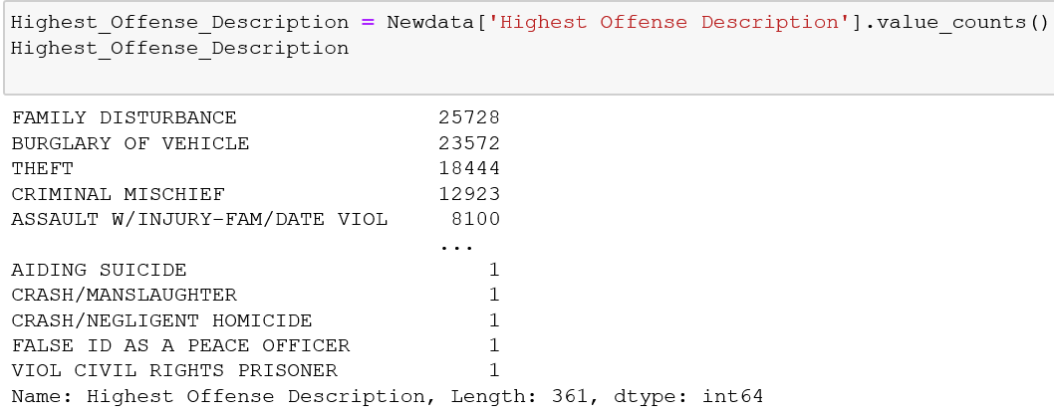
Crime Counts
3 Highest Rated Crimes: Family disturbance, Burglary of Vehicles, Theft

Slide 3
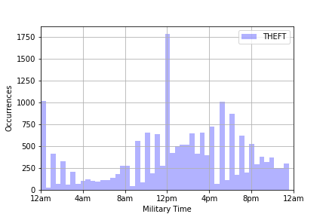
Theft – at what time did this crime occur?
Theft rated at 18,444 occurrences
peak time of Theft occurred at 12PM

Slide 4
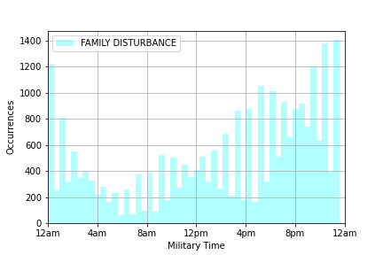
Family Disturbances – what time did this occur?
Family Disturbances rated at 25,278
Crime occurrences gradually increased from 12PM – 12AM
Peak occurrence around 12AM

Slide 5
Burglary of Vehicle:

Slide 6



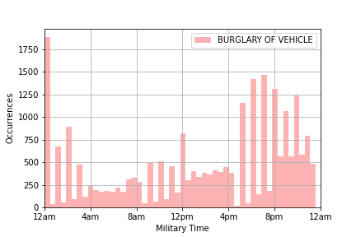
Second highest crime that rated next was burglary of vehicle rated 23,572.

Slide 7
.

