Slide 1
Austin Crime 2017-2020
Question: When a crime is committed, what would the highest rate of crimes be ? And what times did these crimes occur?

Slide 2
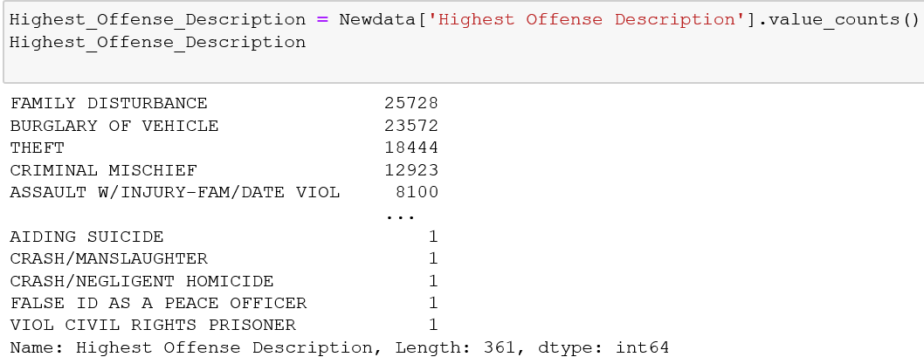
Crime Counts
3 Highest Rated Crimes: Family disturbance, Burglary of Vehicles, Theft

Slide 3
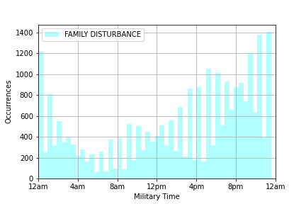
Family Disturbances – what time did this occur?
Family Disturbances rated at 25,278
Crime occurrences gradually increased from 12PM – 12AM
Peak occurrence is around 12AM

Slide 4
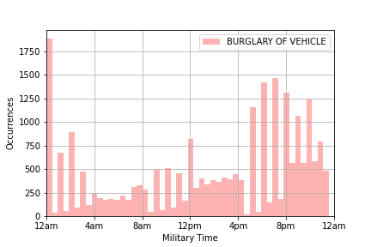
Burglary of Vehicle: rated at 23,572 in occurrences as a second highest crime
Burglary of vehicle peak times rated the highest at 12am and from 4:30 -11pm

Slide 5
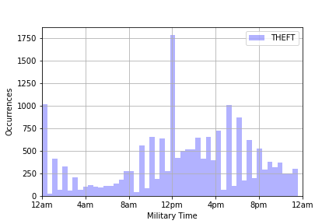
Theft – at what time did this crime occur?
Theft rated at 18,444 occurrences
peak time of Theft occurred at 12PM
Other occurrences between the hours of 4PM – 8PM

Slide 6
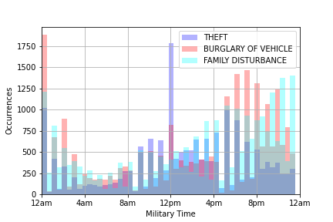
Comparison of 3 Highest Crimes
Conclusion for the analysis of three highest crimes, was that the lowest occurrences happened during the hours of 4Am-8AM.
I had originally thought that aggravated assault would have the highest rated occurrences.

Slide 7

If “Residence/Home” is the most frequent crime location in our data set, then is it safe to assume “Family Disturbance” is the most frequent crime offense description for that location?
Question #2
This Photo by Unknown Author is licensed under CC BY-NC

Slide 8
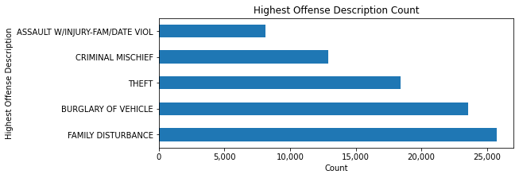
Count of the Highest Crime Offense
We can conclude that “Family Disturbance” has the highest rate of occurrence in our data

Slide 9
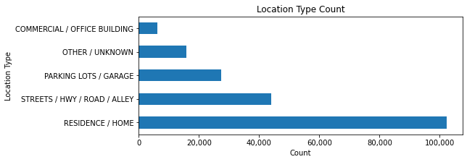
Crime Location Count
We can conclude that “Residence/Home” has the highest rate of occurrence in our data

Slide 10
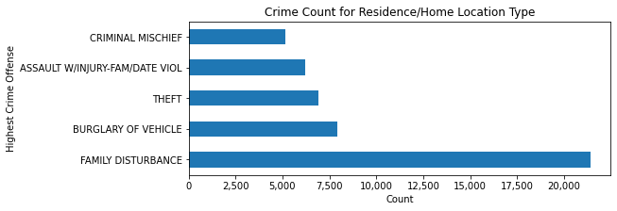
Highest Crime Count Grouped By Location
We can conclude that our “Family Disturbance” is the most frequent crime of for the location of “Residence/Home”

Slide 11

Conclusion
“Family Disturbance” is the most common crime in the “Residence/Home” crime location
This Photo by Unknown Author is licensed under CC BY-SA

