Slide 1

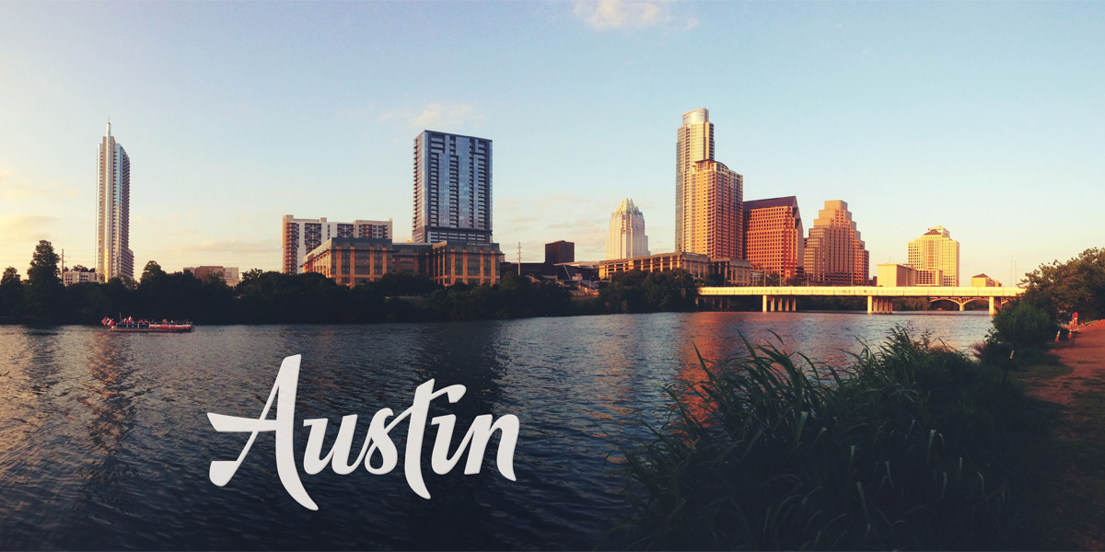
Austin Crime 2017-2020
By: Armand, Shaine & Jordan
This Photo by Unknown Author is licensed under CC BY-SA-NC
This Photo by Unknown Author is licensed under CC BY-SA-NC

Slide 2
Objective
Our objective was to see different trends when it comes to the time, locations of different crimes, and crime types in Austin.

Slide 3
Data Cleaning
We found this data from Catalog.data.gov. With this data it had years from 2005- 2020 with over 500,000 crimes
We decided to only use data from 01/01/2017 – 12/15/2020
After reducing the years we removed the N/A’s along with multiple columns that had excess information
The columns we kept include the crime type, location type, zip codes, dates and a few others

Slide 4
Austin Crime 2017-2020
Question: When a crime is committed, what would the highest rate of crimes be ? And what times did these crimes occur?

Slide 5
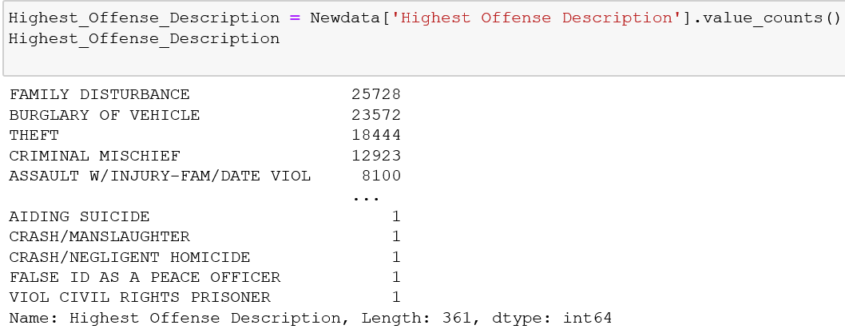
Crime Counts
3 Highest Rated Crimes: Family disturbance, Burglary of Vehicles, Theft

Slide 6
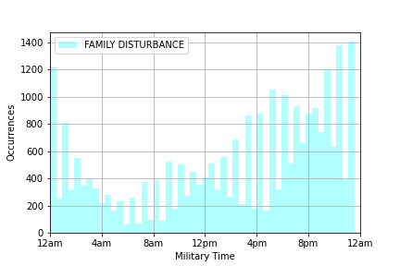
Family Disturbances – what time did this occur?
Family Disturbances rated at 25,278
Crime occurrences gradually increased from 12PM – 12AM
Peak occurrence is around 12AM

Slide 7
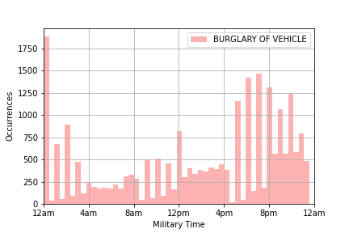
Burglary of Vehicle: rated at 23,572 in occurrences as a second highest crime
Burglary of vehicle peak times rated the highest at 12am and from 4:30 -11pm

Slide 8
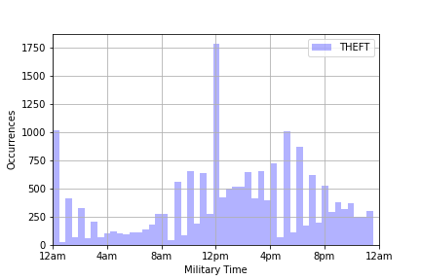
Theft – at what time did this crime occur?
Theft rated at 18,444 occurrences
peak time of Theft occurred at 12PM
Other occurrences between the hours of 4PM – 8PM

Slide 9
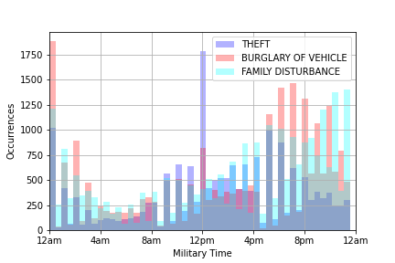
Comparison of 3 Highest Crimes
Conclusion for the analysis of three highest crimes, was that the lowest occurrences happened during the hours of 4Am-8AM.
I had originally thought that aggravated assault would have the highest rated occurrences.

Slide 10

If “Residence/Home” is the most frequent crime location in our data set, then is it safe to assume “Family Disturbance” is the most frequent crime offense description for that location?
Question #2
This Photo by Unknown Author is licensed under CC BY-NC

Slide 11
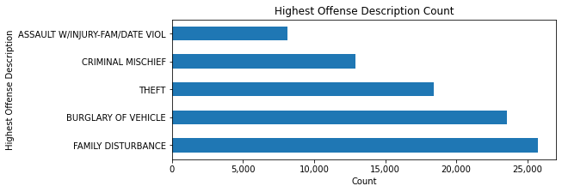
Count of the Highest Crime Offense
We can conclude that “Family Disturbance” has the highest rate of occurrence in our data

Slide 12
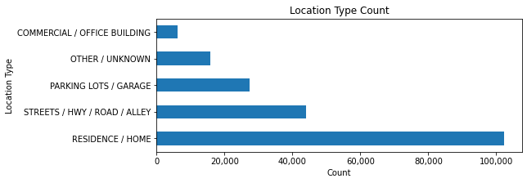
Crime Location Count
We can conclude that “Residence/Home” has the highest rate of occurrence in our data

Slide 13
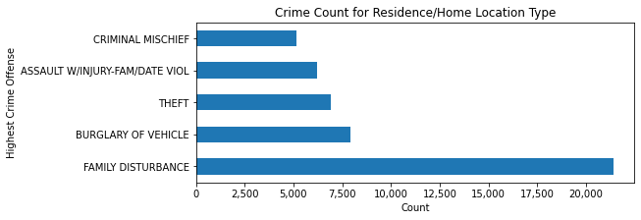
Highest Crime Count Grouped By Location
We can conclude that our “Family Disturbance” is the most frequent crime of for the location of “Residence/Home”

Slide 14

Conclusion
“Family Disturbance” is the most common crime in the “Residence/Home” crime location
This Photo by Unknown Author is licensed under CC BY-SA

Slide 15
If the crime that happened the most was theft, then the location was more on the north side of Austin.

Slide 16
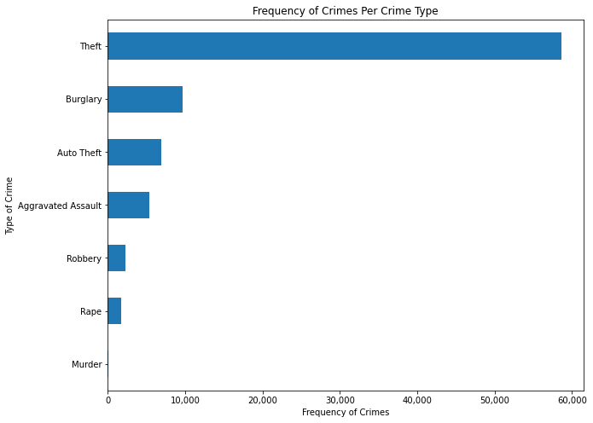
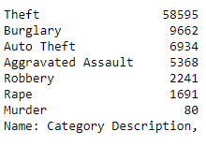
Frequency of crime by type
Theft has most crimes with 58,595 (not including Auto or Robbery)

Slide 17
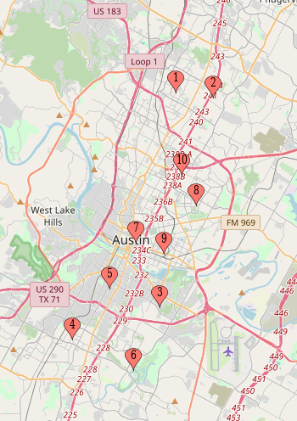
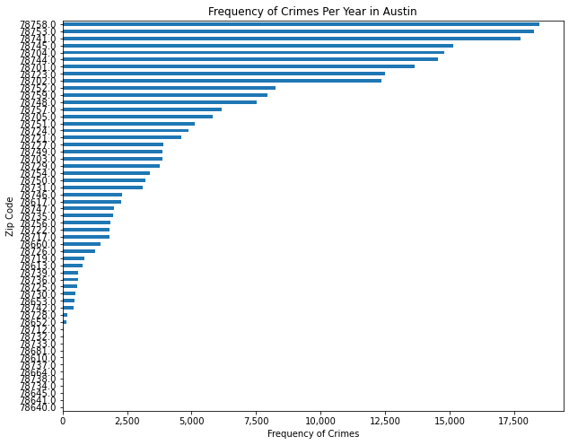
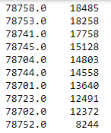
Crimes per Zip Code There are over 50 zip codes within our data. The top two zip codes with the most crimes are on the north side of Austin, but they are spread out. Part of the top 10, at number 7, is the state capitol.

Slide 18
Conclusion
The zip code with the majority of crimes committed was located on the North side of Austin. Part of the top ten zip codes includes the state capitol at number seven with 13,640. Within these years, 2020 had the most of crimes that occurred with 75,292.

