Slide 1
Austin Crime 2017-2020
Question: When a crime is committed, what would the highest rate of crimes be ? And what times did these crimes occur?

Slide 2
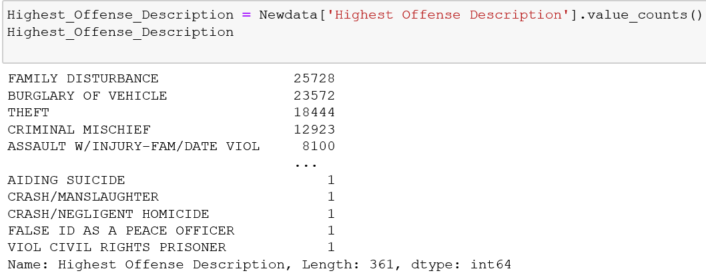
Crime Counts
3 Highest Rated Crimes: Family disturbance, Burglary of Vehicles, Theft

Slide 3
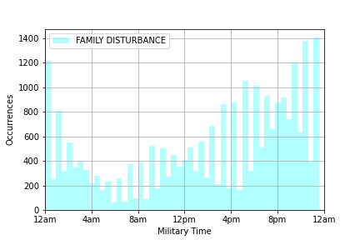
Family Disturbances – what time did this occur?
Family Disturbances rated at 25,278
Crime occurrences gradually increased from 12PM – 12AM
Peak occurrence is around 12AM

Slide 4
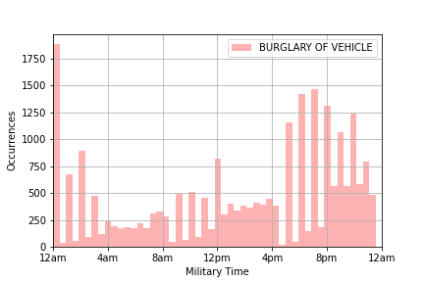
Burglary of Vehicle: rated at 23,572 in occurrences as a second highest crime
Burglary of vehicle peak times rated the highest at 12am and from 4:30 -11pm

Slide 5
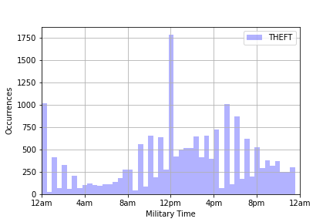
Theft – at what time did this crime occur?
Theft rated at 18,444 occurrences
peak time of Theft occurred at 12PM
Other occurrences between the hours of 4PM – 8PM

Slide 6
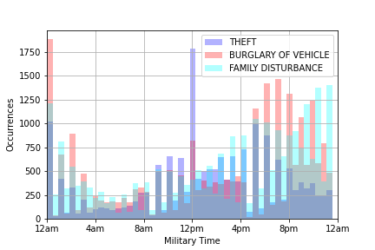
Comparison of 3 Highest Crimes
Conclusion for the analysis of three highest crimes, was that the lowest occurrences happened during the hours of 4Am-8AM.
I had originally thought that aggravated assault would have the highest rated occurrences.

