Slide 1


Seismic Phase Picking Automation Using A Implicit Model
Susana Haing
El Camino College
Berkeley AI Lab, El Ghaoui’s Group
2023 Transfer-to-Excellence Program
Notes:
Talk about outline

Slide 2
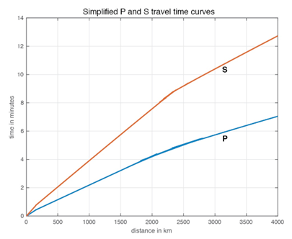
What is Seismic Phase Picking?
The process of identifying and selecting specific seismic wave arrivals on seismographs to determine characteristics of an earthquake
There are 2 waves we are focusing on: P-waves and S-waves
Primary waves (P-waves) and Secondary waves (S-waves) are used to determine an earthquake’s location
Notes:
Image: example of P and S wave timing
Both waves start from the same position and time but due to their speed, the time it takes for them to get somewhere varies
You can see that the blue curve - reps P wave - moves the same distance as the S wave - the red curve - in considerably less time

Slide 3
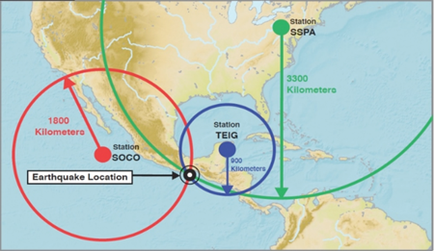
Triangulation Using P-waves and S-waves
Using time difference between P-wave and S-wave arrival from 3 different seismographs can be used to determine an earthquake’s location
Notes:
By calculating the time difference between the waves at a single station, the value we get can be used to infer the distance of an earthquake’s source from any specific station. With 3 of these values, triangulation of an earthquake is possible.
In this figure here, you are able to see that there is triangulation of an earthquake in the North American region. Obviously, distance between a seismic station and an earthquake does not matter, as the distance the waves travel is affected by the amplitude of the earthquake.

Slide 4
Research Motivations
Traditional phase picking must be done by hand
Current automation is too computationally costly
Improve other applications of earthquake monitoring
Notes:
Point 1: doing it by hand is the most accurate, but requires teams of trained analysts to pick them out, making it very labor intensive and time consuming
Point 2: presently, automation is done via deep learning models, which are able to replicate human phase picking to a high degree of accuracy but requires an incredible amount of computational power to do so
Point 3: facilitate a wide range of applications, encompassing urban environmental monitoring, earthquake early warning systems, and scientific educational outreach

Slide 5

Objectives
Reduce requirements of automated seismic phase picking and apply it to a scaled down, low cost device
Raspberry Shake
Notes:
Compared to traditional seismographs, which are expensive and physically larger, these scaled down seismic devices from companies such as Raspberry Shake are more accessible to the rest of the world. This is including developing countries, rural areas, and more, which will assist in earthquake education

Slide 6
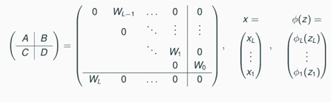
Methods
Use an implicit model over a deep learning model to reduce computational cost and improve
Notes:
This is an example of a FFNN formulated into an implicit model framework. This shows why IM is better than a specific DL model due to the fact that it is simply more general. Consider a FFN with different layers, in here we have L number of layers from 0 to L-1, in an IM, all of the weights show on a diagonal from 0 to W-1, with X being a vector where we stack the intermediate states.
Its structural pattern in IM is in FFNN, which is the same for other more complicated DLMs such as CNNs which has a similar FFNN nature - this makes it possible to format it into an IM
Example of FFNN formulated into implicit model frame work - shows why IM is better than a specific DL model bc it is more general - consider a FFNN with different layers, in here we have L layers from 0 - l-1, in an IM - all weights show on a diagonal.. 0, w1… - wl-1, x = vector where we stack intermediate states -
Math can be worked out to multiply.. X = refers to each layer that is stacked
Z = activation - DLM activation after multiplying - structural pattern in FFNN - same for other more complicated DLMs such as CNNs which has a similar FFNN nature - this makes it possible to put into a IM format

Slide 7
What is an Implicit Model?
Implicit models are a general class of deep learning models
Encapsulates most deep neural networks as special cases
Allows training for more compact models without specific model architecture
No need for handpicking of neural network components
Notes:
With the implicit model, we can train it to be able to determine whether a P-wave or S-wave happened.
Point 1: With deep learning, one of the down sides is that you need to decide what type of neural network to use, ranging from Convolution NN, Recurrent NN and many more, which can make it difficult to do machine learning. With an implicit model however, there is no need for this as it covers most deep learning architectures
Point 2: As the implicit model is simpler, it generalizes model components, which reduces the number of values that need to be adjusted. With the implicit model, we only input the input and output sizes and the flattened input size, in comparison to specific DLMs which need more specifications based on the dataset, goal and model itself.
Point 3: For IM - no need to pick a structure as it will optimize to the best fit one
The IM also works directly with the raw metadata, which reduces the amount of computational power it needs to run as it does not need to preprocess the data.

Slide 8
Methods
Train and test the implicit model on the ETHZ benchmark public dataset on P-wave and S-wave traces
Determine whether the model generates a reliable precision value based on its loss and error
Compare the results to previous research and actual hand picked phase analysis
Apply to Raspberry Shake if applicable
Notes:
For our methods, we simply train and test the implicit model on the ETHZ dataset from Switzerland on Primary and secondary wave traces
Then we would determine whether the model was reliable based on its loss and error and compare the results to previous research and hand picked phase analysis
Finally, our end goal was to apply it to raspberry shake seismology devices depending on whether the model could produce a reliable precision value

Slide 9
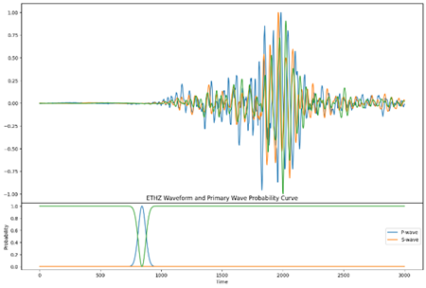
Results
S-wave
P-wave
Notes:
This is a waveform from the ETHZ dataset, and in it you can see there is a P wave and an S wave where the arrows are pointing. The graph on the bottom is the probability curve which is indicated whether a P or S wave is present in the waveform. You can see that the IM indicates a P wave is present with the blue curve.
In this specific waveform, it is quite clean but there is a potential for messier ones due to seismic devices picking up on noise. Noise can vary depending on where the device is located. For example, if a device is near a stadium, then it could pick up the vibrations from a sports game or concert. Or if it is near the road, then it can pick up vibrations from cars passing by as well. The whole goal is to be able to determine whether there is a P or S wave present within all of the noise to sort through from each seismic device.

Slide 10
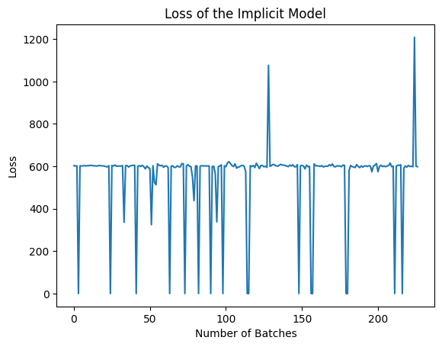
Results
Notes:
Add annotations to the graphs
The implicit model is able to determine whether a P or S wave is present within the waveform
Able to get it to run but there is future work that needs to be done - loss is always fluctuating so there needs to be more indepth investigation
This is the loss graph of the implicit model. As you can see, the implicit model is able to determine whether a P or S wave is present within the waveform, but the loss is constantly fluctuating, so there needs to be a more in depth investigation to determine why and whether the model is truly reliable for our application goals or not.

Slide 11
Results
S-wave
P-wave
Notes:
If we go back to this graph, note that it does not indicate that an S wave is present. However, analysts state that there is a S wave at this point here, which means the model needs some more investigation to be better able to decide whether an S wave is present or not.

Slide 12
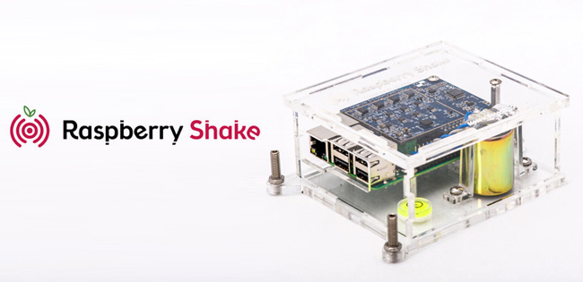
Possible Applications
With continued work, we will be able to increase the accuracy of the implicit model with automating phase picking.
Notes:
Presently, RS devices use extremely simple DLMs for phase picking, with the scaling down of the process by using an IM, we are able to implement a more complex DLM for more accurate phase picking into the device despite its small size and computational power.

Slide 13



Acknowledgements
I would like to give special thanks to:
Alicia Tsai
Lindsay Y. Chuang
Dr. Laurent El Ghaoui
Hopper-Dean Foundation
Everyone involved in the Transfer-to-Excellence Program

Slide 14
Thank You!
Questions?

