Slide 1



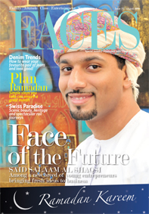




Slide 2

Profile
Since its inception in February 2007, FACES has become a not-to-be missed magazine for leisure reading, with in-depth and incisive material for the entire family.
Distributed FREE every month to the subscribers of Times of Oman, the leading English daily of Oman, more than 20,000 copies of FACES are given during the month end in thousands of homes and offices across Muscat!
News, trends, fashion, food, cars, travel, health, luxury, glamour, personalities or men’s interests, if you want the best leisure read month after month, FACES is an unbeaten bet, reaching a huge and guaranteed subscriber base without fail!

Slide 3
Yet, FACES is not merely about fun and leisure – we also cover features on home and hearth, safety-related articles, health and nutrition and general well-being.
It never ceases to provide new value add-ons and exclusive information on interesting features. The editorial is well thought out and timely as it reaches homes directly.
The editorial features the Who’s Who of Oman, and the main stories are always about FACES of Oman, who are in some form the movers and shakers of Oman.

Slide 4
Three years on, Oman’s premier people & lifestyle magazine resource is a household name and is now reaches you in a BIGGER & BETTER format
With its new glossier layout, FACES now bring you highly visually appealing features editorial/ad spaces on par with international glossies, giving you complete coverage as a reader or advertiser.
Expanding our editorial coverage, the all-new FACES will now include (besides regulars): Art & Culture, Mind & Intellect, Luxury & Lifestyle, Home & Real Estate, Money Matters, Columns by experts, Event photo coverage

Slide 5
Distribution
FACES is truly the widest circulated and read magazine of its kind in Oman. Distributed FREE every month more than 20,000 copies reach out to the readers through various channels
Distributed FREE with leading national daily Times of Oman, FACES promises a guaranteed reach to the newspaper’s subscribers in Muscat and various satellite towns of Oman like Nizwa, Barka, Sohar and Salalah etc.
This reach also spreads out to corporate offices, government organisations, ministries, travel agencies, clinics and many more.
An additional distribution channel reaches restaurants, hotels, cafes, health clubs and other leisure activities places.

Slide 6
Demographics
    Well to do Omani and expat households with capacity to subscribe to a daily newspaper costing RO 0.200 per day
    Target Age Group : 18 - 45 yrs
    Local & Expatriate readers of both sex primarily decision making, brand conscious individuals
    Areas of interest : Lifestyle, Fashion, Health, Travel, Family matters, Entertainment

Slide 7
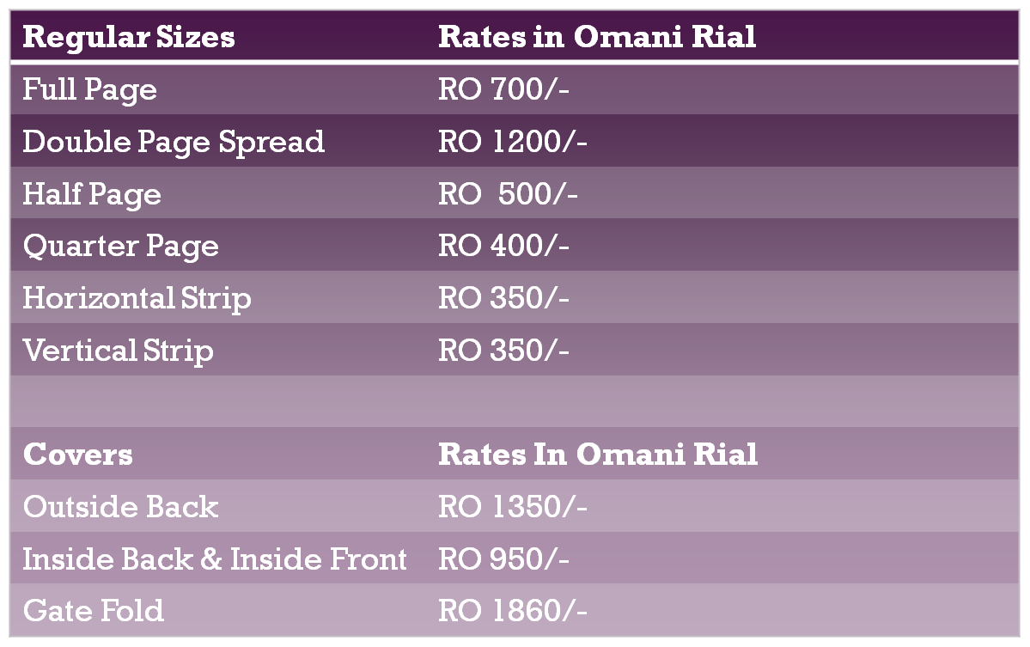
Rates

Slide 8
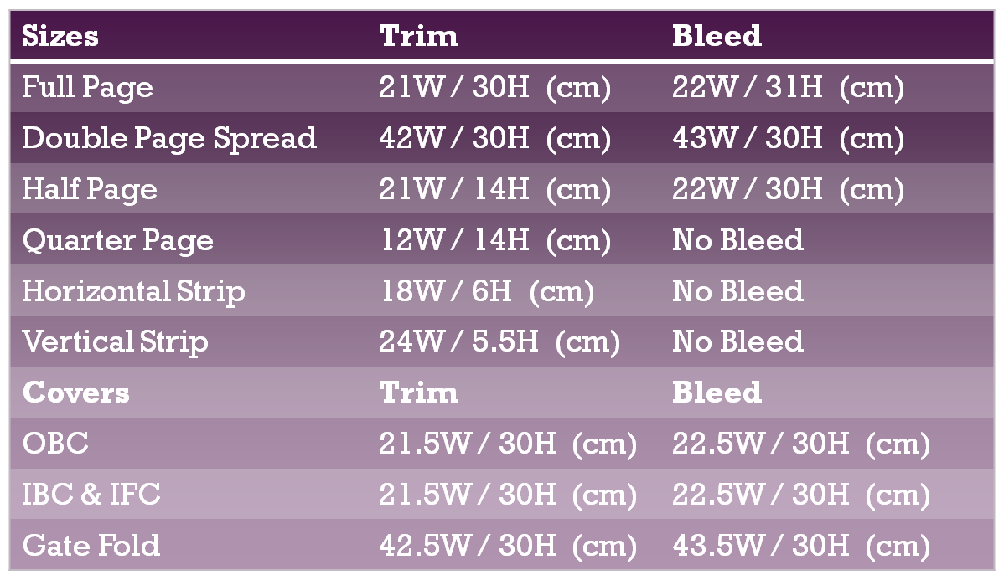
Specifications

Slide 9


Contact Info
\\ Oman
Gsm: +968 95069506
Tel: +968 24702270
Fax: +968 24702260
Email: sales@facesoman.com
\\ Dubai
Gsm: +971 50 6581189 / 4950079
Tel: +9714 3597892 / 3597894
Fax: +9714 3527719
Email: salesdubai@facesoman.com

