Slide 1

DROWSINESS DETECTION USING CNN
BY:
SHAINY SARIGALA 180030200
LAHYA BOLLA 180031128
Lekha reddy 180030193
BHUVANA PRIYA.U 180031177

Slide 2
INTRODUCTION:
Drowsiness detection system is a safety technology.
The eye movement of the driver is monitored live and whenever the driver feels asleep or closes eye for more than 2 sec. Then it alerts the driver with the help of the loud alarm. Thus preventing any accidents from happening.
Drowsy driving isn’t just falling asleep while driving. Drowsy driving can be as small as a brief state of unconsciousness when the driver is not paying full attention to the road.

Slide 3
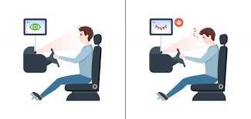
“DROWSINESS IS A BIGGEST PROBLEM FOR ROAD ACCIDENTS AND DATA SCIENCE IS THE BEST REMEDY FOR IT”

Slide 4
requirements:
Python
openCV - for face and eye detection.
Keras - To build our classification model
Tensorflow- Backend of the keras
Pygame - to play alarm sound

Slide 5
OBJECTIVE:
The objective of this project is to prepare a prototype of the driver drowsiness system that alerts the driver drowsiness system is a safety alarm system that alerts the driver when ever he feels drowsy and sleepy.
This is archeived by machine learning model to detect the face of the driver using a camera and analyse the state of the driver.

Slide 6
architecture:
The system is build with keras and CNN
CNN – it is special type of deep learning technique network and it is used extremly well for image classification.
CNN basically consists of the input layer and the output layer and hidden layers which have multiple number of layers.

Slide 7
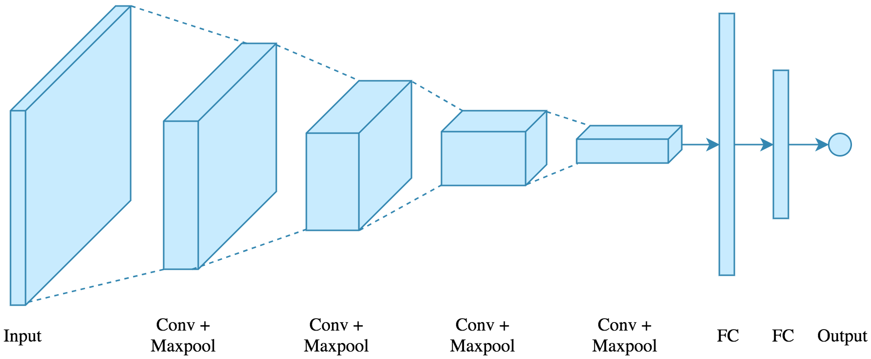

Slide 8
Working procedure:
STEPS:
1)
Takes input as image from a camera with webcam.
To access webcam, we have to make make infinite loop that will capture each frame.
We will be using openCv(cv2.vediocapture(0)) to access the camera and set the capture object(cap)
Cap.read() - it is used to read each frame and we store the image in a frame variable.

Slide 9
Working procedure:
2)
We have to detect face in the image and create a region of intrest.
For detecting face in a image we use haar cascade classifier.
Detect the eyes from ROI and feed it to the classifier.
To extract the eye data from the full image we need to extract the boundary box of the eye then we can pull out the eye image from the frame with this code.
Left_eye contains the image data of the eye. This will be fed into CNN classifier which will predict if the eyes are open or closed similarly, we will be extracting the right eye. Into right_eye.

Slide 10
Working procedure:
Classifier will categorize whether eyes are open or closed.
If eye is closed for more then 2sec then alarm sound will be played to alert the person.and the sound is played with the help of pygame.

