Slide 1
Disaster Tweet Classification
Natural Language Processing + Machine Learning
Project presentation based on the completed NLP notebook
Raw Tweets
Cleaning
TF-IDF
Classifier
0 / 1 Prediction
Goal: identify whether a tweet reports a real disaster or is non-disaster content.

Slide 2
1. Problem Statement & Objectives
WHY THIS MATTERS
OBJECTIVES
Twitter is a real-time information channel during emergencies, but disaster-related language can be ambiguous.
The project treats the task as binary text classification: 1 = real disaster, 0 = non-disaster.
Automation can help filter social-media noise and support faster emergency monitoring.
Develop a machine-learning classifier for disaster-related tweets.
Prioritize useful precision, recall and F1 performance to reduce missed disaster signals.
Build a robust workflow that can handle varied tweet language.
Save the trained model for future predictions.
Disaster Tweet Classification • NLP / Machine Learning | 2

Slide 3
2. Dataset & Data Exploration
Dataset loaded from the project CSV
7,613
tweets
5
columns
4,342
non-disaster
3,271
disaster
COLUMNS
id
keyword
location
text
target
Missing values: keyword = 61; location = 2,534; text and target = 0.
Duplicate rows found: 0.
Target distribution is moderately imbalanced, so stratified splitting/cross-validation was used.
Disaster Tweet Classification • NLP / Machine Learning | 3

Slide 4
3. Text Preprocessing & Feature Engineering
1
Text cleaning
Remove URLs, HTML/special characters, punctuation and other noise.
2
Normalization
Prepare tweet text for consistent token-based representation.
3
TF-IDF
Convert cleaned tweets into numerical features based on term importance.
4
Additional analysis
Explore word frequencies, bigrams/trigrams, tweet characteristics and language patterns.
Raw tweet → cleaned text → TF-IDF vector → ML classifier
Disaster Tweet Classification • NLP / Machine Learning | 4

Slide 5
4. Model Selection & Cross-Validation
5-FOLD CV
StratifiedKFold with 5 folds.
Compared accuracy, precision, recall and F1-score.
Logistic Regression produced the highest cross-validation F1-score among the four candidates.
Linear models are well suited to sparse TF-IDF text features.
Disaster Tweet Classification • NLP / Machine Learning | 5

Slide 6
5. Hyperparameter Tuning
GRID SEARCH
TF-IDF max_features
5,000 / 10,000
A Logistic Regression pipeline was tuned with GridSearchCV.
Search space included TF-IDF max_features, n-gram range and classifier C.
The search used 5-fold stratified cross-validation and F1 as the scoring metric.
Using a pipeline prevents TF-IDF vocabulary leakage across validation folds.
n-gram range
(1,1) / (1,2)
Logistic C
0.1 / 1 / 10
Disaster Tweet Classification • NLP / Machine Learning | 6

Slide 7
6. Final Test-Set Evaluation
80.55%
Accuracy
78.16%
Precision
75.47%
Recall
76.79%
F1-score
Class | Precision | Recall | F1-score
Non-disaster | 0.82 | 0.84 | 0.83
Disaster | 0.78 | 0.75 | 0.77
Test set contains 1,501 unseen tweets (861 non-disaster, 640 disaster).
Disaster Tweet Classification • NLP / Machine Learning | 7

Slide 8
7. Error Analysis & Validation
CONFUSION MATRIX
VALIDATION CHECKS
Predicted
Non-disaster
Predicted
Disaster
724
137
Training/test data were separated before final evaluation.
Stratification preserves the target distribution during validation.
Five-fold cross-validation checks model consistency.
Confusion matrix and classification report expose false positives and false negatives.
The notebook also tests predictions on varied tweet wording and capitalization.
Actual
Non-disaster
157
483
Actual
Disaster
Disaster Tweet Classification • NLP / Machine Learning | 8

Slide 9
8. Model Output & Example Predictions
0 / 1
binary prediction
TF-IDF
text representation
PKL
saved model artifact
“Massive flooding has damaged several houses”
Disaster-related
“I am enjoying a wonderful day with friends”
Non-disaster
“Emergency services are rescuing people after the earthquake”
Disaster-related
Disaster Tweet Classification • NLP / Machine Learning | 9

Slide 10
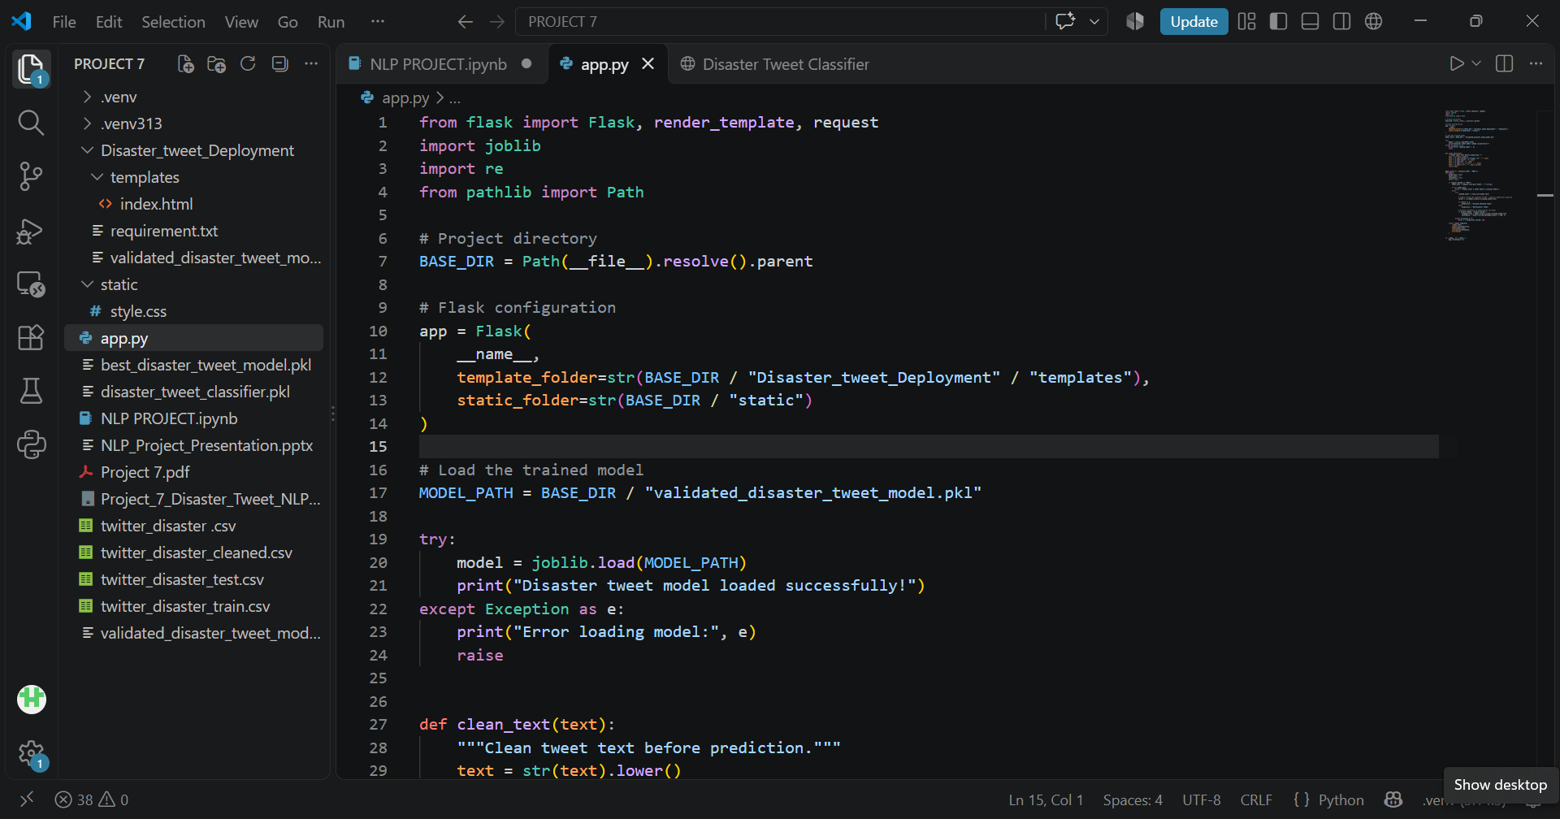
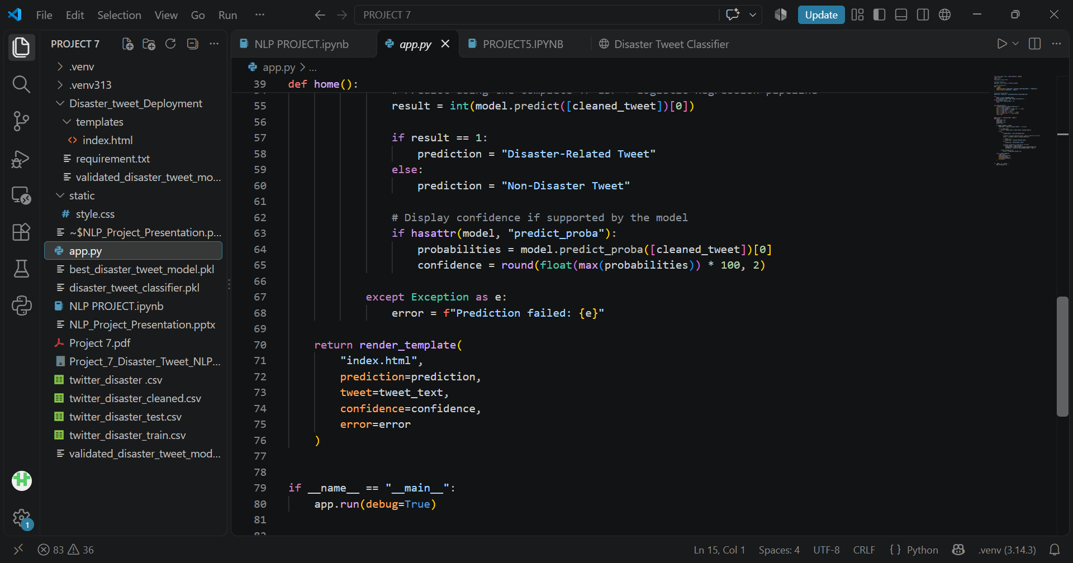
Screenshots from VS Code
app.py
app.py
Disaster Tweet Classification • NLP / Machine Learning | 9

Slide 11
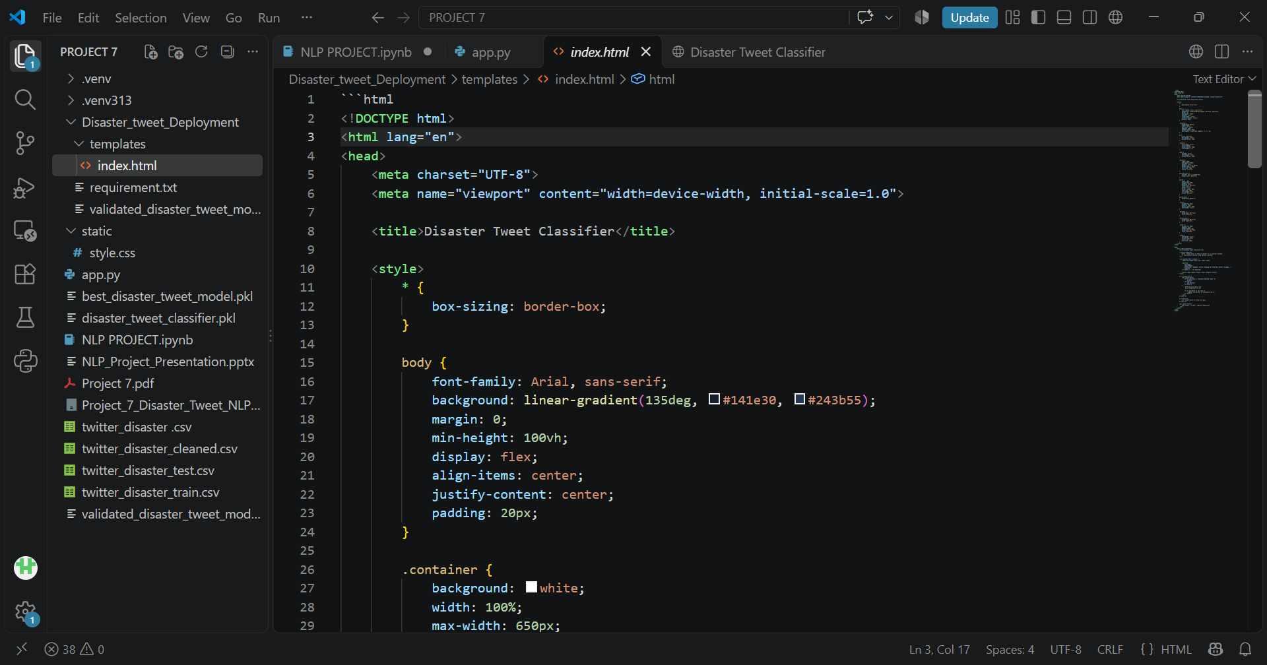
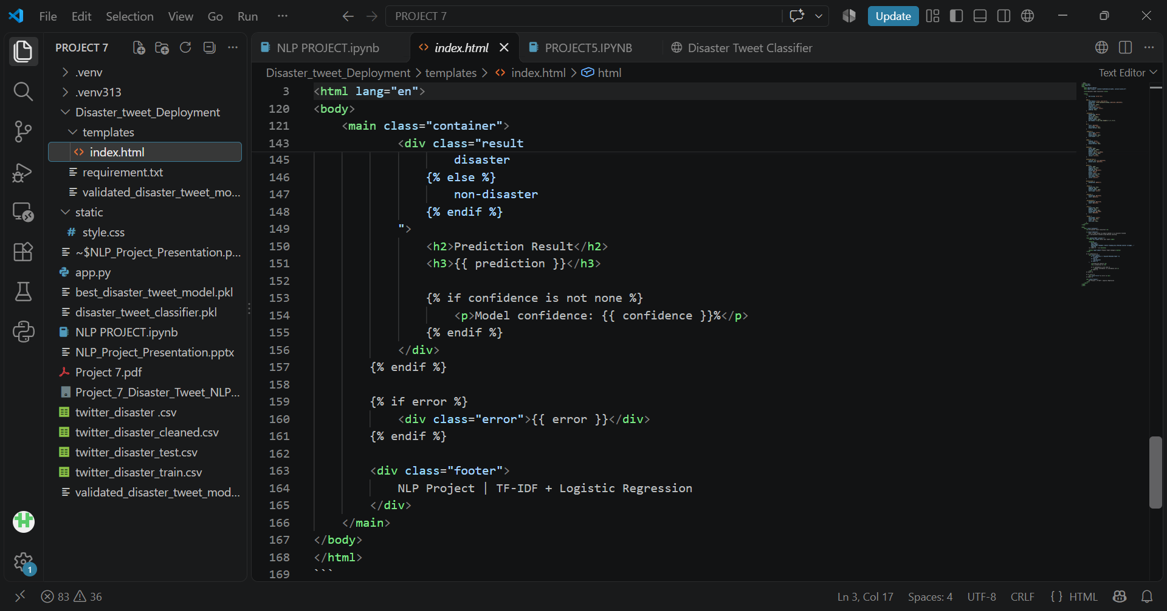
Screenshots from VS Code
html file
html file
Disaster Tweet Classification • NLP / Machine Learning | 9

Slide 12
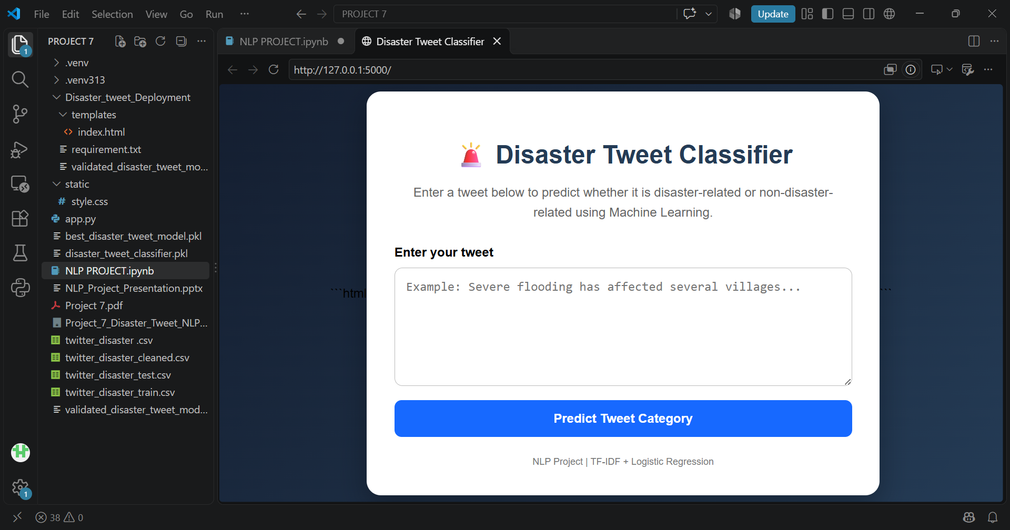
Screenshots from VS Code

Slide 13
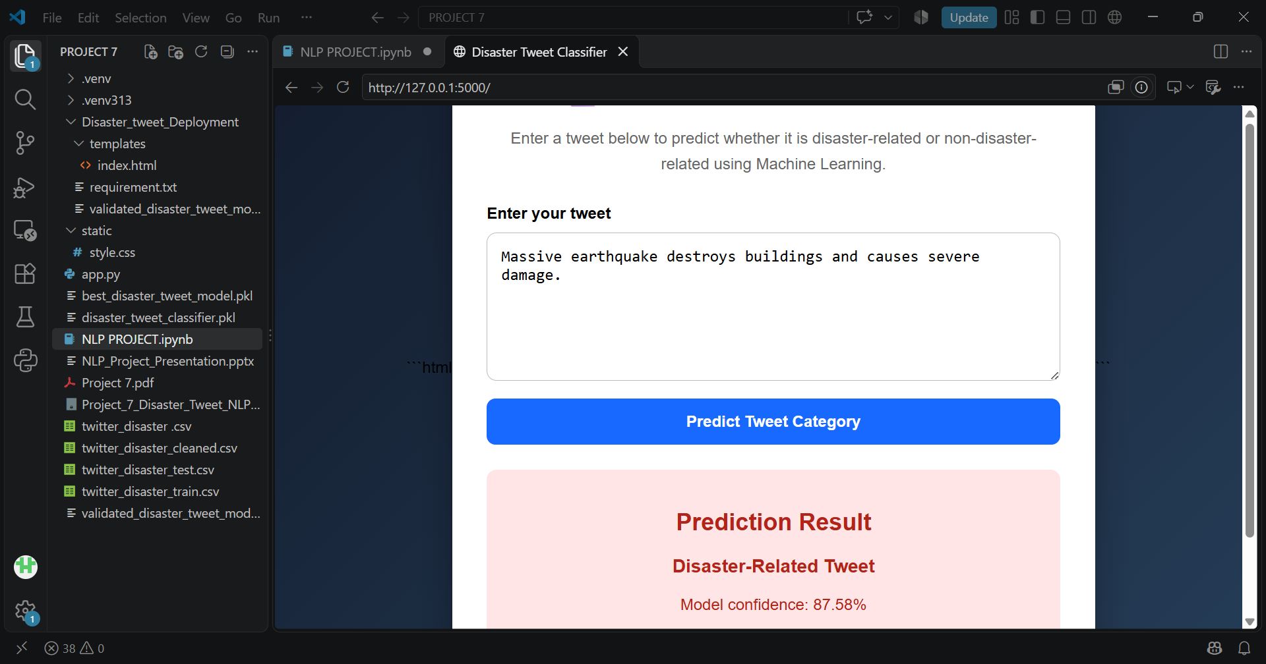
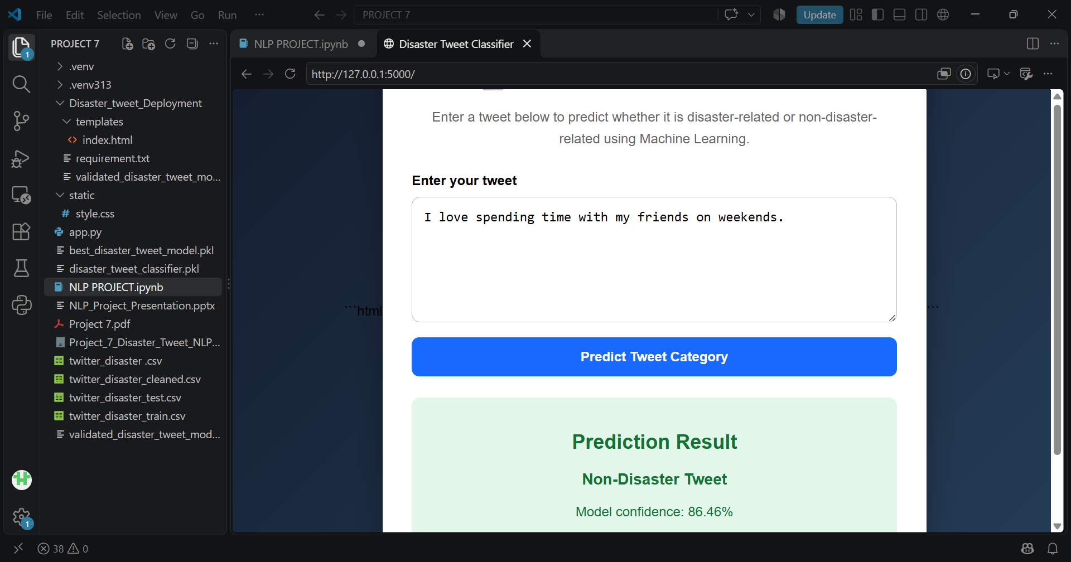
Screenshots from VS Code
Tweet picture with Prediction Results(Disaster-Related Tweet)
Tweet picture with Prediction Results( Non-Disaster Tweet)

Slide 14
9. Conclusion & Future Scope
The project successfully builds an end-to-end NLP workflow for disaster tweet classification.
Logistic Regression with TF-IDF was the strongest candidate in cross-validation and was tuned for final evaluation.
The final test results achieved 80.55% accuracy and 76.79% F1-score.
The trained classifier was saved as a reusable model artifact and tested on new tweets.
Future improvements: richer semantic representations such as Word2Vec/GloVe or Transformer models, stronger context handling, and deployment through a web interface.
Disaster Tweet Classification • NLP / Machine Learning | 9

Slide 15
Thankyou for your time & attention!
PROJECT PRESENTED BY:- IRAM SHAFI
PRESENTED ON:- 15-10-2026

