Slide 1
Blog Site Review Documents

Slide 2
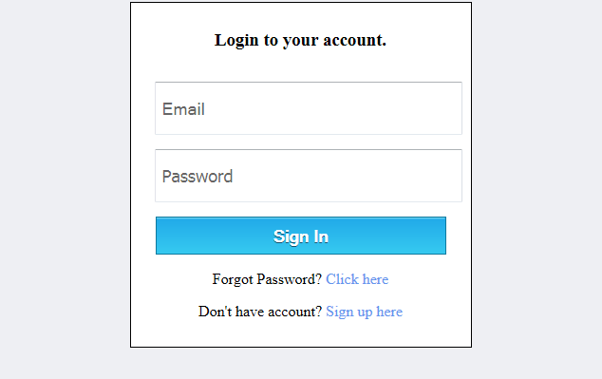
Login Screen

Slide 3
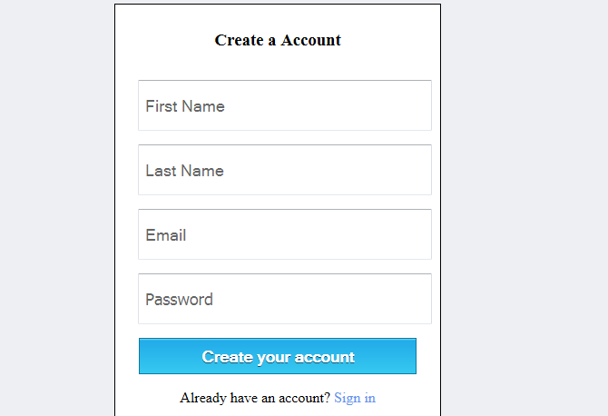
Register Screen

Slide 4
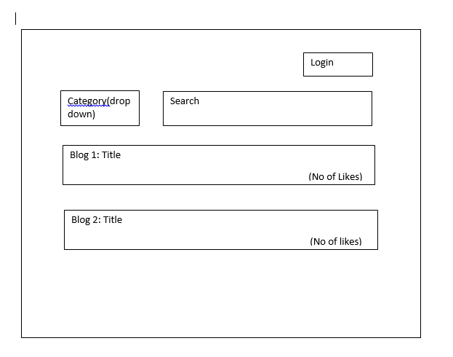
Non logged in users dashboard

Slide 5
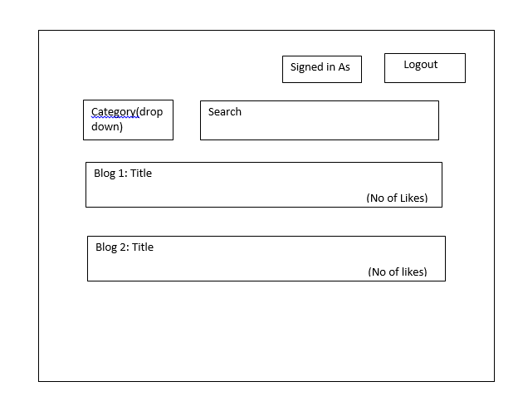
Logged in users dashboard

Slide 6
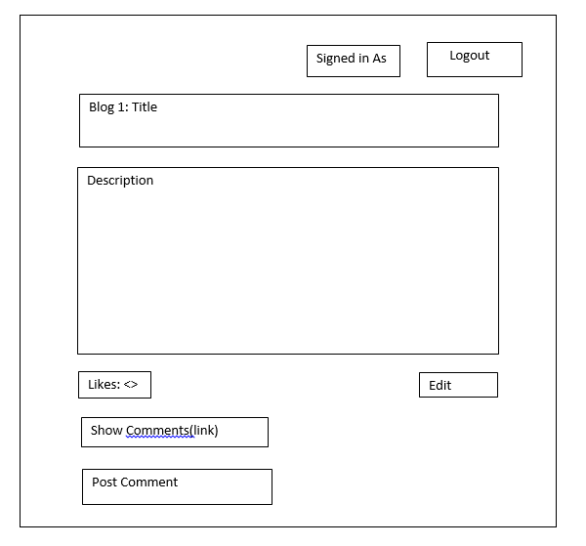
Blog view for logged in users

Slide 7
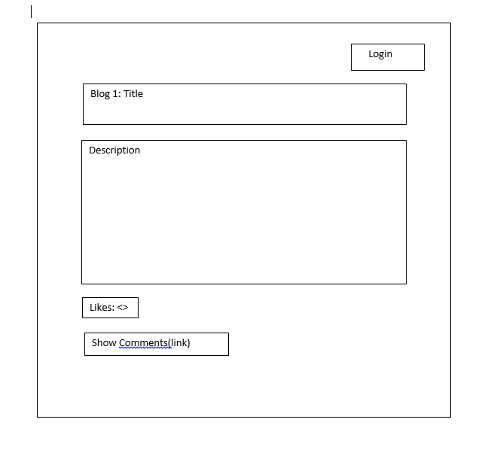
Blog view for Non-logged in users

Slide 8
Technologies used
Client
Jquery/Bootstrap
SpringBoot 1.5
JJWT
Authentication
Spring Enablement
REST API
Spring JAX-RS
JDBC - Hibernate
MySQL

Slide 9
API Classes – Domain Objects

Slide 10
Business Logic and Services used

Slide 11
RootResources and Services used

