Slide 1
Product Recommender for Online Stores
Capstone Project
Data Science Career Track, Springboard
Thanks to mentor Julian Jenkins III

Slide 2
Introduction
Many customer are influenced with the reviews and ratings while buying on online stores.
Ratings 1,2 3,4 5 gives the quick understanding of product quality.
The purpose of this project is to build a recommender for online stores based on customer ratings.
In this project recommendation model is built based on electronics products of Amazon, based on the ratings.

Slide 3
Data source
Source - Amazon Reviews data (http://jmcauley.ucsd.edu/data/amazon/links.html)
For this case study, I am using the Electronics dataset.

Slide 4
Data source
Sample review dataset:
This dataset includes reviews (ratings, text, helpfulness votes), product metadata (descriptions, category information, price, brand, and image features), and links (also viewed/also bought graphs). And has 1689188 records.
"reviewerID": "A2SUAM1J3GNN3B",
"asin": "0000013714",
"reviewerName": "J. McDonald",
"helpful": [2, 3],
"reviewText": "I bought this for my husband who plays the piano. He is having a wonderful time playing these old hymns. The music is at times hard to read because we think the book was published for singing from more than playing from. Great purchase though!",
"overall": 5.0,
"summary": "Heavenly Highway Hymns",
"unixReviewTime": 1252800000,
"reviewTime": "09 13, 2009"

Slide 5
Summary of data set
Number of reviews: 1365131
Number of unique reviewers = 1036895
Number of unique products = 35192
Average rating score: 4.046

Slide 6
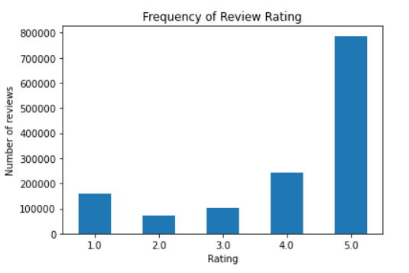
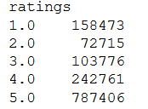
Product Ratings:
Products were rated with discrete numbers 1,2,3,4,5. Most of the reviews rated 5.

Slide 7
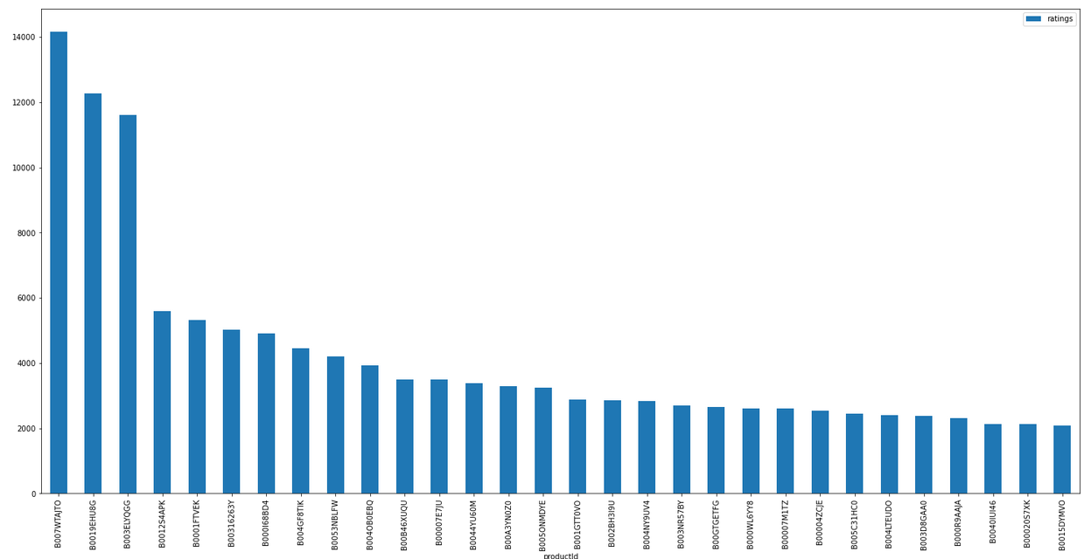
Popular products:
Products were rated with discrete numbers 1,2,3,4,5. Most of the reviews rated 5.
The top 5 most popular product are
B007WTAJTO with ratings 14162
B0019EHU8G with ratings 12274
B003ELYQGG with ratings 11611
B0012S4APK with ratings 5606
B0001FTVEK with ratings 5324

Slide 8
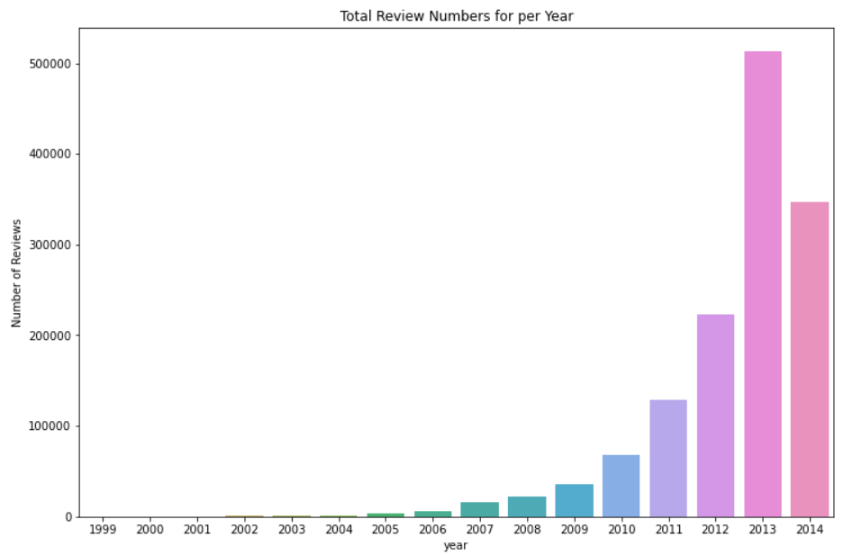
Total Review Number based on years
Number of reviews was maximum in the year 2013.Looks there were hardly ratings done on products till 2002 and slowly started from 2003.
The top 5 most popular product are
2013 with ratings 513513
2014 with ratings 346501
2012 with ratings 223490
2011 with ratings 128834
2010 with ratings 67371

Slide 9
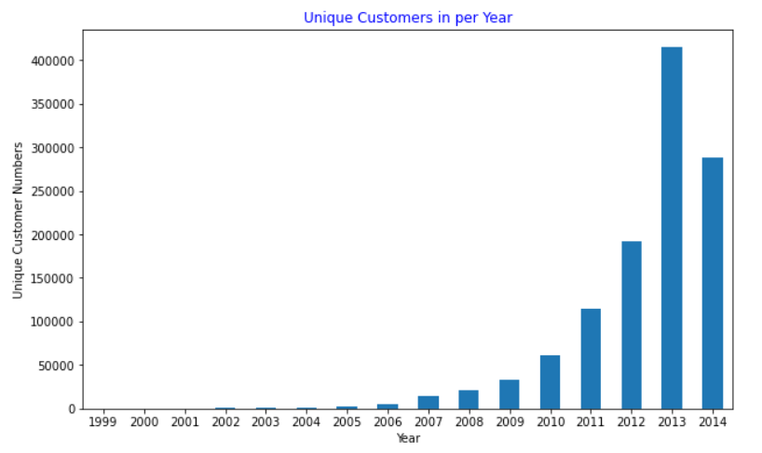
Unique customer per year:
There were a total of 1151618 unique customers visited between 1999 to 2014. Year 2013 has seen the maximum number. Here is the visual distribution
The top 5 most unique customer per year
2010 with customer 61782
2011 with customer 115009
2012 with customer 192277
2013 with customer 414734
2014 with customer 288186

Slide 10
Unique Products per year:
2013 has seen the more products.From the plot looks there were not many products till 2005.
The top 5 years with number of unique product
2010 has seen 7002 products
2011 has seen 11177 products
2012 has seen 17387 products
2013 has seen 26257 products
2014 has seen 24322 products

Slide 11
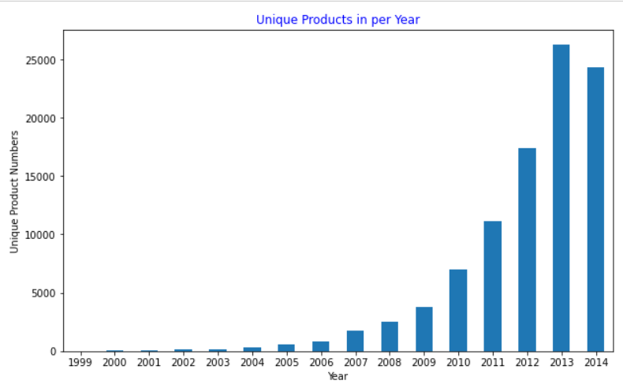
Unique Products per year:
2013 has seen the more products.From the plot looks there were not many products till 2005.
The top 5 years with number of unique product
2010 has seen 7002 products
2011 has seen 11177 products
2012 has seen 17387 products
2013 has seen 26257 products
2014 has seen 24322 products

Slide 12
Model Selection
Surprise Package :http://surpriselib.com/
References
Documentation :https://surprise.readthedocs.io/en/latest/
Installation: http://surpriselib.com/
Git hub : https://github.com/NicolasHug/Surprise
Surprise has many different algorithms built in.Itprovides various ready-to-use prediction algorithms such as baseline algorithms, neighborhood methods, matrix factorization-based ( SVD, PMF, SVD++, NMF), and many others. Also, various similarity measures (cosine, MSD, pearson…) are built-in

Slide 13
Model Selection
Algorithms used
BaselineOnly:Algorithm predicting the baseline estimate for a given user and item.
KNNBaseline:A basic collaborative filtering algorithm taking into account a baseline rating.
NMF:A collaborative filtering algorithm based on Non-negative Matrix Factorization.
Co-clustering:A collaborative filtering algorithm based on co-clustering.
SVD:When baselines are not used, this is equivalent to Probabilistic Matrix Factorization, it is as popularized by Simon Funk during the Netflix Prize

Slide 14
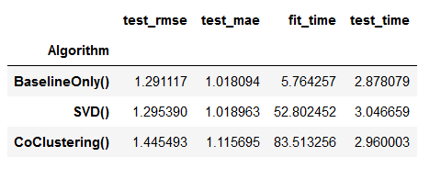
Metrics
Metrics used are rmse and mae.
Results are - BaselineOnly algorithm has given the best rmse.

Slide 15
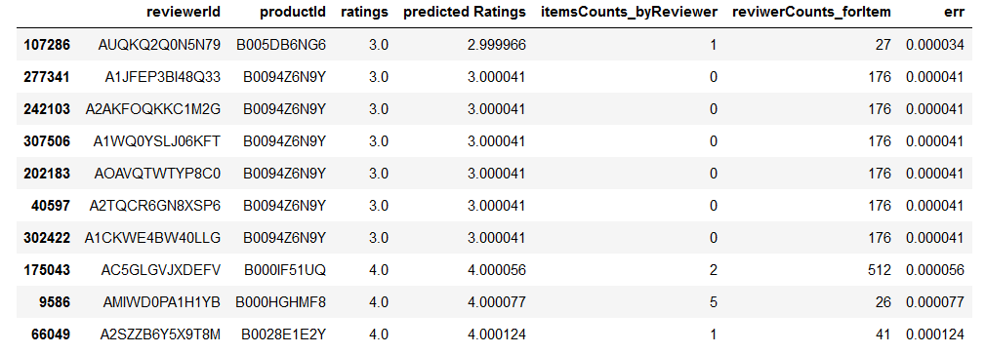
Top 10 best predictions
The above are the top 10 best Predictions. The product 'B000HGHMF8','B000IF51UQ' and 'B0028E1E2Y' are rated best with ratings 4.

Slide 16
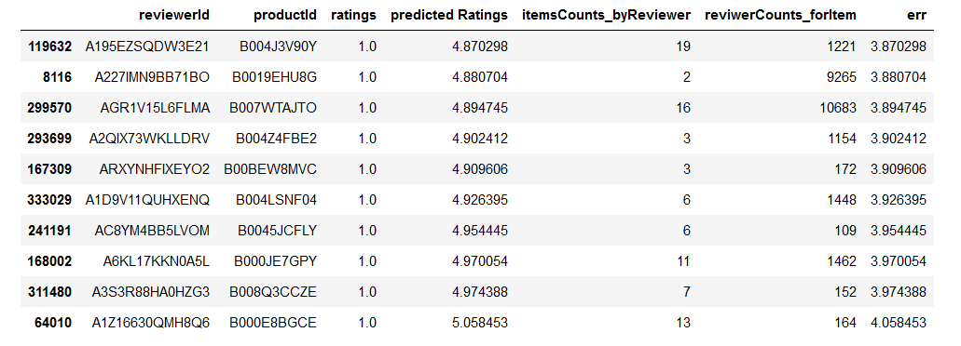
Top 10 worst predictions

Slide 17
Conclusion:
There are many ways to build and improve this recommender system. I couldn't use k-NN algorithms from the Surprise package, as it needs more memory, nor could I complete it on google colab. Using more tuned parameters I did some basic cross validation to select the best parameters. To improve the recommendations, tune these parameters and make sure that the algorithm is serving the best recommendations possible with the data available.

Slide 18
Thank You
Shailaja.S
email:shaila.sid01@gmail.com
Github: https://github.com/shaisid01/Data-Science/tree/main/CapstoneProjects/Capstone%203

