Slide 1

CVR COLLEGE OF ENGINEERING DEPARTMENT OF COMPUTER SCIENCE AND ENGINEERING
A Project seminar-I
on
HELPI – A HEALTHCARE CHATBOT
by
M Ambika 20B81A0565
S Gnanika 20B81A0574
K Tejaswini 20B81A05B1
Under guidance of
Dr.R.K. Selvakumar
Professor

Slide 2
Contents
Abstract
Motivation
Literature review
Limitations of the existing models
Proposed problem statement
Proposed approach of the work
User/Stakeholder requirement analysis
Software requirement/Technology stack
Hardware requirements
Data sets requirement
Architecture of the model
Innovation in the project
Plan of action to complete the project
References

Slide 3
Abstract
Due to technological advancements, the healthcare industry has witnessed the emergence of innovative solutions, and one such solution is the healthcare chatbot. The primary objective of this project is to create a healthcare chatbot capable of offering medical assistance to patients. The proposed chatbot, named "HELPI," functions as a round-the-clock healthcare provider. It utilizes natural language processing (NLP) and machine learning (ML) algorithms such as decision trees to analyze user-provided symptoms and accurately detect specific illnesses or diseases. Subsequently, it offers appropriate healthcare recommendations and suggests relevant medications.

Slide 4
Motivation
Impact on lives: HELPI has the potential to positively impact countless lives by providing accessible, 24/7 medical assistance.
Revolutionizing healthcare: HELPI can contribute to a major evolution in healthcare. By easing the burden on healthcare providers and offering 24/7 support,
Learning and growth: Building HELPI presents a rich learning opportunity to deepen your understanding of AI, NLP, machine learning, and healthcare concepts. The process of gathering data, training the algorithms, and testing the chatbot will continuously challenge and expand your knowledge, giving you valuable technical and problem-solving skills.

Slide 5
Literature review
Reference -1:
Methodology:
"A Systematic Review of Chatbot Applications in Mental Healthcare" by S. Smith. This paper reviews different types of conversational agents used in health care for chronic conditions, examining their underlying communication technology, evaluation measures, and AI methods.
Reference -2:
Methodology:
"Evaluating the Accuracy of Chatbot-based Symptom Assessment for Common Diseases" by K. Wilson, the goal of this study was to evaluate the data-gathering function of currently available chatbot symptom-checkers.
Reference -3:
Methodology:
Exploring the Acceptance and Usability of Chatbots in Elderly Care Settings by M. Johnson
In this paper, explored perceptions of chatbots with varying identities for health information seeking in a diary and interview study
The study primarily focuses on user perceptions and lacks objective measurements of the impact of chatbot interventions on elderly care outcomes..

Slide 6
Limitations of the existing Applications/ Models
The review may lack specificity in terms of the types of mental health conditions addressed. Different mental health issues may require tailored approaches, and a generalized overview may not capture these nuances.
The study focuses on common diseases, potentially overlooking the accuracy of chatbots in assessing symptoms of less prevalent or emerging health conditions.
The study primarily focuses on user perceptions and lacks objective measurements of the impact of chatbot interventions on elderly care outcomes. It may not provide concrete evidence of the effectiveness of chatbots in improving health outcomes for the elderly.

Slide 7
Proposed problem statement
Millions of people lack easy access to basic healthcare information and guidance. Limited access to healthcare providers, especially in remote areas or during off-hours, creates a gap in timely and affordable medical assistance.
Current healthcare chatbots often lack accuracy, comprehensiveness, and user-friendliness. Many chatbots rely on simple keyword matching or limited symptom databases, resulting in inaccurate diagnoses or irrelevant recommendations. Therefore, we need a highly accurate, accessible, and user-friendly healthcare chatbot that can bridge the gap in basic healthcare access.

Slide 8
Proposed approach of the work
Dataset Collection
Data Preparation
Model Training
Model Evaluation
Symptom Prediction
Initialization and Execution

Slide 9
User/Stakeholder requirement analysis
Functionality
24/7 availability
Natural language interface
User profile creation
Patient safety

Slide 10
Software requirement/Technology stack
Software Requirements
Operating System : Windows
Programming languages : Python
NLP libraries : re
Machine learning libraries : Pandas, sklearn, NumPy, csv
Front end : Python-Streamlit

Slide 11
Hardware requirements
CPU- intel5 or higher
RAM- 16GB or higher

Slide 12
Data sets requirement
Symtom_severity.csv : It contains 2 columns, symptoms and their count in the dataset
Symtom_Description.csv : It contains 2 columns, disease and their descriptions.
Symptom_precaution.csv : It contains 5 columns, disease in the first column and the precautions to be taken in the remaining four columns.
Dataset.csv : It contains diseases and its symptoms in its columns. It contains nearly 5000 rows

Slide 13
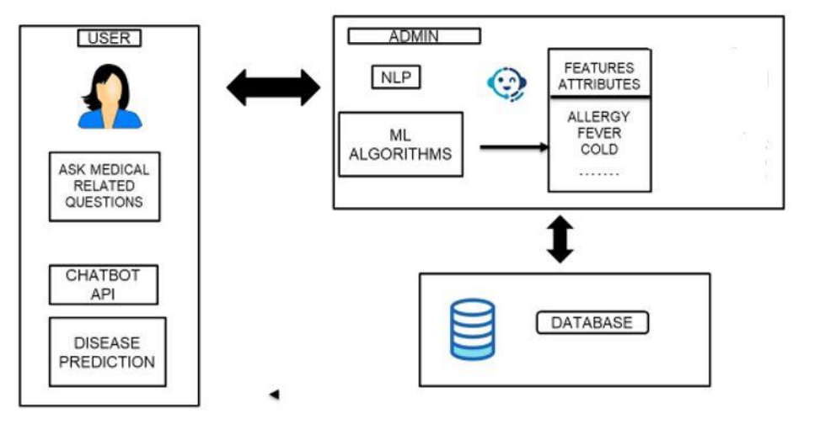
Architecture of the Model

Slide 14
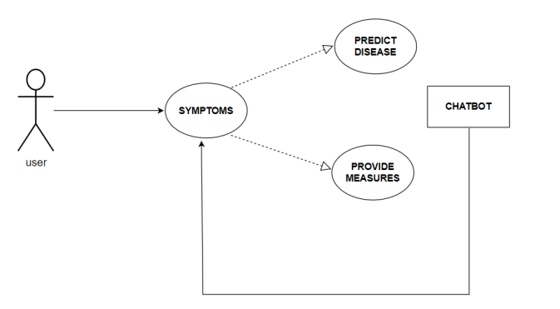
Use-case
Usecase between user and chatbot

Slide 15
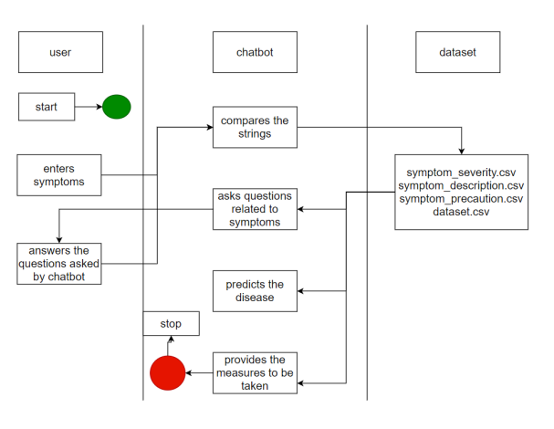
Activity Diagram

Slide 16
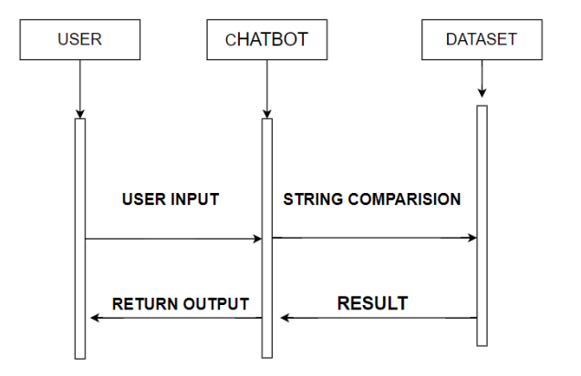
Sequence Diagram

Slide 17
Main code and Implementation

Slide 18
Innovation in the project
Decision Tree Algorithm Selection and Configuration (CART Algorithm)
Choosing and configuring the decision tree algorithm is a critical aspect of developing the HELPI healthcare chatbot.
The CART algorithm, which is capable of handling both classification and regression tasks, has been selected for this project.
It partitions the data recursively based on chosen features to create subsets that are as pure as possible in relation to the target variable.
The resulting decision tree consists of internal nodes representing feature tests and leaf nodes representing predicted responses.

Slide 19
Plan of action to complete the project
Task | Time Required
Dataset Collection | 2 weeks
Data Preprocessing | 1 week
Feature Extraction | 1 week
Model Training | 2 weeks
Model Evaluation | 2 weeks
Model Optimization | 2 weeks
Chatbot Integration | 1 week

Slide 20
References
1. "A Systematic Review of Chatbot Applications in Mental Healthcare" by S. Smith in National Library of Medicine,
2. "An Empirical Study on the Effectiveness of Chatbots in Patient Education" by J. Brown,
3. "Exploring the Acceptance and Usability of Chatbots in Elderly Care Settings" by M. Johnson,

