Slide 1
Employee Data Analysis using Excel
STUDENT NAME: Shaith Khan .C
REGISTER NO: 422200223
DEPARTMENT: B.Com (Information System Management)
COLLEGE: Annai Violet Arts And Science College

Slide 2
PROJECT TITLE
Employee Performance Analysis using Excel

Slide 3


AGENDA
Problem Statement
Project Overview
End Users
Our Solution and Proposition
Dataset Description
Modelling Approach
Results and Discussion
Conclusion
3/21/2024 Annual Review

Slide 4

PROBLEM STATEMENT The problem with defining the fundamental is that they can cover anything related to a company economic well being

Slide 5

PROJECT OVERVIEW Data analysis is used to value a company and determine whether stock is over or undervalued by the market
.

Slide 6

WHO ARE THE END USERS? *Investors *Mangers *Accounts

Slide 7

OUR SOLUTION AND ITS VALUE PROPOSITION Avalue proposition can be classified into three types 1.All benefits 2.Favorable points 3. Difference and resonating Focus

Slide 8
Dataset Description Employee=kaggle 26 features 9-features Emp id number Name text Performance level Gender male female Employee Rating Number

Slide 9

THE "WOW" IN OUR SOLUTION 1.performance level =IFS(Z8≥=5VERY HIGH.
3/21/2024 Annual Review
9

Slide 10
MODELLING
Data set kaggle employee data set
Data cleaning Missing values irrelevant
Formulae performance calculation low medium high
10

Slide 11
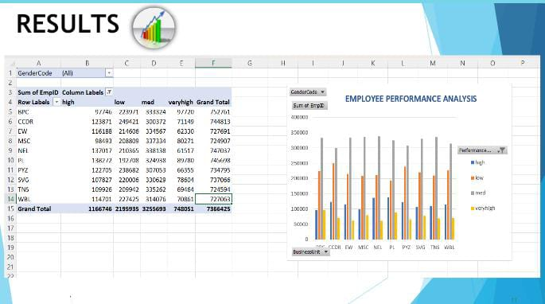
RESULTS
11

Slide 12
conclusion Highlights key findings from the data Making generalized comparison assess The right strength of the claim Are hypothesis supported to what extent to what extent do generaliza hold

