Slide 1

Foodiez
Shaiwal Sachdev
Lucknow,India
CS50 Final Project

Slide 2
Aim
Foodiez is a web application which will help the users to-
Analyze their food habits
Maintain a healthy food intake
Track their Expenditure on Food
Search Local Restaurants
Search Dishes of all cuisines
Add a restaurant review
Add Dish Wise Review for each restaurant
Connect with other Foodies Online
Discuss about Food Habits, Ingredients with others
Share your homemade recipes online

Slide 3
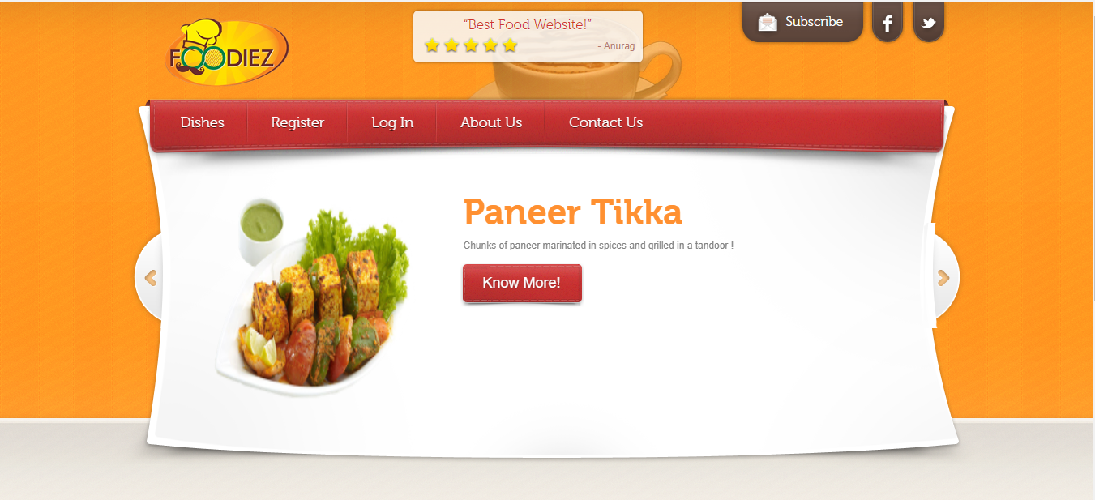
WALKTHROUGH :

Slide 4
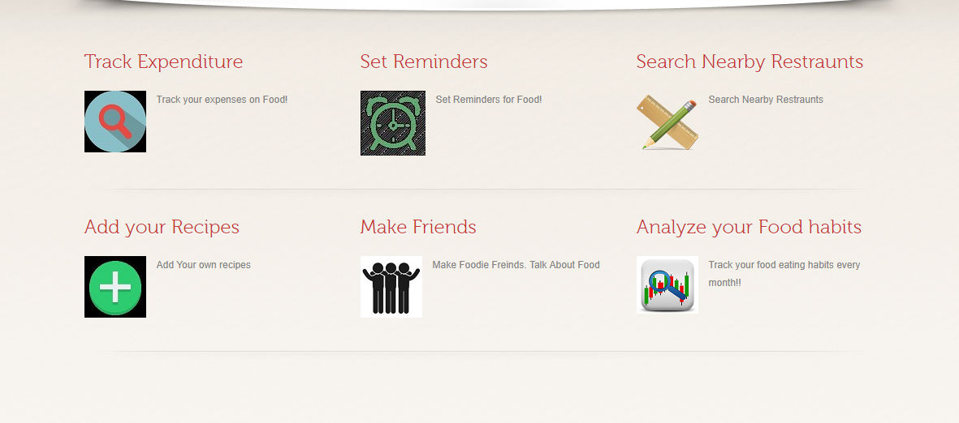
Services:

Slide 5
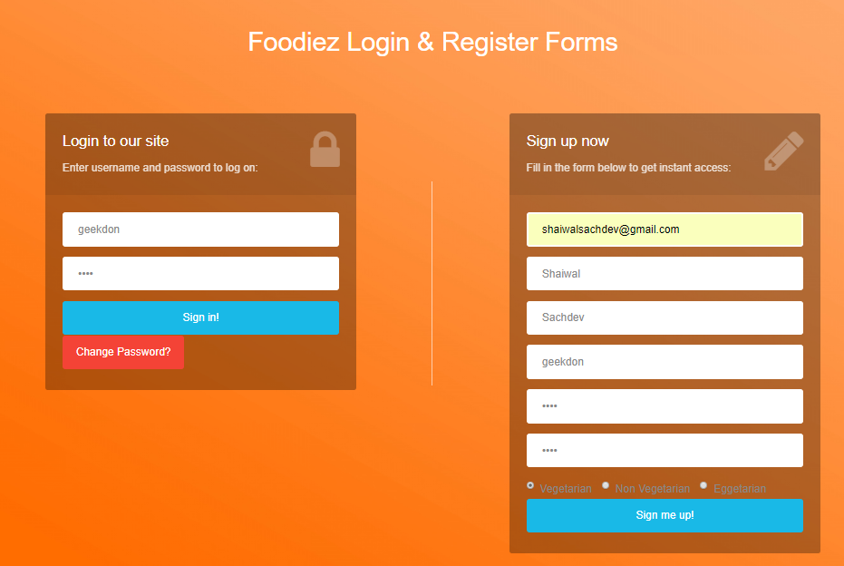
Login/Register Page
First of all person has to register on the website to use all the services.
Then put in your username and password to Log in into your dashboard.

Slide 6
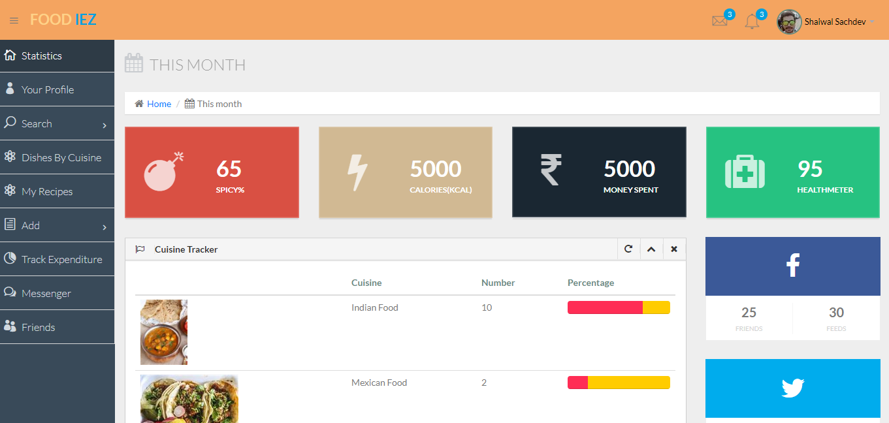
Dashboard :

Slide 7
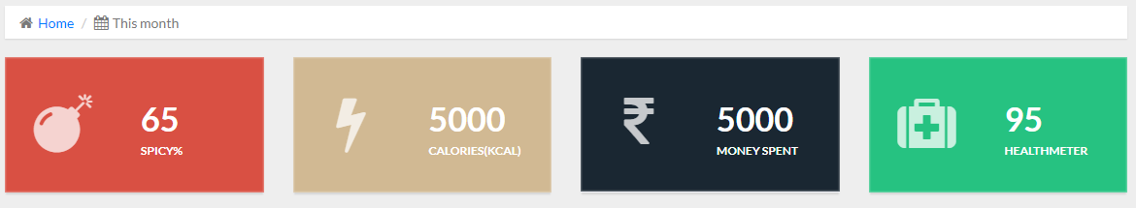
STATISTICS
This will provide the user statistics of that month:
About his or her expenditure on Food by showing total money spent
How much Spicy Food intake that month
Total Average Calories Intake
A Health Meter which decreases on taking excess calorie food
Tracking the entries date wise showing it in a calendar
Cuisine Tracker shows the different cuisines of food intake.
List Of Food Reminders

Slide 8
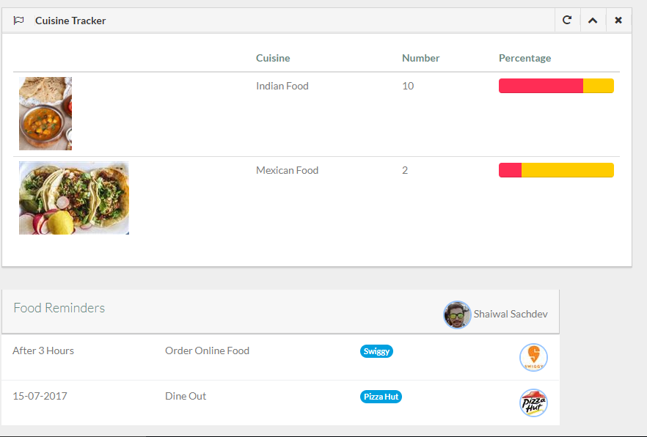
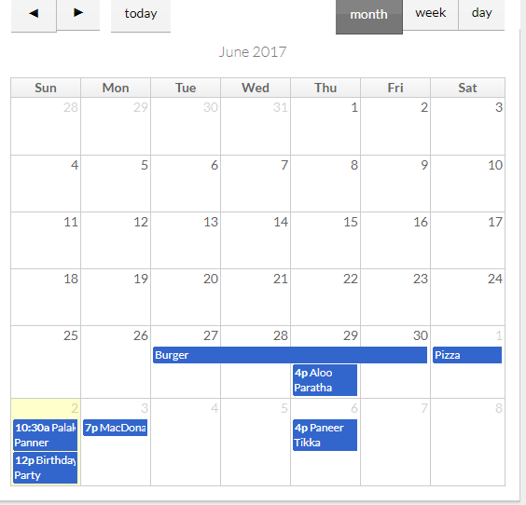

Slide 9
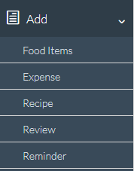
Add Data (Data Input To Website)
Users must enter all the food items he or she eats by Food items form.
Entering enter money spent by Expense Form.
Entering your own recipes and share them with the world.
You can set an food reminder that can be helpful for planning a meetup at some restaurant or ordering food online.
User can enter his/her own info and get it displayed in profile.

Slide 10
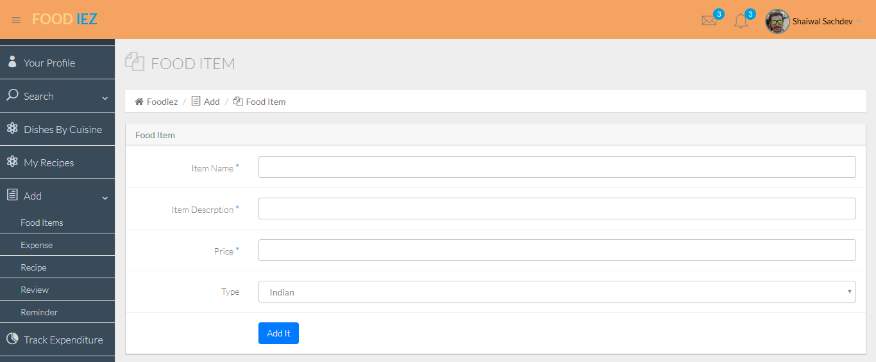


Slide 11
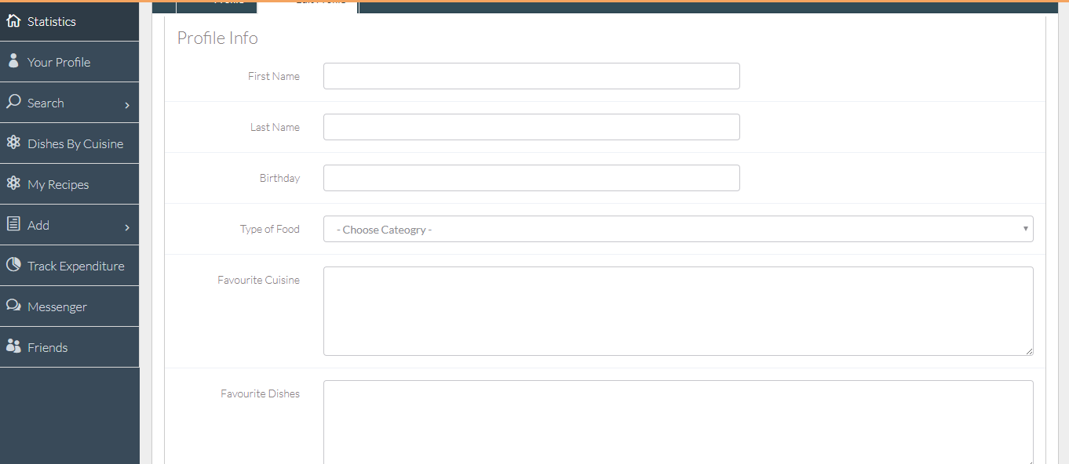
Profile InFo

Slide 12
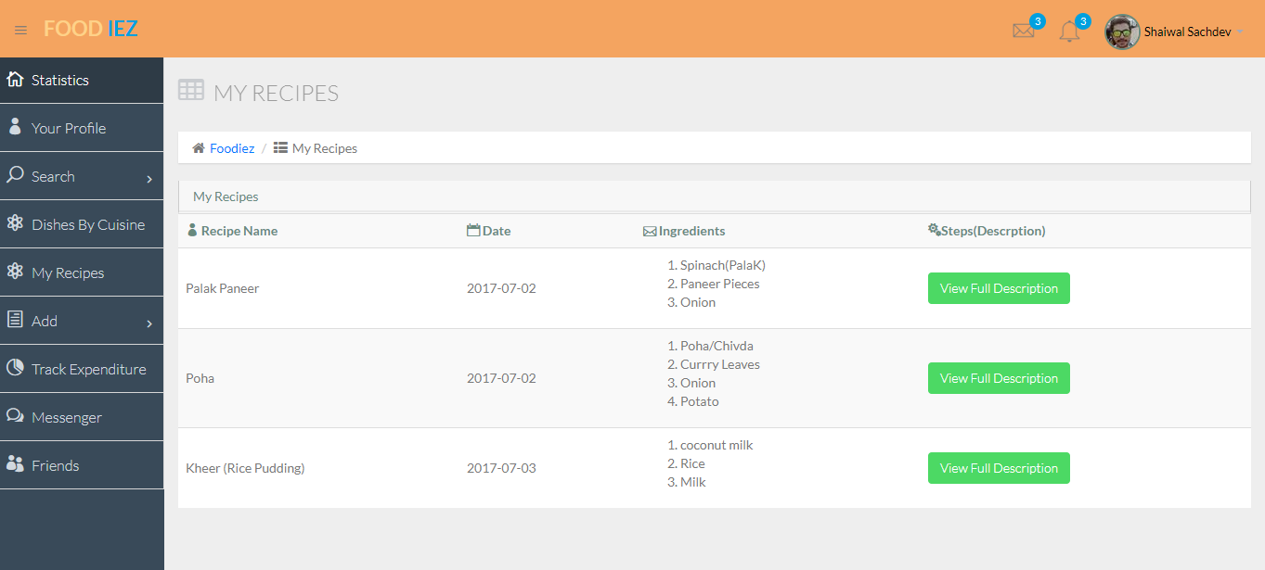
Displaying Data : Your RECIPES

Slide 13
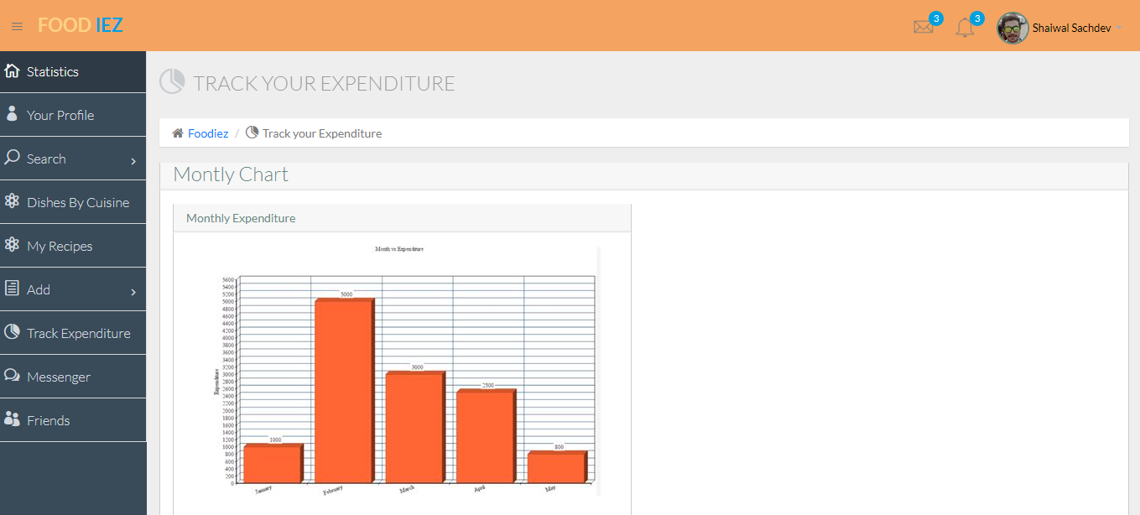
Showing yearly Expenditure

Slide 14
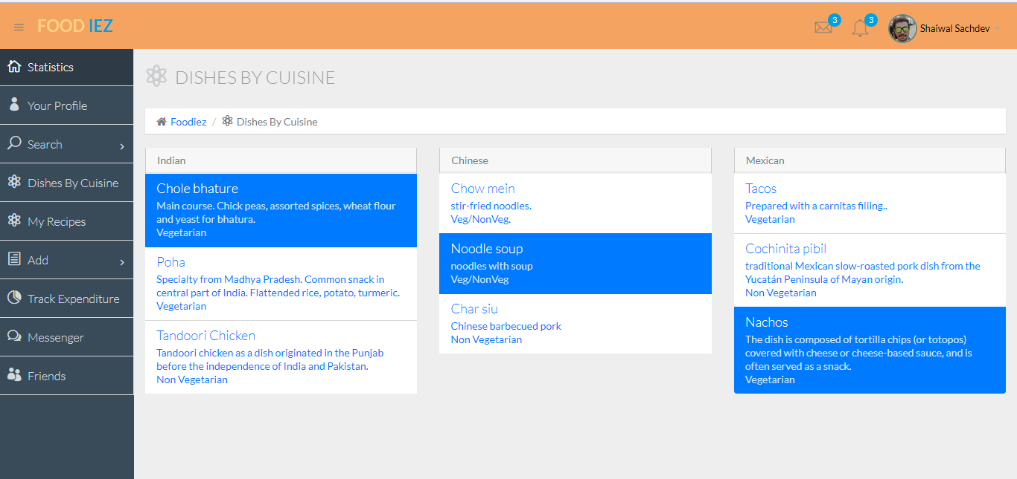
Dishes in Database

Slide 15
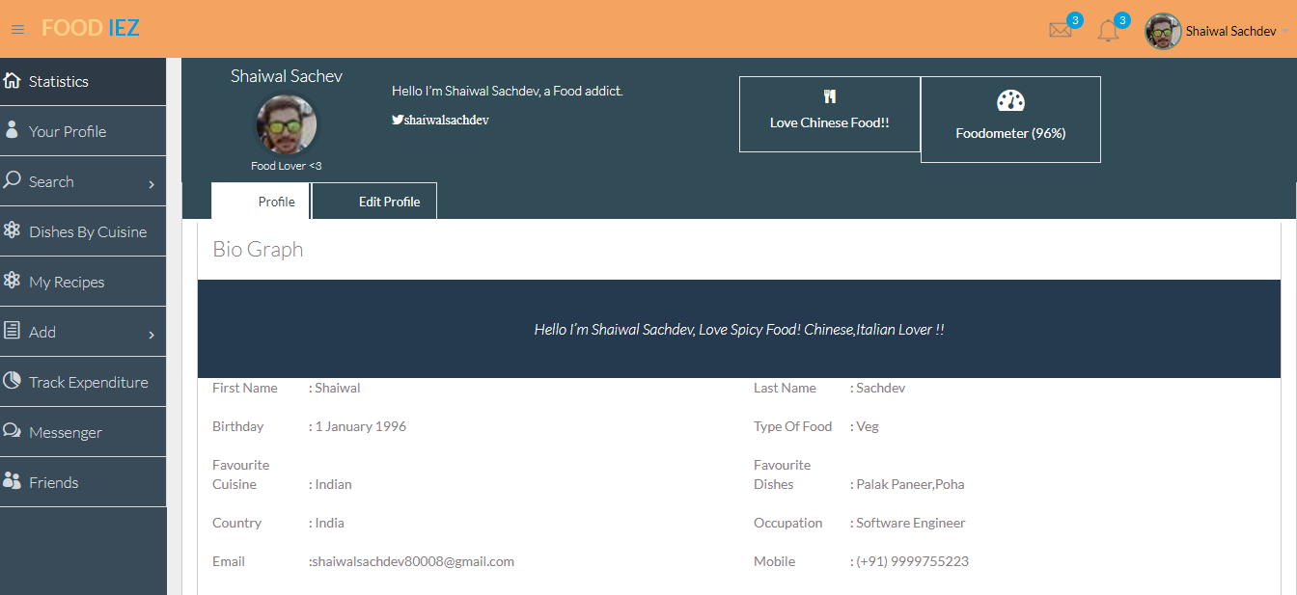
USER PROFILE

Slide 16
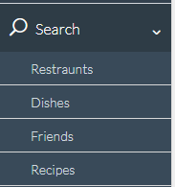
Search facilities
We can get the current user location and find the restaurants near by.
He or She can add reviews to it.
User can search for the dishes in the database and add review to it.
User can search for recipes added by other users.

Slide 17
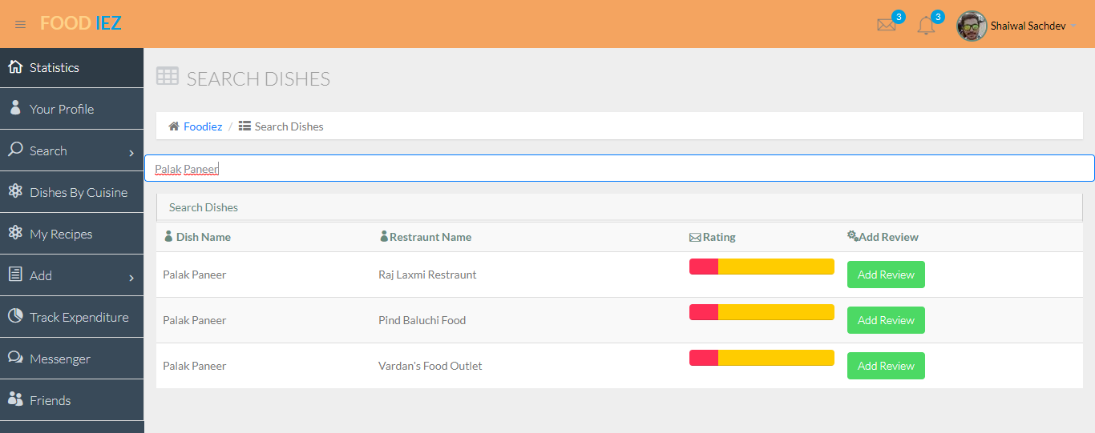
The page shows the dish searched and it is available in different restaurant , we can take feedback from user.

Slide 18
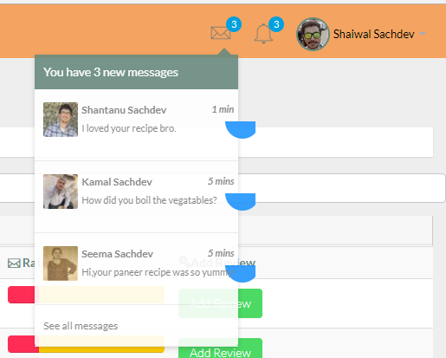
More Services:
We can have more services too:
Messaging Service
Making Friends

Slide 19
THANK YOU

