Slide 1

PROBLEM-7
PCAP Forensics and Attack Isolation

Slide 2
Group members
Amna Nasrullah
Haris usman
Configuration Lead
Risk & Resource Analyst / Deployment Lead
Shaiza Parveen
Security Validation Analyst

Slide 3
OUR CONTENTS
01. Problem Scenario
07. IOC Table
08. Event Timeline
02. Methodology
09. VLAN Segmentation
03. Network Diagram
10. Risk Assessment
04. Device Identification
Final Security Test Results
05. C2-Server
12. GitHub Repo Demo
06. Brute Force
13. Conclusion

Slide 4
INCIDENT OVERVIEW
SITUATION: A homeowner's smart devices started acting strange. Lights turned on/off by themselves. Internet was slow.
OUR TASK: Analyze the PCAP file to find the truth.
THE QUESTIONS:
• Which device was hacked?
• Who is the attacker?
• How did they break in?
• How do we stop it?

Slide 5
FORENSIC INVESTIGATION METHODOLOGY
1
PCAP file loaded in Wireshark
2
MAC address filtering to identify compromised device
3
IP conversation analysis to find C2 server
4
Protocol filter for brute force detection
5
GNS3 topology built for isolation & mitigation

Slide 6
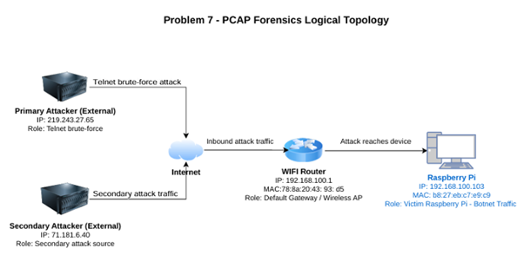
NETWORK TOPOLOGY & ATTACK PATH
Our network has these devices:
Internet (Cloud) - The outside world
Primary Attacker (219.243.27.65) - Main C2 server
Secondary Attacker (71.181.6.40) - Backup C2 server
WiFi Router (192.168.100.1) - Home gateway
Raspberry Pi (192.168.100.103) - Hacked device (victim)

Slide 7
COMPROMISED DEVICE ANALYSIS
DID
FINDINGS
• Device: Raspberry Pi
• IP: 192.168.100.103
• MAC: 58:27:eb:c7:e9:c9
• Vendor: Raspberry Pi Foundation
• Status: Compromised
• Attack Role: Botnet Scanner
We identified the compromised device by analyzing the PCAP file in Wireshark

Slide 8
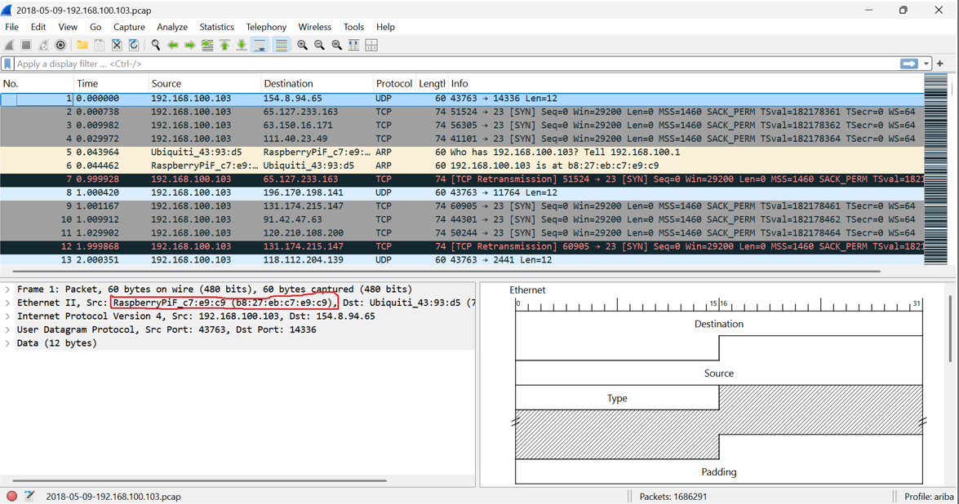
EVIDENCE 1

Slide 9
C2-SERVER COMMUNICATION
(ATTACKER CONTROL)
DID
FINDINGS
WHY IS IT CRITICAL
The attacker's server (219.243.27.65) sent many Telnet packets to the hacked device (192.168.100.103)
The attacker is controlling your device from far away. He can send any command, steal your information, or use your device to attack others. Your device is not yours anymore.
• Attacker IP: 219.243.27.65
• Used Telnet (Port 23)
• Packet size: 60 to 236+ bytes
• Non-stop data flow

Slide 10
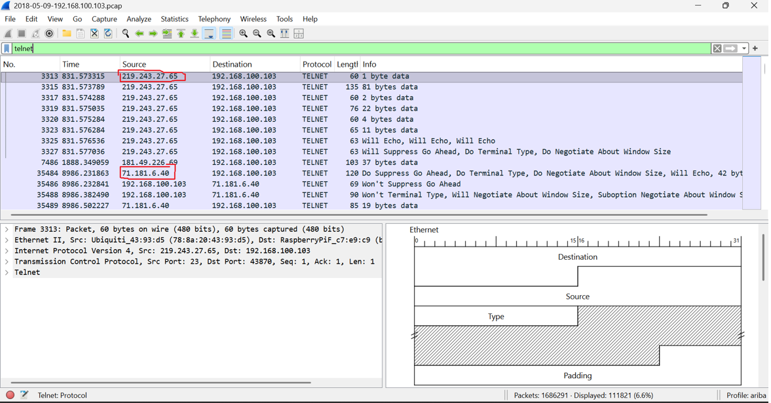
EVIDENCE 2

Slide 11
BRUTE FORCE
LOGIN ATTEMPTS
DID
FINDINGS
WHY IS IT CRITICAL
The attacker tried many username and password combinations to break into the Raspberry Pi using Telnet
• Username: "root" → Password: "123456"
• Username: "enable" → Password: "system"
• Result: "Bad username/Password" repeatedly
• This is called a dictionary attack
This is why the attack happened. The device was using default passwords (like root:123456). If the owner had changed the password, the attacker could never get in. This was 100% preventable.

Slide 12
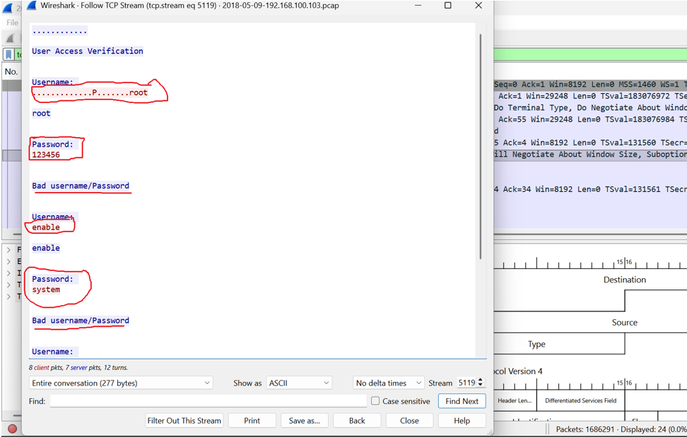
EVIDENCE 3

Slide 13
INDICATORS OF COMPROMISE (IOCs)
IOC TYPE | VALUE | SIGNIFICANCE
Infected Device IP | 192.168.100.103 | Victim smart IoT device (Raspberry Pi) generating malicious outbound traffic.
Infected Device MAC | b8:27:eb:c7:e9:c9 | Physical hardware address associated with the compromised Raspberry Pi.
Primary C2 Server IP | 219.243.27.65 | Active external Command & Control node interacting with the victim via Telnet.
Secondary Threat IP | 71.181.6.40 | Additional external host observed in concurrent unencrypted communication paths.
Target Protocol / Port | TCP Port 23 (Telnet) | TCP Port 23 (Telnet) Unsecured vector exploited for password dictionary attacks.
8

Slide 14
Event Timeline
TIME | EVENT
T+0 min | Attacker starts Telnet brute-force on Port 23
T+2 min | Attacker successfully logs in using "root:123456"
T+3 min | Device starts sending outbound traffic to C2 servers
T+10 min | Security team applies ACL to block attackers
T+11 min | All attacker traffic is blocked
T+12 min | Port security and VLAN isolation enabled

Slide 15
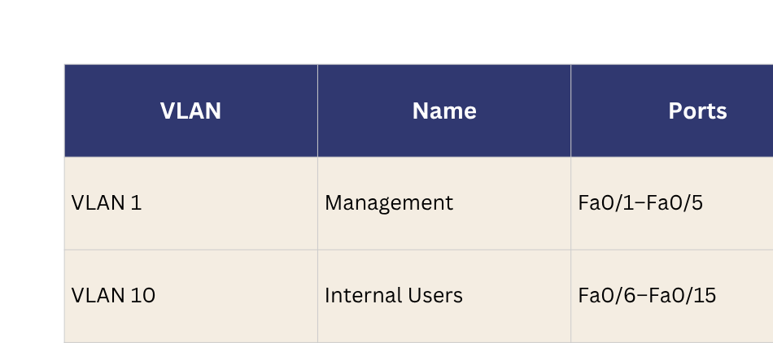
Mitigation: VLAN Segmentation
Problem: All devices were on the same flat network , attacker could reach everything

Slide 16
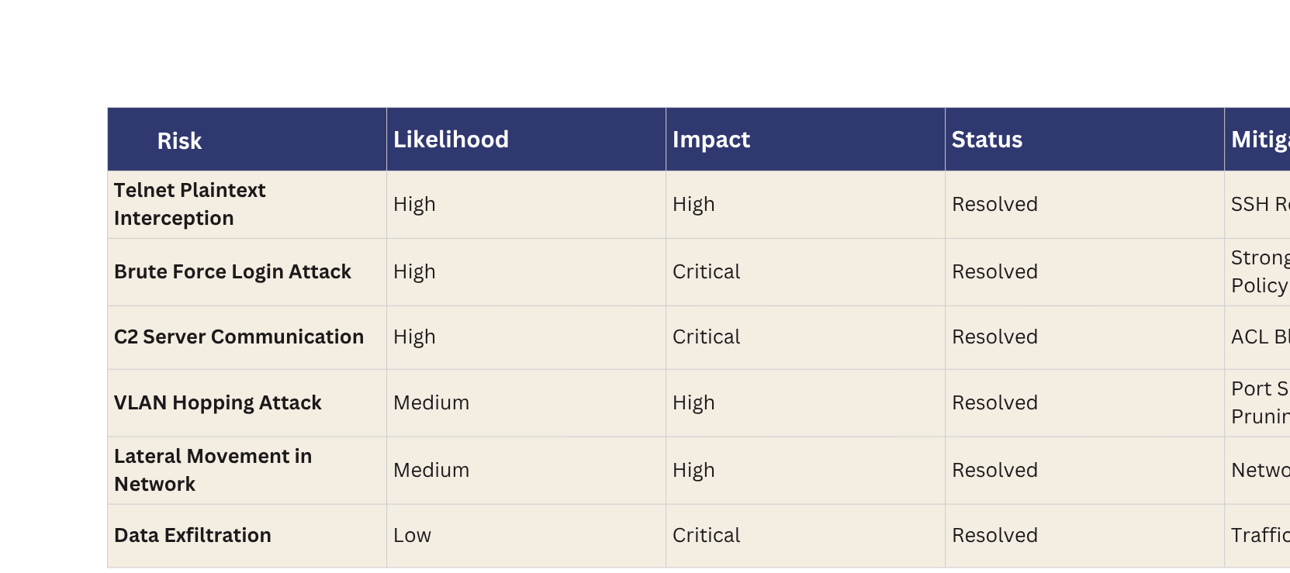
SECURITY RISK ASSESSMENT

Slide 17
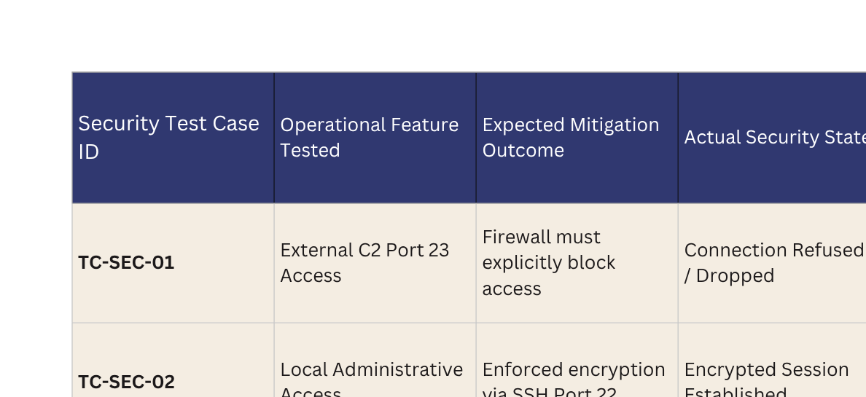
Final Security Test Results

Slide 18
GITHUB REPOSITORY LINK
https://github.com/shaiza124/CN-LAB-Problem-7.git

Slide 19
KEY FINDINGS & CONCLUSION
In conclusion, we found a Raspberry Pi device that was hacked because it was using default credentials. The attacker used Telnet to break in and then controlled the device remotely from a C2 server. We fixed everything by disabling Telnet, enabling SSH, blocking the attacker's IP, and isolating the device in VLAN 20. All our security tests passed. The network is now safe. The most important lesson here is simple: always change default passwords.

Slide 20
THANK YOU

