Slide 1


JSG Industries
Shawn, Brendan, Gavin, Gary

Slide 2
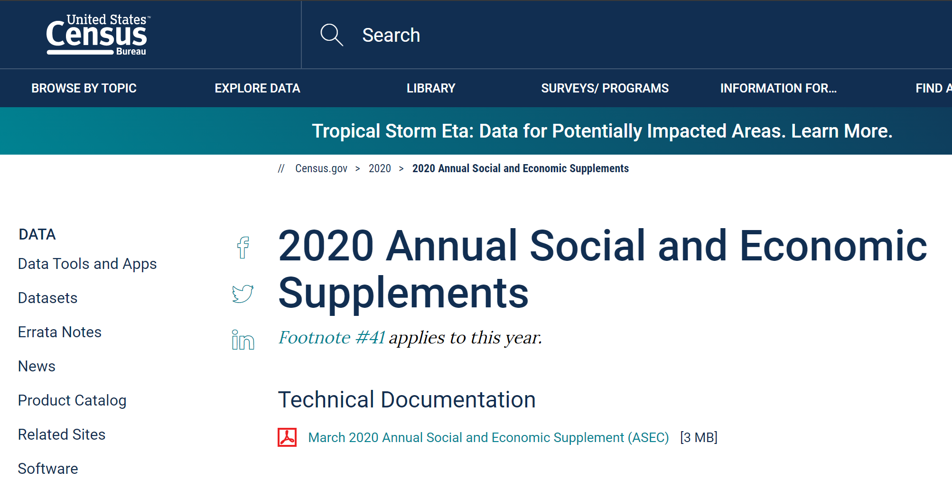
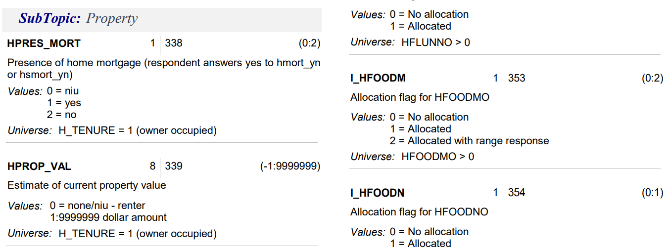

HHINC
FINC_FIN
HPRES_MORT
HDIV_YN
FOWNU18
HINT_YN
RPP
Notes:
Household income, Financial Assistance, Mortgages, Shares of Stock/Mutual Fund, Children under 18, Checking/Savings/Bonds Account, Regional Price Parity

Slide 3
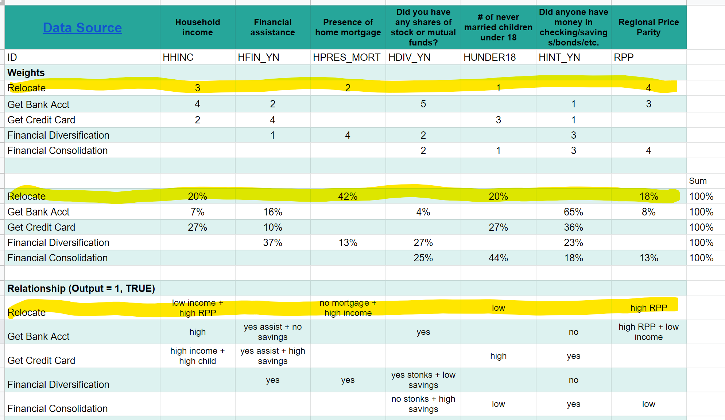

Slide 4
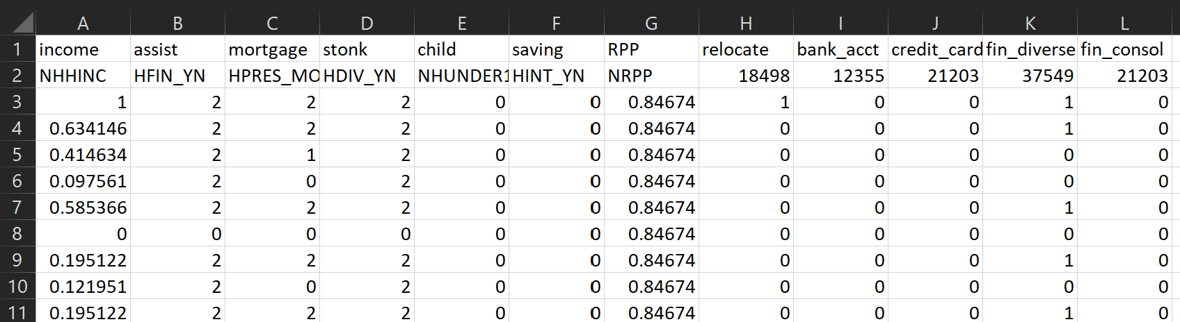
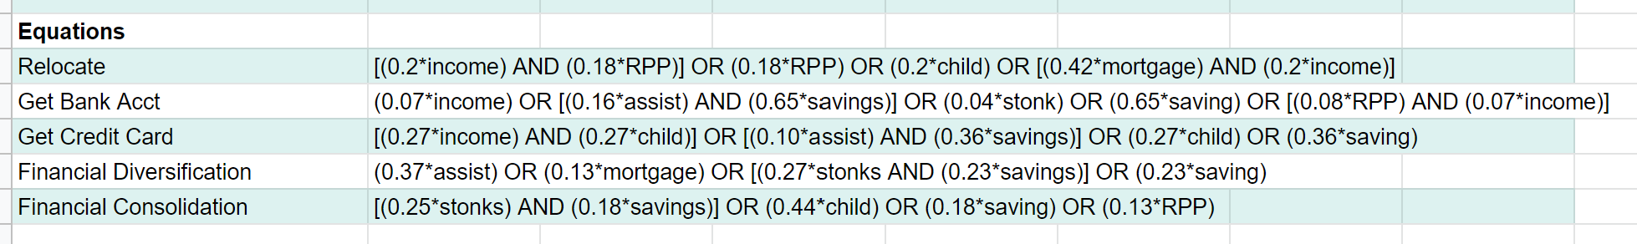
91052
Data Pts.

Slide 5
Technology
stonks-io.herokuapp.com/
Stack: React + Python + Flask
- HTML, JavaScript, CSS, JSON
- Axios (HTTP client library) Nivo (visualization)
App Deployment: Heroku
AI: Scikit library and Multinomial Naive Bayes (MNB) model

