Slide 1


JSG Industries
Shawn, Brendan, Gavin, Gary

Slide 2

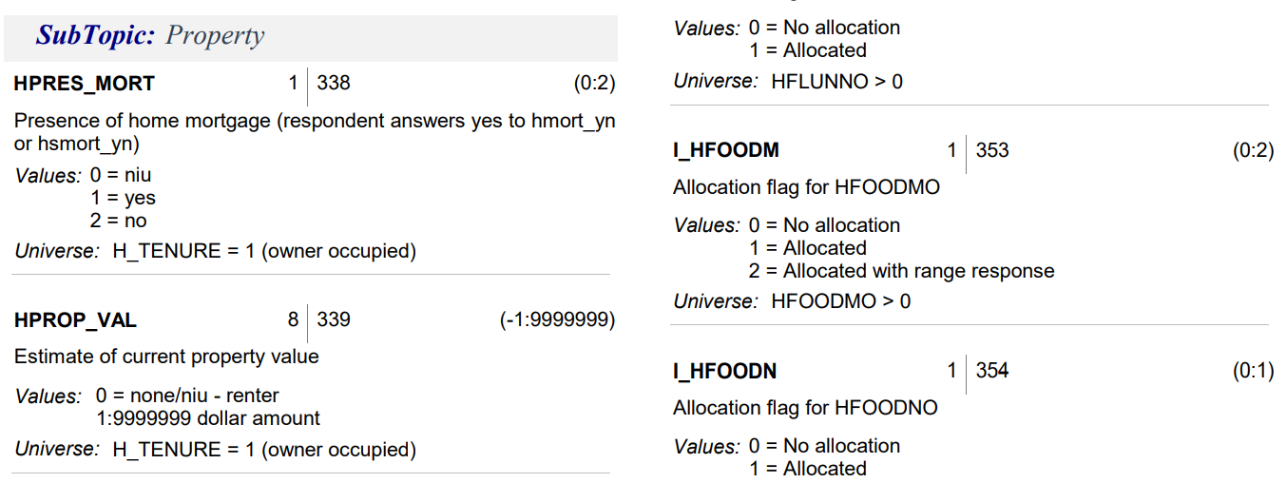
HHINC
FINC_FIN
HPRES_MORT
HDIV_YN
FOWNU18
HINT_YN
RPP

