Slide 1
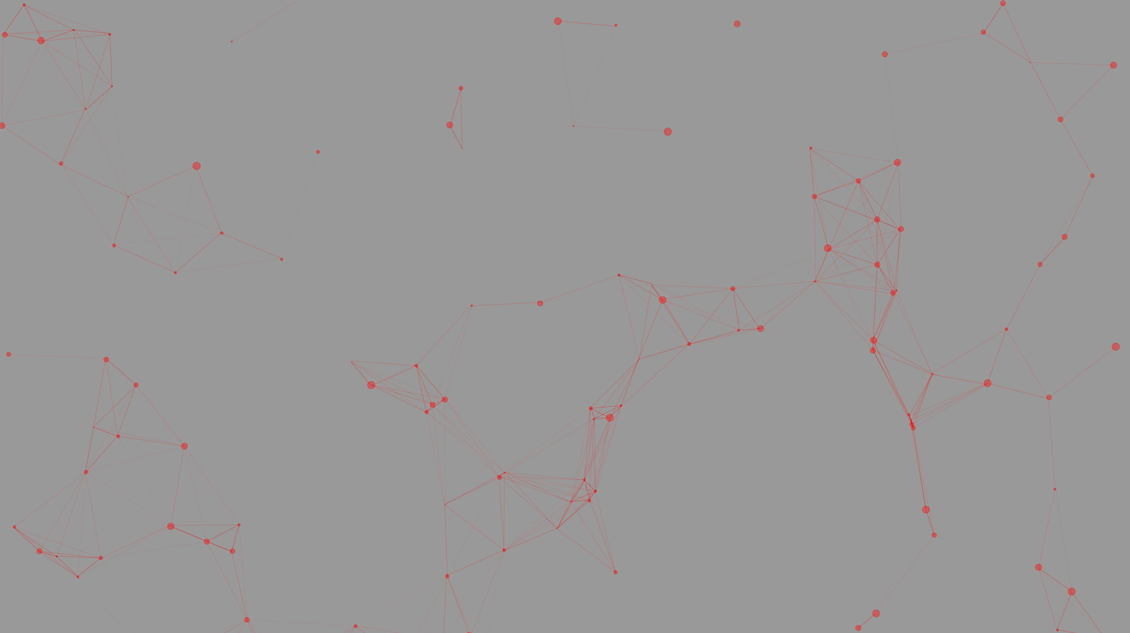

JSG Industries
Shawn, Brendan, Gavin, Gary

Slide 2

Issue
In a 2019 survey, roughly 5.4 percent of households in the US were unbanked
- 56% of unbanked were not interested in getting an acct.
- 36% cite trust/privacy issues in dealing with banks
Notes:
Brendan: Unbanked means no checking/savings account.

Slide 3
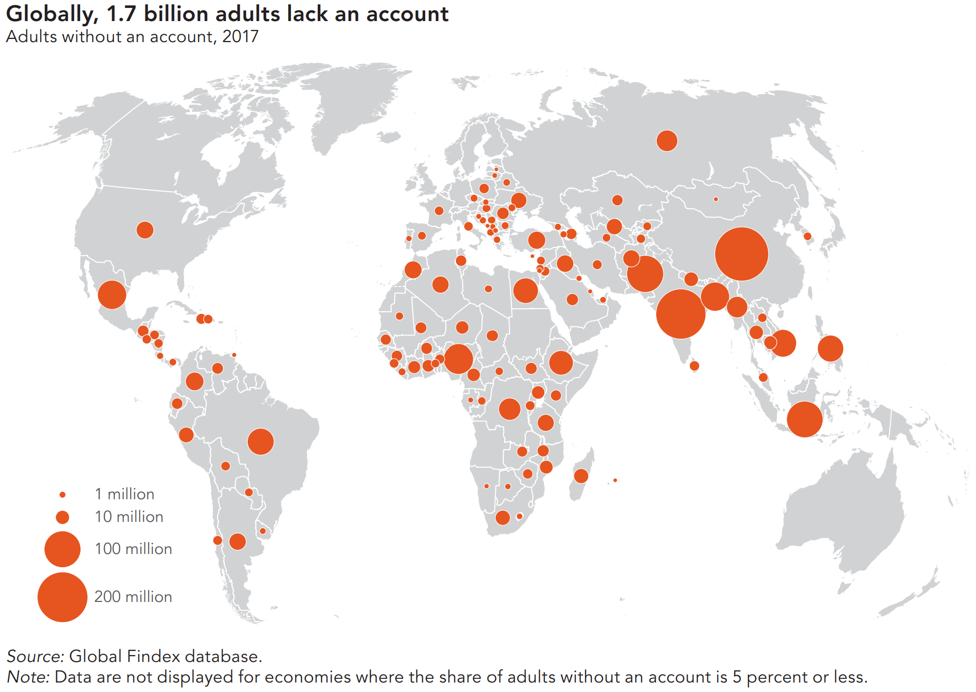
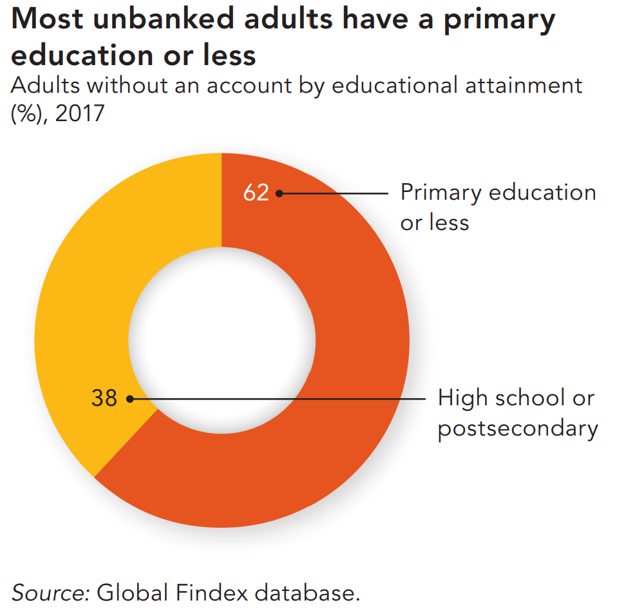
~38% global pop
Notes:
Brendan: On a global scale, roughly 38% of adults are unbanked and this varies across different regions. Since most unbanked adults have a primary education or less, we want to create simple-to-use app

Slide 4
Objective
Provide resources to incrementally improve financial knowledge
Connect with current and future opportunities in banking
Address the need for a simple, quick, and cheap-to-use platform to reduce the economic disparity for impoverished and minority communities
Notes:
Brendan: We discussed the COVID impact on local businesses and we know that here is a correlation between unemployment and the percent of unbanked people. So, we wanted to address this concern. However, we found that we can broaden our scope on a global scale. Our project is an example of a growing field called financial technology or fin tech

Slide 5
Approach
Create a platform to generate financial advice given the complex variety in economic/social status
Collect, label, and find relationships between parameters
Use a trained AI to evaluate the data and adjust the model to increase accuracy in custom input
Provide users with recommended actions
Notes:
Brendan:

Slide 6
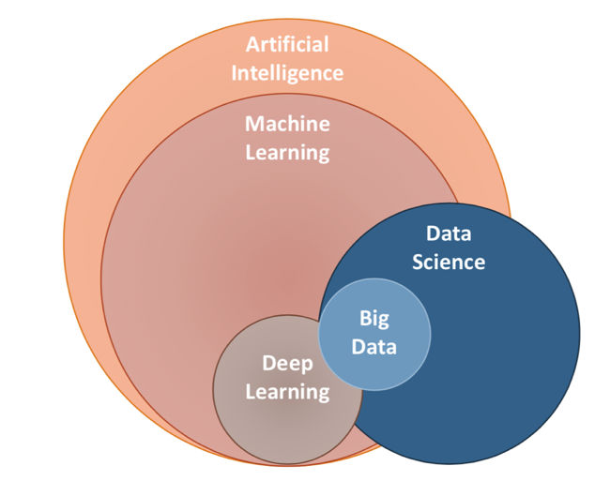
Logic Development
Frontend
Ask for Input
Store and Calculate Parameters for AI
Backend
Train AI to interpret data
Pass the Parameters to the AI
AI determines best course of Action
Frontend
Output AI assessment
Notes:
Shawn

Slide 7

Technology
Stack: React + Python + Flask
- HTML, JavaScript, CSS, JSON
- Axios (HTTP client library) Nivo (visualization)
App Deployment: Heroku
AI: Scikit library and Multinomial Naive Bayes (MNB) model
Notes:
Shawn

Slide 8
Frontend
Notes:
Gavin

Slide 9
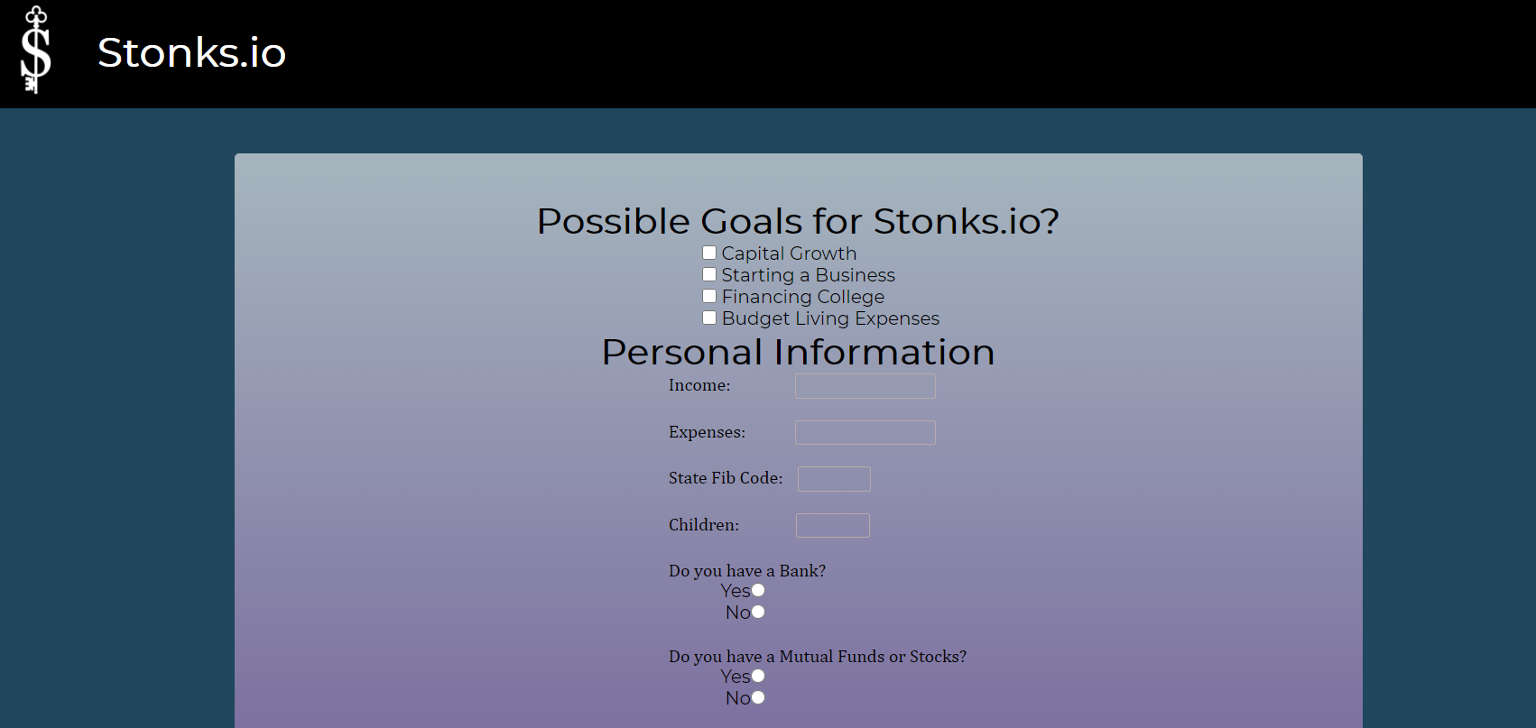
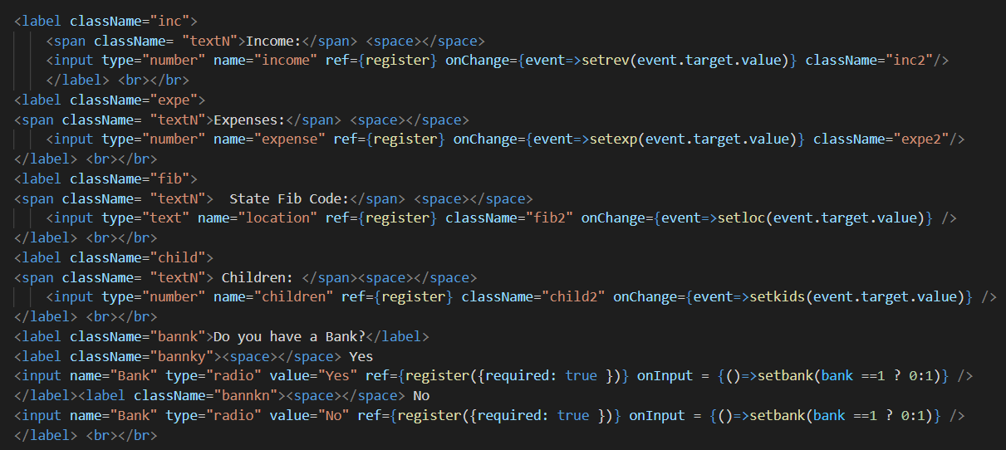
Frontend
~INPUT ~
Forms
React Features
Radio Select
Check-Box
Numerical Input
Styling/CSS
Notes:
Gavin

Slide 10
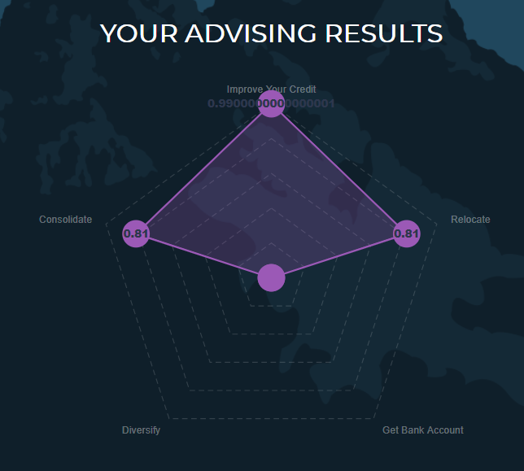
Frontend
~OUTPUT~
Resources
React Features
Radar
Styling/UI
Notes:
Gavin

Slide 11

Demo!
stonks.io
Notes:
Brendan

Slide 12
AI &
Backend
Notes:
Shawn

Slide 13
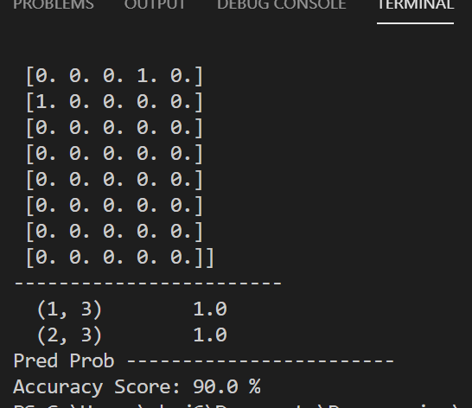
Artificial Intelligence
Trained using multinomial naïve bayes (MNB)
Computes financial advice from situation and goals
Supervised machine learning model
Enriched from market research and multiple data sources
Notes:
Shawn

Slide 14
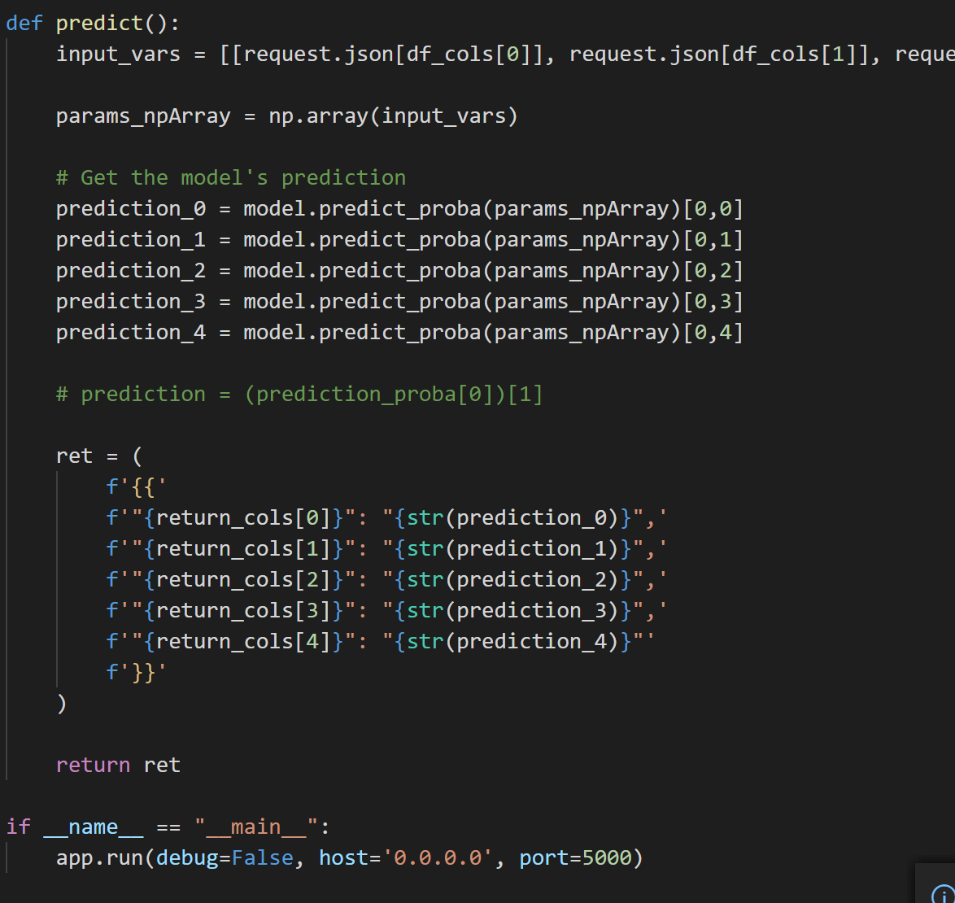
Deployment
Heroku used for deployment of server
Proprietary API used to interface between web application and AI
Notes:
Shawn

Slide 15
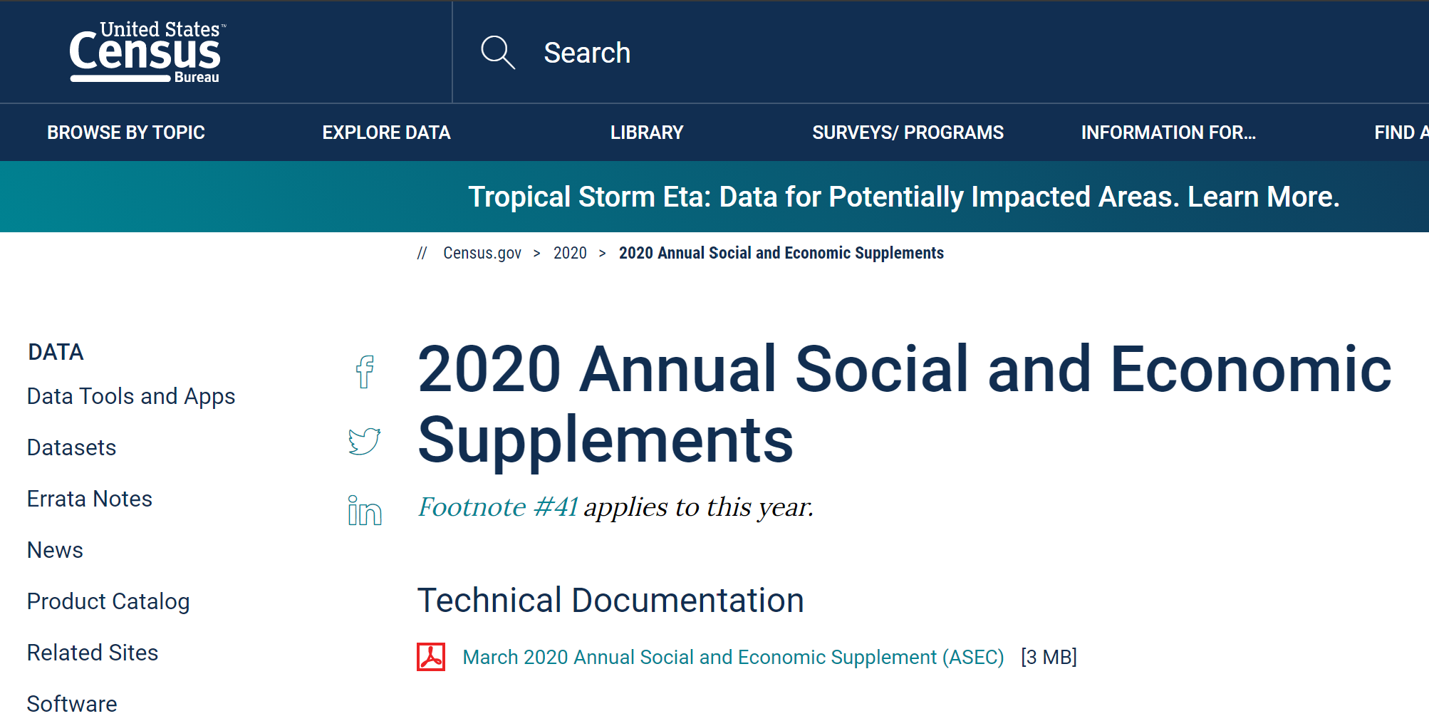
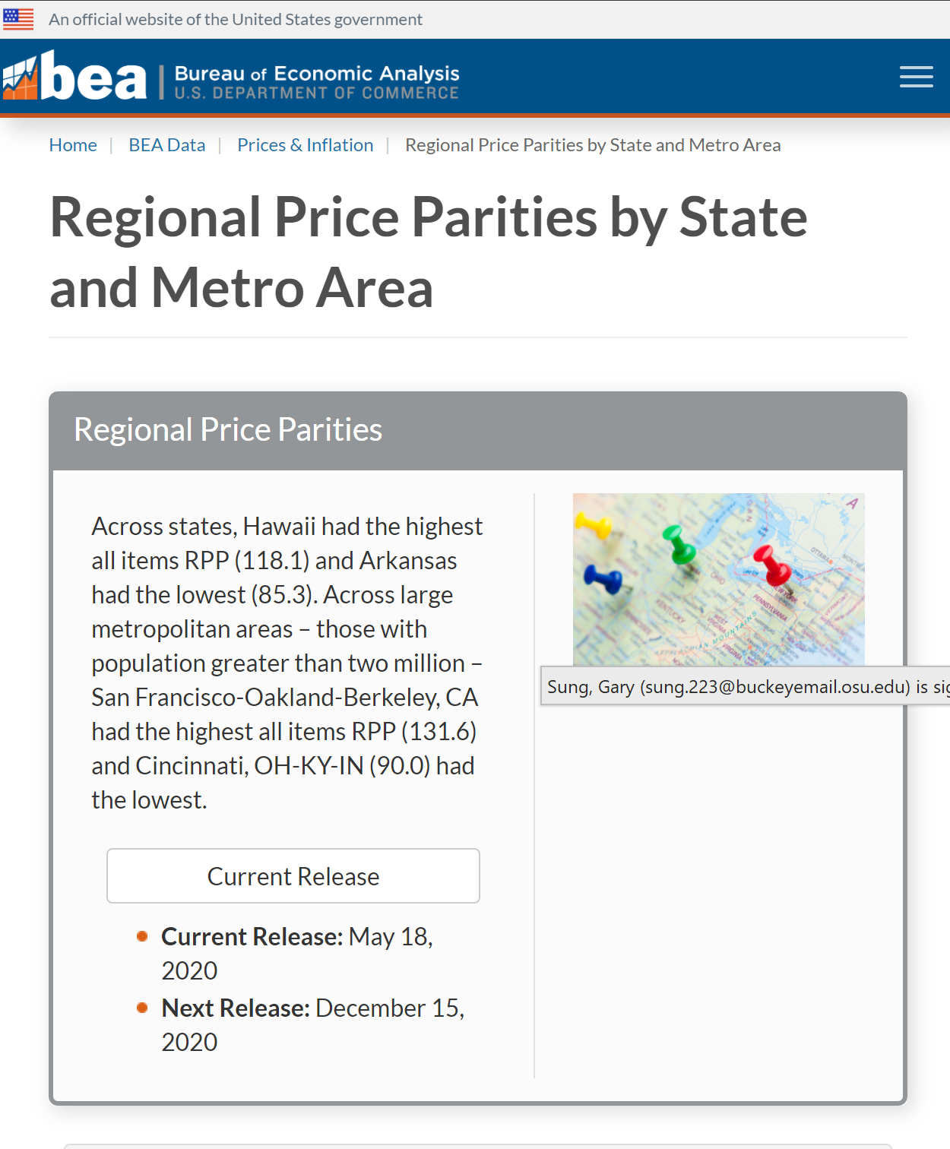
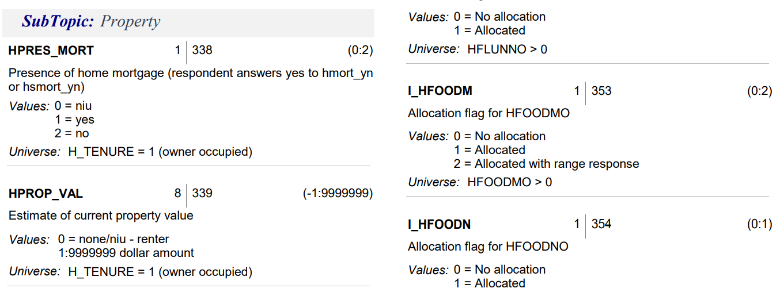
Notes:
Gary: Household income, Financial Assistance, Mortgages, Shares of Stock/Mutual Fund, Children under 18, Checking/Savings/Bonds Account, Regional Price Parity. Files of household, family, person…. We just used household data

Slide 16
Parameters
HHINC household income
FINC_FIN financial assistance (y/n)
HPRES_MORT presence of home mortgage (y/n)
HDIV_YN owning shares of stock or mutual fund (y/n)
FOWNU18 # of children under 18 within household
HINT_YN any money stored in checking or savings account (y/n)
RPP regional price parity
Notes:
Gary:

Slide 17
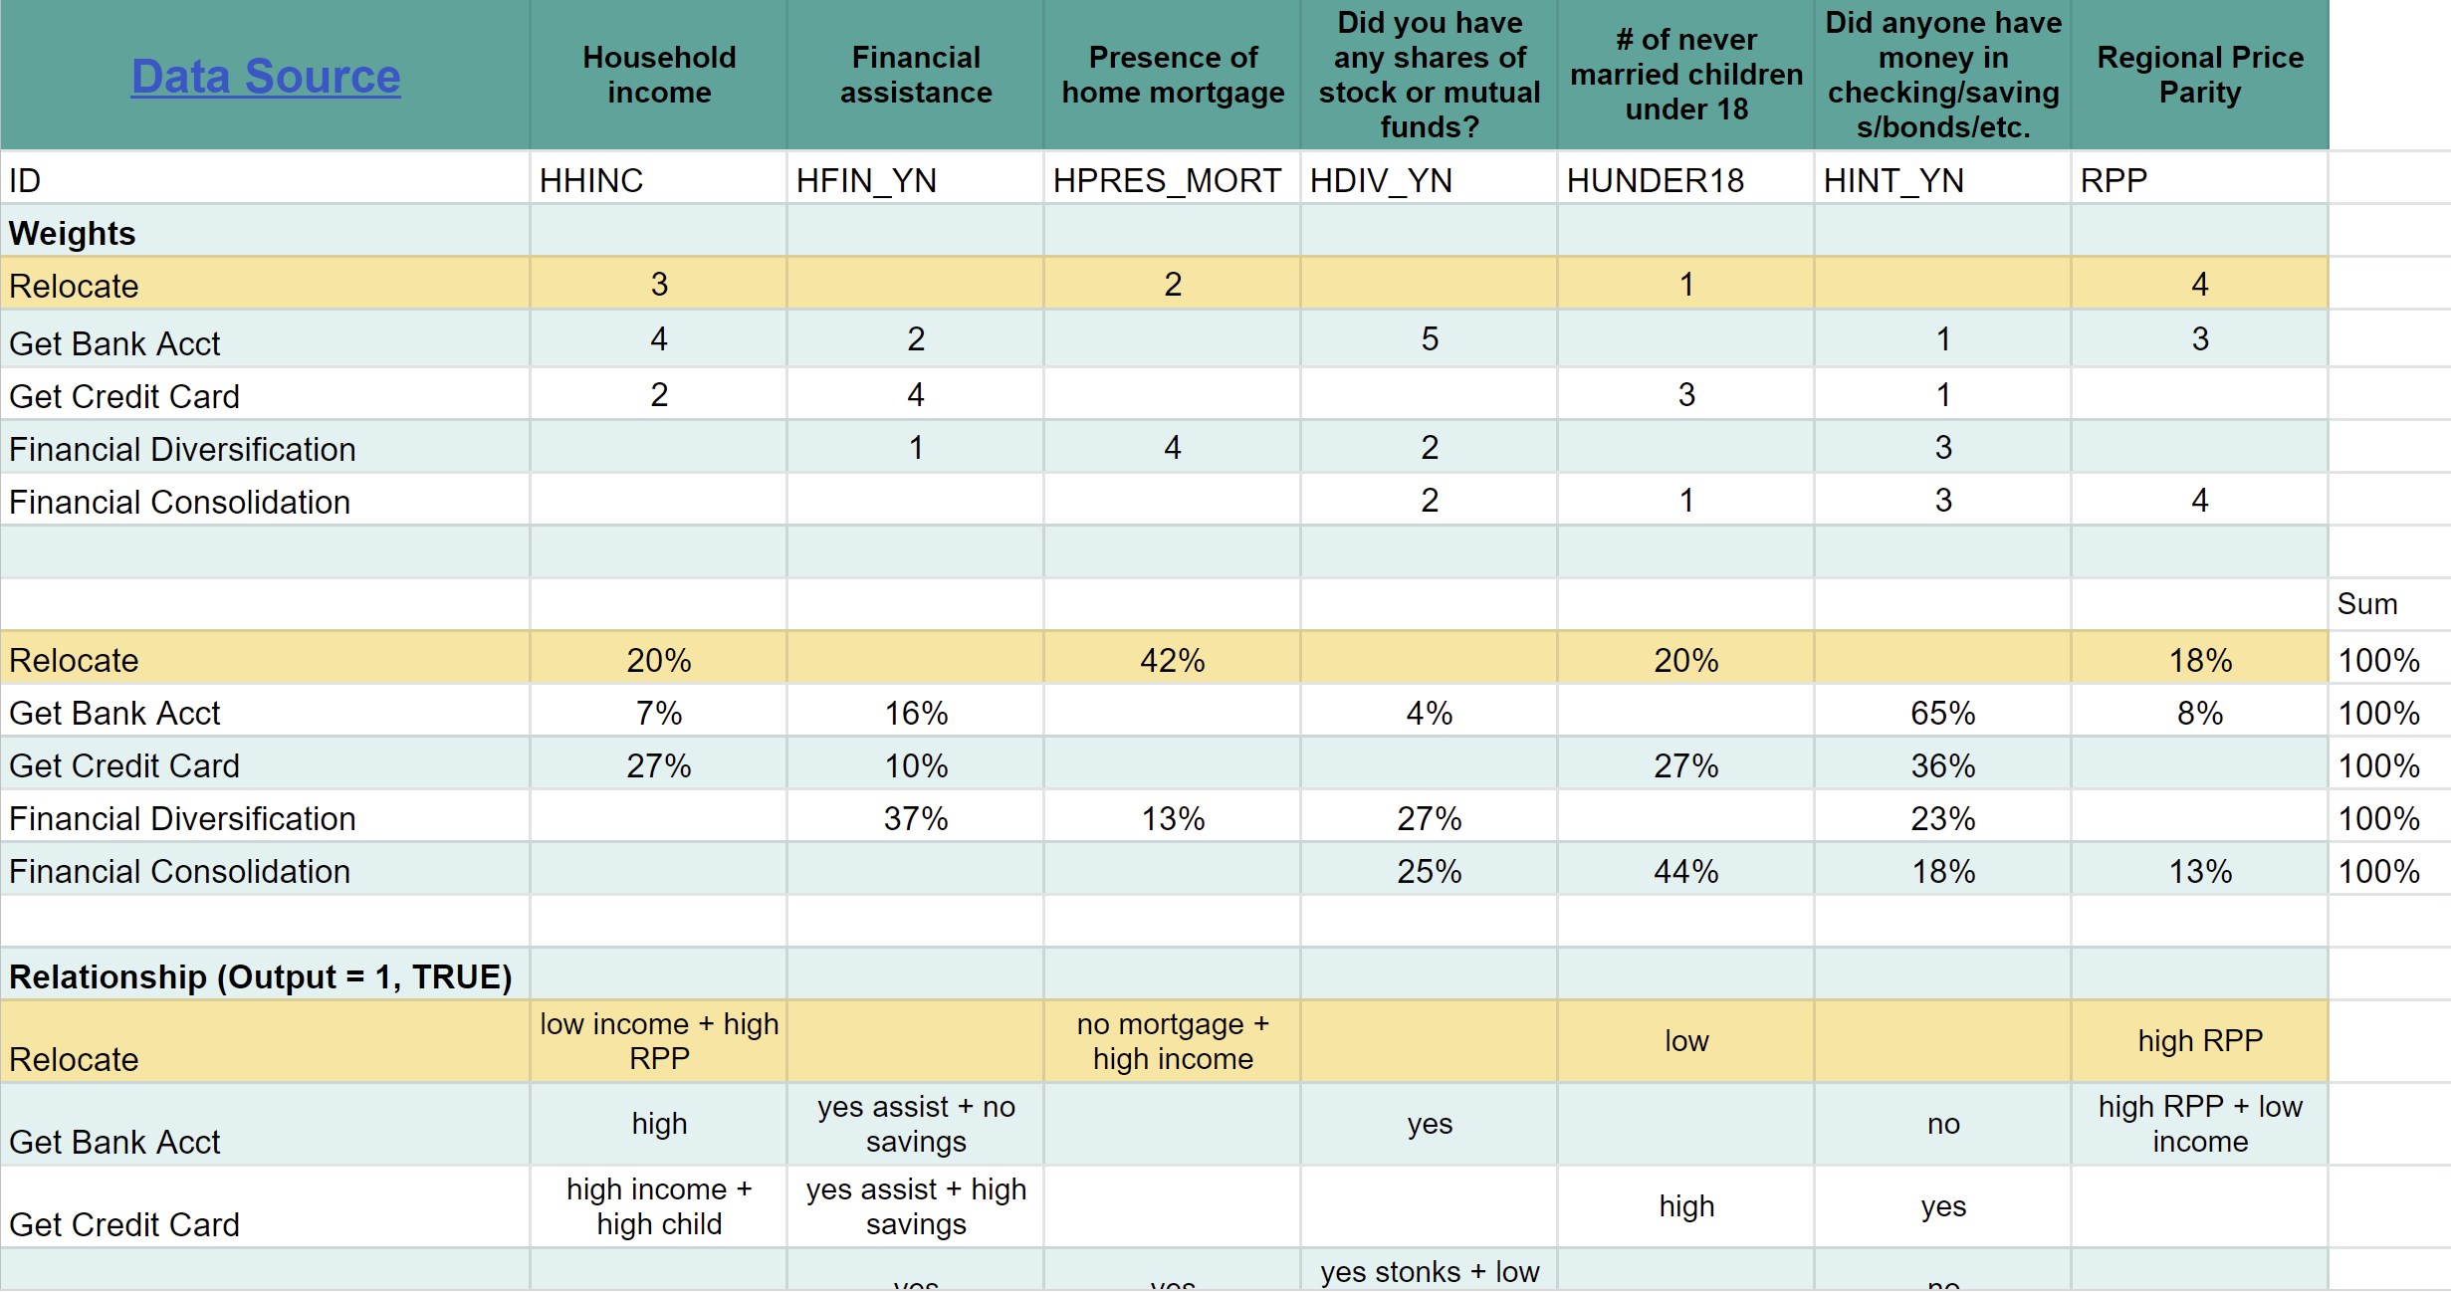
Expected Outcomes
Notes:
Gary

Slide 18
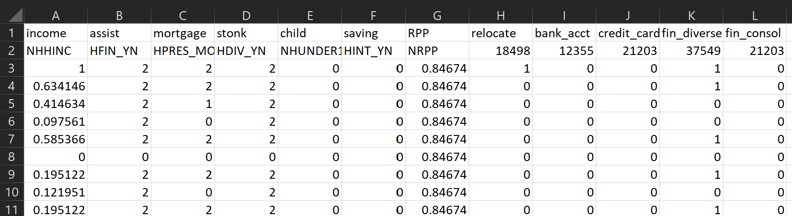
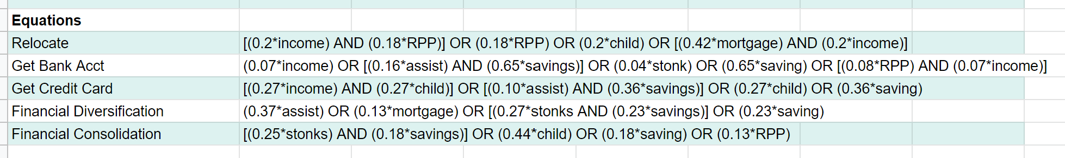
Data Training
Total Data Used to Train AI: 91,052
Notes:
Gary

Slide 19
Data Collection
https://www.bea.gov/data/prices-inflation/regional-price-parities-state-and-metro-area
https://www.census.gov/content/census/en/data/datasets/2020/demo/cps/cps-asec-2020.html
https://www.fdic.gov/analysis/household-survey/index.html
https://www.fdic.gov/analysis/household-survey/2019execsum.pdf
https://globalfindex.worldbank.org/sites/globalfindex/files/chapters/2017%20Findex%20full%20report_chapter2.pdf
https://www.worldbank.org/content/dam/Worldbank/Research/GlobalFindex/PDF/N2Unbanked.pdf

Slide 20
JSG Industries
Shawn, Brendan, Gavin, Gary

Slide 21
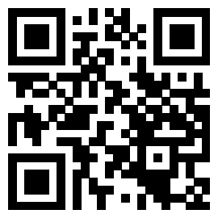
Demo!
go.osu.edu/stonks
Notes:
Brendan

