Slide 1
Exploring DShield Raspberry Pi Honeypot
Krishnarasa Shajeevan

Slide 2
Content
Introduction to Honeypot
Introduction to DShield Raspberry Pi Honeypot and Reason for Choose
Overview of its Purpose and Functionality
Installation, Configuration and Deployment
Screen Recorded Demonstration
Challenges and Limitations
Future Development and Conclusion

Slide 3
Introduction to Honeypot
A honeypot is a cybersecurity mechanism designed to attract and detect malicious activity on a network.
Honeypots can be deployed both within an organization's internal network or on the internet to gather information about cyber threats, tactics, and techniques used by malicious actors.
The primary purpose of a honeypot is to observe and analyse the behaviour of attackers, gather intelligence, and enhance the overall security posture of an organization.

Slide 4
Why use honeypot rather than other security systems
Deception and Misdirection: Honeypots deceive attackers into wasting their time and resources on fake systems, diverting their attention away from real targets. This can buy valuable time for defenders to shore up defences and respond appropriately.
Early Detection: Honeypots can detect attacks at an early stage, often before they reach critical systems or cause damage. This early warning enables organisations to respond proactively and mitigate potential risks swiftly.
Legal and Ethical Considerations: In some cases, organizations may use honeypots to gather evidence of malicious activity for legal or law enforcement purposes. By capturing detailed information about attackers' actions, honeypots can aid in attribution and prosecution efforts.
Insight into Attack Techniques: By analysing the interactions with the honeypot, organizations gain valuable insights into attackers' tactics, techniques, and procedures (TTPs). This knowledge helps in understanding emerging threats and developing more effective countermeasures.

Slide 5

Introduction to DShield Raspberry Pi honeypot
The DShield Raspberry Pi honeypot is a specific type of honeypot designed to run on Raspberry Pi devices. It is a lightweight and cost-effective solution for individuals and small organizations to deploy honeypot functionality in their networks.
The DShield Raspberry Pi honeypot is based on the open-source software provided by the Internet Storm Center's Distributed Intrusion Detection System (DShield).
Reference: Internet Storm Center (https://isc.sans.edu/honeypot.html)

Slide 6
Why choose DShield honeypot?
Global Threat Intelligence Integration - DShield leverages a vast network of volunteer contributors to collect and analyse threat data from around the world
Proven Effectiveness - DShield has a long-standing reputation in the cybersecurity community for its effectiveness in detecting and mitigating a wide range of threats, including malware, botnets, and network intrusions.
Ease of Deployment and Management - Deploying and managing the DShield Honeypot is straightforward. Even users with limited technical expertise can quickly set up and configure the honeypot to start collecting valuable threat data.
Scalability and Flexibility - Whether deployed in a small home network or a large enterprise environment, the DShield Honeypot can scale to meet the needs of diverse use cases.
Educational value - Beyond its practical utility as a threat detection tool, the DShield Honeypot project offers valuable educational opportunities for users to deepen their understanding of cybersecurity concepts and techniques.

Slide 7
Functionality and purposes
Monitoring and Logging - As the honeypot detects suspicious or malicious activity, it logs detailed information about each event, including timestamps, source IP addresses, destination ports, payload data, and any relevant metadata.
Data Collection - As attackers interact with the honeypot, the DShield Honeypot gathers extensive data on their tactics, techniques, and procedures (TTPs), as well as the tools and malware they use.
Emulation of Vulnerable Services - In addition to emulating standard service behaviours, the DShield Honeypot incorporates vulnerabilities and weaknesses commonly found in real-world software and systems.
Alerting - The DShield Honeypot provides robust alerting capabilities to notify users of suspicious or malicious activity detected within their network.

Slide 8
Installation, Configuration and Deployment
1. Configure Raspberry pi - First and foremost, as mentioned above Raspberry Pi 4 model b was used here and write the operating system on it using the SD card reader. After that Pi is connected to the computer and ready to change to a honeypot.
2. Configuration of Honeypot - The configuration of the honeypot is the main module to proceed in any other further understanding of the project. For this DShield Raspberry Pi sensor was used from Git Hub.
3. Connect the Raspberry Pi to the network – After the installation, connect the Pi in the network
4. Get the IP address of the Raspberry Pi – Now that the Raspberry Pi is linked to a network, it will either have an IP address or we have set up the network adapter to obtain one. Upon obtaining an IP address, we must ensure that port 12222 is available for SSH sessions to communicate with the Pi without using an HDMI connection to the monitor. This is necessary for us to communicate with Pi to review the logs.
To get to know the IP address of the Raspberry Pi we use an advanced IP scanner
5. Connect to an SSH session using PUTTY– We are utilising PUTTY, an open-source terminal that is frequently used to interface with Linux computers and other devices, to establish an SSH session. Since our Raspberry Pi runs Linux and port 12222 is open, we can use Putty to set up the device or honeypot and use the same program to see the logs.

Slide 9
Installation, Configuration and Deployment
6. Enter login credentials to access - We require a fundamental security entity, which is our device login credentials, to carry out all of those tasks.
7. Start the honeypot server, by running the honeypot- Now that everything is configured, we can launch the honeypot server, which is located on the Pi and has an IP address given to it. When the server is turned on, we need to continuously monitor the logs and wait for an attacker to try to get through.

Slide 10
Demonstration
(Screen record)

Slide 11
Challenges and Limitations
Limited Resources: Raspberry Pi devices have limited processing power, memory, and storage compared to dedicated servers or appliances. This limitation can impact the honeypot's ability to handle high volumes of traffic or sophisticated attacks, potentially leading to missed opportunities for data collection or analysis.
Network Dependence: The effectiveness of the honeypot relies heavily on the network environment in which it is deployed. Changes in network configurations, firewall rules, or network traffic patterns can affect the honeypot's ability to attract attackers and collect relevant data.
Visibility Constraints: The honeypot can only capture and analyse malicious activities that target the services or vulnerabilities it emulates. It may miss attacks targeting other services or systems not covered by the honeypot's configuration, limiting its scope of threat detection.
Maintenance Overhead: Maintaining and updating the Raspberry Pi honeypot requires ongoing effort, including applying security patches, updating software, and monitoring for performance issues. This maintenance overhead can be challenging, especially for users with limited technical expertise or resources.

Slide 12
Future Development and Conclusion
In the future, a Raspberry Pi-based DShield honeypot may be improved in several ways to enhance its usability, security, and functionality. Here are a few possible improvements:
Improved Monitoring and Logging: To obtain more specific information about incoming threats, enhance the logging capabilities. For a more thorough investigation, this could involve logging timestamps, source IP geolocation information, and packet contents.
Dynamic Response Mechanism: Use dynamic reaction mechanisms to take proactive measures in response to risks that are identified. For instance, dynamically modifying firewall rules to reduce ongoing attacks or automatically blocking malicious IPs at the network level.

Slide 13
Future Development and Conclusion
Improved Reporting and Visualisation: Create an intuitive web interface or dashboard to produce reports and visualise honeypot activities. Users would find it simpler to understand the gathered data and spot trends or patterns as a result.
Scalability and Performance: Make the honeypot software as efficient as possible in handling high traffic volumes. Performance tweaking, code optimisation, and support for distributed deployment architectures might all be part of this.

Slide 14
Future Development and Conclusion
As we can see, if we are not sufficiently security proof, even offering this level of protection can and will be in ineffective. While the project cannot guarantee total protection, but it will assist in identifying the attacker and their goals. Nevertheless, the protection the device offers can still be avoided by using social engineering to get access to the network or by gaining access to it and then granting the user complete access.
This device offers protection against outsiders attempting to access the network through security flaws; nevertheless, if any other machine is out of date or has open ports, it is vulnerable to assault. We need more than just security, prevention, or protection to keep ourselves safe from harm. We also need to exercise caution.

Slide 15
Question?

Slide 16
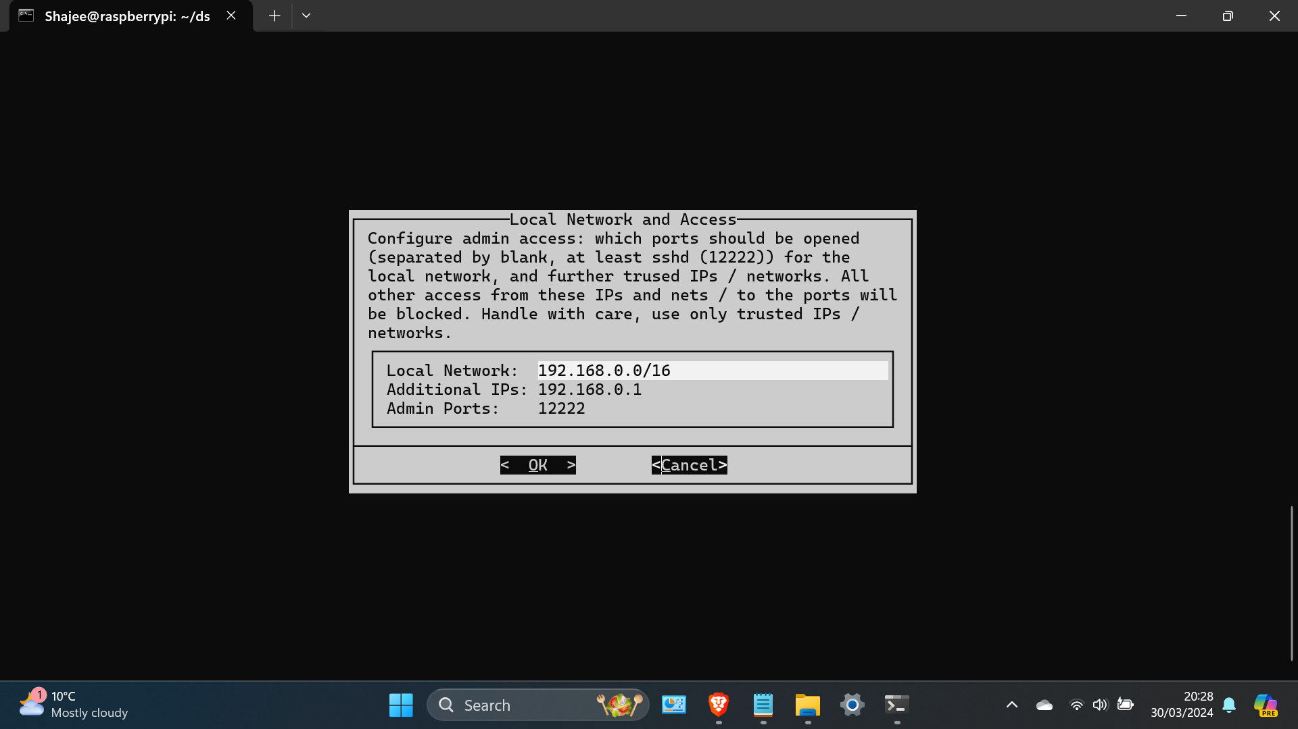
Why No Live demonstration?
Each network has its own unique configuration, including IP address ranges, subnet masks, gateway addresses, and DNS settings. If I configure the Raspberry Pi honeypot with network settings specific to one network, it may not function properly when connected to a different network with different settings.

Slide 17
Thank you

