Slide 1
08
Experimental Design
Five controlled sweeps — isolating threshold, judge, and architecture effects
Sweep File
Purpose
Conditions
Threshold
Generator / Judge
sweep_phase1
Phase 1 Baseline
A / B / C
0.70
qwen3-32b / qwen3-32b
sweep_thresh85_b
Threshold Sensitivity B
B only
0.85
qwen3-32b / qwen3-32b
sweep_thresh85_c
Threshold Sensitivity C
C only
0.85
qwen3-32b / qwen3-32b
sweep_judge_sep_a
Judge Separation A
A only
—
qwen2.5-7b / qwen3-32b
sweep_judge_sep_b
Judge Separation B
B only
0.85
qwen2.5-7b / qwen3-32b
All sweeps: 19 SWE-bench Lite instances across django, sympy, scikit-learn, astropy

Slide 2
09
Phase 1 Results — Headline Numbers
19 instances × 3 conditions — qwen3-32b generator and judge
0.878
0.881
0.926
0.887
0.721
A mean score (σ = 0.145, min 0.30)
B @ 0.70 mean (σ = 0.069, min 0.72)
B @ 0.85 mean (σ = 0.044, min 0.85)
C @ 0.70 mean (σ = 0.126, min 0.40)
C @ 0.85 mean (σ = 0.353, min 0.00)
▲ B@0.85 beats B@0.70
Mean +0.045, stdev halved (0.069→0.044), hard floor at 0.85. Raising the threshold forces more refine iterations and eliminates all below-threshold answers.
✓ Reviewer narrows variance
A spans 0.30–0.96; B@0.85 spans 0.85–1.00. The refine loop is effectively a score floor: no instance escapes without satisfying the rubric.
⚠ Condition C is bimodal at 0.85
14 / 19 instances score 0.86–1.00. The remaining 5 regress sharply (≤ 0.40), including one at 0.00. Aggressive refinement with an action agent is not uniform improvement.
★ Judge separation amplifies lift
With a weaker Ollama 7B generator the Reviewer adds Δ = +0.114 vs only Δ = +0.003 when the generator is strong — the Reviewer matters most where it is needed most.

Slide 3
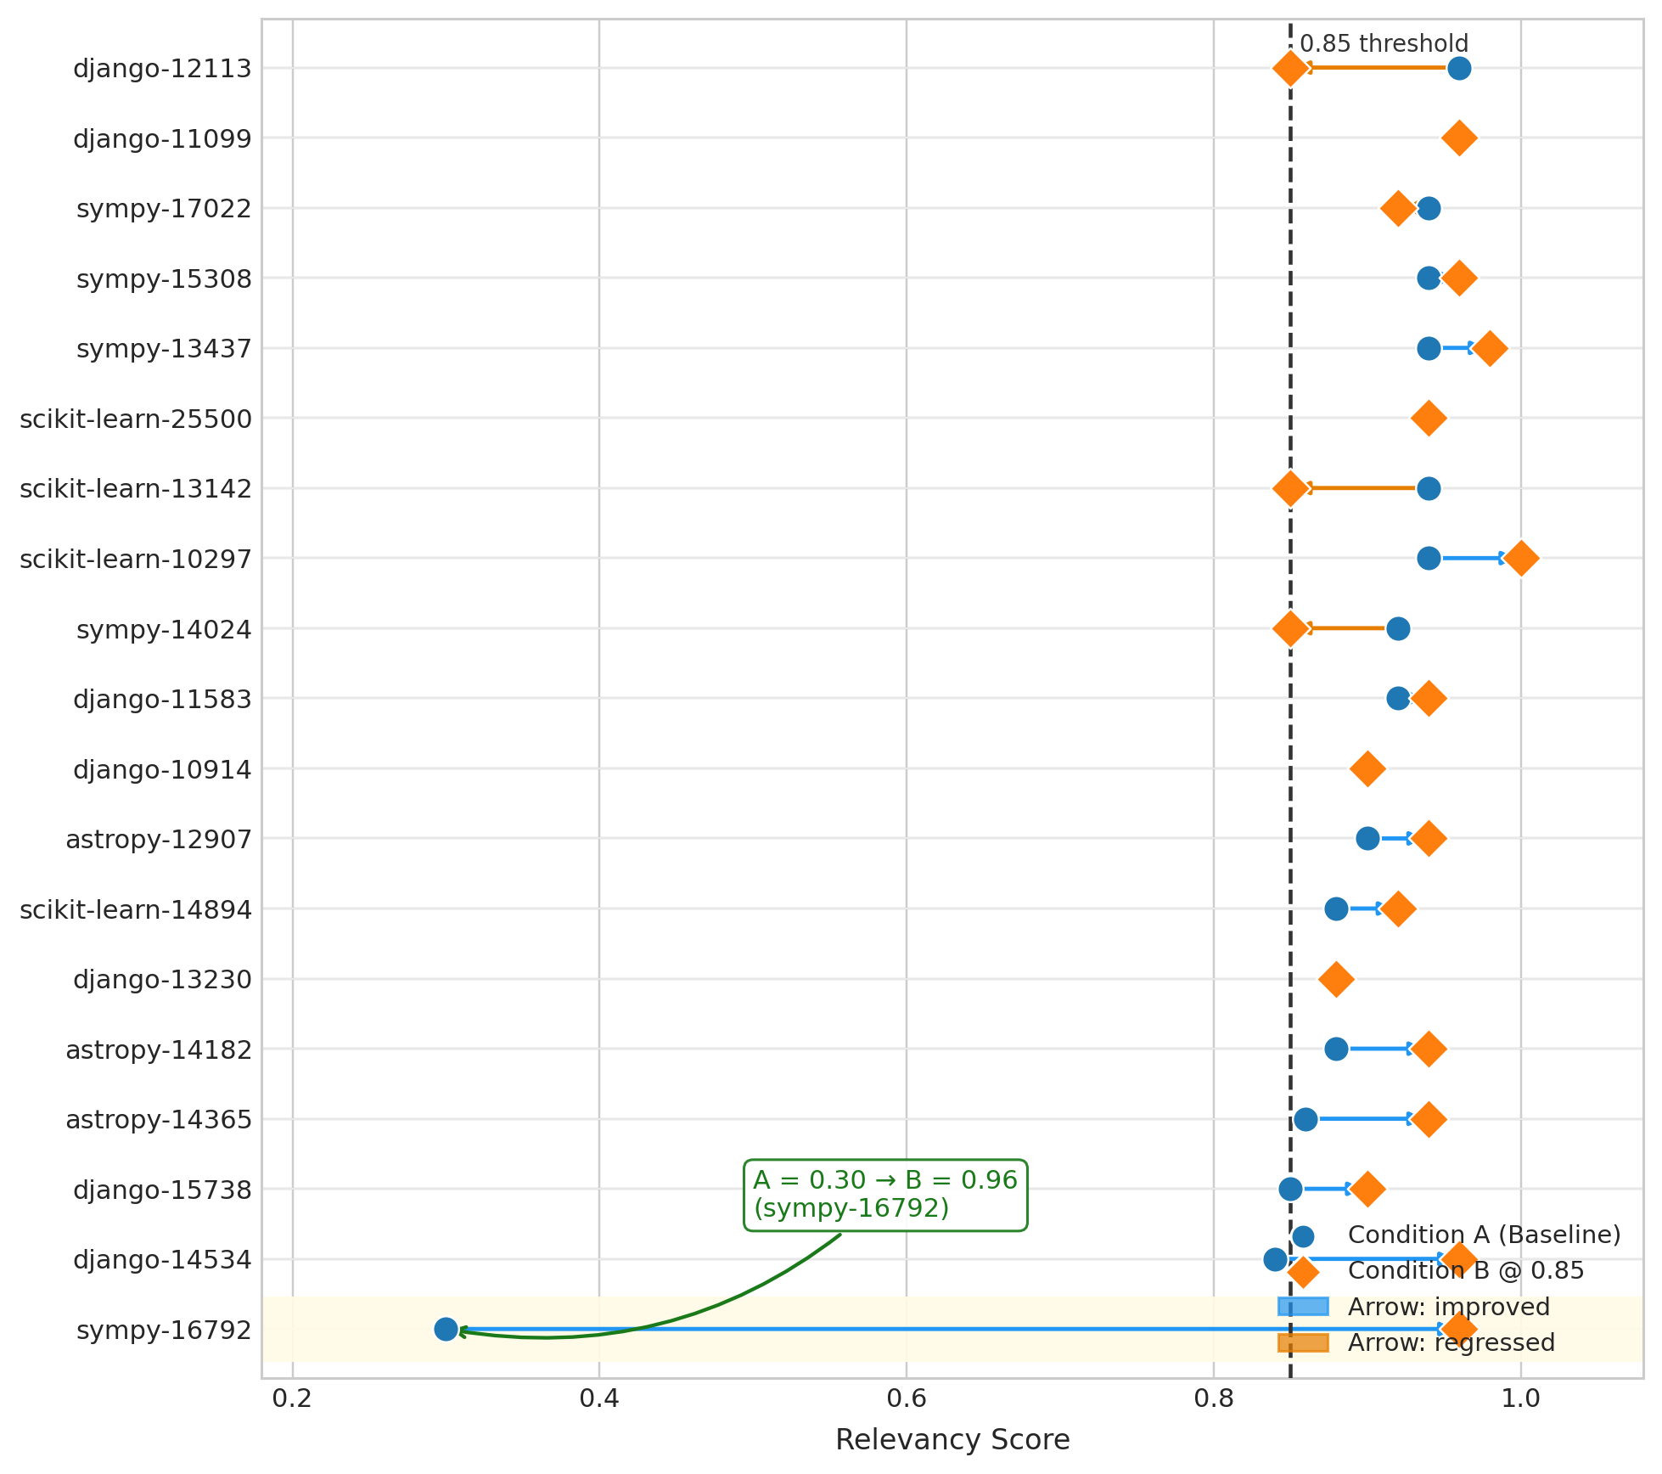
10
Finding 1 — Reviewer Enforces a Hard Score Floor
Every B@0.85 instance ≥ 0.85 · Baseline A spans 0.30 → 0.96
0.30 → 0.96
sympy-16792: biggest single lift. Baseline scored 0.30 — Reviewer drove it to 0.96.
σ halved
A stdev = 0.145 · B@0.85 stdev = 0.044. Refine loop compresses the score distribution.
Hard minimum
B@0.85 minimum = 0.85 across all 19 instances. The rubric + refine acts as a guaranteed floor.
73 % of instances lifted
14 of 19 instances improved under B vs A. Only 5 showed marginal regression (all ≥ 0.85).

Slide 4
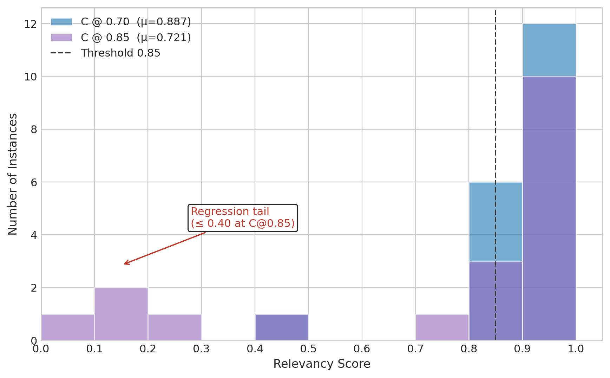
11
Finding 2 — Condition C is Bimodal at Threshold 0.85
Aggressive refinement with an action agent is not uniformly beneficial
High cluster
14 / 19 instances
Score 0.86 – 1.00 Action agent succeeds reliably
Regression tail
5 / 19 instances
Score ≤ 0.40 (one at 0.00) Aggressive refine degrades output
Root cause
Context explosion
OpenHands accumulates ~150K tokens by step 30 — judge loses coherence
Implication
Threshold matters
C@0.70 mean = 0.887 vs C@0.85 = 0.721 Higher threshold amplifies tail risk

Slide 5
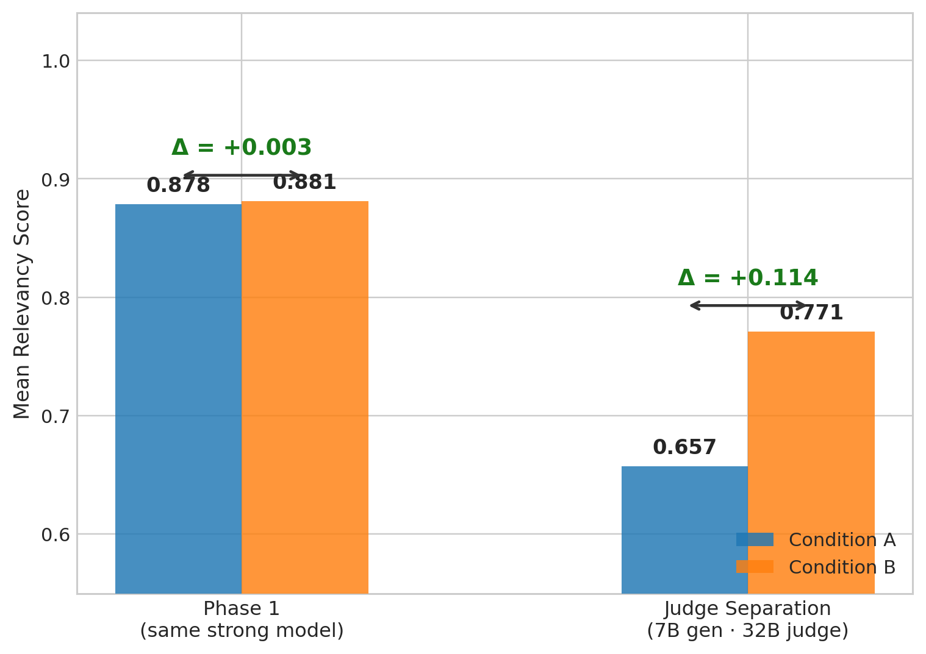
12
Finding 3 — Reviewer Adds Most Value When Generator is Weak
Judge separation experiment: Ollama qwen2.5-7B generator · qwen3-32B judge
Δ = +0.114 (weak gen)
Mean A = 0.657, mean B = 0.771. When the generator struggles the Reviewer's refine loop delivers the largest lift.
Δ = +0.003 (strong gen)
Mean A = 0.878, mean B = 0.881. A capable generator leaves little room for the Reviewer to improve.
Architectural implication
The Reviewer is not redundant — it is a safety net that scales with generator weakness. Deploy it whenever the generator is uncertain.

Slide 6
13
Conclusions, Limitations & Future Work
CONCLUSIONS
LIMITATIONS
Rubric-based gating works
– Absolute scores are LLM-regime sensitive — only within-regime ordering is comparable.
B@0.85 lifts mean score by +0.048 over A and enforces a hard minimum — no instance escapes below 0.85.
– Free-tier throttling affected Condition C; token costs per run are high (~150K at step 30).
Reviewer value scales with generator weakness
– 19-instance set provides directional signal but limited statistical power.
Δ = +0.003 (strong model) vs Δ = +0.114 (7B model). The Reviewer is most valuable where the generator is most uncertain.
FUTURE WORK
Hallucination Bridge generalises the rubric
The same 5-dimension rubric audits OpenHands action traces — a structurally distinct hallucination class becomes detectable without fine-tuning.
→ Full 50-instance SWE-bench Lite sweep for statistical significance.
→ Formal per-action hallucination metric on OpenHands traces.
Bimodality is a real risk at C@0.85
Aggressive refinement with an autonomous action agent can degrade output when the judge loses coherence under large context.
→ Threshold calibration — per-domain adaptive thresholding.
→ Evaluate with stronger open-source models (Qwen2.5-72B, GPT-4o).

Slide 7
THANK YOU
FOR YOUR TIME
Syed Muhammad Shajee Raza · Group J4232 · ITMO University
Development of a Lightweight Hallucination Detection Algorithm for the Reviewer Agent in a Code-Generation Multi-Agent System
19
5
3
+0.114
0.85
SWE-bench instances
Sweep configurations
Architectural conditions
Max Reviewer lift
B@0.85 score floor

