Slide 1
Presentation of project Event Management System for course FullStack Applications with Node.js + Express.js + React.js
Created by
Ivaylo Iliev and Nikolay Naydenov

Slide 2
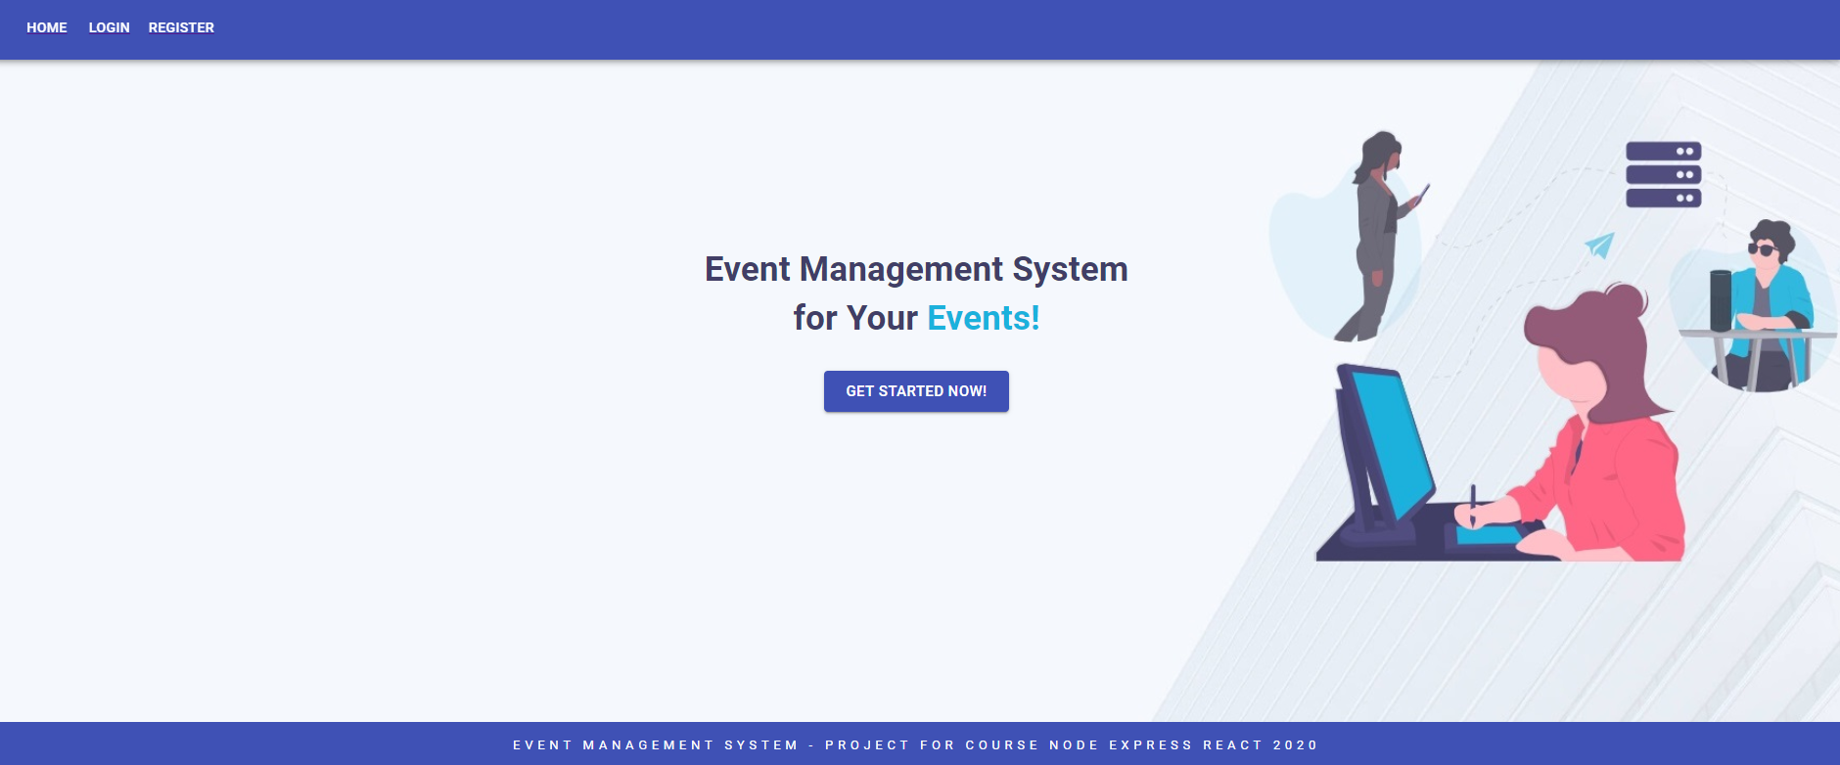
Home view for not logged in user

Slide 3
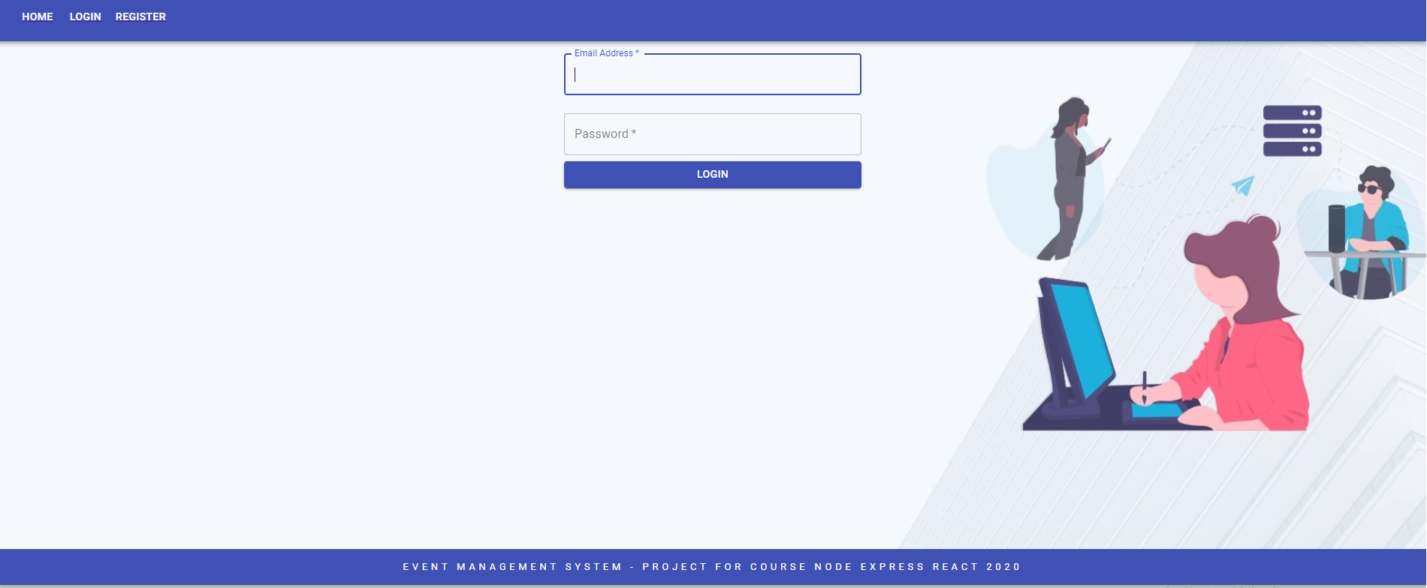
Login functionality view

Slide 4
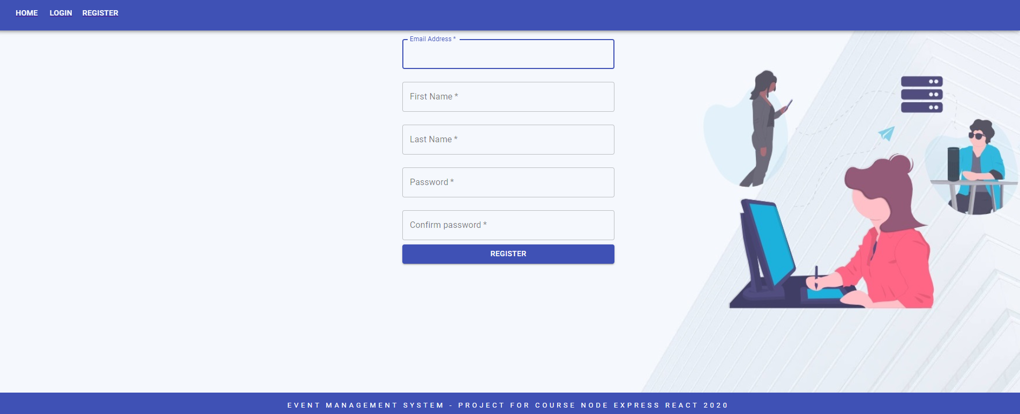
Register functionality view

Slide 5
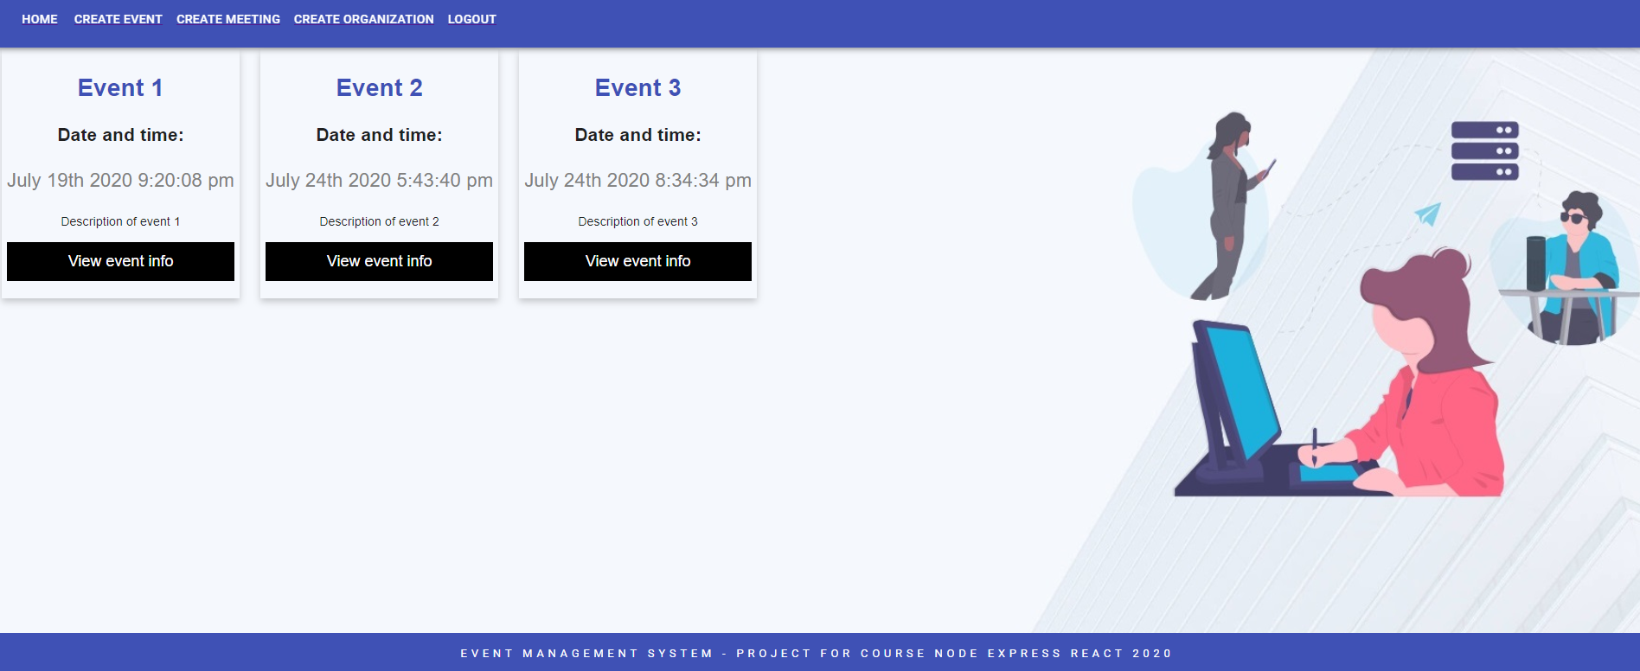
Login view for logged user
Displays his created events or those which he will participate in

Slide 6
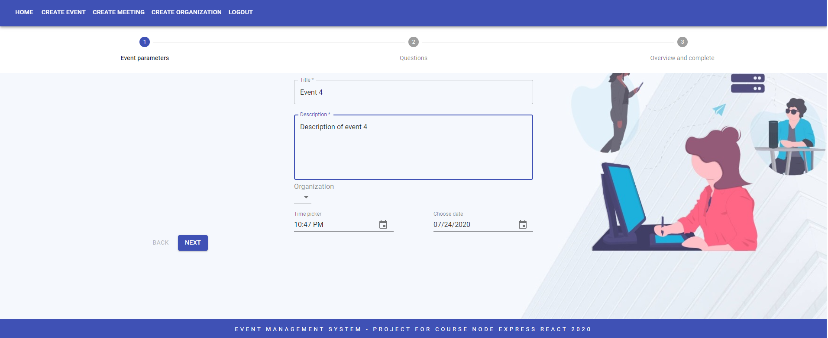
Creating event view – basic details

Slide 7
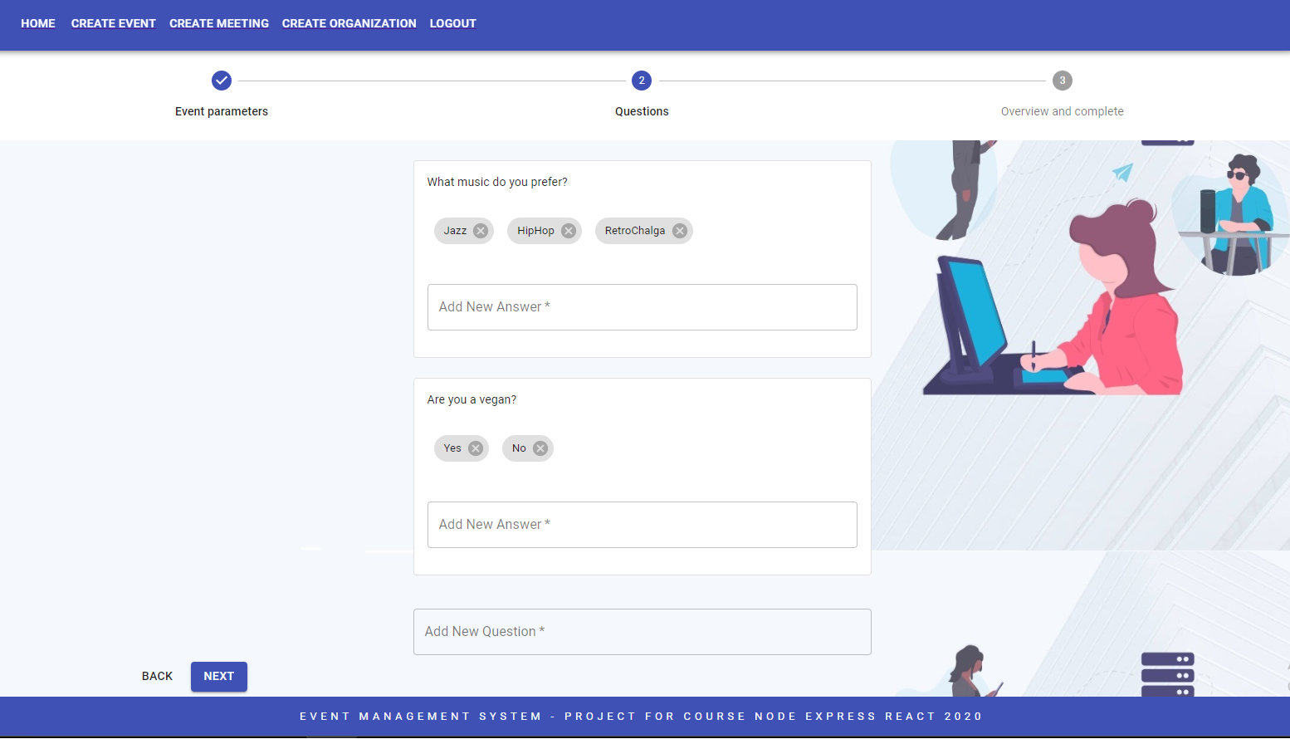
Creating event – adding questions and possible answers

Slide 8
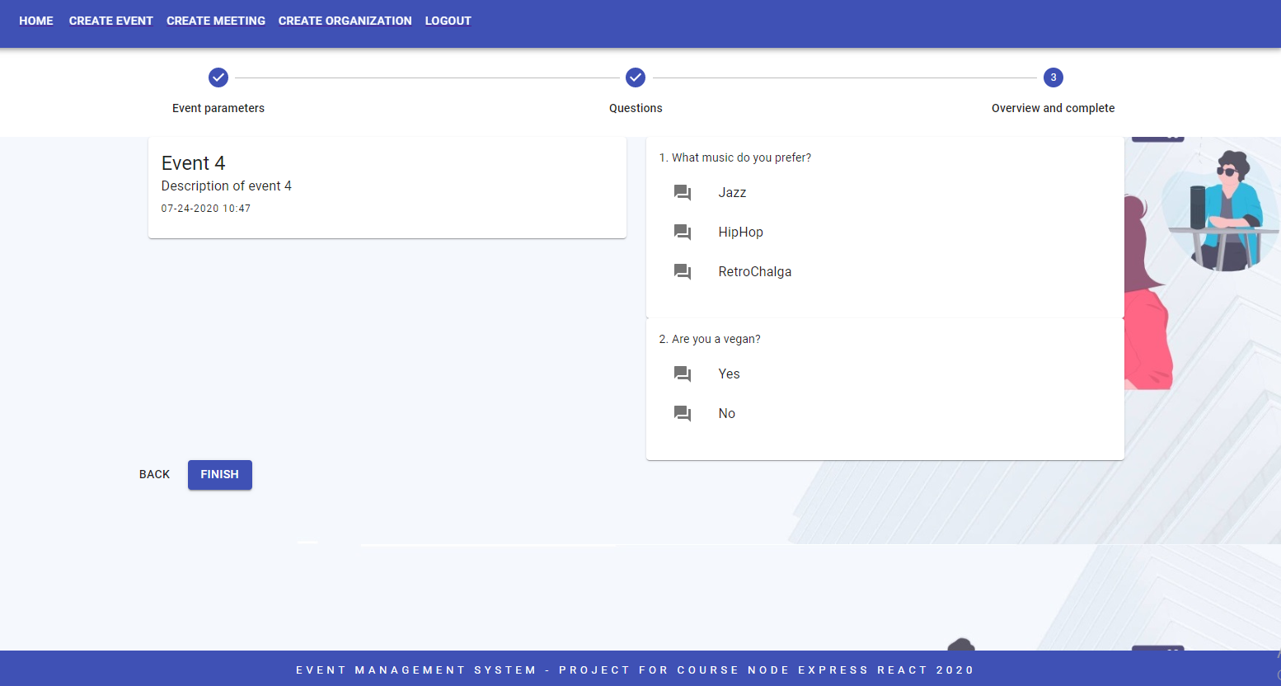
Creating event – overview and complete

Slide 9
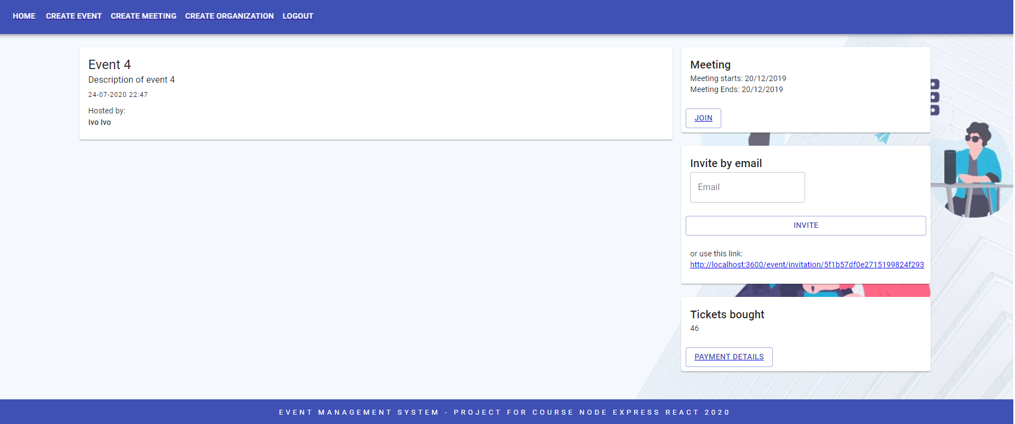
View details of existing event

Slide 10
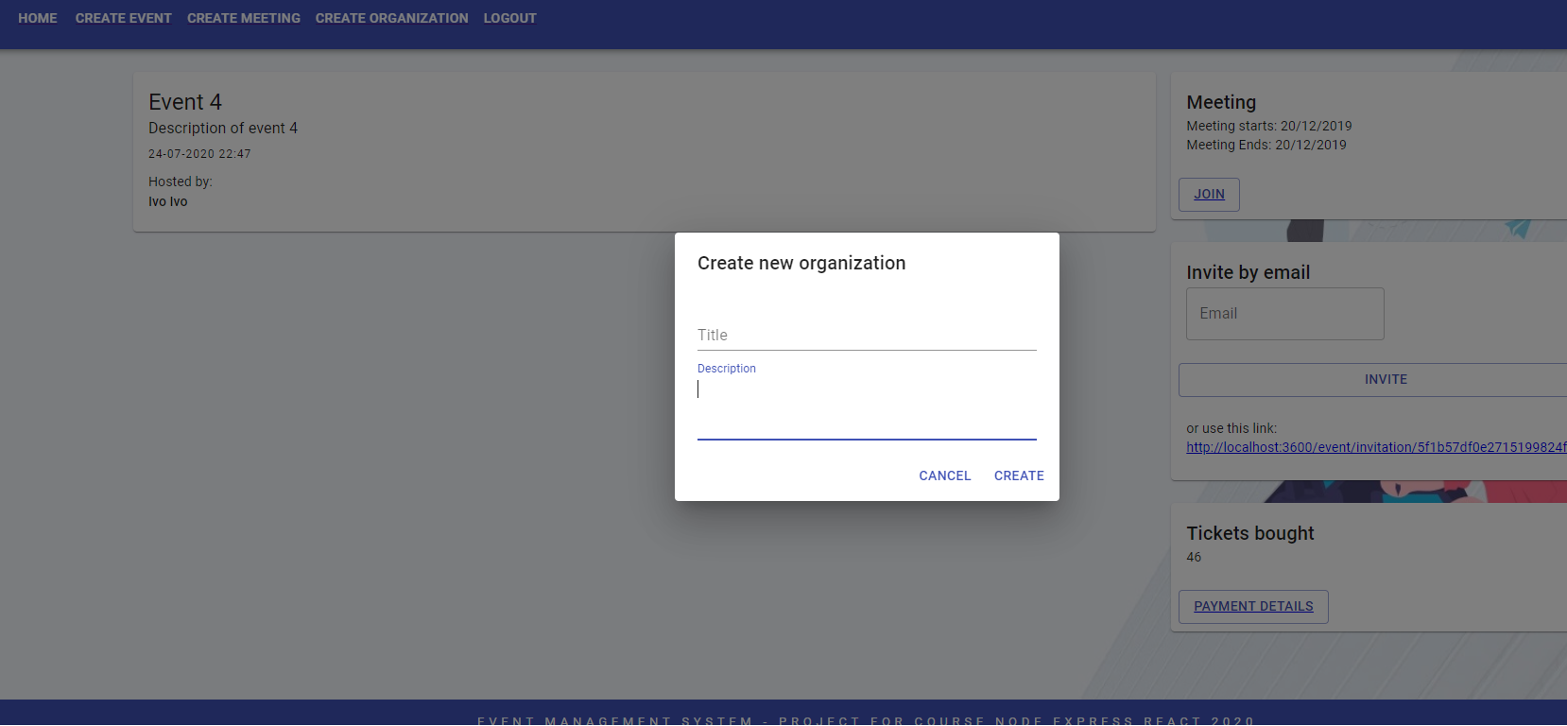
Create organization form

Slide 11
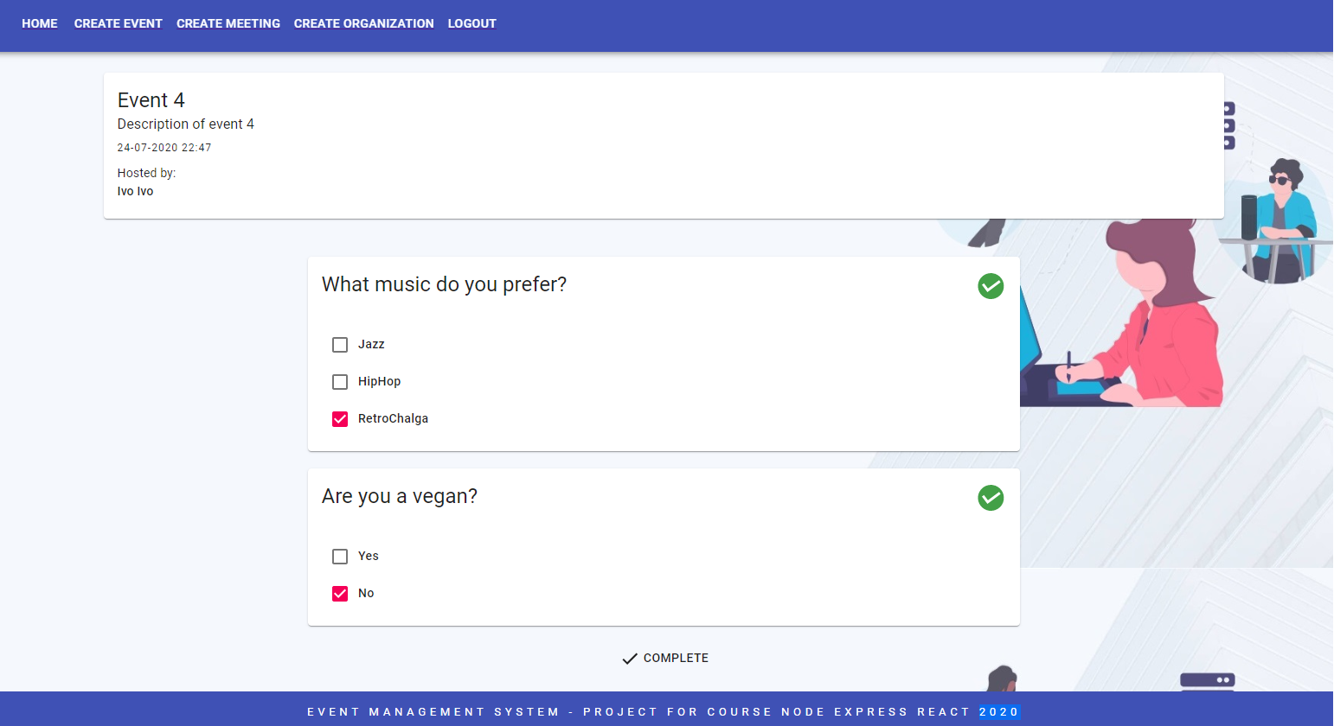
Answering questions view

Slide 12
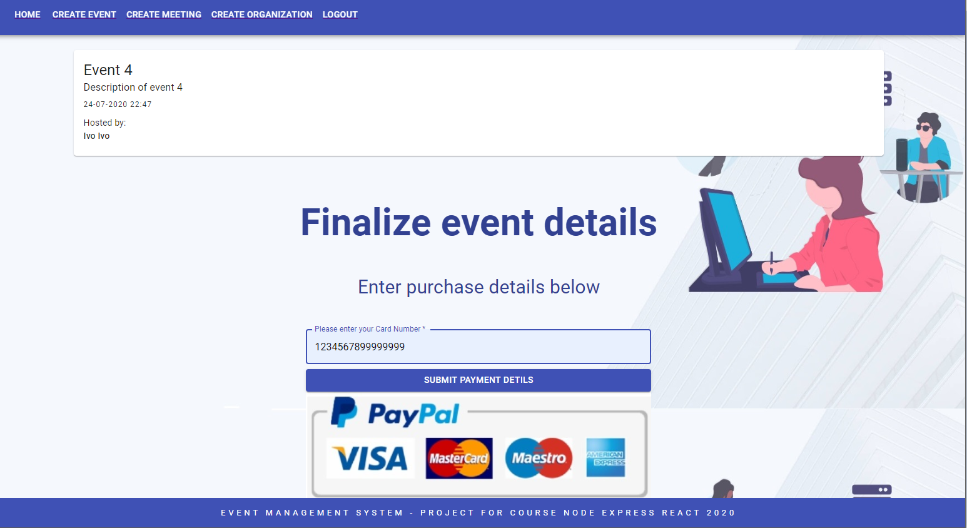
Submitting purchase details

