Slide 1
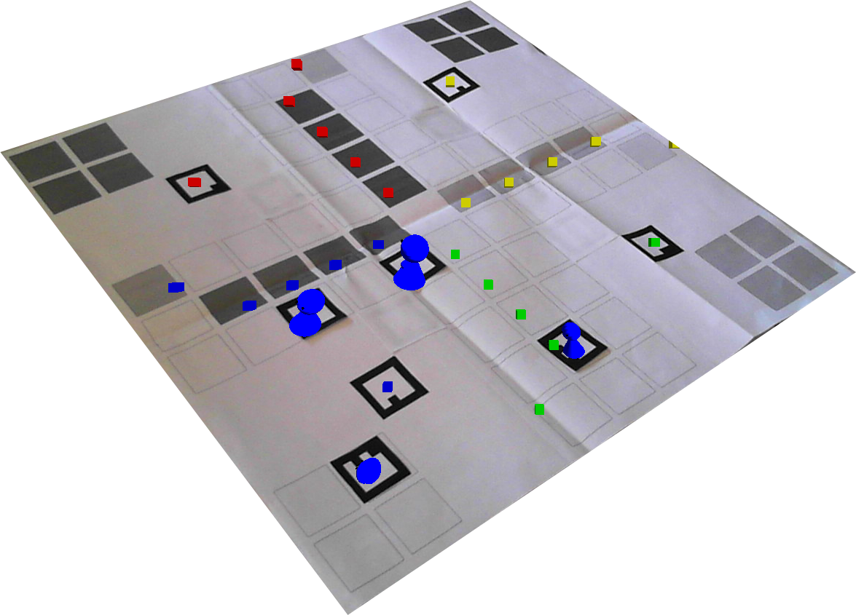



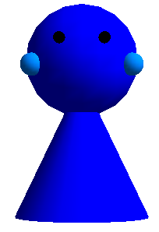
Target 1:
0°
0°
Mensch ärgere dich nicht / Ludo
Marie-Lena Eckert, Moritz Wilfer, Cheng Zhang
Augmented Reality - summer class 2012/2013, Technische Universität München
Board game enriched by Augmented Reality
Features:
  Animation for a pawn which leaves home
  Animation if a pawn reaches the goal
  Animation if one color wins the game
  Animation if a pawn beats another pawn
Usability of a board game combined with nice animations for more entertainment in special situations
Playing field calibration:
The calibration of the playing field is accomplished with four markers attached to the board. Due to them, the target and start fields of each color are detected.
For accurate calibration, world-coordinates are calculated from screen coordinates. Now, vectors between the four markers are computed and used for detecting the important fields.
Triggering of animations:
Animations are triggered, if the distance between a pawn-marker and a
house / start field / another pawn is smaller than a specified constant.
Here, the accurate calibration is essential.
For the beating animation, the pawn which has not moved is chosen as the victim.
Early stage of gaming field: calibration is illustrated with colored boxes
Accurate calibration of the playing field represents a big challenge
Cute pawns for good game experience
Virtual pawns rendered with OpenGL:
The virtual pawns are rendered by the OpenGL state machine. They are built from simple geometric objects.
The animation is conducted with a timer function, which is called periodically.
Every pawn offers 5 types of animation:
  START: Jumping (illustrates pleasant anticipation)
  BEAT: Beats another pawn with a baseball bat
  DEFEAT: Falling down to ground and crying
  WIN: Jumping (illustrates great pleasure)
  VIC: Multiple and fast jumping (illustrates euphoria)
Example: red woman beats man of blue house who starts crying
Technische Universität München – Institut für Informatik

