Slide 1
Forecasting Chinese Outbound Tourism Demand
ISF-TDF2023 | 12-Month Forecasting Project
Sample Data
Forecasting Objective
20 destinations
Monthly Chinese outbound tourism demand
Forecast horizon
Aug 2023 – Jul 2024
Evaluation approach
Cutoff-safe validation and comparative forecasting
Date | Canada | Taiwan China | Hong Kong China | Japan | South Korea | Maldives | Thailand | Australia
2019M06 | 73,620 | 260,919 | 4,000,994 | 880,651 | 475,007 | 23,983 | 836,742 | 80,680
2019M07 | 99,114 | 322,444 | 4,160,688 | 1,050,420 | 519,132 | 32,569 | 983,808 | 150,390
2019M08 | 98,609 | 282,999 | 2,782,897 | 1,000,639 | 578,112 | 32,757 | 1,031,683 | 128,280
2019M09 | 86,857 | 116,037 | 2,412,459 | 819,054 | 541,350 | 24,758 | 852,154 | 98,990
2019M10 | 57,759 | 114,852 | 2,519,243 | 730,631 | 567,695 | 21,926 | 826,431 | 102,710

Slide 2
Forecasting & Validation Framework
Cutoff-safe design separates model selection from the final 12-month forecast
Validation cutoff
Feb 2023
Final cutoff
Jul 2023
HISTORICAL DATA / TRAINING
VALIDATION
FINAL FORECAST
1989M01 → 2023M02
2023M03 → 2023M07
2023M08 → 2024M07
A Training cutoff
B 5-month validation
C Final model refit
12-month forecast
Use observations only
through Feb 2023.
Forecast Mar–Jul 2023
and compare with actuals.
Use public history
through Jul 2023.
Generate Aug 2023–
Jul 2024 forecasts.
Cutoff-safe design: future observations are not used to generate earlier forecasts.

Slide 3
Baseline Forecasting Models
Two simple benchmarks establish the reference point for improved forecasting methods
M1 — Naive Lag-1
M2 — Naive Lag-12
ŷ(t+h) = y(t)
ŷ(t) = y(t−12)
Recent-level benchmark
Seasonal benchmark
Carries the latest available demand level
forward across the forecast horizon.
Uses demand from the corresponding month
one year earlier.
latest level carried forward
annual pattern repeated
Purpose: establish simple reference models before developing and comparing improved forecasting methods.

Slide 4
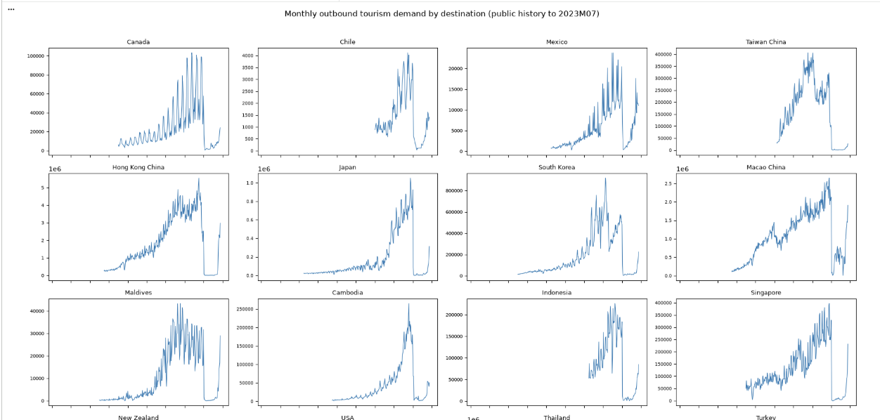
EDA — Tourism Demand Before and After COVID-19
Destination series show strong seasonality, different demand scales, and a major structural break.
Strong pre-COVID
trend & seasonality
Sharp COVID-19
structural break
Uneven recovery
across destinations
Implication: simple historical patterns may be unreliable during the post-COVID recovery period.

Slide 5
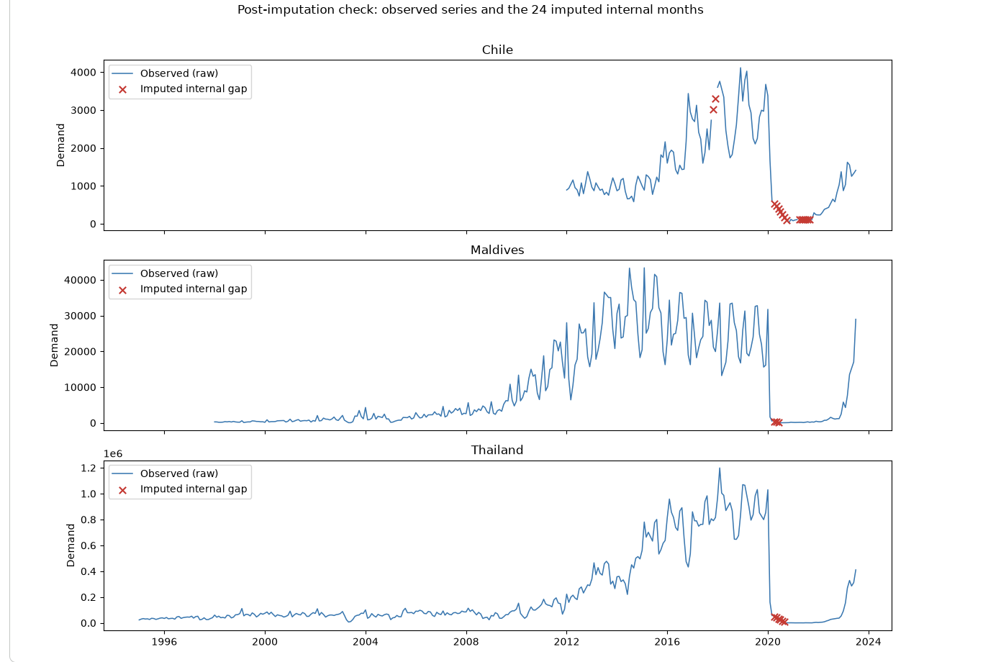
Missing Data & Cutoff-Safe Imputation
Only internal gaps were interpolated; leading missing history was retained.
24 internal missing months
Chile 15
Maldives 3
Thailand 6
Method
Linear interpolation
within observed span
Limitation: long gaps during COVID may not follow a linear trajectory, so imputed values add modelling uncertainty.

Slide 6
From Baselines to Improved Forecasting Models
Eight candidates span simple benchmarks, recovery-aware methods, classical forecasting and a pretrained foundation model.
Baselines
Recovery-aware
Classical / Statistical
Foundation Model
M1 Naive Lag-1
M3 Seasonal Recovery
M5 SARIMA
M7 TimesFM 2.5
Recent level carried forward
Annual seasonality + recovery adjustment
Trend + autoregressive + seasonal structure
Pretrained time-series model
used in zero-shot mode
M2 Naive Lag-12
M4 Blended Recovery
M6 Prophet
Same month from previous year
Recent-level anchor + recovery forecast
Trend with yearly seasonality
M8 Holt-Winters Ensemble
Level, trend & seasonality + recovery blend
Comparison strategy: test whether recovery-aware and fitted models improve on the two simple naive benchmarks under the same cutoff-safe validation window.

Slide 7
Official Validation Results — Mar–Jul 2023
Lower values indicate better performance
Aggregate performance across all 20 destinations under the prescribed cutoff-safe validation window.
Model
Mean MASE
Median MASE
Mean MAPE
Validation leader
M4 Blended Recovery
2.48
1.53
42.84%
M4 Blended Recovery
M8 Holt-Winters Ensemble
2.59
2.01
43.82%
M7 TimesFM 2.5
2.61
2.00
44.29%
2.48
1.53
Mean MASE
Median MASE
M1 Naive Lag-1
2.67
1.70
48.06%
42.84%
M3 Seasonal Recovery
2.71
1.62
45.72%
Mean MAPE
M5 SARIMA
2.96
2.65
54.59%
Best aggregate result on all three
M6 Prophet
4.07
2.63
73.75%
M2 Naive Lag-12
4.41
3.83
77.90%
Official validation evidence favours M4, while M8 and TimesFM remain close competitors.

Slide 8
Validation vs Longer-Horizon Backtest
Mean MASE comparison for the three strongest candidates across the two evaluation windows.
Official 5-Month Validation
12-Month Recovery Backtest
Mar–Jul 2023 | prescribed evaluation
Longer supporting evaluation window
Model
Mean MASE
Model
Mean MASE
M4 Blended Recovery
2.48
M7 TimesFM 2.5
2.08
M8 Holt-Winters
2.59
M8 Holt-Winters
2.17
M7 TimesFM 2.5
2.61
M4 Blended Recovery
2.18
M4 ranks 1st
TimesFM ranks 1st
Only the three strongest models are shown; the remaining five recorded higher mean MASE in both comparisons.
Backtest gap: M4 is only 0.10 MASE behind TimesFM
M4 leads the official validation and remains competitive in the longer 12-month backtest.

Slide 9
Why M4 Blended Recovery Was Selected
Final selection combines the prescribed validation result, longer-horizon evidence, and controlled forecast behaviour.
1
Leads Official Validation
2
Competitive Over 12 Months
3
Balanced Forecast Behaviour
Longer recovery back-test:
M4 mean MASE 2.18
Times FM 2.08
Holt-Winters 2.17
Only 0.10 behind the best mean MASE.
60% M1 recent-level anchor
40% M3 seasonal-recovery forecast
Lag-1 helps control extreme forecasts while the recovery component retains seasonal shape
Best aggregate result across all 20 destinations:
Mean MASE 2.48
Median MASE 1.53
Mean MAPE 42.84%
FINAL MODEL
M4 — Blended Recovery
Selected for refitting on public history through Jul 2023 and forecasting Aug 2023–Jul 2024.

Slide 10
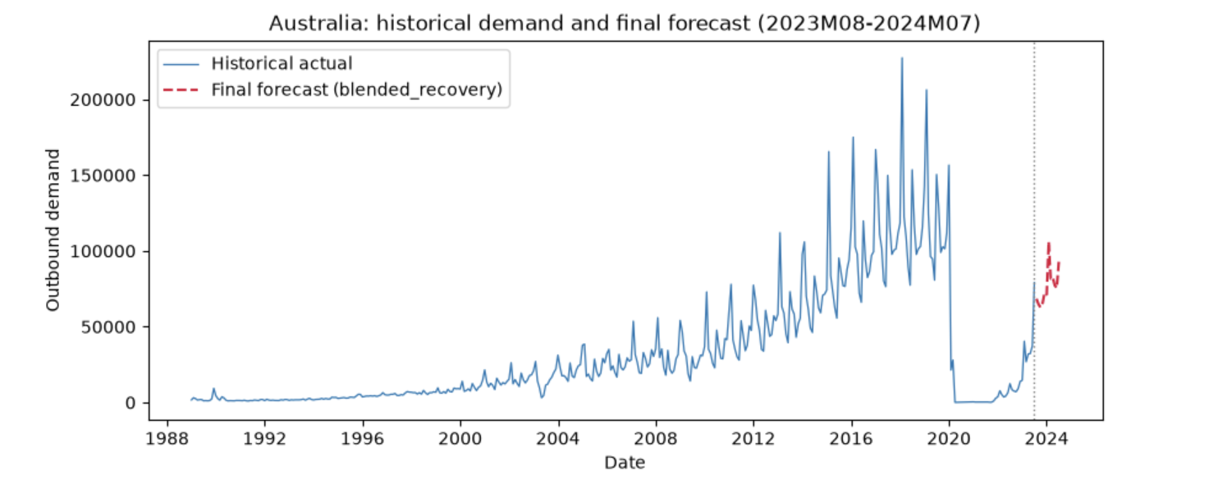
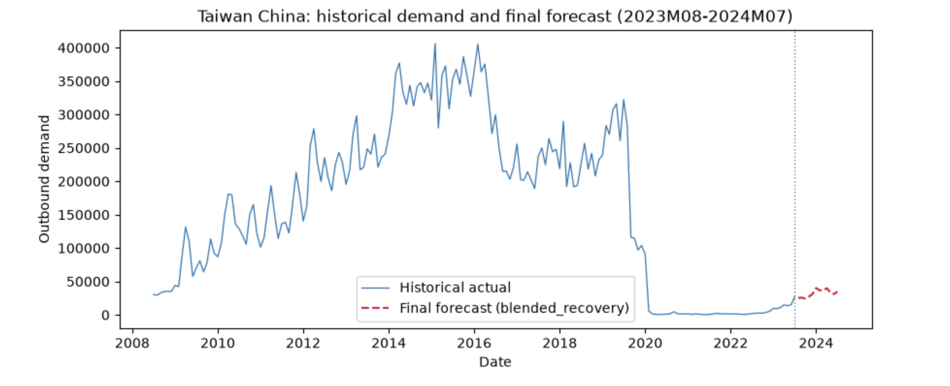
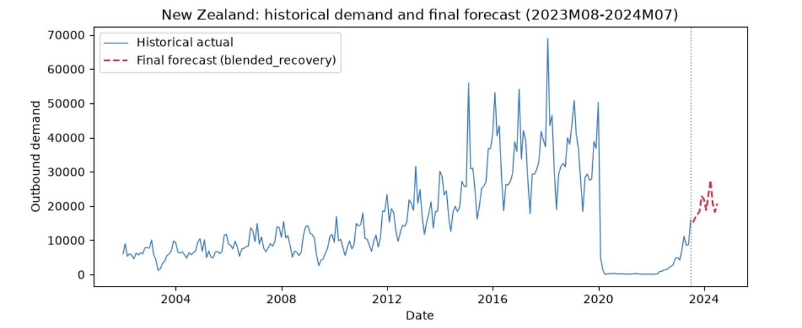
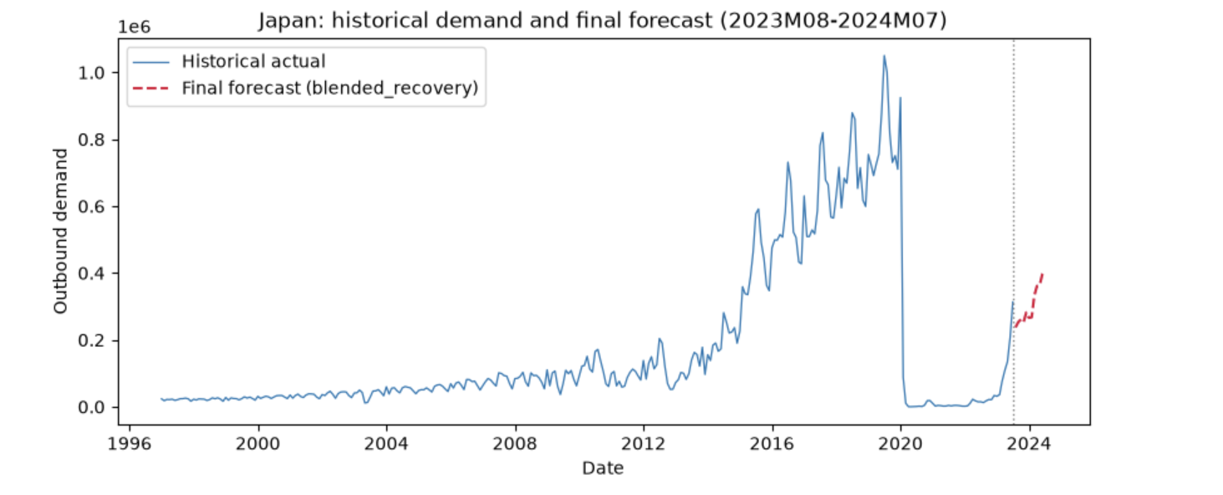
Final 12-Month Forecast — Aug 2023 to Jul 2024
M4 Blended Recovery refitted using public history through Jul 2023; selected destination forecasts shown below.
Final forecast horizon: actual values are not available for Aug 2023–Jul 2024.
Forecast efficacy is therefore established from the preceding held-out validation and 12-month backtest.
Forecasts preserve destination-specific recovery levels and seasonal shape rather than imposing a common trajectory.

Slide 11
Destination-Level Validation Findings
Held-out Mar–Jul 2023
Selected markets show why the best aggregate model need not be the best model for every destination.
Accuracy shown here comes from the held-out validation period, where actual observations were available for comparison.
Australia
Japan
M4 validation MASE 1.04
M4 validation MASE 3.41
vs M1 1.67 | M2 4.07
M3 performs best locally (MASE 3.11). M4 remains competitive at 3.41 and improves on both naive baselines, M1 (4.75) and M2 (5.49)
Strong local result. Final forecast retains seasonal movement while remaining below the historical peak.
Still a challenging market. Recovery remains harder to capture despite improvement over the simple benchmarks.
New Zealand
Taiwan China
M4 is not the local leader
M4 is not the local leader
M3 Seasonal Recovery performs better
Lag-1 and SARIMA outperform M4
Chosen as a related comparison to Australia. The common blend may understate some recovery months.
Contrasting slower-recovery market. A common recovery adjustment can overcorrect for this destination.
Key finding: M4 is strongest overall, but uncertainty and the best-performing model differ across markets.
Destination-level results therefore complement — rather than replace — the aggregate model-selection evidence.

Slide 12
Limitations, Reproducibility & Contributions
Final checks distinguish what the workflow demonstrates from where further validation is still needed.
Limitations
Reproducibility
Collaboration
Submission ready
Final forecast audit passed
CSV regenerated directly from the audited forecast object.
No manual forecast-value editing
Short validation window
Cutoff-safe generation
Shared workflow
Official validation covers only five months.
Final model uses public history only through Jul 2023.
Common cutoffs, destination coverage and evaluation rules.
Recovery uncertainty
Audit passed
Peer review
Post-COVID behaviour varies considerably by destination.
12 months × 20 destinations; finite numeric forecasts with no missing values.
Notebook, forecasts and interpretations reviewed collaboratively.
Imputation assumption
Direct export
Final review
24 internal gaps use linear interpolation; long COVID-period gaps may be nonlinear.
CSV is written from forecast_submission_wide with index=False.
Notebook and submission outputs checked together before export.
Fixed blend weights
Deterministic final model
M4 weight 0.4 and M8 ensemble weight 0.3 were not exhaustively optimised.
M4 can be regenerated from the same data and parameters without manual forecast edits.
Next step: wider rolling-origin validation, imputation sensitivity checks, forecast intervals, and destination-specific model combinations.
These extensions would improve uncertainty assessment while preserving the required point-forecast CSV schema.

