Slide 1

ArgoCD – The Tool For You

Slide 2
Change Me
(Intro Helm)
What is GitOps
Intro to ArgoCD
Demo

Slide 3
Helm:

Slide 4
HELM pic

Slide 5
Gitops
  Describe the entire system declaratively.
  Version the canonical desired system state in Git.
  Automatically apply approved changes to the desired state.
  Ensure correctness and alert on divergence with software agents
  Continuous Deployment with Git as the source of truth

Slide 6
GITOPS kubernetes pic

Slide 7
ArgoCD:
  what it is, what and how it does it
  Out-of-the-box ready for CD
  Ui visolises to see the state of the cluster
  Enables the devolopers access to update/change the cluster objects
  Can ignore and/or override git congifuration for development/Debugging perpocess

Slide 8
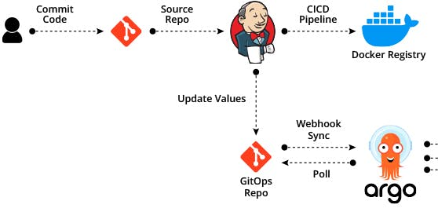


Slide 9
Demo (live/Recorded)
- start from empty cluster in gcp
- upload argo using helm command
- create argo app/s to apply an all inclusive Web application in cluster

