Slide 1
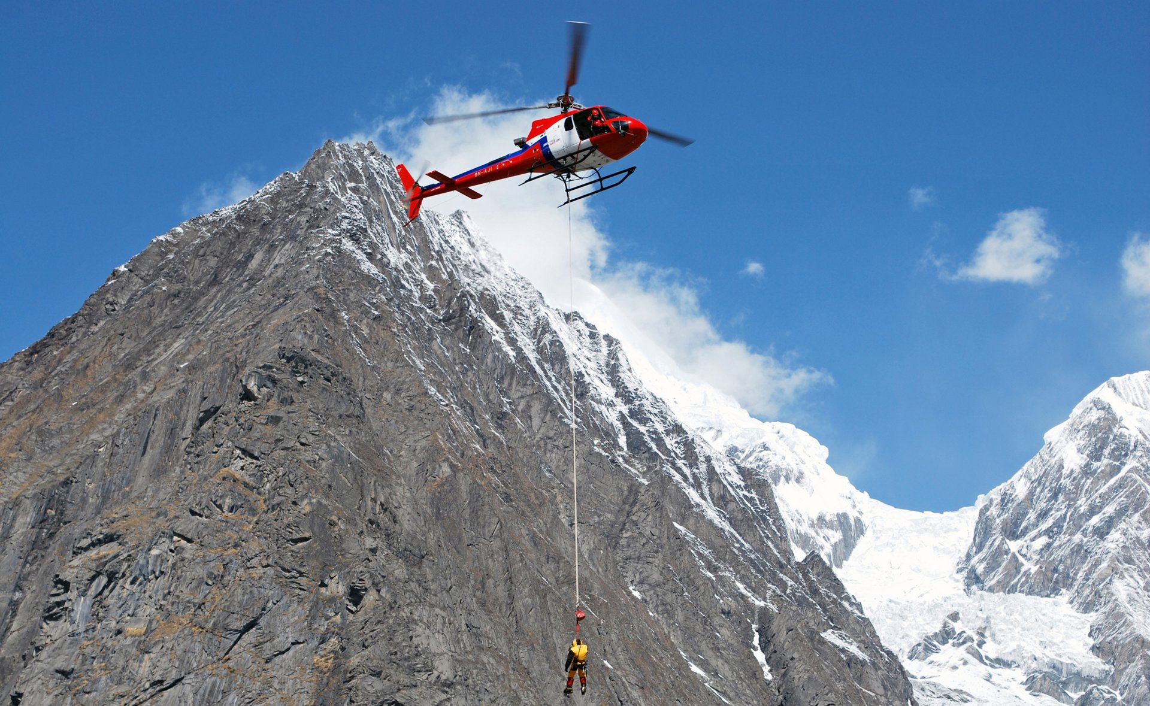

Mountain Rescue Challenge
Imagine that you're stranded on a mountain in the Himalayas, helicopters sadly cannot reach you in your current position.
Don’t worry – you have the SafeZone app!
The app helps you find the safest and easiest route to a place where you can be rescued.
All you need to do is download the relevant maps and load them to the app before your trip.
TAUTOLOGY

Slide 2
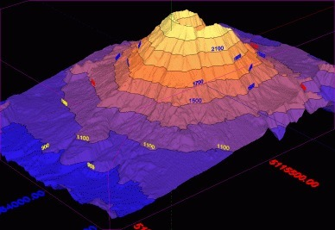
Mountain Rescue Challenge
The SafeZone app will lead you to a rescue area:
Populated areas (villages, hostels etc.)
Topographically flat areas (for helicopter rescue if needed)
Close routes and water sources
How do we do it?
The app maps the potential safe zones in advanced.
On live scenario, the app uses GPS to find your location and plans the closest and safest route to a rescue area.
Using other user’s input about route and safe places.
TAUTOLOGY

