Slide 1
Presenters
Shakeel Khan
Shakeel Khan
Nimra Sajid
date: 7 Jan, 2024

Slide 2
Raillway management system

Slide 3
Introduction
″The Railway Management System marks a signiﬁcant leap in enhancing passenger experience by introducing a modernized and computerized platform for streamlined train-relation activities.
Purpose/significance
Effortless Train Enquiry
Personalized User Experience
Streamlined Ticket Management

Slide 4
Problem
″Traditional Railway System face challenges in efficiently managing train schedules, ticket
reservations and passenger information. Manual processes often lead to inefficiencies and a lack of real-time information for both Railway authorities and passengers.

Slide 5
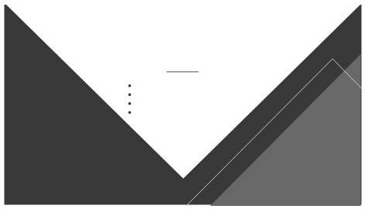
Solution
Time Savings
Customer Convenience
Automation and Digitization
Real-time Information System

Slide 6
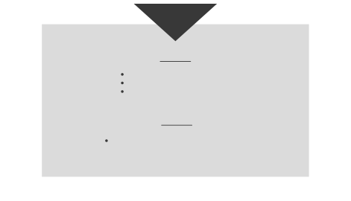
Hardware Requirements
Dedicated server for hosting
Database Storage
Reliable network connectivity
Software Requirements
We have used Microsoft SQL Server to create our Database

Slide 7
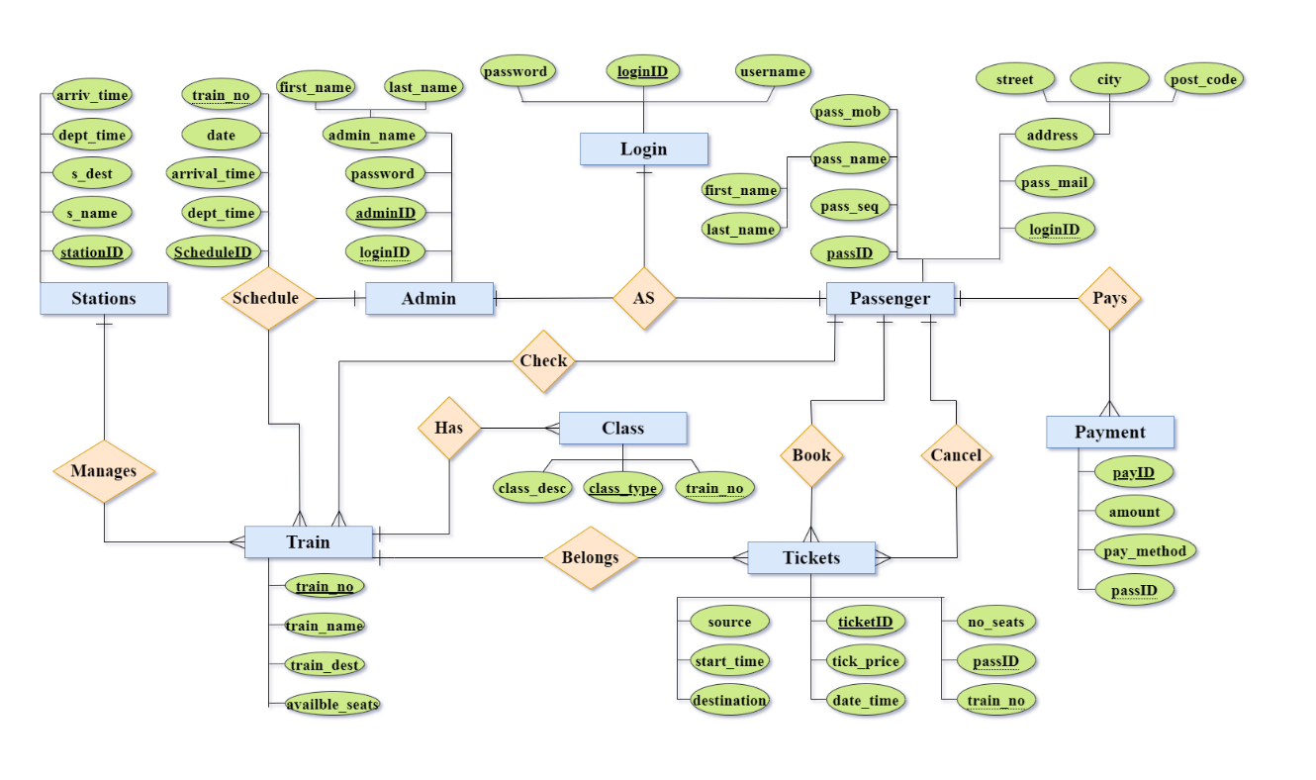
Entity
Relationship
Diagram

Slide 8
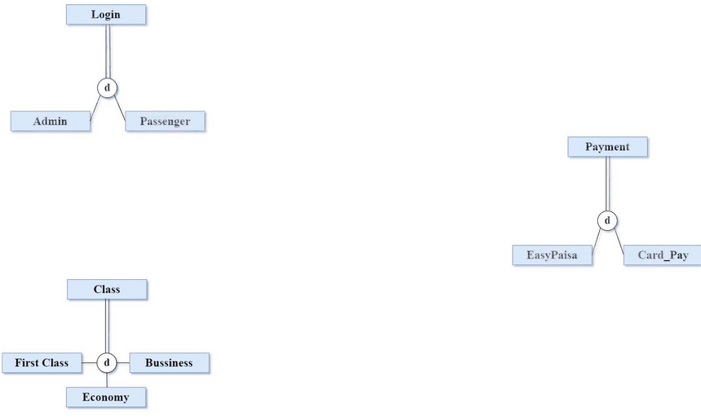
Login
The Login entity has subtypes, catering to both administrators and passengers.
Enables a clear distinction between administrator and passenger logins.
Payment
EERd concepts
Payment entity has subtypes for di erent payment methods, including EasyPaisa and Card pay.
Captures diverse payment options available to passengers.
Class
Class entity has subtypes representing di erent classes on trains.
Allows passengers to choose their preferred class during booking.

Slide 9
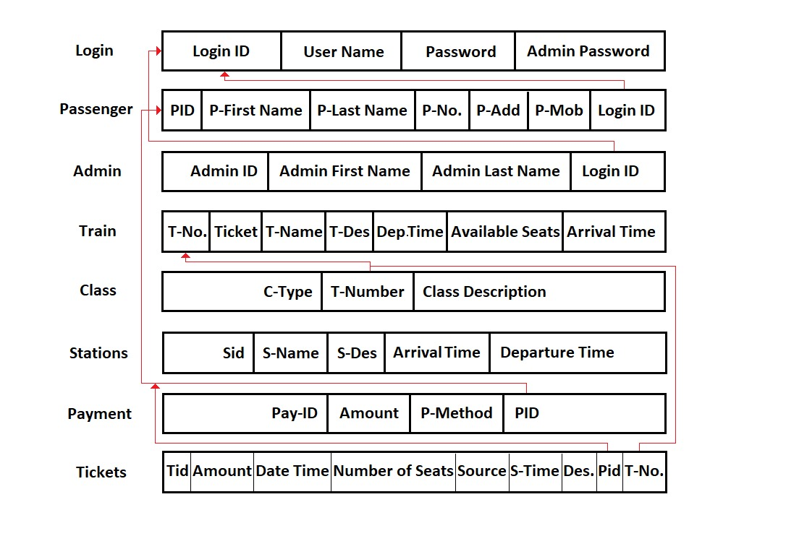
Relational Schema

Slide 10
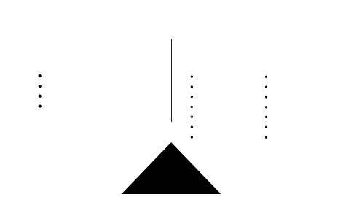
Key feautres
Tables
Fast process
Searching the data is easy
Information is accurate
Data is more efficient
Login
Passenger
Admin
Train
Tickets
Schedule
Class
Stations
Payment
Business
First Class
Economy
Card Pay
EasyPaisa

Slide 11
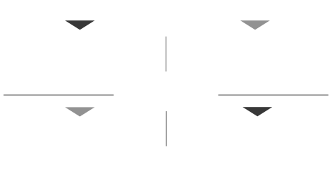
query to fetch schedule details with source and destination
Retrieve all trains and their available seats
SELECT s.schedule_id, s.departure_time, s.arrival_time, s.date, t.source, t.destination FROM Schedule s JOIN Train t ON s.tno = t.tno;
SELECT Train.tno, Train.tticket, Train.tname, Train.tdes, Train.departure_time, Train.arrival_time, Train.available_seats FROM Train;
Retrieve the payment details for a specific passenger
Retrieve the classes available for a specific tr ain
SELECT Payment.payid, Payment.amount, Payment.pmethod .FROM Payment
WHERE Payment.pid = {passenger_id};
SELECT Class.ctype, Class.class_description FROM Class WHERE Class.tno = {train_number};

Slide 12
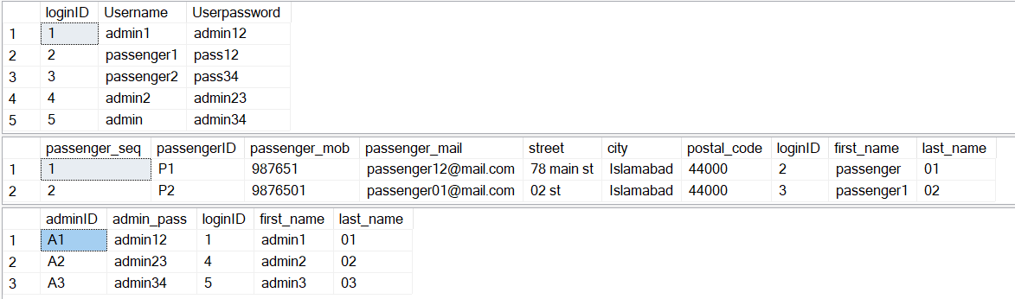
Relations With Data

Slide 13
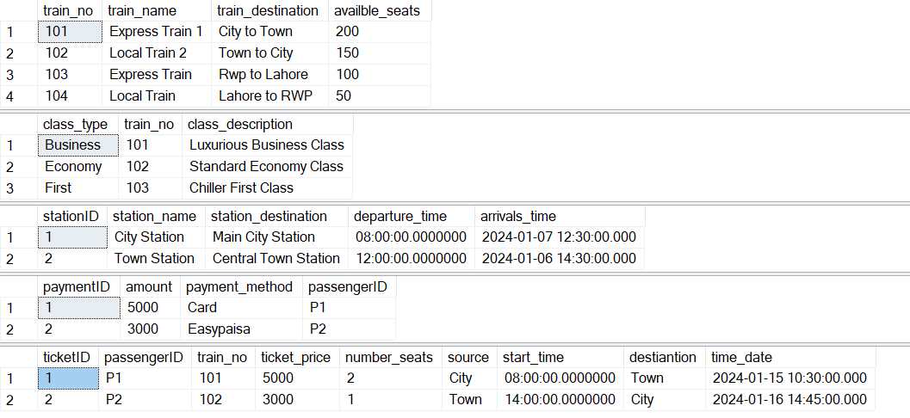
Relations With Data

Slide 14
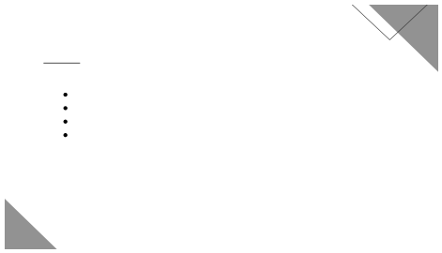
Future Work
Feedback Mechanism
Real-time train tracking integration
Develop a mobile app for greater accessibility
Regularly optimize system performance

Slide 15

Conclusion
The railway management system modernizes traditional rail services By streamlining the reservation process, we aim to enhance the overall user experience, o ering passengers a modern and e cient platform for booking and managing their train journeys.

Slide 16
Q & A

Slide 17
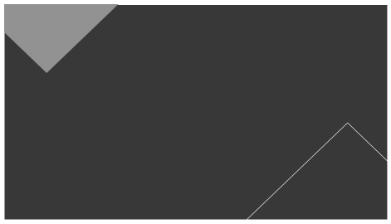
Thanks you

