Slide 1

RAJASTHAN INSTITUTE OF ENGINEERING AND TECHNOLOGY , JAIPUR
Department of Computer Science Engineering
Present To:
Mr Mukesh Chaudhary
( Asst. Prof. )
Present By:
Mohammad Shakeel Ahamad
16ERECS022
VII Sem.
Computer Science

Slide 2
WHAT WE GIVE YOU ?
Python Introduction.
Why Python ?
Object Oriented Concepts.
Data Analysis.
Numpy.
Pandas.
Machine Learning With Python.
Basic.
Classification.
Clustering.
Regression.
Django.

Slide 3
Python Introduction

Slide 4
INTRODUCTION
Python is a widely used general-purpose, high level programming language. It was initially designed by Guido van Rossum in 1991 and developed by Python Software Foundation. It was mainly developed for emphasis on code readability, and its syntax allows programmers to express concepts in fewer lines of code.
Python is a programming language that lets you work quickly and integrate systems more efficiently.

Slide 5
WHY PYTHON ? ? ? ? ? ? ? ?
Designed to be easy to learn and master.
Clean , Clear Syntax.
Very Few Keywords.
Highly Portable.
Runs Almost Anywhere – high end servers and workstations, down to window CE.
Uses Machine Independent Bytecode.
Extensible.
Designed to be extensible using C/C++, allowing access to many external libraries.

Slide 6
Productivity !
Reduced Development Time.
> code is 2-10x shorter than c, c++ , Java.
Improve Program Maintenance.
> Code is extremely readable.
Less Training.
> Language is very easy to learn.

Slide 7
Object oriented concepts

Slide 8
OOP’s
Python is a multi-paradigm programming language. Meaning, it supports different programming approach.
One of the popular approach to solve a programming problem is by creating objects. This is known as Object-Oriented Programming (OOP).
An object has two characteristics:
> attributes
> behavior
Let's take an example:
> Parrot is an object,
> name, age, color are attributes
> singing, dancing are behavior

Slide 9
1. | Inheritance | A process of using details from a new class without modifying existing class.
2. | Encapsulation | Hiding the private details of a class from other objects.
3. | Polymorphism | A concept of using common operation in different ways for different data input.

Slide 10
DATA ANALysis

Slide 11
Data visualization using Bokeh
Bokeh is a data visualization library in Python that provides high-performance interactive charts and plots. Bokeh output can be obtained in various mediums like notebook, html and server. It is possible to embed bokeh plots in Django and flask apps.
bokeh.models : A low level interface that provides high flexibility to application developers. bokeh.plotting : A high level interface for creating visual glyphs.

Slide 12
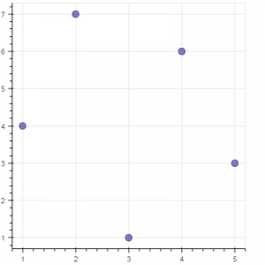
Example.
# import modules
from bokeh.plotting import figure, output_notebook, show
# output to notebook
output_notebook()
# create figure
p = figure(plot_width = 400, plot_height = 400)
# add a circle renderer with
# size, color and alpha
p.circle([1, 2, 3, 4, 5], [4, 7, 1, 6, 3],
size = 10, color = "navy", alpha = 0.5)
# show the results
show(p)

Slide 13
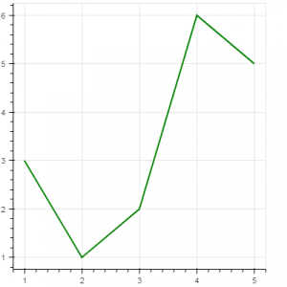
Example 2.
# import modules
from bokeh.plotting import figure, output_notebook, show
# output to notebook
output_notebook()
# create figure
p = figure(plot_width = 400, plot_height = 400)
# add a line renderer
p.line([1, 2, 3, 4, 5], [3, 1, 2, 6, 5],
line_width = 2, color = "green")
# show the results
show(p)

Slide 14
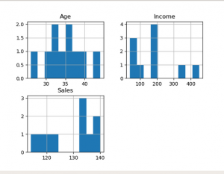
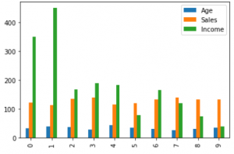
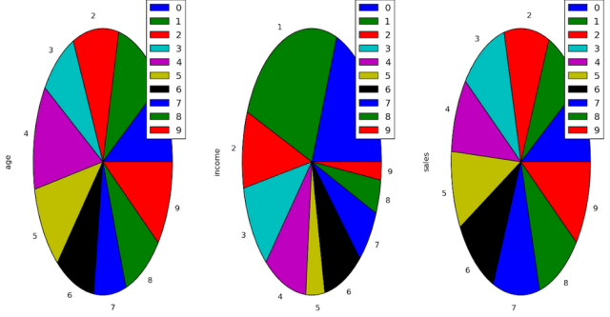
Data visualization
Data Visualization is the presentation of data in graphical format. It helps people understand the significance of data by summarizing and presenting huge amount of data in a simple and easy-to-understand format and helps communicate information clearly and effectively.
1. Histogram :
2. Column Chart :
3.Pie Chart :

Slide 15
Example.
# import pandas and matplotlib
import pandas as pd
import matplotlib.pyplot as plt
# create 2D array of table given above
data = [['E001', 'M', 34, 123, 'Normal', 350],
['E002', 'F', 40, 114, 'Overweight', 450],
['E003', 'F', 37, 135, 'Obesity', 169],
['E004', 'M', 30, 139, 'Underweight', 189],
['E005', 'F', 44, 117, 'Underweight', 183],
['E006', 'M', 36, 121, 'Normal', 80],
['E007', 'M', 32, 133, 'Obesity', 166],
['E008', 'F', 26, 140, 'Normal', 120],
['E009', 'M', 32, 133, 'Normal', 75],
['E010', 'M', 36, 133, 'Underweight', 40] ]
# dataframe created with
# the above data array
df = pd.DataFrame(data, columns = ['EMPID', 'Gender',
'Age', 'Sales',
'BMI', 'Income'] )
# create histogram for numeric data
df.hist()
# show plot
plt.show()

Slide 16
NUMPY
Numpy is a general-purpose array-processing package. It provides a high-performance multidimensional array object, and tools for working with these arrays. It is the fundamental package for scientific computing with Python. Besides its obvious scientific uses, Numpy can also be used as an efficient multi-dimensional container of generic data.
Arrays in Numpy
Array in Numpy is a table of elements (usually numbers), all of the same type, indexed by a tuple of positive integers. In Numpy, number of dimensions of the array is called rank of the array.A tuple of integers giving the size of the array along each dimension is known as shape of the array. An array class in Numpy is called as ndarray. Elements in Numpy arrays are accessed by using square brackets and can be initialized by using nested Python Lists.
Creating a Numpy Array Arrays in Numpy can be created by multiple ways, with various number of Ranks, defining the size of the Array. Arrays can also be created with the use of various data types such as lists, tuples, etc. The type of the resultant array is deduced from the type of the elements in the sequences.

Slide 17
Example.
Import numpy as np
arr=np.array[1, 2, 3, 4, 5]
for i in arr:
print(i)
Output:-
1
2
3
4
5

Slide 18
PANDAS
Pandas DataFrame :- is two-dimensional size-mutable, potentially heterogeneous tabular data structure with labeled axes (rows and columns). A Data frame is a two-dimensional data structure, i.e., data is aligned in a tabular fashion in rows and columns. Pandas DataFrame consists of three principal components, the data, rows, and columns.
Creating a DataFrame.
Dealing With Row and Column.
Indexing and Selecting Data.
Working With Missing Data.
Itreating Over Rows And Column.

Slide 19
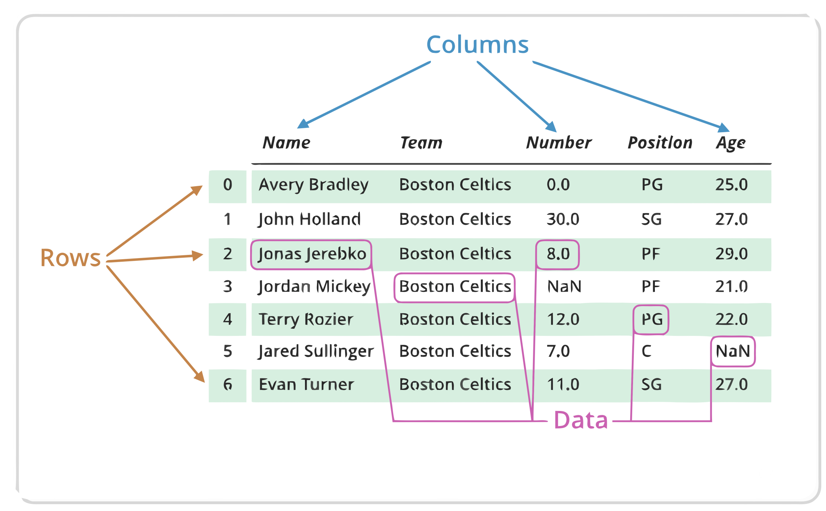

Slide 20
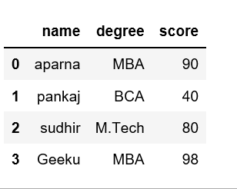
Example.
Output.
# importing pandas as pd
import pandas as pd
# dictionary of lists
dict = {'name':["aparna", "pankaj", "sudhir", "Geeku"],
'degree': ["MBA", "BCA", "M.Tech", "MBA"],
'score':[90, 40, 80, 98]}
df = pd.DataFrame(dict)
print(df)

Slide 21
MACHINE LEARNING

Slide 22
Introduction
Machine learning is a subfield of artificial intelligence (AI). The goal of machine learning generally is to understand the structure of data and fit that data into models that can be understood and utilized by people.
Although machine learning is a field within computer science, it differs from traditional computational approaches. In traditional computing, algorithms are sets of explicitly programmed instructions used by computers to calculate or problem solve. Machine learning algorithms instead allow for computers to train on data inputs and use statistical analysis in order to output values that fall within a specific range. Because of this, machine learning facilitates computers in building models from sample data in order to automate decision-making processes based on data inputs.

Slide 23
Terminology
• Features
– The number of features or distinct traits that can be used to describe each item in a quantitative manner.
• Samples
– A sample is an item to process (e.g. classify). It can be a document, a picture, a sound, a video, a row in database or CSV file, or whatever you can describe with a fixed set of quantitative traits.
• Feature vector
– is an n-dimensional vector of numerical features that represent some object.
• Feature extraction
– Preparation of feature vector – transforms the data in the high-dimensional space to a space of fewer dimensions.
• Training/Evolution set
– Set of data to discover potentially predictive relationships.

Slide 24
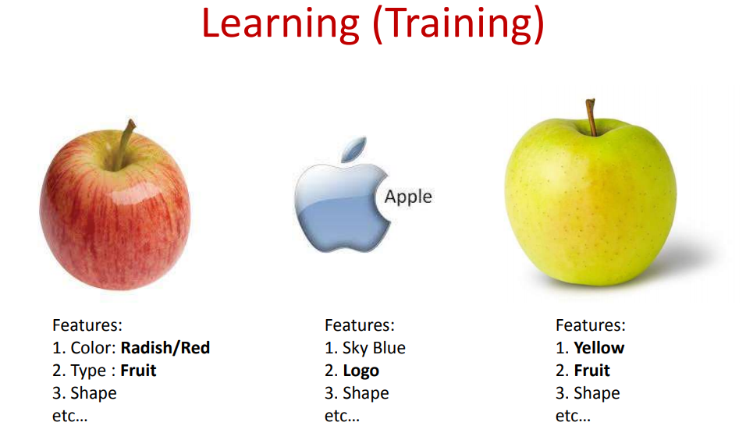

Slide 25
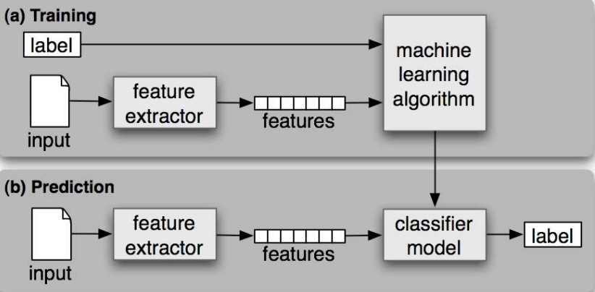
WORK FLOW

Slide 26
CATEGORIES
Supervised Learning
-the correct classes of the training data are known.
Unsupervised Learning
-the correct classes of the training data are not
known.

Slide 27
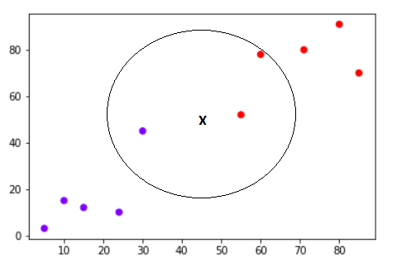
KNN ALGORIYHM
The K-nearest neighbors (KNN) algorithm is a type of supervised machine learning algorithms. KNN is extremely easy to implement in its most basic form, and yet performs quite complex classification tasks. It is a lazy learning algorithm since it doesn't have a specialized training phase. Rather, it uses all of the data for training while classifying a new data point or instance.

Slide 28
CLASSIFICATION
• classify a document into a predefined category.
• documents can be text, images • Popular one is Naive Bayes Classifier.
• Steps:
– Step1 : Train the program (Building a Model) using a training set with a category for e.g. sports, cricket, news,
– Classifier will compute probability for each word, the probability that it makes a document belong to each of considered categories
– Step2 : Test with a test data set against this Model

Slide 29
CLUSTeRING
• clustering is the task of grouping a set of objects in such a way that objects in the same group (called a cluster) are more similar to each other
• objects are not predefined
• For e.g. these keywords
– “man’s shoe”
– “women’s shoe”
– “women’s t-shirt”
– “man’s t-shirt”
– can be cluster into 2 categories “shoe” and “t- shirt” or “man” and “women”
• Popular ones are K-means clustering and Hierarchical clustering

Slide 30
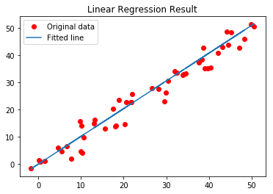
Regression
• is a measure of the relation between the mean value of one variable (e.g. output) and corresponding values of other variables (e.g. time and cost).
• regression analysis is a statistical process for estimating the relationships among variables.
• Regression means to predict the output value using training data.
• Popular one is Logistic regression (binary regression)

Slide 31

Thank you.

