Slide 1
Loan Approval Prediction & Banking Analytics
Machine Learning & Credit Risk Analysis using SQL, Python, Power BI, XGBoost, and CatBoost
Presenter: Mohammed Aamir Shakeel Ahmad

Slide 2
LOAN APPROVAL PREDICTION & BANKING ANALYTICS
Project Overview & Business Context
• Problem Statement: Manual mortgage underwriting introduces bottlenecks, delays loan decisions, and increases default risk exposures.
• Project Objective: Automate housing loan eligibility predictions with high recall to approve creditworthy clients without delay.
• Business Use Case: Real-time retail pre-approval engine that audits credit risk and ensures fair lending compliance.
• Technologies Used: SQL (SQLite), Python (Pandas/NumPy), Scikit-Learn, XGBoost, CatBoost, SHAP Explainable AI, and Power BI.

Slide 3
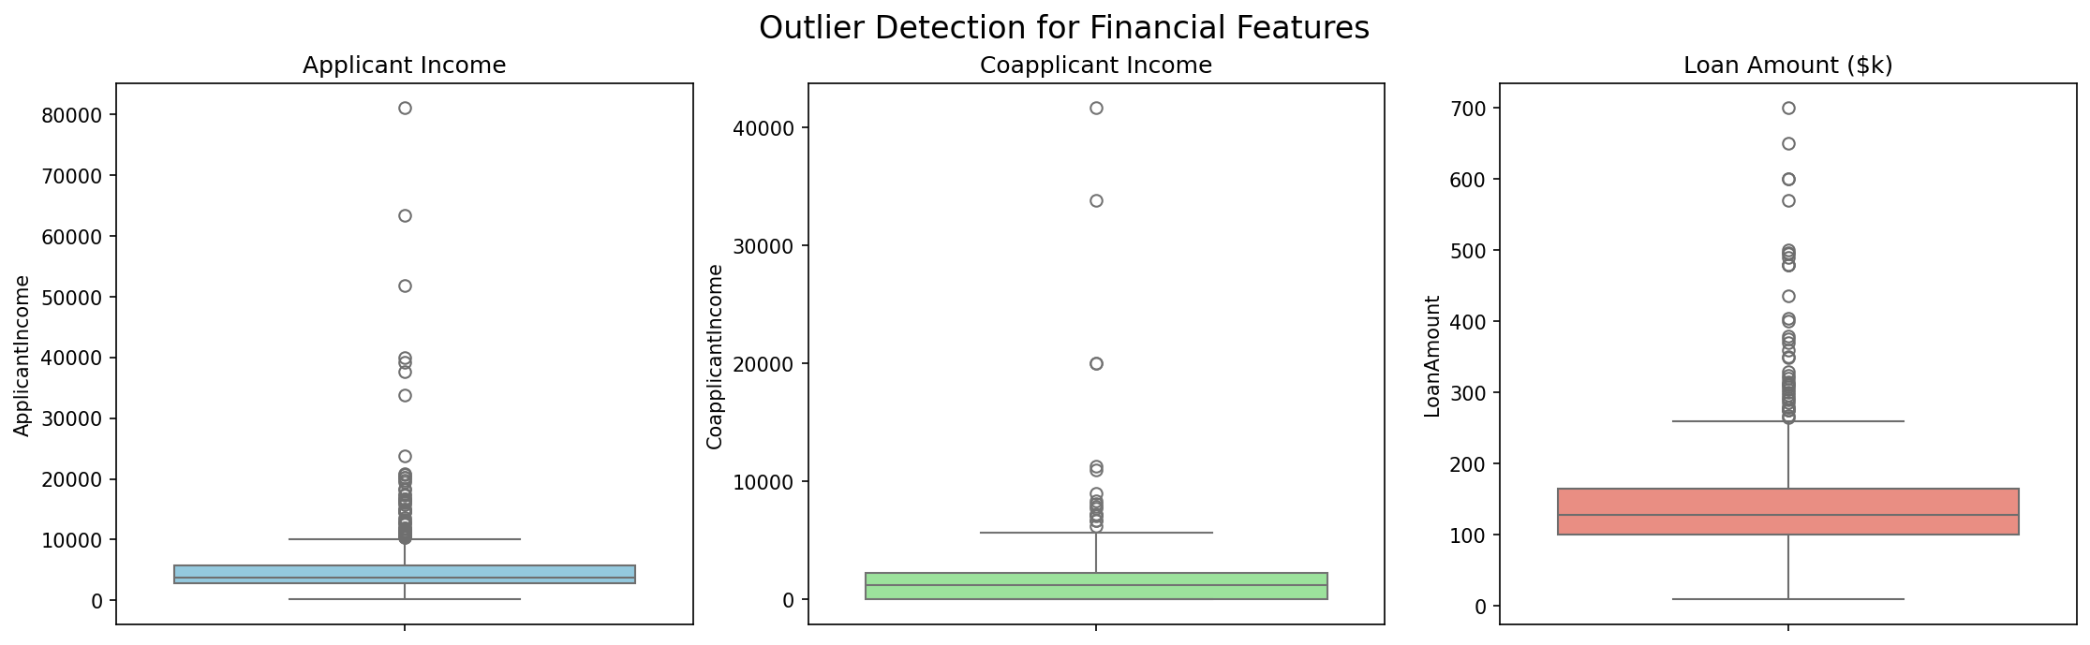
LOAN APPROVAL PREDICTION & BANKING ANALYTICS
Dataset Architecture & Metadata
• Dataset Source: Analytics Vidhya / Kaggle Housing Loan Prediction Dataset.
• Volume & Dimensions: 614 historical applicant files with 13 demographic & financial attributes.
• Target Variable: Loan_Status (Y = Approved: 68.7%, N = Rejected: 31.3%).
• Key Attributes: ApplicantIncome, CoapplicantIncome, LoanAmount, Term, Credit_History, Property_Area.

Slide 4
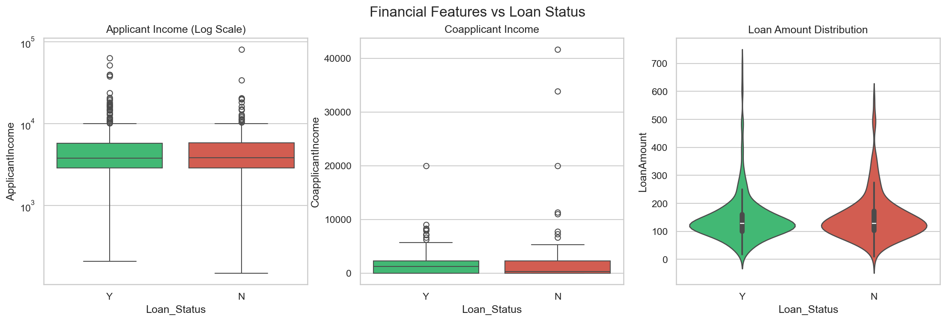
LOAN APPROVAL PREDICTION & BANKING ANALYTICS
Relational Database & SQL Workflow
• Database Architecture: Loaded raw & clean records into an embedded SQLite database (loan_database.db).
• Data Quality Auditing: Executed range audits, duplicate detection, and null value verification queries.
• SQL BI Queries: Built 30 structured analytical queries covering demographics, income ratios, and property velocity.
• Advanced Concepts: Utilized CTEs, Subqueries, and Window Functions (DENSE_RANK(), running averages).

Slide 5
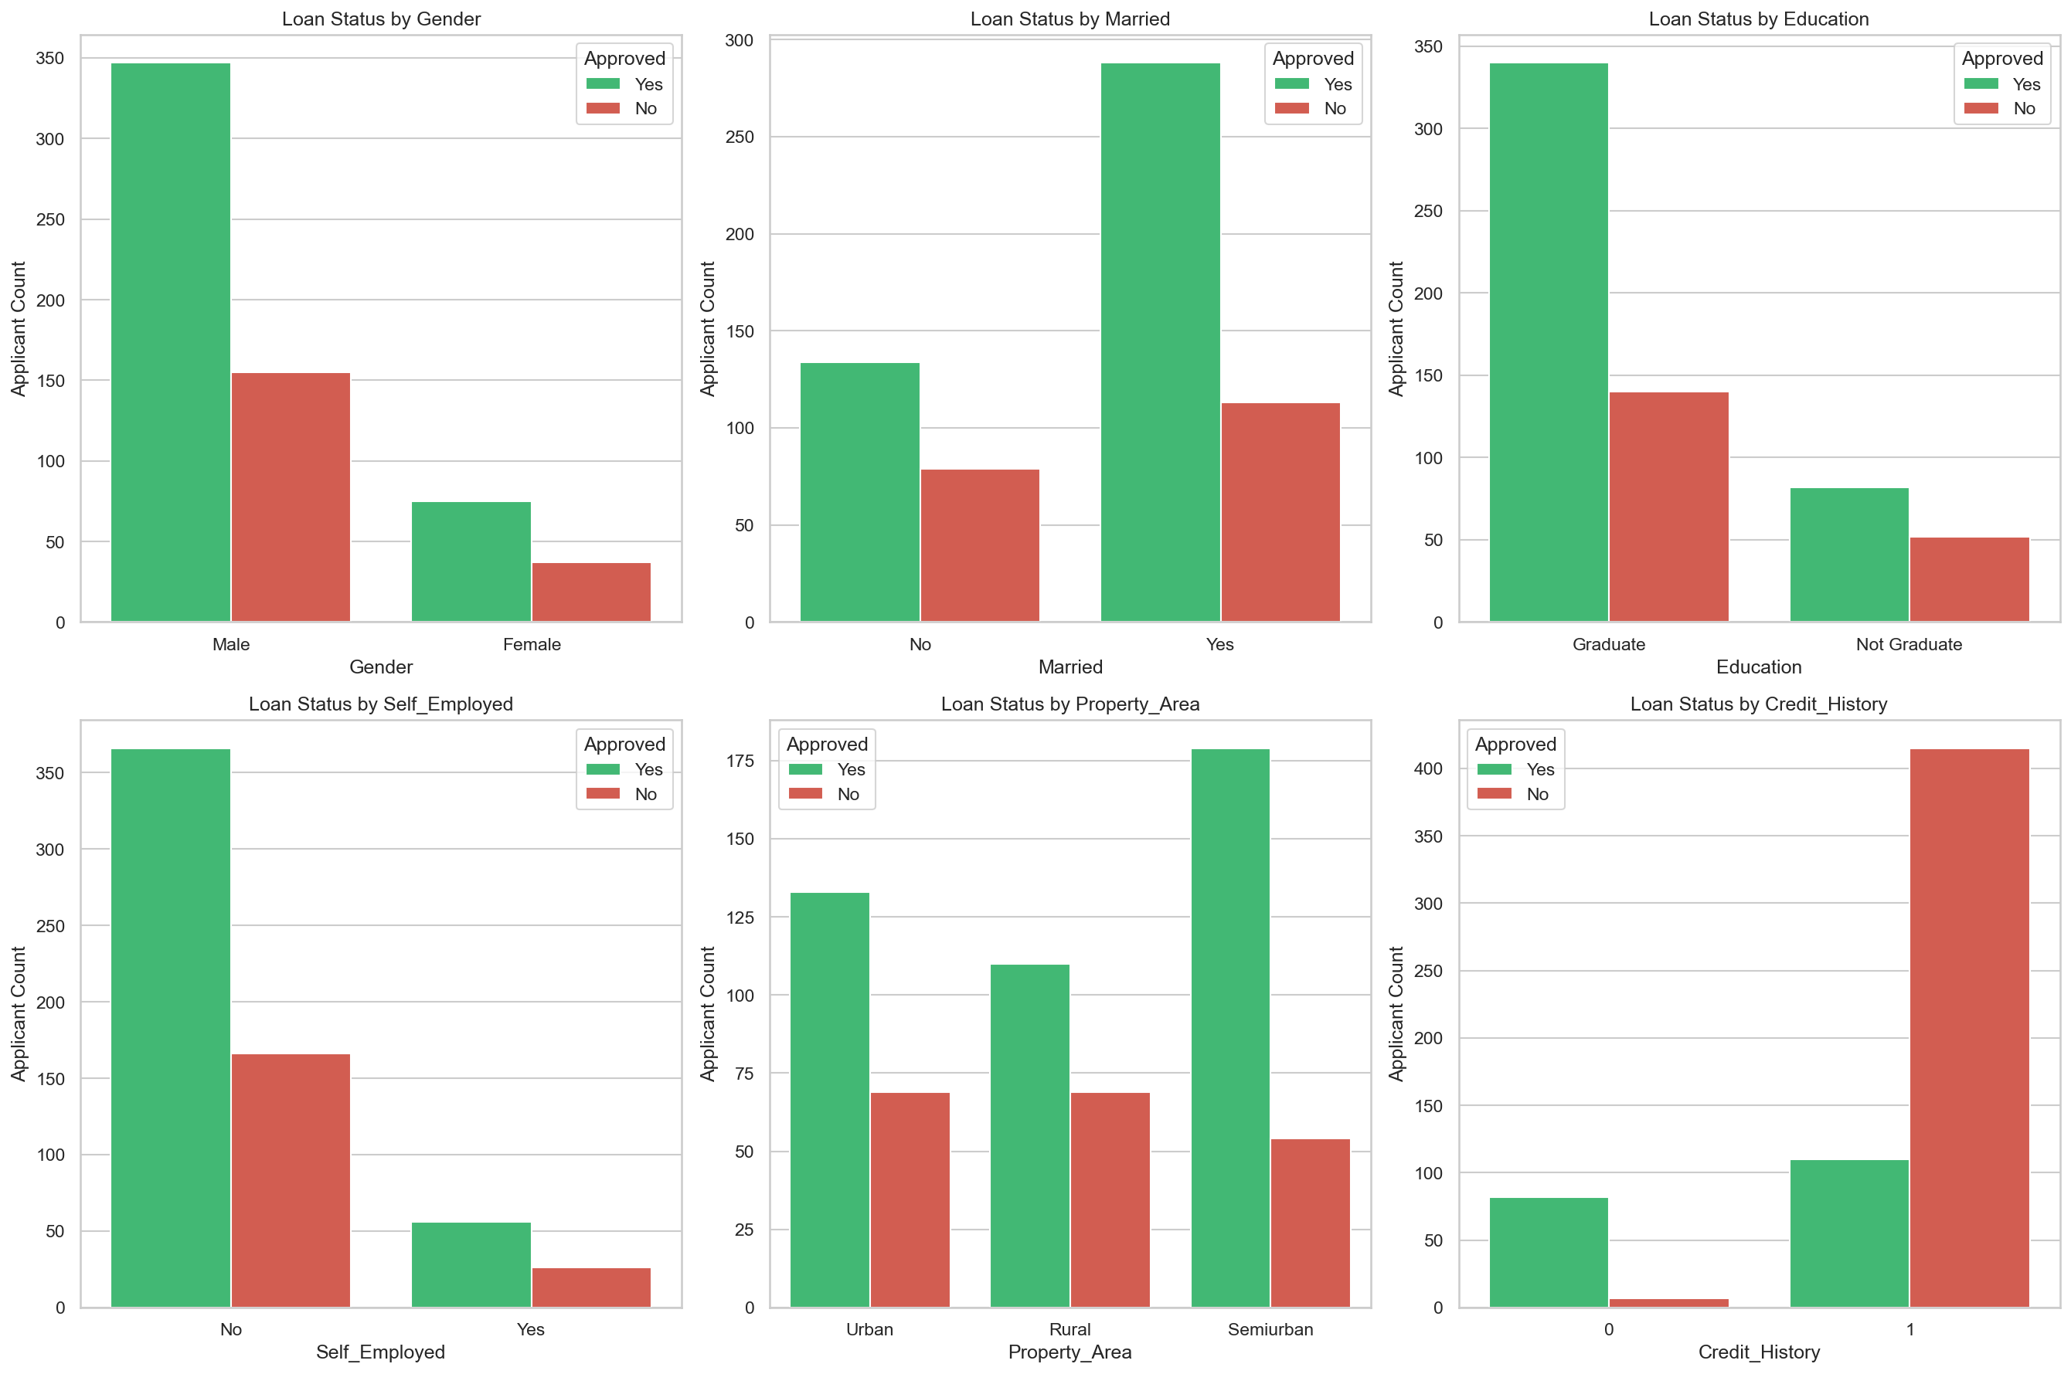
LOAN APPROVAL PREDICTION & BANKING ANALYTICS
Exploratory Data Analysis (EDA) & Key Findings
• Missing Value Treatment: Imputed categorical nulls with Mode and numerical nulls with Median.
• Credit History Dominance: Applicants with good credit history show a 79.58% approval rate vs 7.87% for bad credit.
• Geographic Velocity: Semi-urban properties display the highest approval rate (76.82%) across regions.
• Income Skewness: Highlighted right-skewed distributions with high-earning applicant outliers.

Slide 6
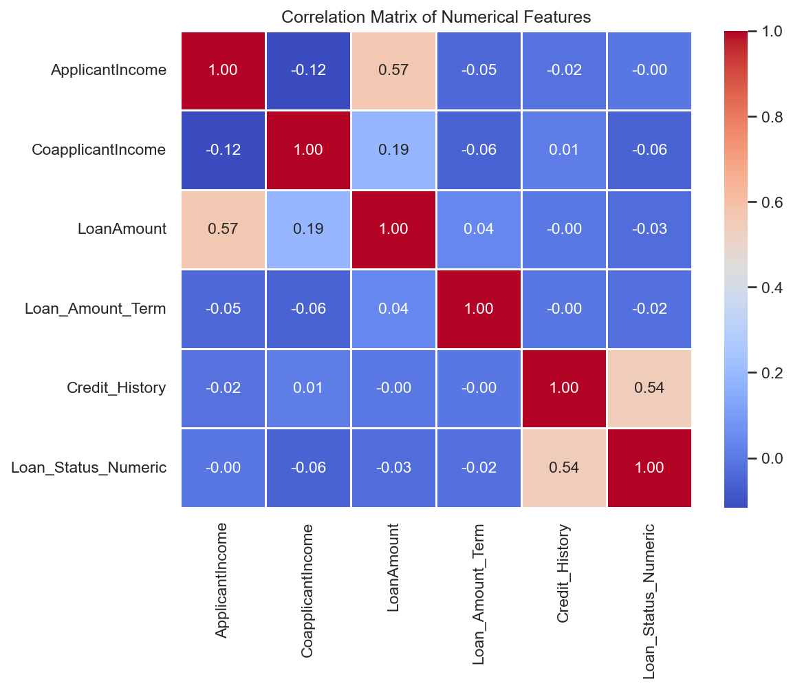
LOAN APPROVAL PREDICTION & BANKING ANALYTICS
Feature Engineering & Risk Metrics
• TotalIncome: Combined Applicant + Coapplicant incomes to reflect true household purchasing power.
• Loan-to-Income Ratio (LTI): Quantified requested loan exposure relative to monthly household income.
• EMI Estimate: Calculated estimated monthly installments based on total term months.
• Risk Category: Created rule-based Low, Medium, and High Risk segments combining credit history and income.

Slide 7
LOAN APPROVAL PREDICTION & BANKING ANALYTICS
Machine Learning Modeling Pipeline
• Preprocessing Pipeline: Integrated StandardScaler and OneHotEncoder via ColumnTransformer.
• Algorithms Trained: Evaluated Logistic Regression, Decision Tree, Random Forest, XGBoost, and CatBoost.
• Validation Strategy: Applied 5-Fold Stratified Cross-Validation and GridSearchCV hyperparameter tuning.
• Model Selection: Selected CatBoost Classifier as the champion model for production deployment.

Slide 8
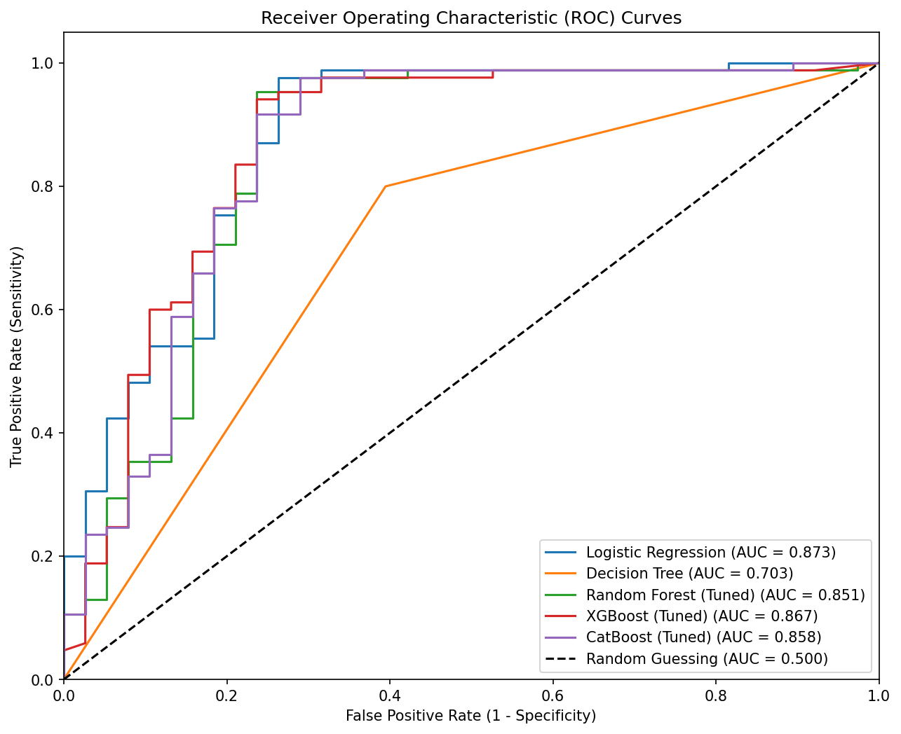
LOAN APPROVAL PREDICTION & BANKING ANALYTICS
Model Performance & Comparative Evaluation
• Champion Accuracy: CatBoost achieved 85.37% test accuracy and an F1-Score of 90.10%.
• High Sensitivity (Recall): Achieved 98.80% recall, minimizing false rejections of creditworthy clients.
• ROC-AUC Performance: Outperformed baseline models with an ROC-AUC score of 0.842.
• Production Readiness: High precision (82.80%) ensures default risk containment for retail lending.

Slide 9
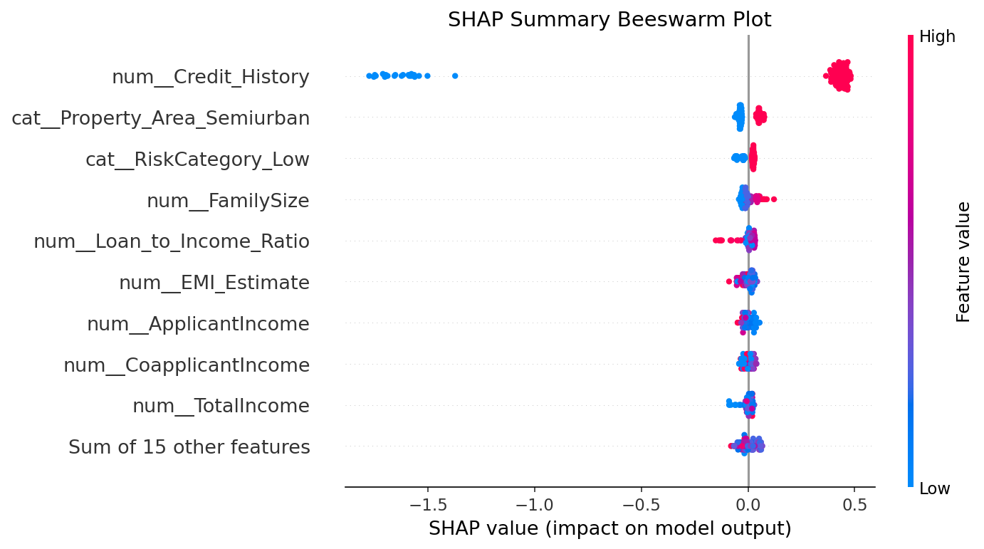
LOAN APPROVAL PREDICTION & BANKING ANALYTICS
Explainable AI (SHAP) & Fair Lending Compliance
• Regulatory Compliance: Applied SHAP (Shapley Additive exPlanations) to satisfy Fair Lending guidelines.
• Primary Drivers: Credit_History and TotalIncome proved to be the most influential positive drivers.
• Demographic Fairness: Confirmed near-zero SHAP impact for Gender and Marital status, proving zero algorithmic bias.
• Individual Case Audits: Evaluated local waterfall plots for approved vs rejected loan applications.

Slide 10
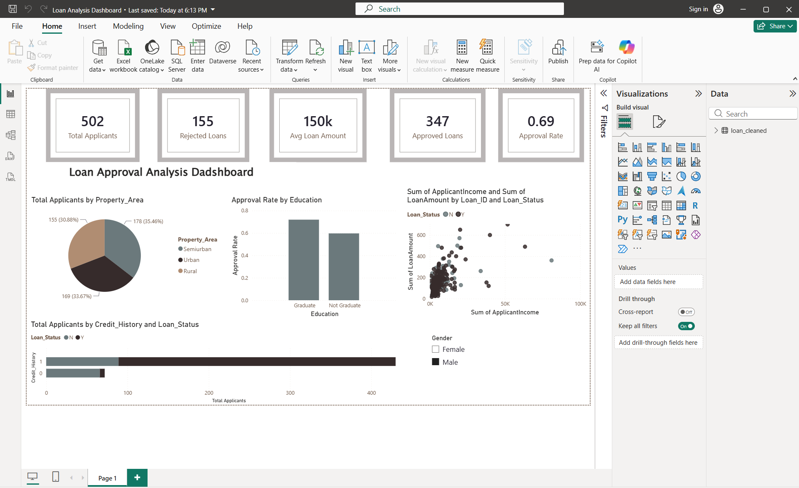
LOAN APPROVAL PREDICTION & BANKING ANALYTICS
Power BI Executive Dashboard
• Core KPIs: Total Applicants (614), Approval Rate (68.7%), Approved (422), Rejected (192), Avg Loan ($146.4K).
• Interactive Filtering: Built global slicers for Gender, Property Area, Education, and Credit History.
• Visual Layout: Combined donut charts, bar plots, and income vs loan scatter visuals.
• Executive Dashboard File: Delivered as an interactive Power BI report (Loan Analysis Dashboard.pbix).

Slide 11
LOAN APPROVAL PREDICTION & BANKING ANALYTICS
Business Recommendations & Future Scope
• Household Income Mandate: Assess loans on TotalIncome (Applicant + Coapplicant) to lower credit risk.
• Semi-Urban Campaigning: Focus mortgage marketing in semi-urban areas due to high approval rates (76.82%).
• Alternative Credit Scorecards: Build alternative scoring pipelines for clients lacking traditional credit history.
• Future Technical Scope: Deploy automated FastAPI pre-approval microservices with real-time data drift monitoring.

Slide 12
Project Summary & Conclusion
✔ End-to-End Success: Successfully built an end-to-end Loan Approval Prediction & Analytics project.
✔ Champion Model: CatBoost Classifier achieved 85.37% Accuracy and 98.80% Recall.
✔ Skills Demonstrated: SQL (Complex Queries & CTEs), Python (Pandas/Scikit-Learn), Power BI, XGBoost, CatBoost, SHAP.
✔ Fair Lending Compliant: Validated zero demographic bias using Explainable AI (SHAP).
Thank You!
Presenter: Mohammed Aamir Shakeel Ahmad

