Slide 1


Lecture 01
Dr. Shakeel Ahmed
Assistant Professor Statistics, School of Natural Sciences
NUST H-12 Islamabad

Slide 2
Overview
What is Python?
How to “install Python” on your computer?
How to write and execute Python codes?

Slide 3
What is Python?
Python is a programming language.
Provides us with a strict set of grammatical rules that correspond to well-defined instructions for a computer.
We can write text documents that are relatively simple and intuitive for humans to read, and
Can inform the computer to perform precise operations.
Python code is simply text that conforms to the Python language.

Slide 4
Python
“Python is an experiment in how much freedom programmers need. Too much freedom and nobody can read another's code; too little and expressiveness is endangered.”
- Guido van Rossum

Slide 5
What is a Python Interpreter?
A Python interpreter is any computer program that is capable of :
Read in a text file (e.g. my_code.py).
Parse the text and determine if it obeys the rules of the Python language.
Translate the parsed text into instructions, according to the Python language’s specifications.
Instruct the computer to carry out the tasks.
A Python script is executed from top-to-bottom by the interpreter.

Slide 6
Installing Python
Python and other useful Python libraries can be installed via the Anaconda platform.
Installing the Anaconda platform will install the following:
Python; specifically, the CPython interpreter that we discussed in the previous section.
A number of useful Python packages, like matplotlib, NumPy, and SciPy.
Jupyter, which provides an interactive “notebook” environment for prototyping code.
conda: a package manager that will allow you to install and update Python and additional Python packages, while handling all compatibility issues for you.

Slide 7
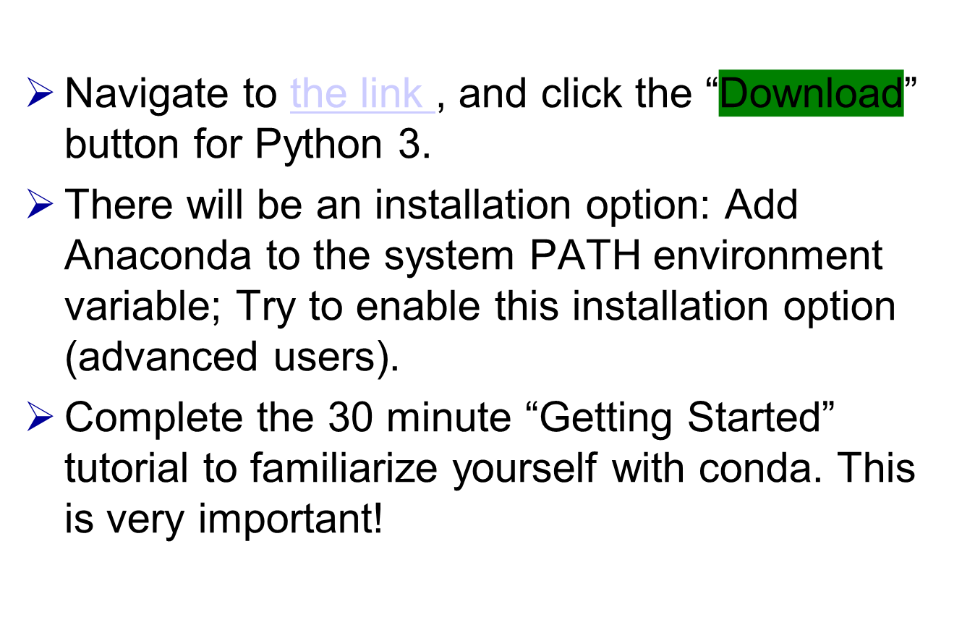
Installing Anaconda

Slide 8
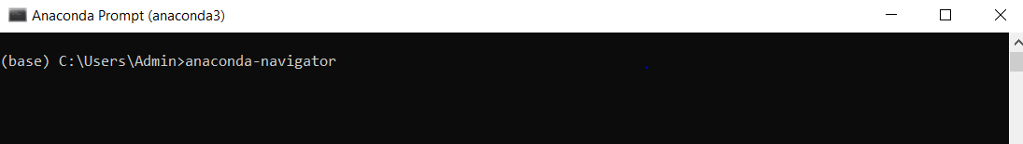
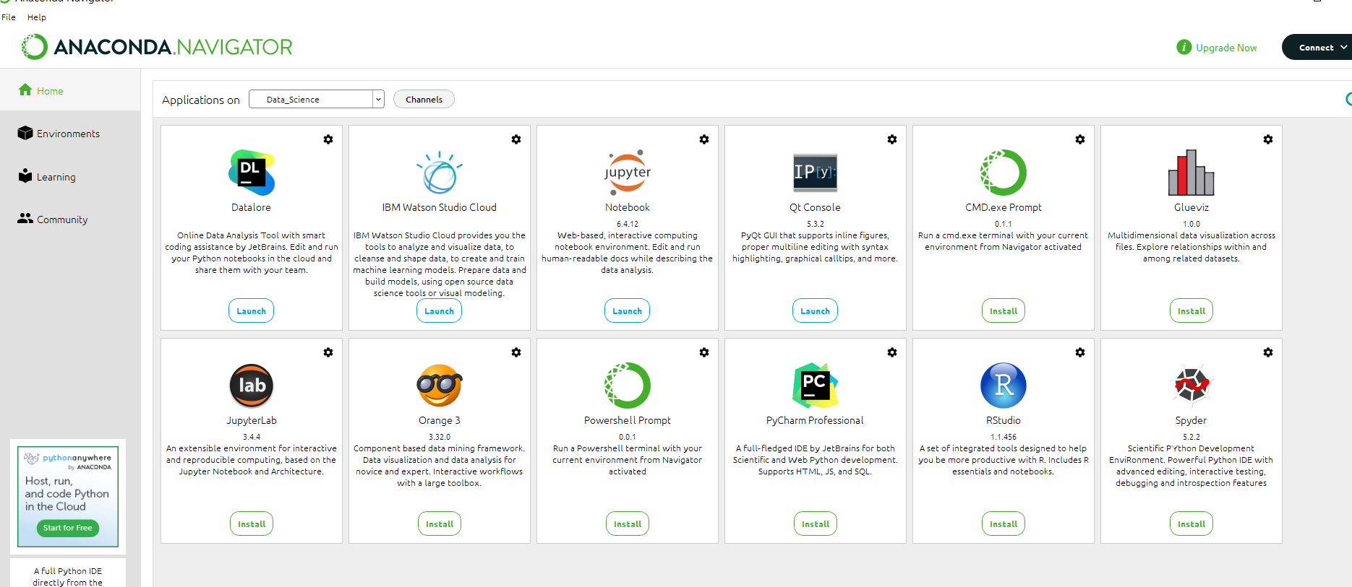
Anaconda Navigator
Go to Anaconda prompt from the search menu of your computer and
Write >>>anaconda-navigator

Slide 9
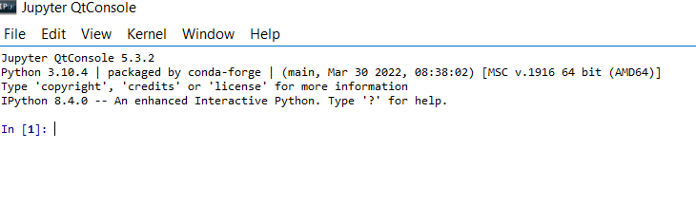
IPython console
Let’s open an IPython console from anaconda navigator
or
Start cmd.exe if you are a Windows user and type ipython into the console and hit <Enter>. You should see the following display on your screen: and you can start writing your codes here

Slide 10
Jupyter Notebook
Open Jupyter Note Book From
Anaconda Navigator
JupyterLab is the latest web-based interactive development environment for notebooks, code, and data.
Its flexible interface allows users to configure and arrange workflows in data science, scientific computing, computational journalism, and machine learning.
A modular design invites extensions to expand and enrich functionality.

Slide 11

The Basics

Slide 12
A Code Sample (in IDLE)
x = 34 - 23 # A comment.
y = “Hello” # Another one.
z = 3.45
if z == 3.45 or y == “Hello”:
x = x + 1
y = y + “ World” # String concat.
print x
print y

Slide 13
Enough to Understand the Code
Indentation matters to code meaning
  Block structure indicated by indentation
First assignment to a variable creates it
  Variable types don’t need to be declared.
  Python figures out the variable types on its own.
Assignment is = and comparison is ==
For numbers + - * / % are as expected
  Special use of + for string concatenation and % for string formatting (as in C’s printf)
Logical operators are words (and, or, not) not symbols
The basic printing command is print

Slide 14
Basic Datatypes
Integers (default for numbers)
  z = 5 / 2 # Answer 2, integer division
Floats
  x = 3.456
Strings
  Can use “” or ‘’ to specify with “abc” == ‘abc’
  Unmatched can occur within the string: “matt’s”
  Use triple double-quotes for multi-line strings or strings than contain both ‘ and “ inside of them:
  “““a‘b“c”””

Slide 15
Assignment
Binding a variable in Python means setting a name to hold a reference to some object
  Assignment creates references, not copies
Names in Python do not have an intrinsic type, objects have types
  Python determines the type of the reference automatically based on what data is assigned to it
You create a name the first time it appears on the left side of an assignment expression:
x = 3
A reference is deleted via garbage collection after any names bound to it have passed out of scope

Slide 16
Naming Rules
Names are case sensitive and cannot start with a number. They can contain letters, numbers, and underscores.
  bob Bob _bob _2_bob_ bob_2 BoB
There are some reserved words:
  and, assert, break, class, continue, def, del, elif, else, except, exec, finally, for, from, global, if, import, in, is, lambda, not, or, pass, print, raise, return, try, while

Slide 17
Naming conventions
The Python community has these recommend-ed naming conventions
joined_lower for functions, methods and, attributes
joined_lower or ALL_CAPS for constants
StudlyCaps for classes
camelCase only to conform to pre-existing conventions
Attributes: interface, _internal, __private

Slide 18
Assignment
You can assign to multiple names at the same time
  >>> v, w = 2, 3
  >>> v
  2
  >>> w
  3
This makes it easy to swap values
  >>> w, w = y, x
Assignments can be chained
  >>> a = b = x = 2

Slide 19
Types of Objects in Python
Python has five standard data types −
Numbers
String
List
Tuple
Dictionary

Slide 20
Sequence Types
Tuple: (‘john’, 32, [CMSC])
  A simple immutable ordered sequence of items
  Items can be of mixed types, including collection types
Strings: “John Smith”
  Immutable
  Conceptually very much like a tuple
List: [1, 2, ‘john’, (‘up’, ‘down’)]
  Mutable ordered sequence of items of mixed types

Slide 21
Sequence Types 1
Define tuples using parentheses and commas
  >>> tu = (23, ‘abc’, 4.56, (2,3), ‘def’)
Define lists are using square brackets and commas
  >>> li = [“abc”, 34, 4.34, 23]
Define strings using quotes (“, ‘, or “““).
  >>> st = “Hello World”
  >>> st = ‘Hello World’
  >>> st = “““This is a multi-line
  string that uses triple quotes.”””

Slide 22
Sequence Types 2
Access individual members of a tuple, list, or string using square bracket “array” notation
Note that all are 0 based…
>>> tu = (23, ‘abc’, 4.56, (2,3), ‘def’)
>>> tu[1] # Second item in the tuple.
‘abc’
>>> li = [“abc”, 34, 4.34, 23]
>>> li[1] # Second item in the list.
34
>>> st = “Hello World”
>>> st[1] # Second character in string.
‘e’

Slide 23
Positive and negative indices
>>> t = [23, ‘abc’, 4.56, (2,3), ‘def’]
Positive index: count from the left, starting with 0
  >>> t[1]
  ‘abc’
Negative index: count from right, starting with –1
  >>> t[-3]
  4.56

