Slide 1


Lecture 02
Dr. Shakeel Ahmed
Assistant Professor Statistics, School of Natural Sciences
NUST H-12 Islamabad

Slide 2

The Basics

Slide 3
Slicing: return copy of a =subset
>>> t = (23, ‘abc’, 4.56, (2,3), ‘def’)
Omit first index to make copy starting from beginning of the container
>>> t[:2]
(23, ‘abc’)
Omit second index to make copy starting at first index and going to end
>>> t[2:]
(4.56, (2,3), ‘def’)

Slide 4

Some Basic Functions
command | Function
print() | Print object onto the screen
type() | Print type of object on your screen
abs( ) | Absolute value of the object in case of numbers
Input() | Users are asked to give input
pow( ) | Power of a number pow(x,a) for base x and power a
Max(), min() | Highest value in list or tuple with number, the longest string Smallest value in list or tuple with number, the shortest string
Sorted() | Sorting object in ascending or descending order
Round() | Rounding off digits to nearest decimal
Len() | See the Length of object
id | Unique ID
Help() | To take help from web related to any function
Sum() | Sum of elements in an object

Slide 5
Types of Operators
Python supports the following types of operators.
Arithmetic Operators
Comparison (Relational) Operators
Assignment Operators
Logical Operators
Bitwise Operators (excluded)
Membership Operators
Identity Operators

Slide 6
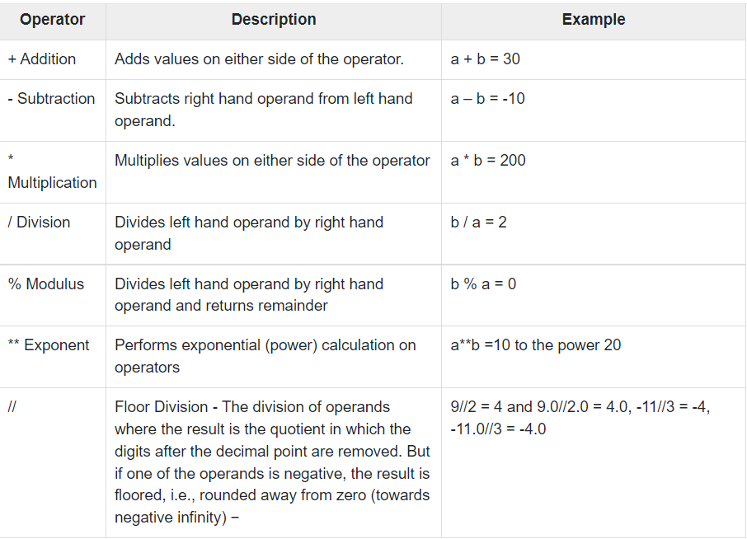
Arithmetic Operators

Slide 7
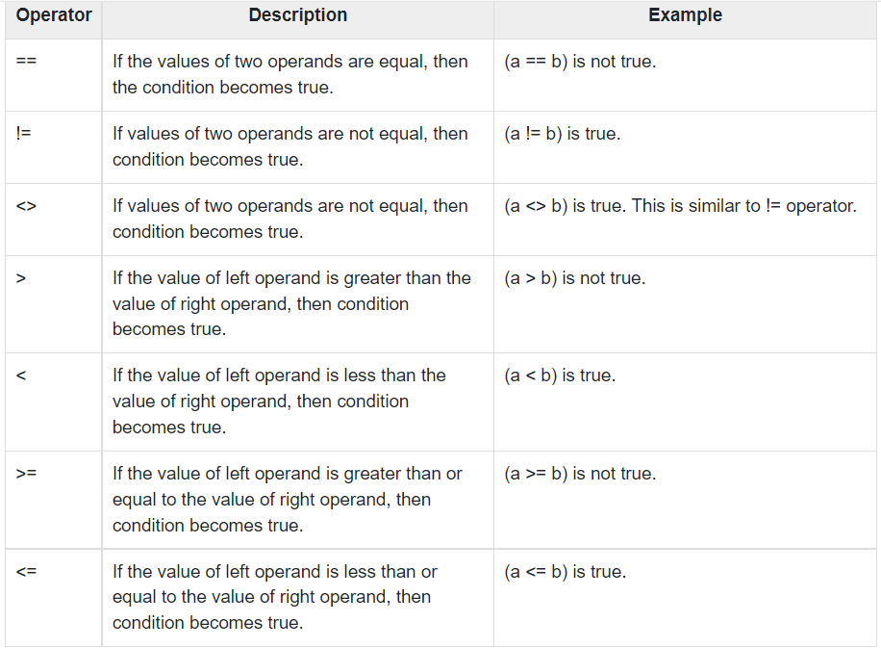
Comparison Operators

Slide 8
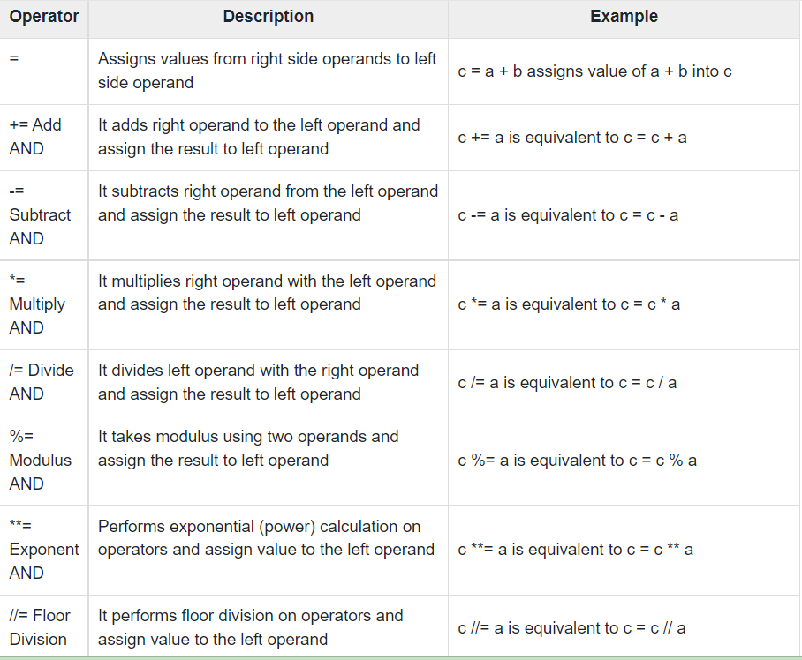
Assignment Operators

Slide 9
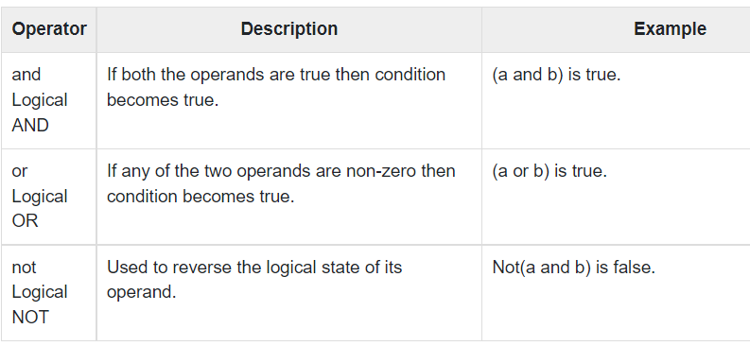
Logical Operators

Slide 10
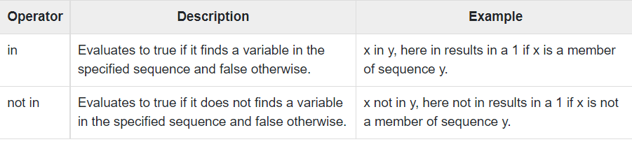
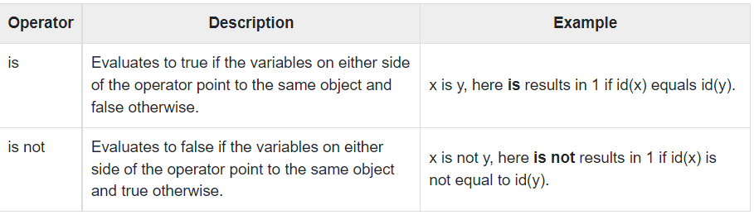
Membership Operators
Identity Operators

Slide 11
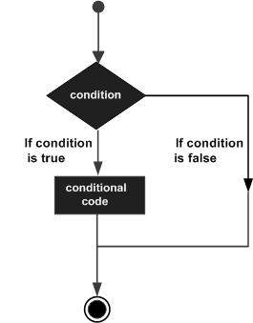
Decision Making

Slide 12
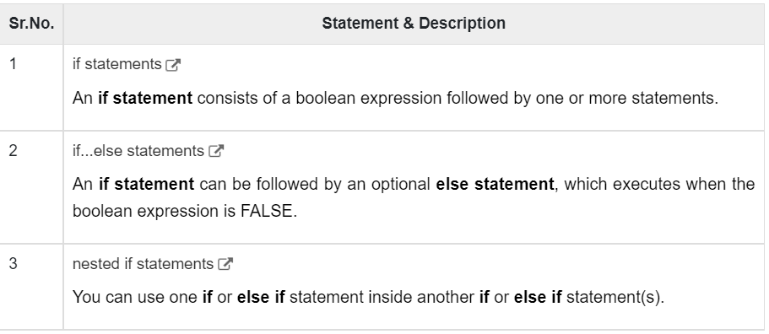
Ifelse statements

Slide 13
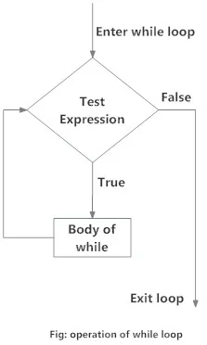
While Loop

