Slide 1


Lecture 04
Dr. Shakeel Ahmed
Assistant Professor Statistics, School of Natural Sciences
NUST H-12 Islamabad

Slide 2

Supervised Learning

Slide 3
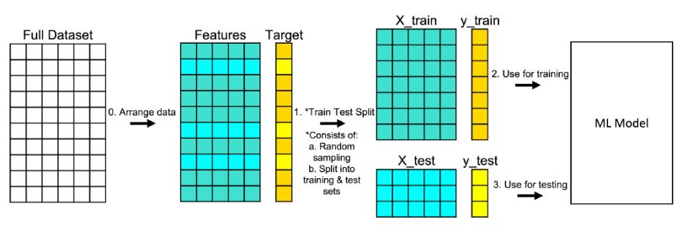
Spliting Data into Test and Training

Slide 4
Splitting Data
1. ARRANGE THE DATA
Make sure your data is arranged into a format acceptable for train test split. Separating your full data set into “Features” and “Target.”
2. SPLIT THE DATA
Split the data set into two parts — a training set and a test set. This consists of random sampling without replacement about 75 percent of the rows (you can vary this) and putting them into your training set. The remaining 25 percent is put into your test set. In “Features” and “Target” indicate where their data will go (“X_train,” “X_test,” “y_train,” “y_test”) for a particular train test split.

Slide 5
Training and Testing
3. TRAIN THE MODEL
Train the model on the training set. This is “X_train” and “y_train” in the image.
4. TEST THE MODEL
Test the model on the testing set (“X_test” and “y_test” ) and evaluate the performance.
Plot the predicted value and the observed values on a plot

Slide 6
Results Interpretation
R_square:
Adjusted R_square
F Statistic (p-value): f is a statistic used to test the significance of regression coefficients in linear regression models.
t statistics (p-values): t-statistics are used to test the significance of regression coefficients in linear regression models.

Slide 7
Model Accuracy
1. AIC (Akaike’s Information Criteria), AIC is used to penalize the inclusion of additional variables to a model. It adds a penalty that increases the error when including additional terms. The lower the AIC, the better the model.
2. AICc is a version of AIC corrected for small sample sizes.
3. BIC (Bayesian information criteria) is a variant of AIC with a stronger penalty for including additional variables to the model.
4.

Slide 8
Testing Other Assumptions
Durbin Watson Test: The DW statistic ranges from zero to four, with a value of 2.0 indicating zero autocorrelation. Values below 2.0 mean there is positive autocorrelation and above 2.0 indicates negative autocorrelation.
The Jarque-Bera test: It is a goodness-of-fit test that determines whether or not residuals have skewness and kurtosis that matches a normal distribution. The test statistic of the Jarque-Bera test is always a positive number and if it’s far from zero, it indicates that the sample data do not have a normal distribution.

