Slide 1


Lecture 05
Dr. Shakeel Ahmed
Assistant Professor Statistics, School of Natural Sciences
NUST H-12 Islamabad

Slide 2

Supervised Learning

Slide 3
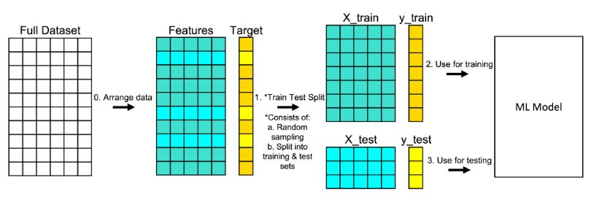
Splitting Data

Slide 4
Splitting Data
1. ARRANGE THE DATA
Make sure your data is arranged into a format acceptable for train test split. Separating your full data set into “Features” and “Target.”
2. SPLIT THE DATA
Split the data set into two parts — a training set and a test set. This consists of random sampling without replacement about 75 percent of the rows (you can vary this) and putting them into your training set. The remaining 25 percent is put into your test set. In “Features” and “Target” indicate where their data will go (“X_train,” “X_test,” “y_train,” “y_test”) for a particular train test split.

Slide 5
Training and Testing
3. TRAIN THE MODEL
Train the model on the training set. This is “X_train” and “y_train” in the image.
4. TEST THE MODEL
Test the model on the testing set (“X_test” and “y_test” ) and evaluate the performance.
Plot the predicted value and the observed values on a plot

Slide 6
Logistic Regression
Logistic regression is a statistical method for predicting binary classes. The outcome or target variable is dichotomous in nature. Dichotomous means there are only two possible classes.
Binary Logistic Regression: The target variable has only two possible outcomes such as Spam or Not Spam, Cancer or No Cancer.
Multinomial Logistic Regression: The target variable has three or more nominal categories such as predicting the type of Wine.
Ordinal Logistic Regression: the target variable has three or more ordinal categories such as restaurant or product rating from 1 to 5.

Slide 7
Binary Logistic Regression
Target Variable: A qualitative variable consisting two classes. Yes|No Absence|Presence Disease|Non-Disease and so on.
Predictors:
Predictors may be off any type including dummies, ordinal and numerical variables
For example, age, Education, Marital Status, Profession etc.
Binary logistic first evaluates the impact of change in predictors on the odds of being in a class.
It then helps in predicting the class of the object in test set using the fitted model on the training set.

Slide 8
Model Building
# import the class
from sklearn.linear_model import LogisticRegression
# instantiate the model (using the default parameters)
m1 = LogisticRegression(random_state=0)
Link: https://realpython.com/logistic-regression-python/
# fit the model with data
m1.fit(X_train, y_train)
y_pred = m1.predict(X_test)

Slide 9
Results
Model Coefficients
Specifies impact of predictors on log-odd-ratio
>>> m1.intercept_
>>> model.coef_
Predicted probabilities
>>> model.predict_proba(x)
This gives predicted probabilities of falling observations in class with Y=1, and Y=0.
Predicted Classes
This gives predicted probabilities of falling observations in class with Y=1, and Y=0.

Slide 10
Model Accuracy
Confusion Matrix.
The confusion matrix shows the numbers of the following:
True negatives in the upper-left position
False negatives in the lower-left position
False positives in the upper-right position
True positives in the lower-right position
>>> confusion_matrix(y_test, model.predict(x_test))
2. ROC Curve:
Receiver Operating Characteristic(ROC) curve is a plot of the true positive rate against the false positive rate. It shows the tradeoff between sensitivity and specificity.

