Slide 1

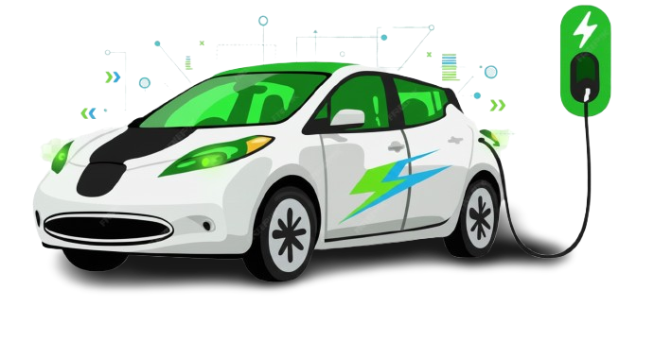
Electric Vehicle Market Analysis
Provide Insights to an Automative Company on Electric Vehicles Launch in India
Presented By Shakeer Shaik

Slide 2

Agenda :
Problem Statement
Project Focus - What This Analysis Solves
Dataset Overview
Key Growth Metrics
Primary Analysis
Secondary Analysis
Recommendations

Slide 3
Problem Statement
AtliQ Motors is a US-based automotive giant specializing in Electric Vehicles (EV).
Over the last 5 years, they have achieved a significant 25% market share in the EV and Hybrid segment in North America.
The company has a very limited presence in the Indian market, currently holding less than 2% market share.
The company intends to launch its bestselling North American models in India to grow its footprint.
Chief of AtliQ Motors India requires a detailed market study of the existing EV and Hybrid landscape in India before proceeding with the launch.

Slide 4
Project Focus - What This Analysis Solves
Market Entry & Prioritization : Identifying high-potential Launch Cities by regional EV penetration, charging infrastructure density, and consumer income levels to ensure a successful initial rollout.
Competitive Positioning : Evaluating top-selling models and pricing structures to define AtliQ’s unique value proposition and gain market share from established players.
Customer Insights & Demand Forecasting : Modeling buying behavior and adoption factors to accurately estimate sales potential for AtliQ’s bestselling models within the Indian context.
Infrastructure & Ecosystem Readiness : Mapping current charging networks and identifying gaps to determine where strategic partnerships or infrastructure investments are needed to reduce range anxiety.
Data-Driven GTM Strategy : Developing a comprehensive go-to-market plan that includes optimal pricing, distribution channels, and pilot launch approaches to mitigate risks and maximize long-term ROI.

Slide 5
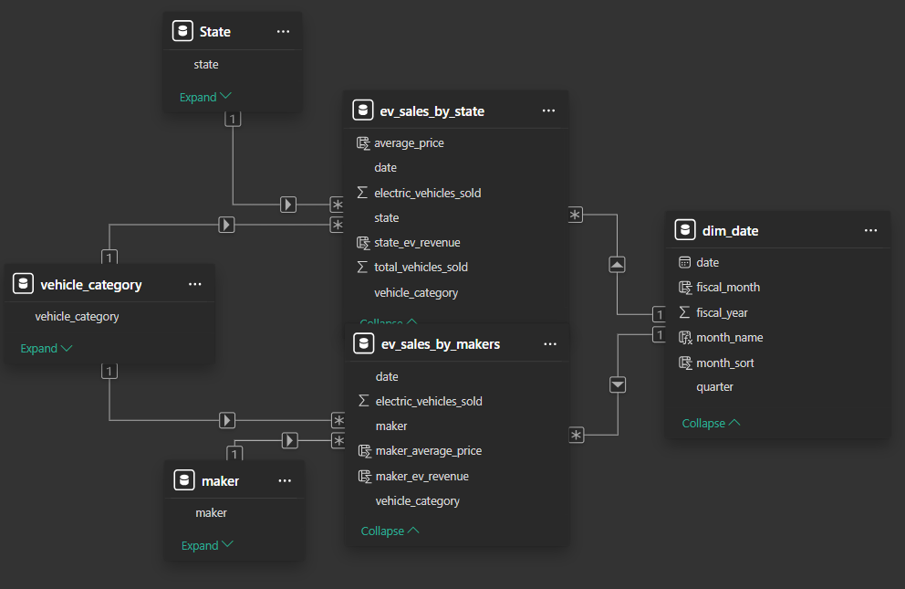
Dataset Overview
Dataset Tables :
Dim Date
EV Sales by State
EV Sales by Makers
Key Point :
Fiscal Year starting on April 1st and ending on March 31st of the following year in India

Slide 6
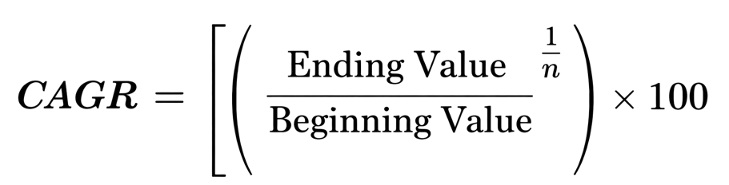
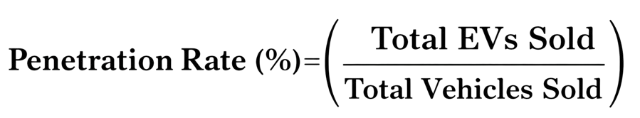
Key Growth Metrics
CAGR(Compound Annual Growth Rate) :
CAGR measures the mean annual growth rate over a specified period longer than one year
A high CAGR indicates a rapidly expanding market with strong demand.
EV Penetration Rate :
Represents percentage of EVs sold compared to total number of vehicles sold.
High Penetration shows strong adoption of Evs by people

Slide 7

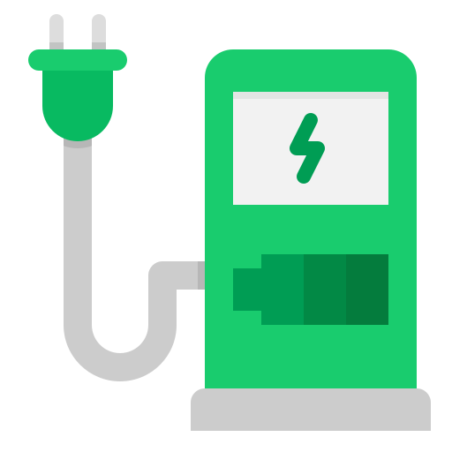
PRIMARY ANALYSIS

Slide 8
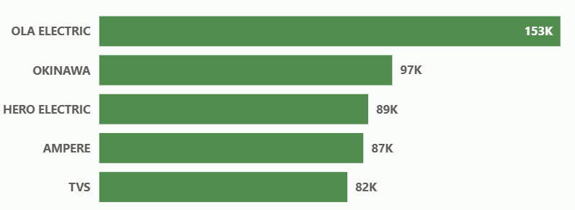
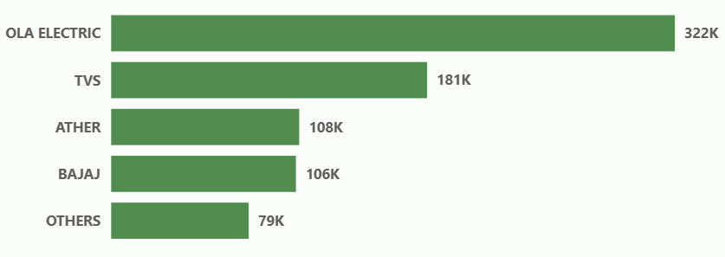
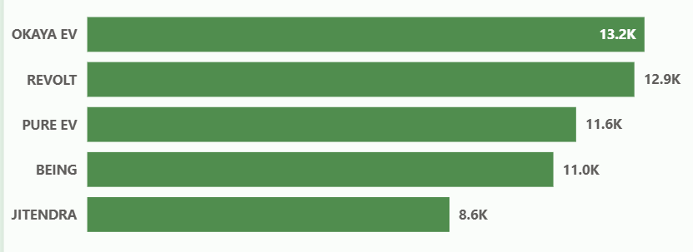
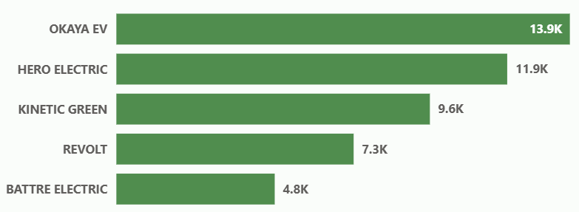
PA -1
List the top 5 and bottom 5 makers for the fiscal years 2023 and 2024 in terms of the number of 2-wheelers sold.
2023
2024
Top 5
Bottom 5
Ola Electric doubled its sales, growing from 153K units in 2023 to 322K units in 2024 | TVS jumping from 82K to 181K units (~120%) increase & climbing from 5th to 2nd place | Bajaj was not in the Top 5 in 2023 but secured the 4th spot in 2024 with 106K units.
2023 - Okinawa (97K) & Ampere (87K) - have completely dropped out in 2024 | Hero Electric fell from 89K units in 2023 to the (11.9K units)(~86%) drop in 2024.

Slide 9
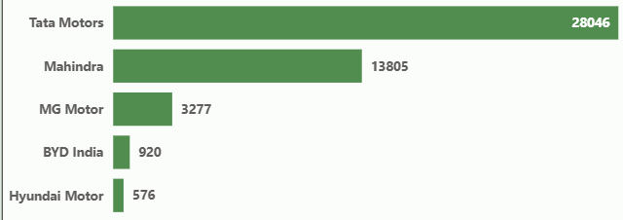
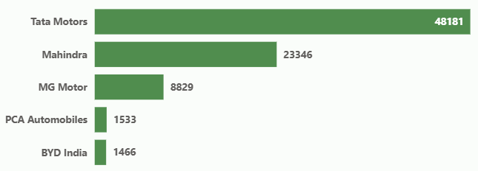
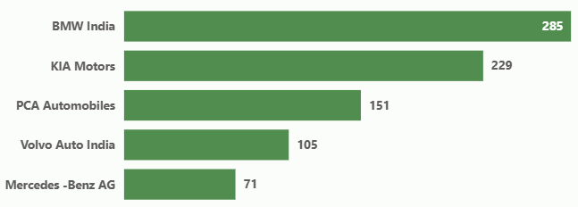
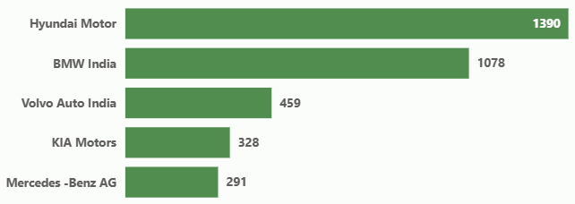
PA -2
List the top 5 and bottom 5 makers for the fiscal years 2023 and 2024 in terms of the number of 4-wheelers sold.
2023
2024
Top 5
Bottom 5
Top 3 Makers – Tata Motors(72%), Mahindra(69%), MG Motors(169%) YoY increase from 2023 to 2024
Volvo Auto India, KIA Motors, Mercedes – Benz AG remains in bottom 5 from 2023 to 2024

Slide 10
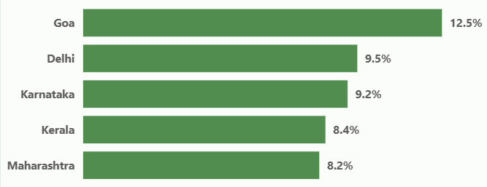
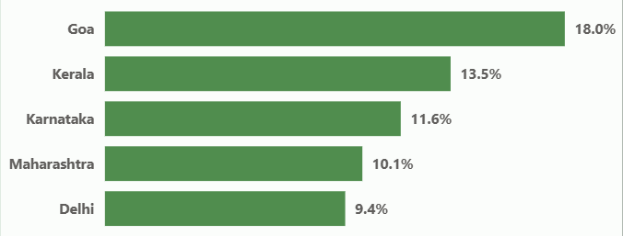
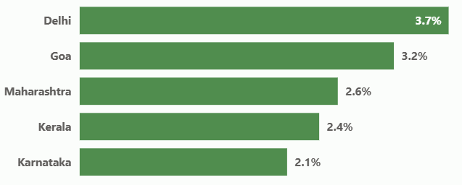
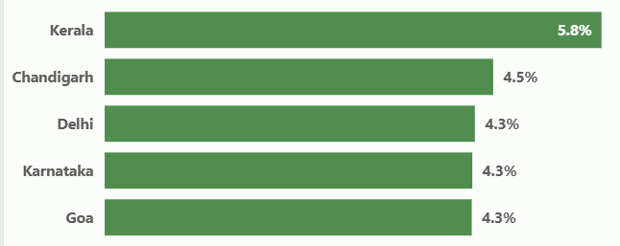
PA -3
Identify the top 5 states with the highest penetration rate in 2-wheeler and 4-wheeler EV sales in FY 2023 & 2024.
2023
2024
2-wheelers
4-wheelers
2 Wheelers : Goa(12.5% -> 18%), Kerala(8.4% -> 13.5%), Karnataka(9.2% -> 11.6%) |Delhi shows declined rate
4 Wheelers : Kerala(2.4% -> 5.8%), Chandigarh new one (4.5%) | Delhi, Karnataka, Goa all have same(4.3%)
Overall 2-wheeler EV penetration (10-18%) significantly higher compare to 4-wheelers (4-6%)

Slide 11
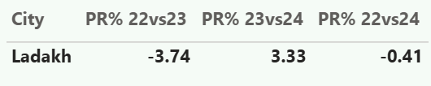

PA -4
List the states with negative penetration (decline) in EV sales from 2022 to 2024?
2-wheelers
2022 vs 2023: Declined by -3.74%
2023 vs 2024: Recovered with +3.33%
Net 2022 vs 2024: -0.41% decline
4-wheelers
2022 vs 2023: Declined by -1.54%
2023 vs 2024: Recovery of +0.51%
Net 2022 vs 2024: -1.04% decline

Slide 12
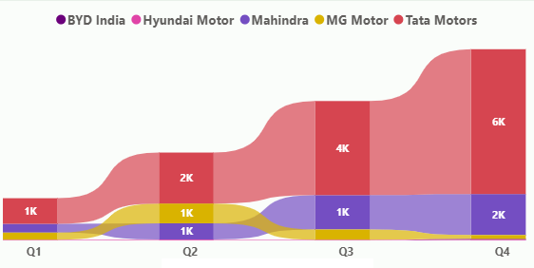
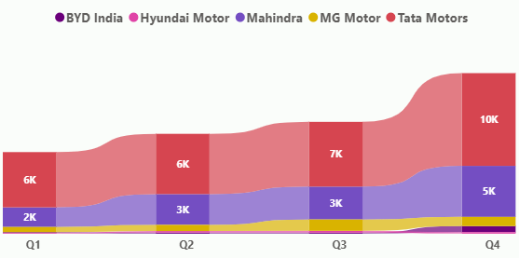
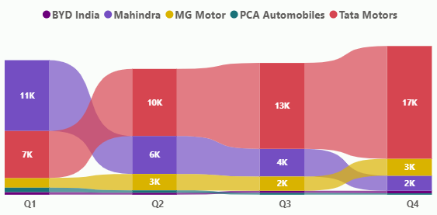
PA -5
What are the quarterly trends based on sales volume for the top 5 EV makers (4-wheelers) from 2022 to 2024?
2022
2023
2024
Tata Motors leads in almost all quarters except 2024 Q1, where Mahindra briefly overtakes with 11K sales.
Mahindra’s strong Q1 is followed by a significant drop, reaching only 2K in Q4.

Slide 13
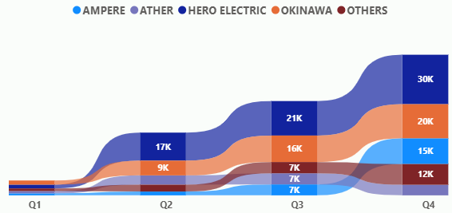
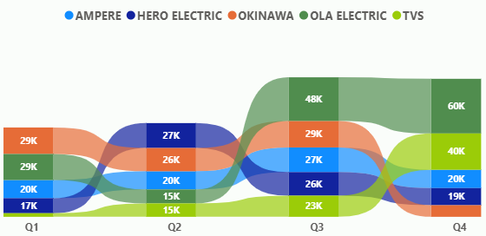
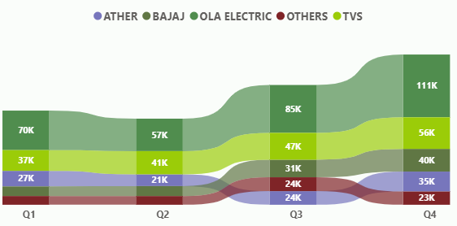
PA -6
What are the quarterly trends based on sales volume for the top 5 EV makers (2-wheelers) from 2022 to 2024?
2022
2023
2024
2024 volumes are significantly higher across all quarters compared to 2022.
Q4 consistently records highest sales each year, driven by festive demand.
Q1 is the weakest quarter, suggesting post-festival slowdown & budget sensitivity.
2022 : Market dominated by Hero Electric & Okinawa.
2023 : Entry and rise of Ola Electric & TVS
Hero Electric and Okinawa show slower growth by 2024.

Slide 14
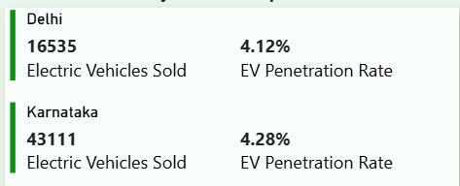
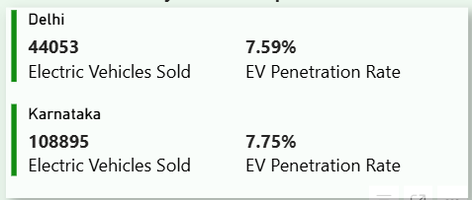
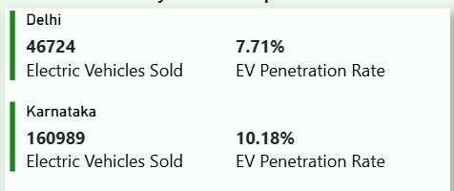
PA -7
How do the EV sales and penetration rates in Delhi compare to Karnataka from 2022 to 2024?
2022
2023
2024
EV Sales : Karnataka significantly outperformed Delhi with 160,989 EV units sold vs Delhi's 46,724 (Karnataka sold ~3.4 times more).
Penetration Rate: Karnataka achieved a higher rate at 10.18% compared to Delhi's 7.71% (a gap of ~2.47%).
In prior years (2022–2023), the states had very similar penetration (~4.2% in 2022 and ~7.6–7.8% in 2023), but Karnataka pulled ahead decisively in 2024.

Slide 15
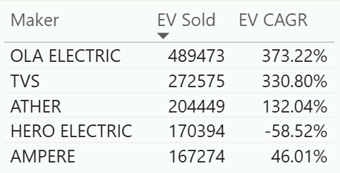
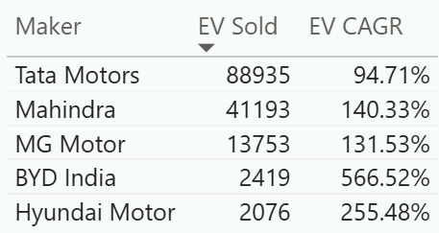
PA -8
List down the compounded annual growth rate (CAGR) in 2-W& 4-W for the top 5 makers from 2022 to 2024.
2-Wheelers
4-Wheelers
OLA Electric leads the market with ~489K units sold, showing explosive growth (373% CAGR).
TVS emerges as a strong challenger with 330% CAGR, indicating rapid scale-up.
Hero Electric shows a sharp decline (-58% CAGR), signaling loss of market momentum.
Tata Motors dominates volumes (~89K units sold) with steady growth (95% CAGR).
Mahindra & MG Motor show strong momentum (130–140% CAGR), indicating rising competition.
BYD India records exceptional growth (566% CAGR) despite low base volumes—strong future potential.
Hyundai shows rapid early growth (255% CAGR) but remains in the adoption phase.

Slide 16
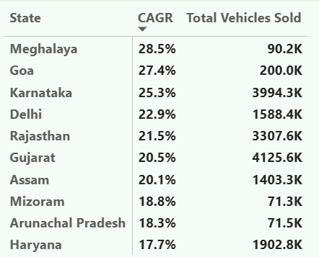
PA -9
List down the top 10 states that had the highest compounded annual growth rate (CAGR) from 2022 to 2024 in total vehicles sold.
Meghalaya has highest CAGR(28.5%) | units sold(~90k)
followed by Goa CAGR(27.4%) | units sold(~200k)
Karnataka CAGR(25.3%) | units sold(~4M)
Gujarat CAGR(20.5%) | units sold(~4.1M)

Slide 17
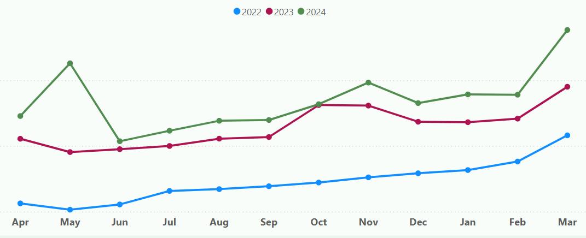
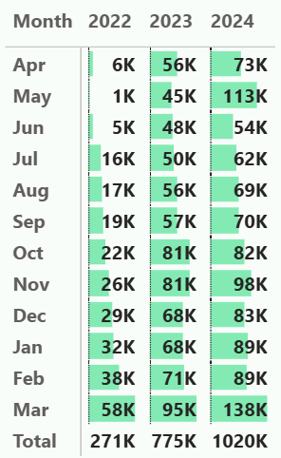
PA -10
What are the peak and low season months for EV sales based on the data from 2022 to 2024?
March is a Peak Month for the EV sold units across all the 3 years
2022-2023 : May is a low demand month
But in 2024 June is a low demand month

Slide 18
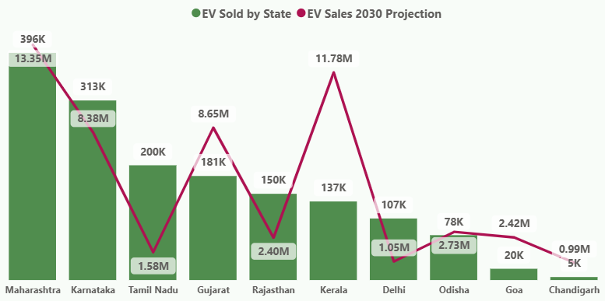
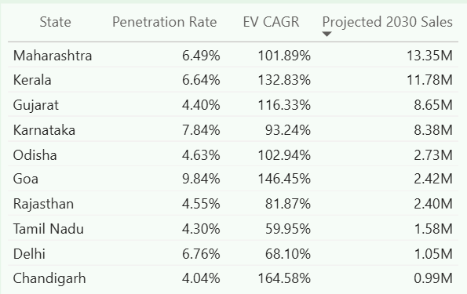
PA -11
What is the projected number of EV sales (including 2-wheelers and 4 wheelers) for the top 10 states by penetration rate in 2030, based on the compounded annual growth rate (CAGR) from previous years?
Maharashtra leads EV sales (~396K units) & projected to reach 13.35M by 2030, making it the largest EV market.
Kerala & Gujarat are high-growth acceleration markets, with EV CAGR above 115%, ideal for rapid expansion.
Goa & Chandigarh, showing the highest growth rates despite smaller base volumes.
Karnataka combines high penetration with strong demand
Delhi & Tamil Nadu show moderate growth, suggesting emerging saturation or higher price sensitivity.

Slide 19
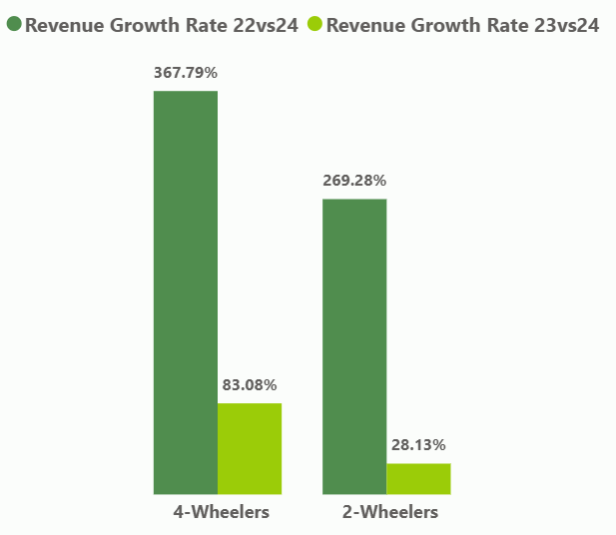
PA -12
Estimate the revenue growth rate of 4-wheeler and 2-wheelers EVs in India for 2022 vs 2024 and 2023 vs 2024
(2022 - 2024)
4-Wheelers lead revenue expansion with a ~368% growth, significantly outperforming 2-wheelers.
2-Wheelers grew ~269%, showing strong adoption but at a slower pace compare to 4-wheelers.
(2023 - 2024)
4-Wheelers sustained strong growth (83%), indicating continued demand.
2-Wheelers growth slowed sharply (28%), signaling Increased competition,Pricing pressure, Saturation in urban markets
future growth will depend on innovation, affordability, and rural penetration.

Slide 20
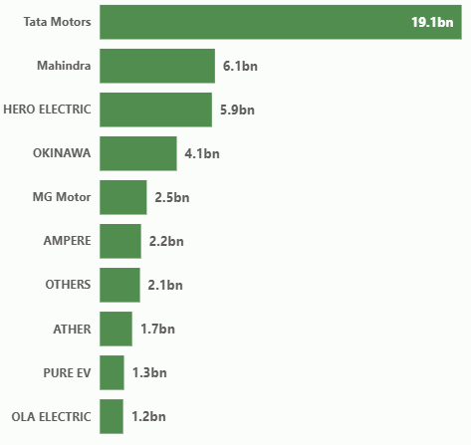
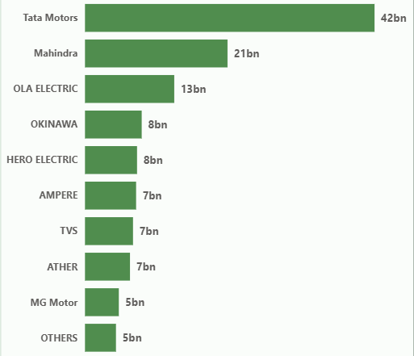
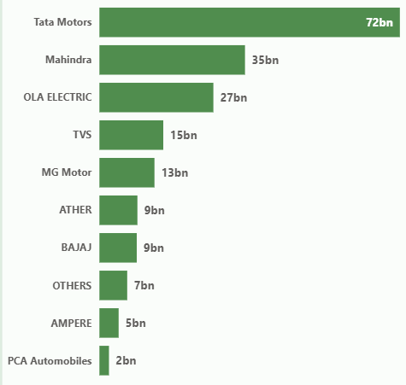
PA -13
Top 10 Makers based on Revenue
2022
2023
2024
Tata Motors consistently dominates across all 3 years : ₹19.1bn (2022) → ₹42bn (2023) → ₹72bn (2024).
Mahindra holds its 2nd position across all 3 years : ₹6.1bn (2022) → ₹21bn (2023) → ₹35bn (2024).
Ola Electric jumps from last position in 2022 (₹1.2bn) to Top 3 by 2024 (₹27 bn).
Brands like TVS (₹15bn), Ather (₹9bn), and Bajaj (₹9bn) emerge strongly in 2024.
Companies like Ampere, Okinawa, Hero Electric lose their market share ranking by 2024.

Slide 21
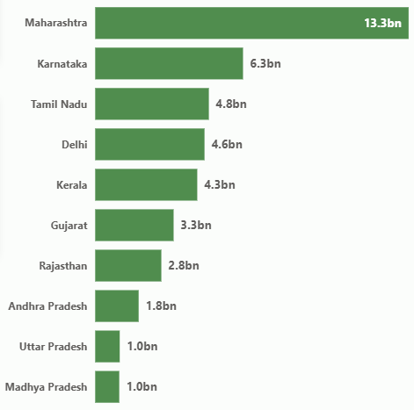
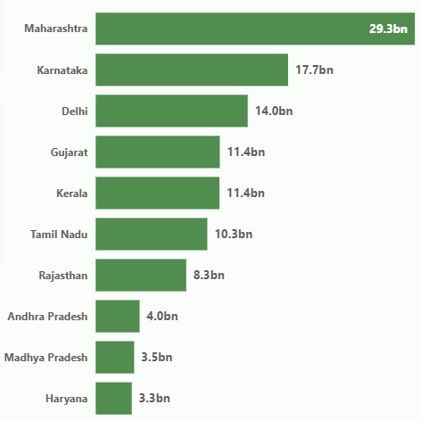
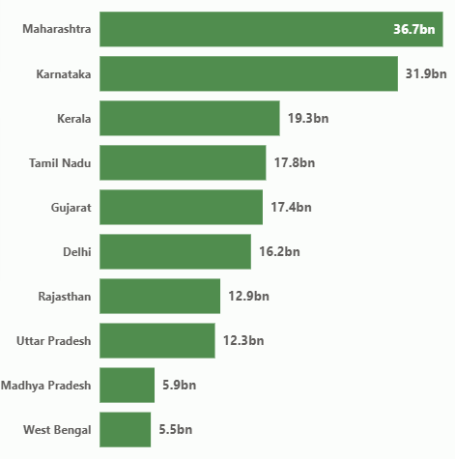
PA -14
Top 10 States based on Revenue
2022
2023
2024
Maharashtra leads across all three years, growing from ₹13.3bn(2022) → ₹36.7bn(2024)
Karnataka shows the fastest scale-up, jumping from ₹6.3bn(2022) → ₹31.9bn(2024)
Kerala emerges as a high-growth state,4.3bn(2022) → 19.3bn(2024).

Slide 22
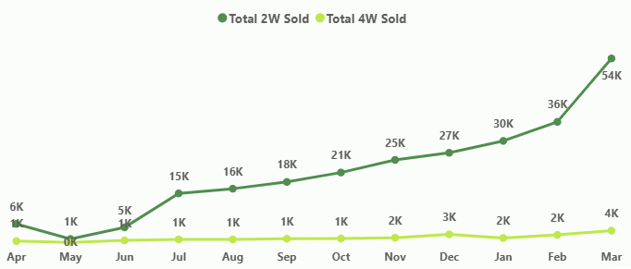
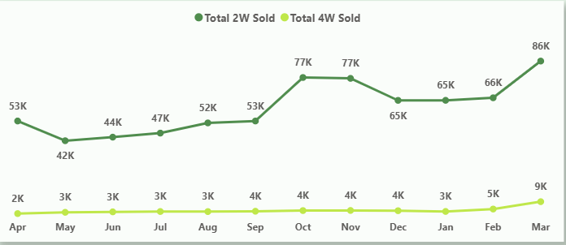
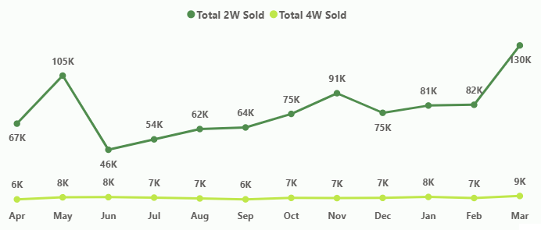
PA -15
Total 2-Wheelers & 4-Wheelers Sold by Month
2022
2023
2024

Slide 23
SECONDARY ANALYSIS

Slide 24
SA -1
Why are customers choosing 4-Wheeler EVs in 2023–2024?
Cost Savings (Long-Term Ownership)
Lower running cost per km compared to ICE vehicles
Reduced maintenance (fewer moving parts)
Rising fuel prices making EVs economically attractive over 5–7 years
Government Incentives
Central subsidies (FAME-II,PM E-drive Scheme)
State-level incentives: road tax waiver, registration fee exemption, purchase subsidies
Strong correlation seen in Kerala, Delhi, Maharashtra, Karnataka
Environmental & Social Factors
Urban consumers increasingly value sustainability
Corporate and premium buyers shifting toward EVs to reduce carbon footprint
Alignment with ESG and green mobility goals

Slide 25
SA -2
Impact of Government Incentives on EV Adoption - Which states benefited the most?
PM E-DRIVE Scheme (Oct 2024 – Mar 2026) - Total Budget : ₹10,900 Crore
EV Adoption Targets
e-2 Wheelers: ~24.79 lakh vehicles
e-3 Wheelers: ~3.2 lakh vehicles
e-Ambulances: ₹500 Cr allocation
e-Trucks: ₹500 Cr allocation
e-Buses: 14,028 buses | ₹4,391 Cr allocation
Demand Incentive Structure
FY 2024–25: ₹5,000 / kWh
FY 2025–26: ₹2,500 / kWh
e-Bus Deployment Focus
Priority Cities (>40 lakh population)
Delhi | Mumbai | Kolkata | Chennai | Ahmedabad | Surat | Bengaluru | Pune | Hyderabad
Charging Infrastructure Expansion
Total Allocation: ₹2,000 Crore
22,100 fast chargers for e-4Ws
1,800 chargers for e-Buses
48,400 chargers for e-2Ws & e-3Ws
Testing & Quality Infrastructure
₹780 Crore for modernization of MHI testing agencies
Enhances safety, quality, compliance & EV standards

Slide 26
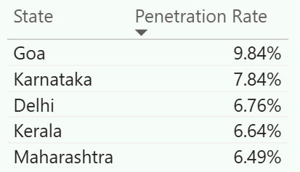
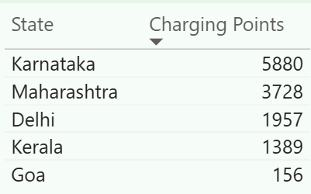
SA -3
Charging Infrastructure vs EV Sales - is there a correlation?
Strong Positive Correlation Observed
Top 5 States with High Sales & Penetration - Maharashtra, Karnataka, Delhi, Kerala, Goa
States with dense charging infrastructure show :
Higher EV penetration
Better repeat adoption
Faster transition from 2W -> 4W EVs
4W EV adoption is highly sensitive to charger availability
2W EV adoption is less dependent but still benefits from infrastructure

Slide 27
SA -4
Ideal Brand Ambassador for AtliQ Motors - India Launch
Recommended Brand Ambassador : MS Dhoni
High fan following across urban + semi-urban India
Appeals to both mass (2W) and premium (4W) audiences
Known for Calm leadership, Reliability, Long-term thinking
Already associated with sustainability and EV startups
Dhoni represents trust, performance, and reliability - perfectly aligned with AtliQ’s EV & Hybrid positioning

Slide 28
SA -5
Best State to Set Up Manufacturing Unit
Tamil Nadu - Automotive & EV Manufacturing Specialist
Strong automotive & EV supply chain in India
Flexible capital & training subsidies
Strong SEZ ecosystem
Gujarat – Infrastructure & Export Powerhouse
Excellent port-led logistics (40% of India’s cargo)
Ideal for export-oriented EV production.
Maharashtra – Market Access & Financial Hub
India’s largest GDP state with mature supplier ecosystem
Proximity to major EV demand centers
Access to financial institutions & corporate headquarters.
Karnataka – Innovation & R&D hub
Strong EV startups
Software & battery R&D talent
Suitable for advanced EV design & innovation-focused units.

Slide 29
SA -6
Top 3 Strategic Recommendations for AtliQ Motors
1. Dual-Segment Market Domination Strategy
2-Wheelers : Launch affordable EVs with battery-swap, subscription, fleet partnerships (logistics & delivery) to drive mass adoption.
4-Wheelers : Introduce a compact urban EV & mid-range SUV with strong range, fast-charging, and safety features to capture high-margin customers.
2. State-Focused Phased Launch Strategy
Phase 1 (High volume states) : Maharashtra, Karnataka, Delhi, Kerala, Goa.
Phase 2 (High CAGR growth states) : Uttar Pradesh, Assam, Tripura, Meghalaya, Haryana.
3. Ecosystem-Led Scaling: Charging, Manufacturing & Partnerships
Co-invest in fast-charging & offer home-charger installation bundles.
Set up manufacturing in Tamil Nadu or Gujarat to leverage subsidies, skilled labor, supply-chain depth.
Use CAGR & penetration-driven forecasting to optimize plant capacity, inventory, and expansion pace.

Slide 30
Recommendations
Adopt a dual-market strategy: 2-wheelers for high volume & brand scale, 4-wheelers for high-margin growth.
Launch first in Maharashtra & Karnataka, the strongest states for EV sales, revenue, and infrastructure readiness.
Expand next into Tamil Nadu & Gujarat to accelerate national scale in EV-friendly markets.
Target high-CAGR states early (Uttar Pradesh, Tripura, Meghalaya, Chandigarh) to secure first-mover advantage.
Position 2W EVs as affordable, daily-commute solutions aligned with India’s price-sensitive demand.
Set 4W EVs as premium, long-range vehicles to maximize revenue per customer.
Align product launches with Q4 demand peaks, especially March, to capitalize on seasonal sales.
Invest early in charging partnerships and ecosystem support to build long-term customer trust and adoption.

Slide 31


