Slide 1
PYTHON DATA ANALYTICS PROJECT
Bank Customer Churn Analysis
An End-to-End Analysis of Customer Behavior Across Region, Age, Income, and
Employment Segments to Uncover Churn Drivers
Presented by: Shakeer Shaik
Python • Pandas • NumPy • Matplotlib • Seaborn

Slide 2
AGENDA
What We'll Cover
01
Project Objective
07
Univariate: Salary Segmentation
02
Data Overview & Standardization
08
Churn Behavior: Tenure & Products
03
Handling Missing Values
09
Churn Behavior: Satisfaction Score
04
Numeric Columns Profile
10
Assumptions Tested
05
Outlier Detection & Treatment
11
Key Insights
06
Feature Engineering
12
Recommendations

Slide 3





B
Bank Customer Churn
GOAL
Project Objective
Perform an end-to-end Bank Customer Churn Analysis using Python — analyzing customer behavior across region, state, age groups, income segments, and employment types — to identify churn patterns and generate actionable business insight.
Clean
Engineer
Explore
Insight
Handle missing values & outliers
Build meaningful new features
Uni-, bi- & multivariate EDA
Translate patterns into action
03

Slide 4

B
Bank Customer Churn
PREPARATION
Data Overview & Standardization
Retrieved and processed the dataset with Pandas: inspected structure with df.info(), then standardized every column name — lower-cased and spaces replaced with underscores — for consistent downstream referencing.
Standardized Column Set
Standardization Rule
row_number
age
df.columns.str.lower().str.replace(" ", "_")
salary
credit_score
tenure
balance
All headers converted to lowercase.
Spaces replaced with underscores for clean referencing.
16 core columns carried through the full analysis.
hascrcard
hasloan
hasfd
num_of_products
isactivemember
exited
complain
count_of_complaints
satisfaction_score
point_earned
04

Slide 5

B
Bank Customer Churn
DATA CLEANING
Handling Missing Values
salary
Imputed with median
balance
Imputed with 0
Card Type — Cleaned Categories
satisfaction_score
Imputed with median
gender
Rows with missing values dropped
card_type standardized to UPPERCASE + trimmed → four clean categories: Silver, Gold, Platinum, Not Applicable.
card_type
Imputed with mode (most frequent)
05

Slide 6
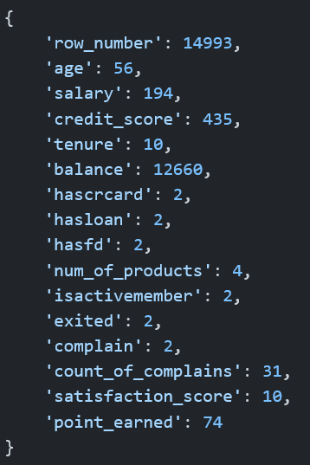
B
Bank Customer Churn
EXPLORATION
Numeric Columns Profile
What This Tells Us
row_number is (almost) fully unique (14,993) — confirming it's a record identifier, not a modeling feature.
Six flags — hascrcard, hasloan, hasfd, isactivemember, exited, complain — each have exactly 2 unique values, confirming they are binary.
tenure has only 10 distinct values and num_of_products only 4, both well-suited to grouping and cross-tabs.
salary shows just 194 unique values across ~15K rows — many customers share identical salary figures, worth flagging for downstream modeling.
balance (12,660 unique) and credit_score (435 unique) behave as near-continuous variables.
Unique value count per numeric column
06

Slide 7
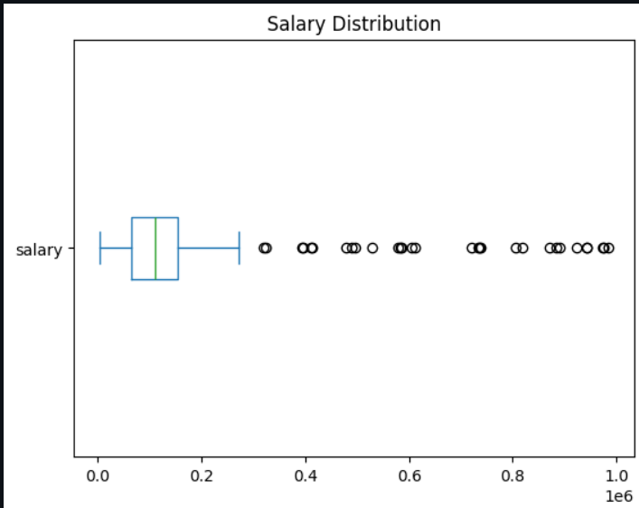

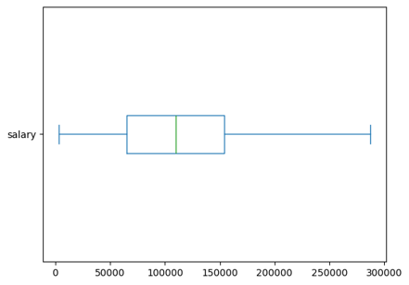
B
Bank Customer Churn
SALARY — IQR METHOD
Outlier Detection & Treatment
Before
After (capped)
IQR Bounds
Lower Bound
₹ -68,500
Upper Bound
₹ 287,500
Salary values above the upper bound were capped (winsorized) using np.where, rather than dropped — preserving sample size while removing distortion from extreme high-income outliers.
The same IQR approach was applied to balance, capping its upper outliers as well.
07

Slide 8
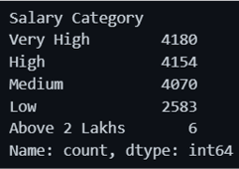
B
Bank Customer Churn
FEATURE ENGINEERING
Univariate Analysis: Salary Segmentation
Salary Category
Range
Customers
Segment Distribution
Low
≤ ₹50,000
2,583
Medium
₹50,001 – ₹100,000
4,070
High
₹100,001 – ₹150,000
4,154
Very High
₹150,001 – ₹200,000
4,180
Above 2 Lakhs
> ₹200,000
6
Once salary outliers were capped at ₹287,500, almost no customers remained above the “Above 2 Lakhs” threshold (just 6 of ~15,000) — a sign that these salary bands should be redefined post-cleaning to stay meaningful.
08

Slide 9




B
Bank Customer Churn
NEW VARIABLES
Feature Engineering
Debt-to-Income Ratio
Loyalty Score
High Complainer Flag
(balance + hasloan×salary×0.3) / salary
(tenure × satisfaction_score) / (1 + complaints)
complaints > state average
Financial stability indicator per customer.
Rewards long tenure & satisfaction, penalizes complaints.
Flags customers above their state's complaint norm.
Tenure Group
Credit Score Range
Salary Category
5-year bins, 0–40 years
5 bins, 200–1200
5 tiers: Low → Above 2 Lakhs
Groups customers for cohort-style comparison.
Segments customers by credit tier.
Income-based segmentation for EDA.
09

Slide 10
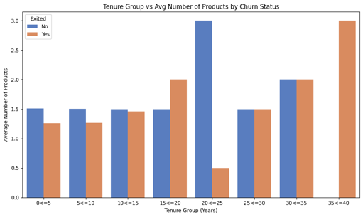
B
Bank Customer Churn
CHURN EDA
Tenure vs Product Usage by Churn Status
Key Takeaways
Average product usage among retained customers stays fairly flat (~1.5) across most tenure bands.
The 20–25 year tenure band shows a striking divergence: retained customers average 3.0 products vs just 0.5 for churned ones.
In the 15–20 year band, churned customers actually use more products on average (2.0) than retained ones (1.5).
The 35–40 year band has churned-only customers averaging 3.0 products — too small a group to generalize from.
10

Slide 11
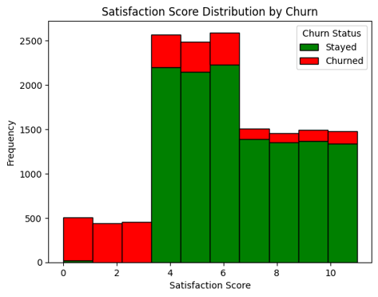
B
Bank Customer Churn
CHURN EDA
Satisfaction Score Distribution by Churn
Key Takeaways
Scores 0–2 are overwhelmingly churned — almost no customer in this band stayed.
From score 3 onward, the pattern flips sharply: the vast majority of customers stayed.
Scores 4–10 show a consistently high volume of retained customers with only a modest, steady share churning.
Satisfaction score is one of the clearest single-variable churn signals in the dataset.
11

Slide 12


B
Bank Customer Churn
HYPOTHESIS-DRIVEN EDA
Assumptions Tested
Satisfaction & loyalty points
Customers with low satisfaction and low loyalty points are more likely to churn — tested via scatter plot of satisfaction_score vs point_earned, colored by churn.
Satisfaction score gap
Churned customers have lower satisfaction scores than those who stay — confirmed by the stacked histogram: scores 0–2 are almost entirely churned.
Complaints & churn
Among customers who complained, a higher proportion end up churning — examined via a pie chart of churn share within complainants.
Salary & balance
Customers with high salary and high balance are less likely to churn — explored via a sampled scatter plot of salary vs balance, colored by churn.
Fixed Deposit holding
Churn rate differs between FD holders and non-holders — measured via churn proportion pie chart among hasfd = 1 customers.
12

Slide 13
KEY INSIGHTS
What the Data Tells Us

Slide 14
B
Bank Customer Churn
KI-1
Data Quality & Cleaning
Missing values were minimal and handled with targeted rules: median for salary & satisfaction, zero for balance, dropped rows for gender, mode for card_type.
card_type required case + whitespace cleanup before it resolved into four clean categories: Silver, Gold, Platinum, Not Applicable.
Salary and balance both carried extreme high-end outliers; IQR-based capping (winsorizing) preserved all 14,993 records while removing distortion.
14

Slide 15
B
Bank Customer Churn
KI-2
Feature Behavior
row_number is a pure identifier; six flags (hascrcard, hasloan, hasfd, isactivemember, exited, complain) are binary — ideal for churn segmentation.
salary showing only 194 unique values across ~15K rows suggests repeated exact figures, worth a closer look before using it in a predictive model.
After capping, the Salary Category thresholds (Low → Above 2 Lakhs) leave only 6 customers above ₹200,000 — the top band should be redefined.
15

Slide 16
B
Bank Customer Churn
KI-3
Churn Behavior Patterns
Satisfaction score is the strongest single-variable churn signal observed: scores 0–2 are almost entirely churned, while 4+ skews heavily retained.
Product usage by tenure is uneven — most bands hover near 1.5 products regardless of churn, but the 20–25 year band shows a sharp divergence (3.0 retained vs 0.5 churned).
Five hypotheses — spanning satisfaction, complaints, salary/balance, and FD holding — were tested with dedicated scatter, histogram, and pie-chart views to triangulate churn drivers.
16

Slide 17
RECOMMENDATIONS
Turning Insight Into Action
1
Prioritize retention outreach for customers scoring 0–2 on satisfaction — the strongest churn signal observed.
2
Investigate the 15–25 year tenure bands further — product usage patterns diverge sharply from churn status here.
3
Redefine Salary Category thresholds after outlier capping so segments stay meaningful ("Above 2 Lakhs" is now nearly empty).
4
Audit the 194 unique salary values across ~15K customers for duplicated or synthetic entries before using salary in a model.
5
Standardize categorical fields (card_type, gender, state) on ingestion to prevent recurring case/whitespace issues.
6
Extend the complaint, FD-holding, and salary/balance assumption tests into a combined churn propensity score.
7
Automate the median/mode imputation and IQR-capping pipeline so future data refreshes stay consistent.
17

Slide 18

Thank You
From raw spreadsheet to churn insight — a complete Python data-pipeline showcasing
cleansing, feature engineering, and evidence-based business recommendations.

