Slide 1
A
ATLIQ HARDWARE
Business Insights 360
A 360° Power BI Dashboard for Finance, Sales, Marketing,
Supply Chain & Executive Decision-Making
Presented by: Shakeer Shaik

Slide 2
AGENDA
What We'll Cover
01
Company Overview
06
Key Business Metrics
02
Problem Statement
07
Dashboard Walkthrough
03
Project Objective
08
Key Insights
04
Data Overview
09
Recommendations
05
Data Cleaning & Transformation

Slide 3



A
AtliQ Hardware
WHO IS ATLIQ HARDWARE
Company Overview
AtliQ Hardware is a rapidly growing electronics company specializing in hardware products, including PC accessories, printers, and more. Over the years, AtliQ has expanded significantly, establishing a strong global presence across APAC, North America, Latin America, and the European Union.
Sales Platforms
Product Divisions
Sales Channels
Brick-and-Mortar (Croma, Best Buy)
E-Commerce (Amazon, Flipkart)
Networking & Storage (N & S)
Peripherals & Accessories (P & A)
PC
Retailers (third-party, on/offline)
Direct Stores (AtliQ-branded)
Distributors (China, South Korea)
Note: AtliQ's customers are retailers and distributors, while consumers are the end users.
03

Slide 4

A
AtliQ Hardware
THE CHALLENGE
Problem Statement
AtliQ Hardware's reliance on scattered Excel sheets for analytics led to inefficient decision-making.
This resulted in significant losses, particularly during its Latin American expansion.
Competitors leveraging advanced data analytics gained an edge, leaving AtliQ struggling to keep up.
To improve transparency in data-driven decisions and stay competitive, AtliQ launched a data analytics project to enhance decision-making and strategic growth.
04

Slide 5






A
AtliQ Hardware
GOAL
Project Objective
Develop an intuitive dashboard that delivers actionable insights for Finance, Sales, Marketing, and Supply Chain teams, along with an Executive view — enhancing transparency, improving data accessibility, and empowering stakeholders to make informed, data-driven decisions for strategic growth and efficiency.
Finance
Sales
Marketing
Supply Chain
Executive
Dedicated view
Dedicated view
Dedicated view
Dedicated view
Dedicated view
05

Slide 6


A
AtliQ Hardware
SOURCES
Data Overview
AtliQ Hardware provided two SQL databases and three Excel files for analysis, covering actual sales from September 1, 2017, to December 31, 2021 (fiscal year runs September–August).
Excel Files
Database: gdb041
Database: gdb056
Operating Expenses
Targets (FY 2022 only)
Market Share (PC division only)
Fact: fact_forecast_monthly
Fact: fact_sales_monthly
Dim: dim_customer
Dim: dim_market
Dim: dim_product
freight_cost
gross_price
manufacturing_cost
post_invoice_deductions
pre_invoice_deductions
06

Slide 7


A
AtliQ Hardware
PREPARATION
Data Cleaning & Transformation
Standardized & Trimmed Data
Data Structuring & Optimization
Removed leading and trailing spaces from text fields.
Standardized naming conventions for consistency.
Created a dim_date table for better time-based analysis.
Appended fact_sales_monthly and fact_forecast_monthly into a single fact_actual_estimates table to simplify calculations.
Added calculated fields in fact_actual_estimates using data from relevant tables.
Disabled load for tables used to derive calculations, optimizing performance and reducing report size.
07

Slide 8
A
AtliQ Hardware
GLOSSARY
Key Business Metrics (1/2)
Gross Revenue / Gross Sales
Total revenue generated from selling products before any deductions like discounts or costs.
Pre-Invoice Deduction
Discounts applied before the invoice is generated, usually negotiated or promotional.
Net Invoice Sales
Gross Revenue minus Pre-Invoice Deductions; the amount on the final invoice.
Post-Invoice Deduction
Deductions applied after invoicing, such as rebates, returns, or allowances.
Net Sales
Net Invoice Sales minus Post-Invoice Deductions; actual revenue realized.
Manufacturing Cost
Total cost to produce each product: raw materials, labor, and overhead.
Freight Cost
Cost to transport products from factories to warehouses, stores, or customers.
COGS
Manufacturing Cost + Freight Cost + other direct costs.
Gross Margin
Net Sales minus COGS.
08

Slide 9
A
AtliQ Hardware
GLOSSARY
Key Business Metrics (2/2)
Gross Margin %
(Gross Margin / Net Sales) × 100.
Operational Expense (OPEX)
Costs to run the business: salaries, rent, utilities, admin, logistics, support.
Marketing Spend
Budget spent on promotion, advertising, campaigns, branding, and acquisition.
Net Profit
Gross Margin minus OPEX, Marketing Spend, and other expenses.
Forecast Quantity
Number of units the company expects to sell in a period.
Sold Quantity
Actual number of units sold in the period.
Forecast Accuracy
How close the forecast is to actual sales; higher % = better planning.
Net Error / Absolute Error
Difference between forecasted and actual sales (directional / absolute).
09

Slide 10
DASHBOARD WALKTHROUGH
Home • Finance • Sales • Marketing • Supply Chain • Executive

Slide 11

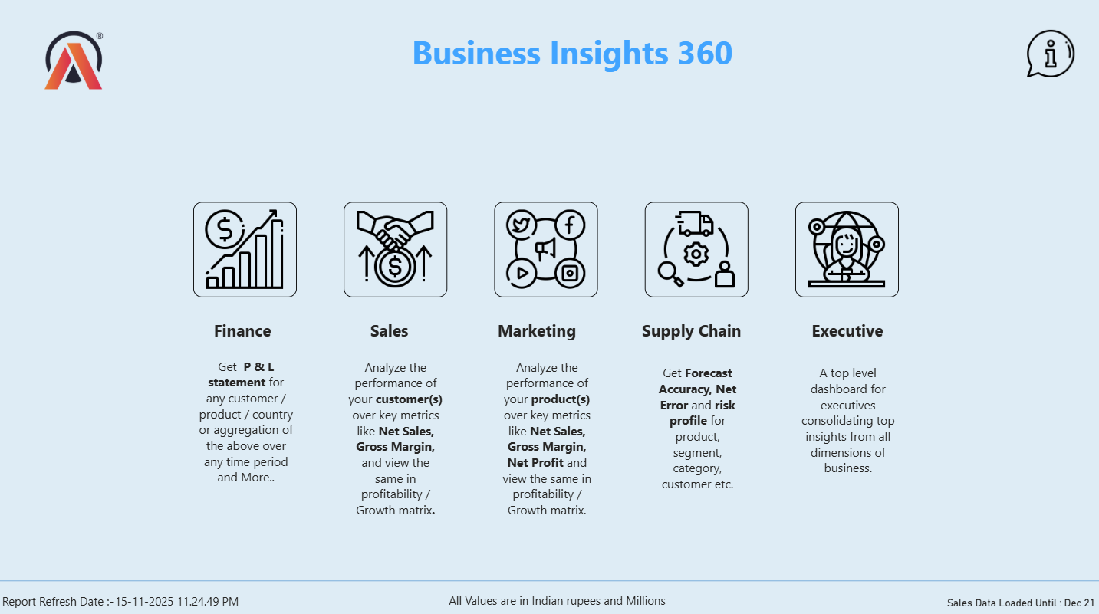
A
AtliQ Hardware
HOME
Home Page
Key Takeaways
Central landing page linking to five focused views: Finance, Sales, Marketing, Supply Chain, and Executive.
Finance: full P&L statement for any customer, product, or country, over any time period.
Sales: customer performance across Net Sales, Gross Margin, and Net Profit.
Marketing: product performance in a profitability / growth matrix.
Supply Chain: Forecast Accuracy, Net Error, and risk profile by product, segment, category, customer.
Executive: a top-level consolidated view across all business dimensions.
11

Slide 12
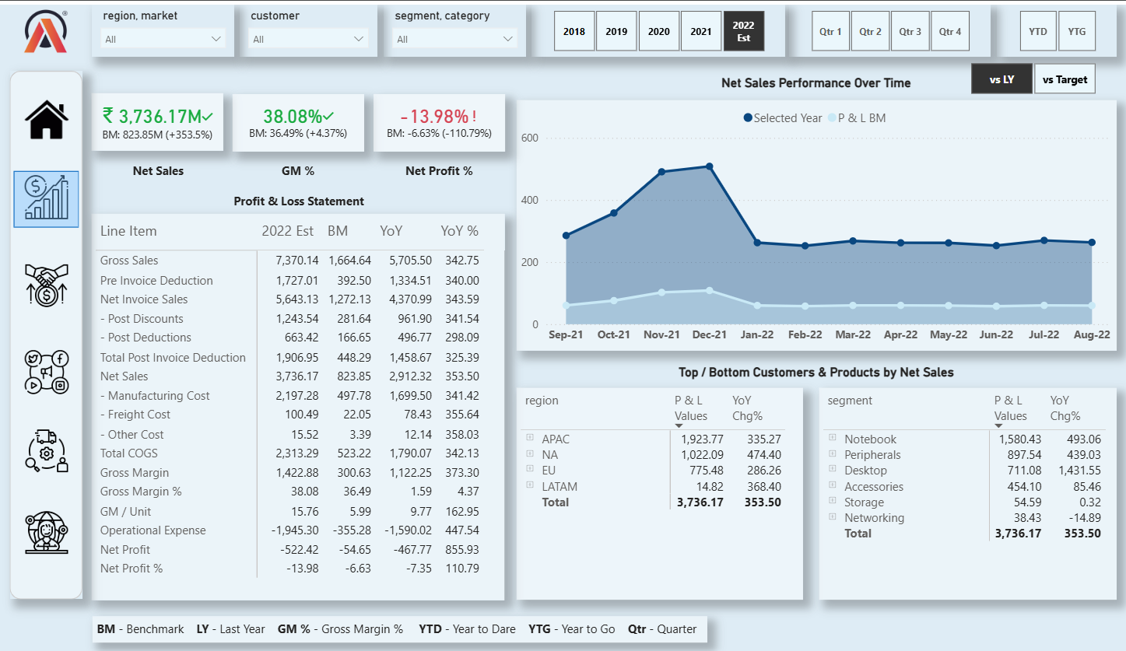
A
AtliQ Hardware
FINANCE
Finance View
Key Takeaways
FY2022 (Est.) Net Sales of ₹3,736.17M, up 353.5% vs benchmark, with 38.08% Gross Margin.
Full Profit & Loss statement: Gross Sales down to Net Profit, each line with benchmark and YoY% comparison.
Net Profit % stands at -13.98%, reflecting continued high operational and marketing expense.
APAC leads regional Net Sales (₹1,923.77M); Notebook leads segment Net Sales (₹1,580.43M) with the highest YoY growth (493%).
Net Sales performance tracked monthly from Sep-21 to Aug-22 against the P&L benchmark.
12

Slide 13
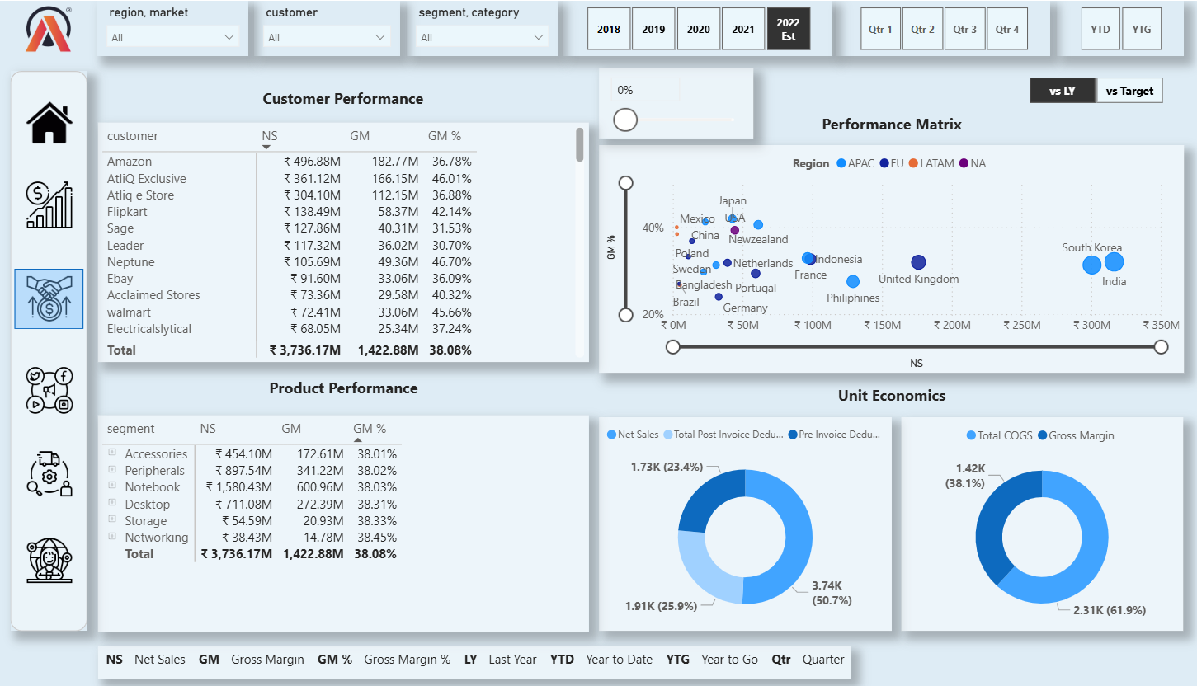
A
AtliQ Hardware
SALES
Sales View
Key Takeaways
Customer Performance table ranks Amazon, AtliQ Exclusive, and Atliq e Store as top contributors to Net Sales.
Product Performance by segment shows Gross Margin % holding steady near 38% across all segments.
Performance Matrix plots Net Sales vs Gross Margin % by market — India and South Korea lead in Net Sales.
Unit Economics donuts break down Net Sales into deductions and COGS into Gross Margin.
Enables drill-down by region, market, customer, segment, and category via top filters.
13

Slide 14
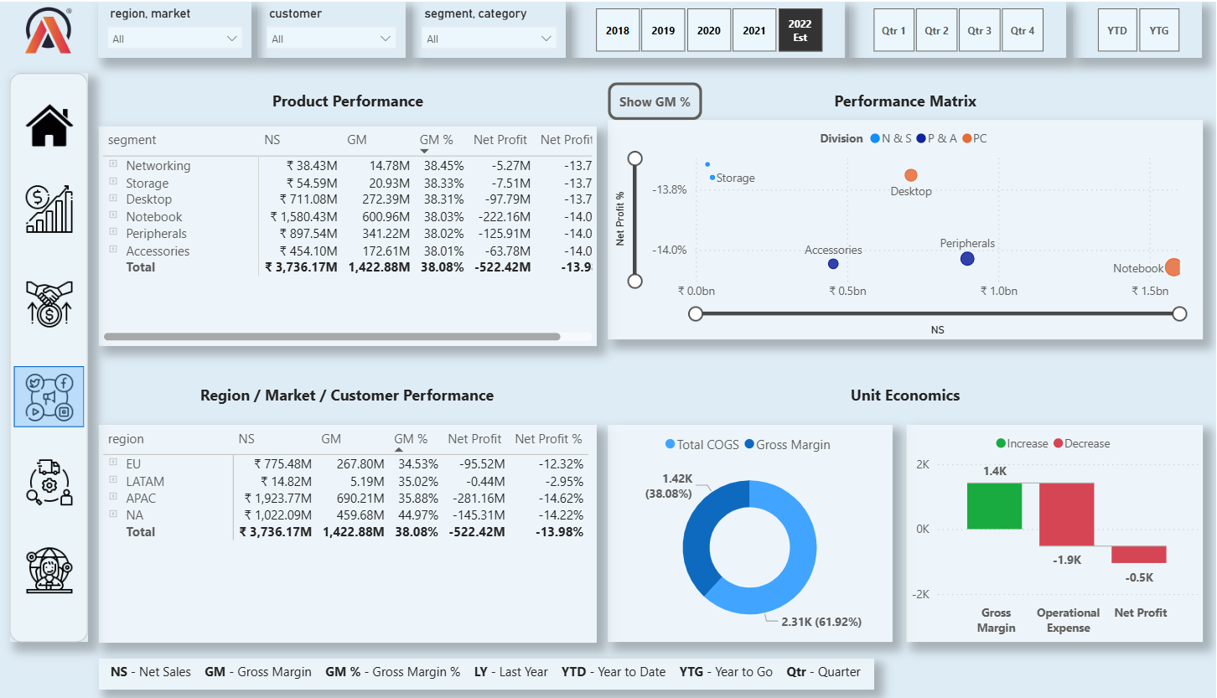
A
AtliQ Hardware
MKTG
Marketing View
Key Takeaways
Product Performance Matrix maps Net Sales against Net Profit % by division — Notebook has the highest Net Sales but is deep in negative Net Profit %.
Storage and Accessories post smaller revenue but stay closer to breakeven Net Profit %.
Region / Market / Customer Performance table breaks out Gross Margin % by region, led by NA at 44.97%.
Unit Economics donut: COGS represents 61.92% of total, leaving 38.08% Gross Margin.
Supports a 'Show GM%' toggle for switching the matrix view between Net Profit % and Gross Margin %.
14

Slide 15
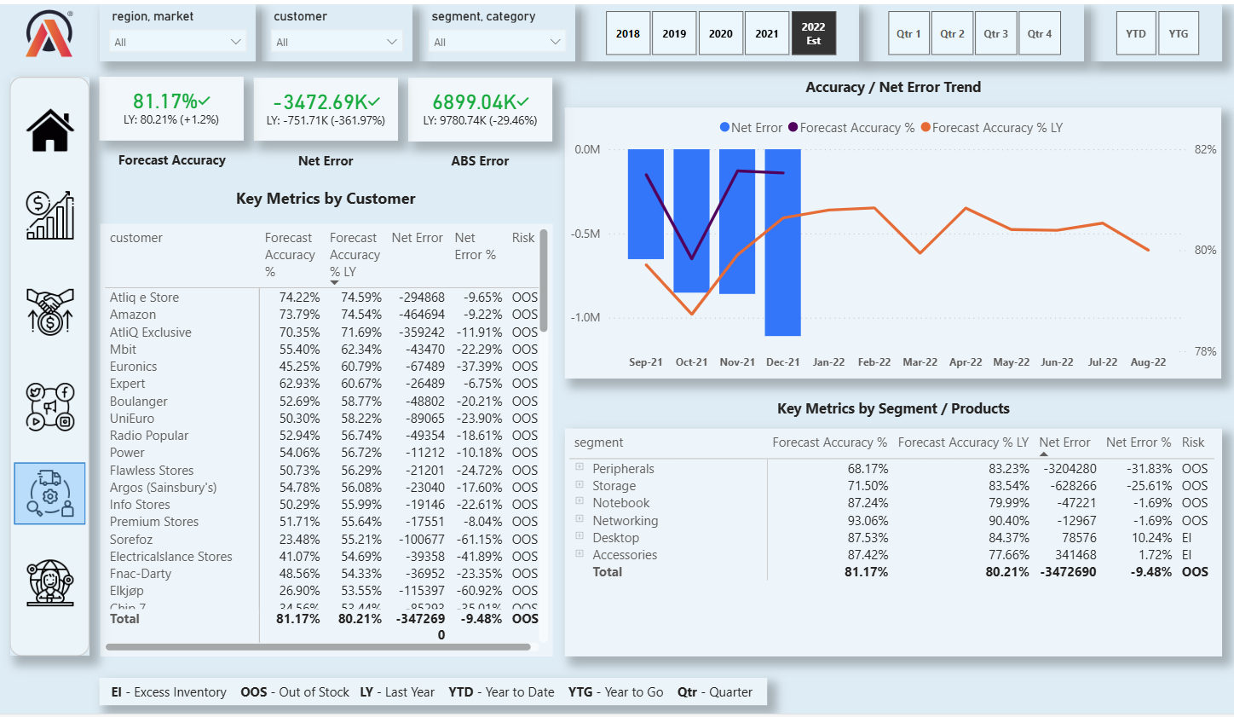
A
AtliQ Hardware
SUPPLY
Supply Chain View
Key Takeaways
FY2022 (Est.) Forecast Accuracy of 81.17%, up 1.2 points vs last year; Net Error of -3,472.69K units.
Accuracy / Net Error trend charted monthly from Sep-21 to Aug-22 against last year's accuracy line.
Key metrics by customer flag risk profile — most customers show Out-of-Stock (OOS) risk, a few show Excess Inventory (EI).
By segment: Networking (93.06%) and Accessories (87.42%) forecast most accurately; Peripherals (68.17%) and Storage (71.50%) lag.
Segment-level Net Error % highlights Peripherals as the largest under-forecast at -31.83%.
15

Slide 16
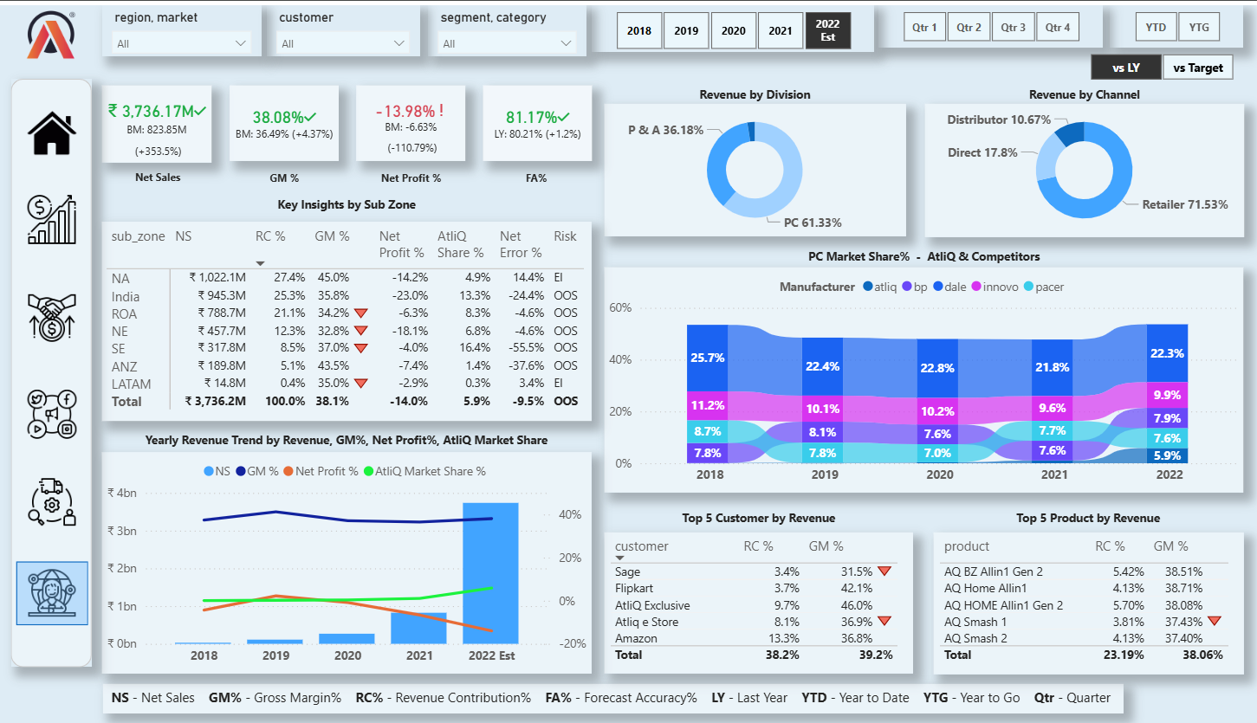
A
AtliQ Hardware
EXEC
Executive View
Key Takeaways
Consolidated FY2022 (Est.) scorecard: Net Sales ₹3,736.17M, GM% 38.08%, Net Profit% -13.98%, FA% 81.17%.
Revenue by Division: PC leads at 61.33%; by Channel: Retailer leads at 71.53%.
PC Market Share trend (2018–2022) shows AtliQ growing from ~7.8% to 22.3%, while Dale remains the largest player.
Key Insights by Sub Zone table ranks India, ROA, and NA as top revenue contributors, most flagged Out-of-Stock (OOS) risk.
5-year Net Sales trend shows sharp FY2022 growth, alongside a widening gap between GM% and Net Profit%.
16

Slide 17
KEY INSIGHTS
What the Data Tells Us

Slide 18
A
AtliQ Hardware
KI-1
Business Growth & Financial Performance
Rapid expansion: Net Sales grew ~280% (FY2019), ~140% (FY2020), ~200% (FY2021), and ~350% (FY2022).
Net Profit % has remained negative since FY2020 due to high operational and marketing expenses — typical for a company in its growth phase.
18

Slide 19

A
AtliQ Hardware
KI-2
Revenue & Market Trends
APAC remained the largest market (FY2019–FY2022), led by India, while Latin America was the smallest.
Amazon was the top global customer every year; Nova (Austria) has been the smallest since FY2020.
Notebook had the highest revenue growth every fiscal year, but the most negative Net Profit % in FY2022, likely from higher marketing spend.
Desktop had the lowest growth in FY2019 & FY2020; Networking became the weakest segment in FY2022.
USB flash drives underperformed in FY2021 & FY2022, signaling product or market challenges.
19

Slide 20

A
AtliQ Hardware
KI-3
Sales & Customer Insights
A flat post-discounting model applied uniformly across products and customers is significantly eroding Gross Margin %.
A performance-based discounting strategy, tailored per product and customer within each market, is recommended to optimize profitability.
Certain products — AQ 5000 Series Electron 9 5900X, AQ MB Elite, AQ Wi Power Dx1 — had zero sales in FY2022, likely due to demand shifts or outdated models.
20

Slide 21
A
AtliQ Hardware
KI-4
Forecast Accuracy & Supply Chain Efficiency
Forecast Accuracy (FCA%) dropped from ~86% (FY2019) to ~73% (FY2020) due to COVID-19 disruptions, then improved to ~80% (FY2021) and ~81% (FY2022).
Excess inventory was the major issue in FY2019–FY2020, while stock shortages became the challenge in FY2021–FY2022.
Work-from-home demand surged in FY2020, causing stockouts for processors, keyboards, and WiFi extenders.
21

Slide 22

A
AtliQ Hardware
KI-5
Competitive Position & Market Share
AtliQ's PC market share grew from ~1% (FY2021) to ~6% (FY2022), though Dale remains the dominant player.
India was the fastest-growing market, reaching ~13% share in FY2022.
Among subzones, North America had the highest revenue in FY2022, but AtliQ's market penetration remained only ~5%.
22

Slide 23

A
AtliQ Hardware
KI-6
Operational & Strategic Insights
Sales peaked from September to December across all years, likely driven by festive and year-end promotions.
Retailers contributed ~72% of revenue in FY2022.
The UK had the highest marketing costs, making it a key area for strategy review, followed by Germany (low revenue, high marketing spend).
23

Slide 24
RECOMMENDATIONS (1/2)
Strategic Recommendations
Gradually reduce operational and marketing expenses after capturing significant market share to improve Net Profit %.
1
Shift from flat post-discounting to a performance-based model per product and customer in each market.
2
Expand distribution and targeted marketing in high-growth regions like APAC, especially India.
3
Reevaluate the pricing or cost structure of the Notebook segment to enhance Net Profit %.
4
Investigate USB flash drive underperformance — consider repositioning, discontinuing, or improved models.
5
24

Slide 25
RECOMMENDATIONS (2/2)
Strategic Recommendations
Improve forecasting, especially for customers, using real-time data to minimize stock imbalances.
6
Develop targeted strategies to increase market share in North America.
7
Strengthen competitiveness in the PC segment through differentiation to challenge dominant players like Dale.
8
Optimize marketing spend in the UK and Germany to improve return on investment.
9
Align inventory planning and promotions with the September–December sales surge.
10
25

Slide 26

Thank You
Business Insights 360 turns scattered spreadsheets into a single source of truth —
driving faster, more confident decisions across AtliQ Hardware.

