Slide 1



Cheapify
The bright side of choosing.
Shakir Bashar · Founder
Youth Entrepreneurship Program · Final Pitch
capa.auk
CAPA AUK
capa@auk.edu.krd
Notes:
Time: ~8s
Good morning. I'm Shakir Bashar, a computer engineer — and this is Cheapify: the bright side of choosing.

Slide 2
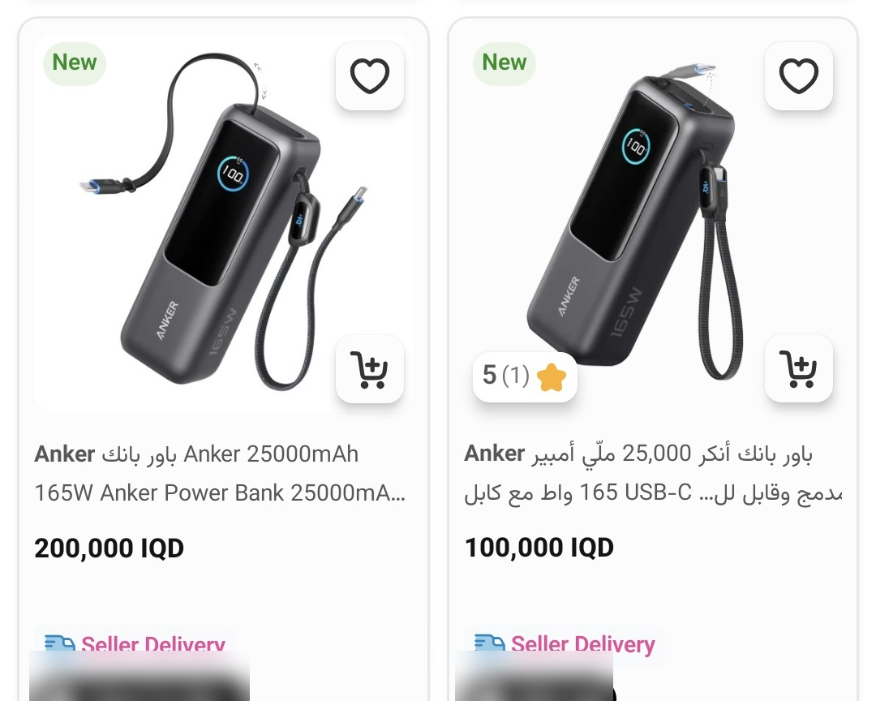
Problem
Same power bank. 100,000 or 200,000 IQD.
Every price we found for this model (IQD)
Instagram
Miswag
iBazzar
+122%
≈ 110,000 IQD more for the same model
80k
100k
120k
140k
160k
180k
200k
Miswag app — same search, same screen (Oct 20, 2026)
Live app listings captured Oct 20, 2026 (Miswag, iBazzar); Instagram offers from seller posts dated Apr–Oct 2026. Seller names blurred.
Notes:
Time: ~23s
This is one power bank — the Anker 25,000, 165 watt. Same model. On one app's search page, it's listed at 100,000 dinars… [click] and right beside it, at 200,000. [click] Across Instagram and shopping apps, we found it anywhere from 90,000 to 200,000 dinars. [click] That's 122 percent more — for the exact same product.
Key numbers:
100,000 vs 200,000 IQD — Price evidence screenshots (Sep–Oct 2026)
90,000 – 200,000 IQD — Price evidence screenshots (Sep–Oct 2026)
+122% — Price evidence screenshots (Sep–Oct 2026)
≈ 110,000 IQD — Price evidence screenshots (Sep–Oct 2026)

Slide 3
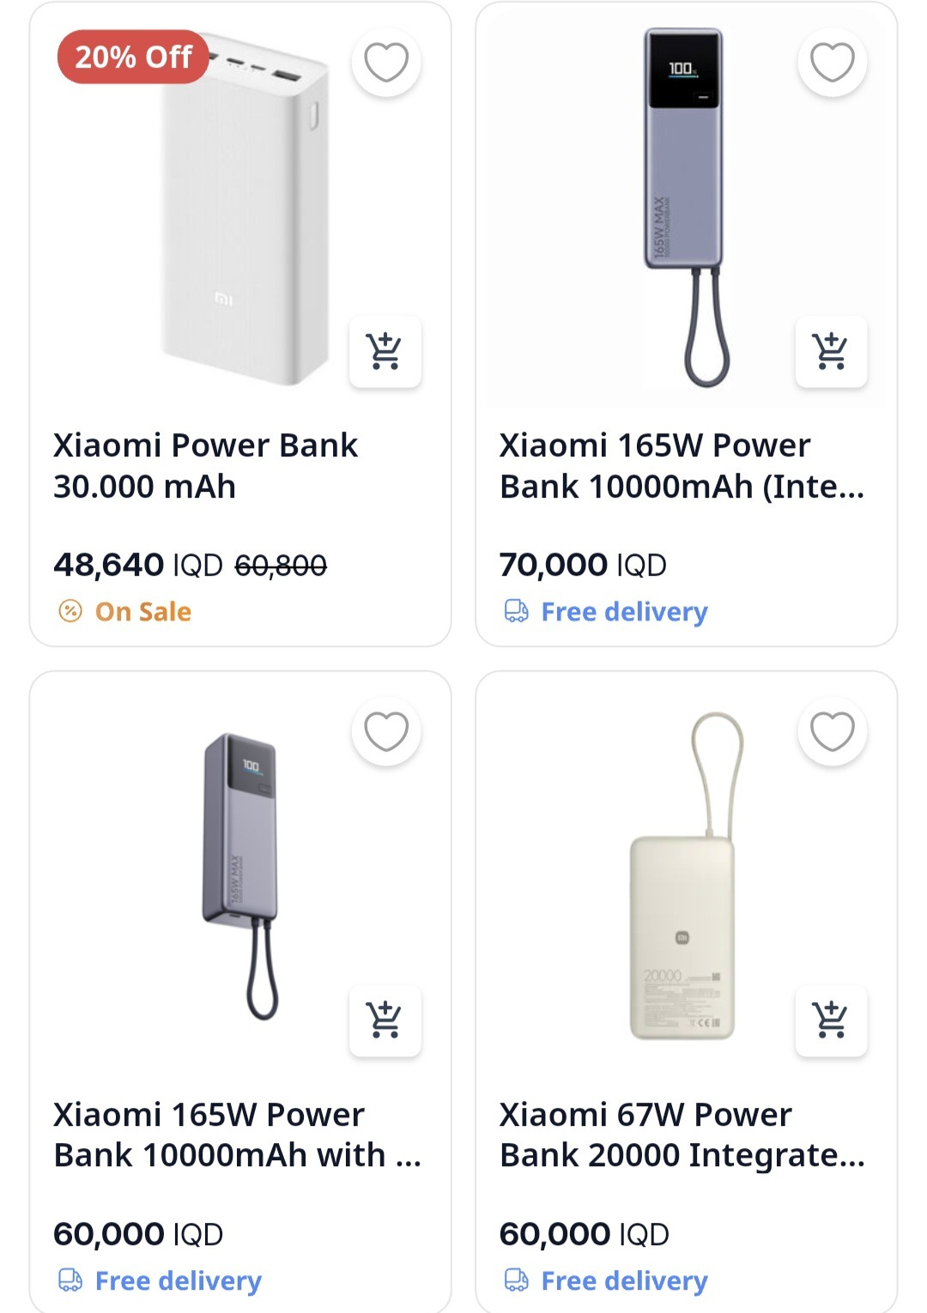
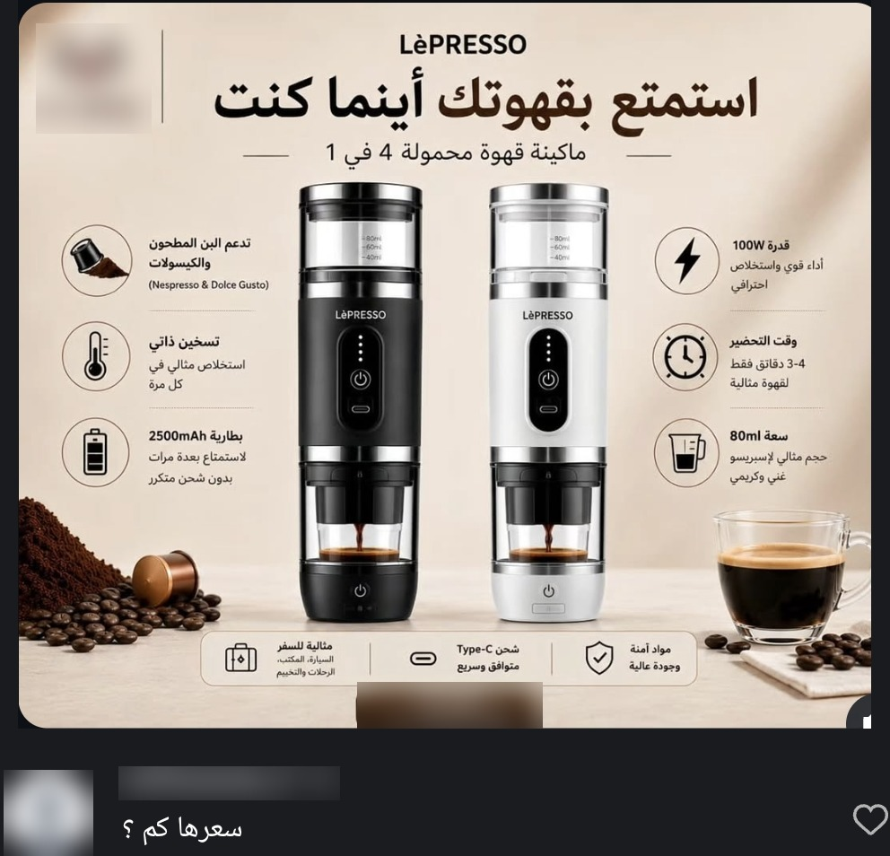
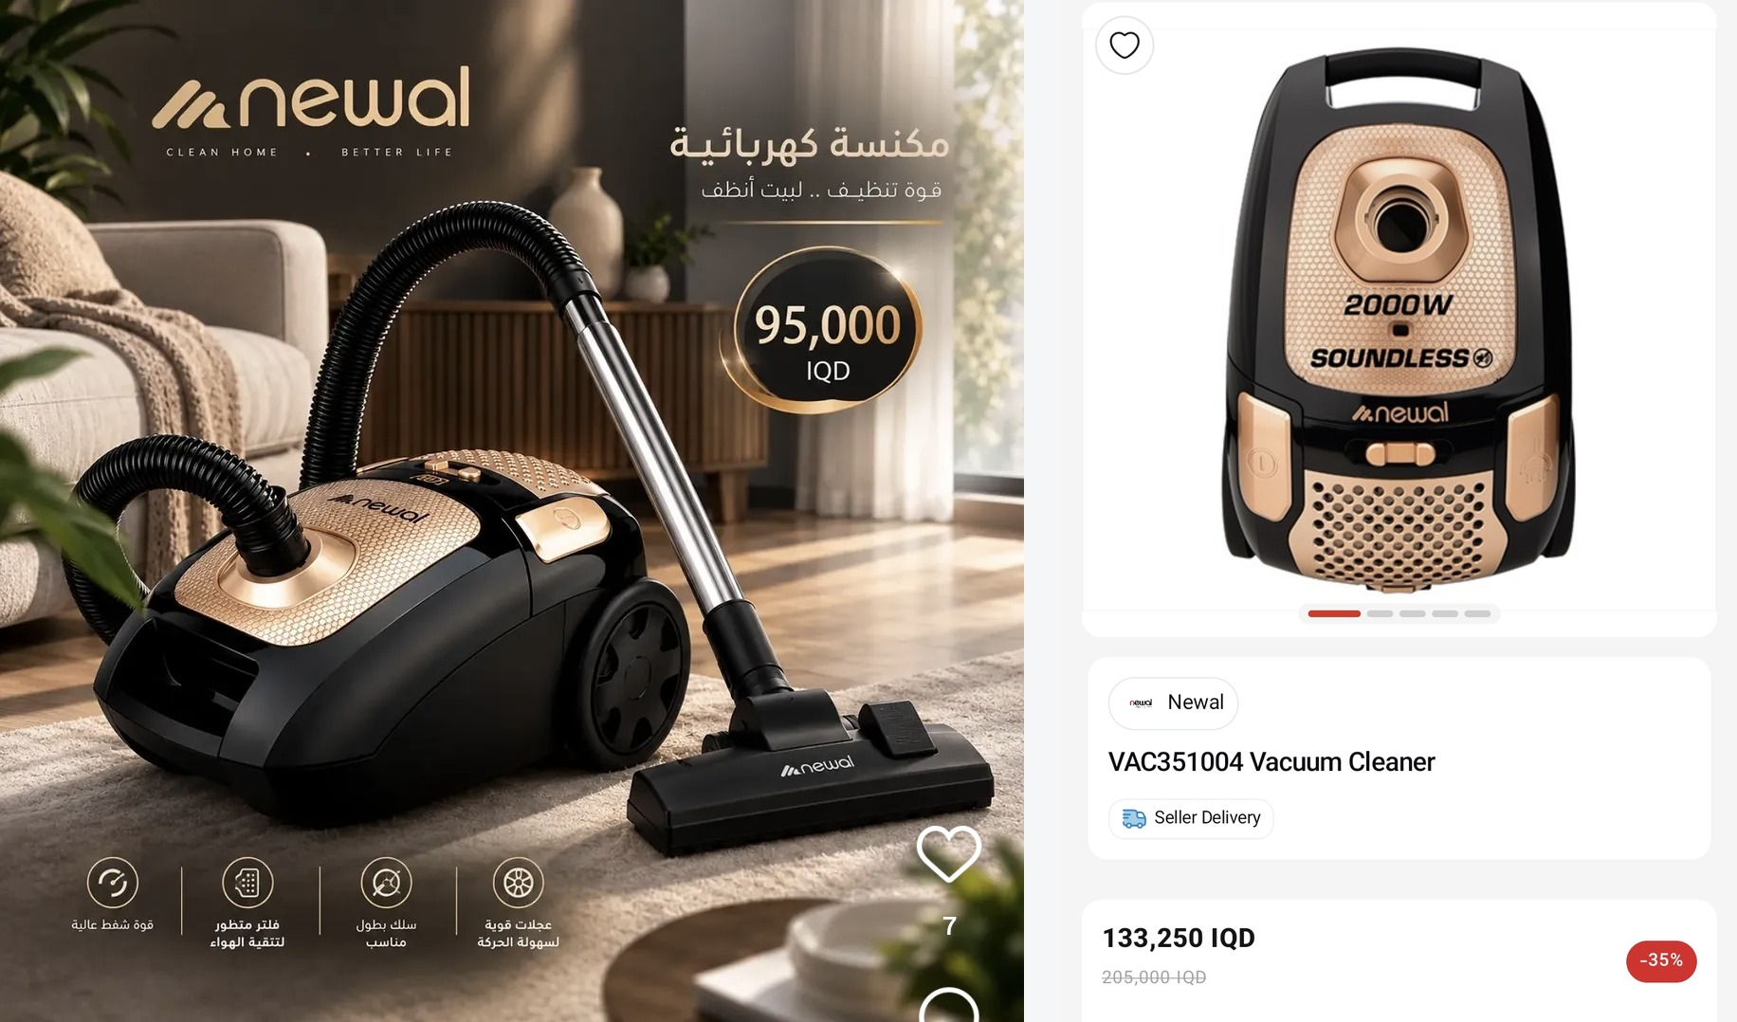
Problem · evidence
It's not one product. It's the whole market.
Same product, listed twice
No price: 'call to order'
A fake “deal”
iBazzar app · 60,000 vs 70,000 IQD
Instagram · a buyer asks: “How much is it?”
Same Newal vacuum: 95,000 on Instagram · “−35%” at 133,250 on Miswag
97%
of 179 surveyed shoppers notice big price gaps on the same item
55%
of merchants pick answering “price?” messages as a top headache — the most common answer
Screenshots Sep–Oct 2026 (shop names and phone numbers blurred) · Cheapify market survey, n=199 (179 shoppers, 20 merchants), Sep–Oct 2026.
Notes:
Time: ~27s
And it's not one product — it's the whole market. [click] Apps list the same item twice, at two prices. [click] Instagram pages hide the price — under the post, someone asks: “How much is it?” [click] And a marketplace sells a vacuum as a 35 percent “deal” — Instagram has it for 95,000. [click] In our survey of 199 people, 97 percent of shoppers see these gaps.
Key numbers:
97% — Cheapify market survey, n=199 (Sep–Oct 2026)
55% — Cheapify market survey, n=199 (Sep–Oct 2026)
199 — Cheapify market survey, n=199 (Sep–Oct 2026)
95,000 vs 133,250 IQD — Price evidence screenshots (Sep–Oct 2026)

Slide 4
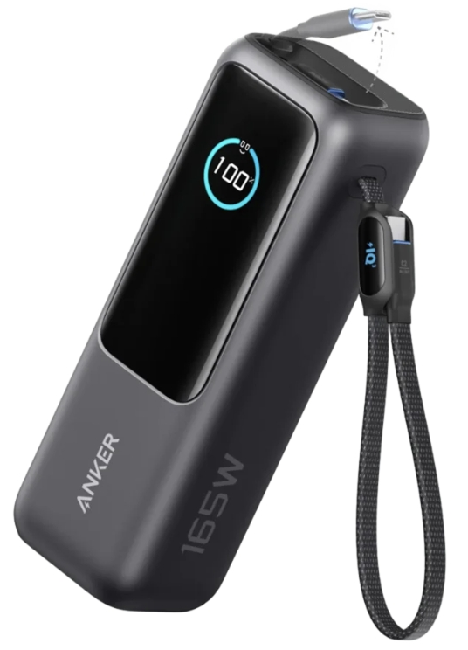

Solution
One product. One page. Every seller.
iBazzar
Instagram
Anker Power Bank 25,000 mAh · 165 W
Anker 25K 165W
Anker 25K 165W
134,000 IQD
One page · every verified seller
95,000 IQD
Miswag
Anker 25K 165W
Instagram
Seller
200,000 IQD
Anker 25K 165W
Item
Delivery
Doorstep total
Arrives
Price? DM us
Store A · Duhok
92,000
+3,000
95,000 IQD
Today
BEST VALUE
1
Lowest doorstep total
Store D · Erbil
91,000
+5,000
96,000 IQD
1–2 days
2
Fastest delivery
Store B · Duhok
Miswag
Miswag
99,000
+3,000
102,000 IQD
Today
Anker 25K 165W
Anker 25K 165W
3
Best seller rating
100,000 IQD
Instagram
121,000 IQD
Store C · Duhok
121,000
+3,000
Anker 25K 165W
124,000 IQD
Today
99,000 IQD
Ranking can't be bought.
Illustration — store names and prices are examples.
Notes:
Time: ~24s
Today, one product is scattered across pages and apps. Cheapify's rule is simple: [click] one product, one page. [click] Every seller of that product sits on it, showing the doorstep total — item plus delivery. [click] Then our Best Value ranking picks the winner: lowest doorstep total, then fastest delivery, then seller rating. And the ranking can never be bought.
Key numbers:
Doorstep total — Fast Delivery (Duhok) courier quote, Oct 2026
3,000 IQD — Fast Delivery (Duhok) courier quote, Oct 2026
3 ranking rules — Cheapify go-to-market plan

Slide 5



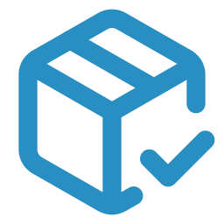



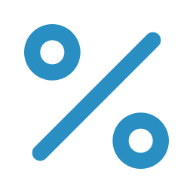
Value proposition
Shoppers save. Merchants sell.
For shoppers
For merchants
Every price, side by side
Orders, not interrogations
No more checking ten pages
Ready orders with address and variant
Order in 30 seconds
Free dashboard
No “price?” DMs, no waiting
Stock, orders and payouts in one place
Cash on delivery or card
Fair, low fee
Doorstep total shown upfront
About 3.8% on a typical 25,000 IQD order
Notes:
Time: ~20s
For shoppers: [click] every price side by side, an order in thirty seconds, and cash on delivery — or card. For merchants: [click] real orders instead of “price?” messages, a free dashboard for stock and payouts, and a fair fee — about 3.8 percent on a typical order.
Key numbers:
≈ 3.8% — Cheapify financial model
30 seconds — Cheapify go-to-market plan

Slide 6
Target market
Duhok first: about 1 million people.
Iraq
Duhok governorate
Launch area: Duhok · Semel · Zakho
People
People
People
46.1M
census
1.60M
census
1.06M
census
Internet users
Internet users
Internet users
39.6M
published
≈ 1.34M
estimate
≈ 0.89M
estimate
Online shopping / year
Online shopping / year
Online shopping / year
$1.32B
published
≈ $46M
estimate
≈ $30M
estimate
Break-even needs only about 0.4% of the launch area's online shopping.
Launch: Duhok · Semel · Zakho
Next: Erbil · Mosul · Sulaymaniyah
Then: all of Iraq
Population: 2024 national census (Iraqi Ministry of Planning). Internet users: DataReportal, Digital 2026: Iraq. E-commerce: ECDB, Iraq 2025. Duhok figures marked “estimate” = Iraq rate × Duhok population share.
Notes:
Time: ~24s
We launch in Duhok city, Semel and Zakho. [click] Duhok governorate has 1.6 million people; [click] our launch area alone has about 1.06 million — roughly 890,000 online, spending about 30 million dollars a year shopping online. We need just 0.4 percent of that to break even. [click] Then Erbil, Mosul and Sulaymaniyah — then all of Iraq.
Key numbers:
46.1M · 1.60M · 1.06M — 2024 national census, Iraqi Ministry of Planning
39.6M — DataReportal, Digital 2026: Iraq
$1.32B — ECDB, Iraq e-commerce 2025
≈ 0.89M · ≈ $30M — 2024 national census, Iraqi Ministry of Planning
≈ 0.4% — Cheapify financial model

Slide 7



Target customers
Who we serve.
Shoppers
target groups
Merchants
Young professionals · 23–38
Social-media shops in Duhok
Tech, gadgets, perfume — no time for DMs
Instagram · Facebook · TikTok
1,500–50,000 followers
20–150 products
Tech, accessories, beauty, home, perfume
Families · 26–48
Kitchen, home, personal care — savings and reliable delivery
Students & deal hunters · 18–24
85%
sell on Instagram or Facebook
Chargers, cables, gaming — refuse to overpay
75%
want to try Cheapify
88%
of 179 surveyed shoppers would use an app like Cheapify
of 20 surveyed merchants
Age groups are our targeting plan — the survey did not ask age. Survey: Cheapify market survey, n=199 (179 shoppers, 20 merchants), Sep–Oct 2026.
Notes:
Time: ~22s
Who exactly? Young professionals with no time for DMs, families who want savings and reliable delivery, and students who refuse to overpay — 88 percent of surveyed shoppers would use an app like this. [click] And Duhok's social-media shops: 85 percent sell on Instagram or Facebook, and 75 percent want to try Cheapify.
Key numbers:
88% — Cheapify market survey, n=199 (Sep–Oct 2026)
85% — Cheapify market survey, n=199 (Sep–Oct 2026)
75% — Cheapify market survey, n=199 (Sep–Oct 2026)
~8 — Cheapify market survey, n=199 (Sep–Oct 2026)

Slide 8



Product
Order in 30 seconds. Pay at the door.
1
Search
Cheapify
1
Checkout
Your store · Orders
Payout sent
Anker 25K · 165 W
Find any product in one place
Order #1042 · delivered
Anker 25K · 165 W
anker power bank
4 sellers
Return window closed (48 h)
New order
2
Compare
Item
92,000
2
Anker 25K · Black · ×1
Anker 25K · 165 W
Every seller on one page — Best Value on top
Item
92,000
Delivery (Duhok)
3,000
95,000 IQD · cash on delivery
from 95,000 IQD · 4 sellers
Store A · Duhok
Cheapify fee
−2,960
Order
95,000 IQD
3
BEST VALUE
3
Doorstep total
Duhok — Malta
Doorstep total
Doorstep total upfront · cash or card
95,000 IQD
Anker 10K · 30 W
Paid to you
Accept
Print waybill
Store D · Erbil
from 35,000 IQD
89,040 IQD
96,000 IQD
Cash on delivery
4
Merchant packs, courier picks up
Doorstep total
4
Xiaomi 10K · 165 W
The order lands on the dashboard and WhatsApp
Card / e-wallet
Courier pickup today
Store B · Duhok
102,000 IQD
from 60,000 IQD
Automatic payout
5
Doorstep total
5
Order now
Paid 48 hours after delivery, minus our fee
Concept screens — app in development.
Notes:
Time: ~23s
Here's how it works. A shopper searches. [click] Sees every seller on one page, Best Value on top. [click] Orders in thirty seconds — cash on delivery, or card. [click] The merchant gets a ready order, packs it, and the courier picks it up. [click] 48 hours after delivery, the merchant is paid automatically, minus our fee.
Key numbers:
30 seconds — Cheapify go-to-market plan
48 hours — Cheapify financial model
2,960 IQD — Cheapify financial model

Slide 9
Business model
We earn only when an order is delivered.
Shopper pays 28,000 IQD (25,000 item + 3,000 Duhok delivery)
950 fee + 500 delivery margin
28,000 IQD
Merchant 24,050 IQD — keeps 96% of the item price
Courier 2,500
Cheapify 1,450
Our fee gets lighter as prices rise
5%
From our 1,450 IQD
3%
WhatsApp order messages
−90
Login codes
−25
1.5%
Share of returns
−20
Re-sending failed deliveries
−200
first 10,000 IQD
10,001 – 100,000
above 100,000
Profit per delivered order
1,115 IQD
Example: 25,000 IQD item, cash on delivery, Duhok city; courier rate 2,500 IQD quoted by Fast Delivery (Duhok). The delivery margin applies once the courier contract is signed. Card processing fees not yet quoted.
Notes:
Time: ~22s
We only earn when an order is delivered. On a 25,000-dinar order, the shopper pays 28,000. [click] 24,050 goes to the merchant, [click] 2,500 to the courier, [click] 1,450 to us. [click] Our fee gets lighter as prices rise. [click] After about 335 in costs — messages, returns, re-deliveries — we keep 1,115 dinars per order.
Key numbers:
28,000 IQD — Cheapify financial model
24,050 · 2,500 · 1,450 — Cheapify financial model
5% · 3% · 1.5% — Cheapify financial model
335 IQD — Cheapify financial model
1,115 IQD — Cheapify financial model

Slide 10




Competitor analysis
Nobody else puts every seller on one page.
Instagram / Facebook
Miswag
iBazzar
Elryan
Cheapify
Prices shown upfront
One page per product
Every seller compared on that page
Third-party sellers can join
yes
partly
no
Based on in-app screenshots (Sep–Oct 2026) and public platform information.
Notes:
Time: ~21s
Look at today's options. [click] On Instagram, prices are often hidden. Miswag, iBazzar and Elryan show prices — but the same product shows up in several listings, and Elryan sells only its own stock. [click] Only Cheapify puts every seller of a product on one page — and compares them for you.
Key numbers:
4 platforms — Price evidence screenshots (Sep–Oct 2026)
4 criteria — Price evidence screenshots (Sep–Oct 2026)

Slide 11






Growth strategy
We grow on two sides: stores and shoppers.
Stores
Shoppers
I sign the first 20 stores in person
Targeted ads across Duhok
Bazaar visits, Instagram outreach, a 45-second demo video
Facebook, Instagram, TikTok — real products, real prices
A founding offer they can't ignore
Short videos
0% commission in month 1 + their products in our paid ads
“The old way vs the Cheapify way”
Their followers come too
Campus & workplace deals
Store link in bio and in replies to “price?” comments
UoD, AUK, Nawroz and office hubs
Waitlist & referrals
~52 contacts ready · credits only after a delivered order
More stores
Lower prices
More shoppers
More orders
Notes:
Time: ~23s
We grow on two sides. [click] Stores: I sign the first 20 in person, with zero commission in month one and free ads — and they bring their own followers. [click] Shoppers: targeted ads across Duhok, short videos, campus and workplace deals, and referrals. [click] Then the loop: more stores, lower prices, more shoppers, more orders.
Key numbers:
20 — Cheapify go-to-market plan
0% — Cheapify go-to-market plan
~52 — Cheapify market survey, n=199 (Sep–Oct 2026)
~8 — Cheapify market survey, n=199 (Sep–Oct 2026)

Slide 12
Financial feasibility
Break-even at about 20 orders a day.
~585 orders / month
Fast
Planned
Slow
keeps rising
break-even · about 20 a day
+$3k
1,115 IQD
+$2k
profit per delivered order
+$1k
Lowest cash point
Monthly break-even
All losses recovered
Fast
−$1,800 (month 2)
Month 3
Month 6
Planned
−$2,180 (month 3)
Month 4
Month 8
$0
−$1k
Slow case: profitable
every month from month 7
−$2k
−$3k
Start
Launch
M2
M4
M6
M8
M10
Planned: orders grow 100 → 2,000 a month; Fast: twice that pace; Slow: half. Costs 652,000 IQD/month after launch (790,000 from month 6), incl. 1.7M IQD startup. Assumes 25,000 IQD average order and a signed courier contract. USD at 1,500 IQD.
Notes:
Time: ~26s
We break even at about 585 orders a month — around 20 a day. [click] On our planned pace, the lowest cash point is about 2,200 dollars; we break even in month four and recover everything by month eight. [click] With a strong growth push: month three and month six. [click] Even if growth is slow, we're profitable every month from month seven.
Key numbers:
≈ 585 orders / month — Cheapify financial model
1,115 IQD — Cheapify financial model
−$2,180 (month 3) — Cheapify financial model
−$1,800 (month 2) — Cheapify financial model
652,000 IQD — Cheapify financial model

Slide 13

Funding
What $7,500 makes possible.
Each amount has a job
Launch gap (until break-even)
$2,200
$7,500 — Grow fast
Growth marketing
$2,500
+ growth marketing and founding-store kits → aims for the fast case
Registration & legal
$1,000
$7,500
$4,500 — Launch properly
Merchant kits & packaging
$900
+ hand-run pilot, company registration (unlocks the courier contract and card payments), larger reserve
≈ 11.25M IQD
Reserve
$800
Pilot test (10–20 orders)
$100
$2,500 — Reach break-even safely
Covers the cash gap until monthly break-even
No salaries. No developers. I build the platform myself.
Notes:
Time: ~29s
We're asking for 7,500 dollars, and every dollar has a job. [click] Cash gap, growth, registration, store kits, pilot, reserve. [click] 2,500 carries us safely to break-even. [click] 4,500 adds the pilot and registers the company — unlocking the courier contract and card payments. [click] 7,500 adds a real growth push, aiming for the fast case. [click] And none of it goes to salaries or developers — I build the platform myself.
Key numbers:
$7,500 (≈ 11.25M IQD) — Cheapify financial model
$4,500 · $2,500 — Cheapify financial model
$2,200 — Cheapify financial model

Slide 14

Funding is done — what now?
Grant → pilot → launch → break-even.
First
Next
Launch
Month 4
Month 7+
1
2
3
4
5
Register the company & sign the courier contract
Hand-run pilot:
10–20 real orders
20 founding stores go live in Duhok
Monthly break-even
Erbil · Mosul · Sulaymaniyah
Rates already quoted
Measure real order size and costs
Cash on delivery; card soon after
About 600 orders a month
Then all of Iraq
We report monthly: delivered orders · sales volume · active stores · repeat orders · delivery time
Notes:
Time: ~16s
Once funded: [click] we register and sign the courier contract — rates are already quoted. [click] We run 10 to 20 real orders by hand. [click] We launch with 20 founding stores. [click] Break-even by month four, [click] then Erbil, Mosul and Sulaymaniyah.
Key numbers:
10–20 — Cheapify financial model
20 — Cheapify go-to-market plan
Month 4 · ~600 orders — Cheapify financial model

Slide 15
Thank you
The bright side of choosing.
ڕوویێ گەش یێ هەلبژارتنێ
الجانب المشرق للاختيار
getcheapify.com
Shakir Bashar · Founder
capa.auk
CAPA AUK
capa@auk.edu.krd
Notes:
Time: ~4s
Cheapify — the bright side of choosing. Thank you.

Slide 16
Appendix
Fee schedule: lighter as prices rise
5% on the first 10,000 IQD · 3% on 10,001–100,000 · 1.5% above 100,000 — marginal, like tax brackets: a higher price never pays a lower fee.
Item price (IQD) | Cheapify fee (IQD) | Effective rate
5,000 | 250 | 5.0%
10,000 | 500 | 5.0%
25,000 | 950 | 3.8%
45,000 | 1,550 | 3.4%
100,000 | 3,200 | 3.2%
150,000 | 3,950 | 2.6%
350,000 | 6,950 | 2.0%
1,200,000 | 19,700 | 1.6%
Notes:
Backup for questions.

Slide 17
Appendix
Unit economics per order
Per 25,000 IQD order (Duhok city) | IQD
Platform fee | +950
Delivery margin (3,000 charged − 2,500 courier) | +500
WhatsApp notifications | −90
Login codes (OTP) | −25
Returns | −20
Failed-delivery re-attempts | −200
Kept per delivered order | +1,115
Break-even (monthly costs 652,000 IQD after launch, incl. a capped 225,000 incentive pool)
Case | Kept per order | Break-even orders / month
Base case | 1,115 | ~585
Courier contract not signed | 615 | ~1,060
Average order 20,000 IQD | 965 | ~676
Incentive pool doubled | 1,115 | ~787
Notes:
Backup for questions.

Slide 18
Appendix
Three growth scenarios
Scenario | Orders by month 6 | Lowest cash point | Monthly break-even | All losses recovered
Fast (2× plan) | 2,700 / month | −$1,800 (month 2) | Month 3 | Month 6
Planning | 1,350 / month | −$2,180 (month 3) | Month 4 | Month 8
Slow (half of plan) | 675 / month | −$2,750 (month 6) | Month 7 | ~Month 20
Includes 1.7M IQD startup costs and two build months before launch. USD at 1,500 IQD.
Notes:
Backup for questions.

Slide 19
Appendix
Survey: what 199 people told us
Shoppers (179)
Merchants (20)
97% notice price gaps on the same item (39% often see large gaps)
88% would use a side-by-side app · 10% maybe · 2% prefer DMs
Top annoyances: untrusted / duplicate pages ~52% · found it cheaper after buying ~47% · DM just to ask the price ~46% · delivery delays ~27%
~52 usable beta-waitlist contacts
85% sell on Instagram / Facebook
75% would try Cheapify · 15% maybe (depends on commission) · 10% no
Top headaches: “price?” DMs 55% · price conflicts 45% · cost of own app/site 35% · manual delivery coordination 35%
~8 valid pilot-store leads
Limits: self-selected sample; only 10 Kurdish-language responses; stated intent is not purchases — the hand-run pilot measures real behavior.
Notes:
Backup for questions.

Slide 20
Appendix
Six documented price cases
Product | Lowest | Highest | Gap | Where
Anker power bank 25K 165W | 90,000 (Instagram) | 200,000 (Miswag) | +122% | Instagram, iBazzar, Miswag
ASUS VA24EHF monitor | 135,000 (Elryan) | 163,350 (Miswag) | +21% | Elryan, Miswag
Hoco HX80 coffee maker | 25,000 (Instagram) | 35,280 (Miswag) | +41% | Instagram, Miswag
Newal 2000W vacuum | 95,000 (Instagram) | 133,250 (Miswag) | +40% | Instagram, Miswag
Xiaomi 165W power bank | 60,000 | 70,000 | +17% | Same app (iBazzar)
Coffee machines (two posts) | — | — | No price shown | Instagram: “call / DM to order”
Screenshots Sep–Oct 2026; Instagram posts dated Apr–Oct 2026.
Notes:
Backup for questions.

Slide 21
Appendix
Top risks and how we handle them
Risk | How we handle it
Buyers and sellers bypass the app | Low fee (~3.8%), no contact details on parcels, credits and ratings count only on-platform
Slower growth than planned | Plan is already conservative; half-speed case capped at ~$2,750; hand-run pilot tests demand before spending
Courier contract delayed | Registration first (budgeted); second courier quote as fallback; without the margin, break-even ≈ 1,060 orders/month
Failed deliveries ("not at home") | One free re-attempt; 3 failures remove cash-on-delivery; WhatsApp reminder before delivery
Courier transfers cash late | Contract sets a transfer deadline (target 24 h); merchants are paid only after the money arrives; card payments reduce cash
Notes:
Backup for questions.

Slide 22
Appendix
How an order flows
1
2
3
4
5
6
7
Checkout (cash or card)
Merchant accepts
Sealed package + waybill
Courier pickup
Delivery (cash collected)
Courier transfers to Cheapify
Merchant paid after 48 h
Returns: 48 hours — faulty item: merchant pays the return; change of mind: customer pays 3,000 IQD.
Refunds: card → back to the card; cash orders → Cheapify credit, or electronic transfer for faulty items.
Failed delivery: one free re-attempt, then back to the merchant.
Packaging: opaque and sealed; tamper tape on orders ≥ 50,000 IQD.
Notes:
Backup for questions.

Slide 23
Appendix
How we sized Duhok
Figure | Value | How | Source
Launch-area population | 1,062,224 | Duhok 497,029 + Zakho 398,876 + Semel 166,319 | 2024 census
Duhok governorate population | 1,599,871 | — | 2024 census
Launch-area internet users | ≈ 0.89M | 1,062,224 × 83.8% | DataReportal rate (Iraq)
Launch-area online shopping | ≈ $30M / year | 2.30% of Iraq's population × $1.32B | ECDB Iraq 2025
Break-even sales | ≈ $117,000 / year | 585 orders × 25,000 IQD × 12 ÷ 1,500 | Cheapify model
Share needed | ≈ 0.4% | $117,000 ÷ $30M | —
No official Duhok internet or e-commerce figures exist; estimates use Iraq-wide rates. Duhok is 80% urban, so these are likely conservative.
Notes:
Backup for questions.

