Slide 1
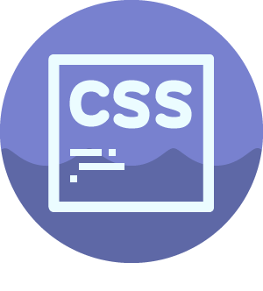
FRONT END WEB DEVELOPEMENT
BATTACH YAHIA
Senior full stack developer at glaxiom

Slide 2
# COURSE CONTENT
1# CSS Role and Syntax
2# CSS Selectors
3# Common CSS Concepts
4# CSS Layouts
5# Responsive Design
6# CSS Animation

Slide 3

1# CSS Role and Syntax
Cascading Style Sheets
Notes:
CSS describes how HTML elements are to be displayed

Slide 4
1# CSS Role and Syntax
ROLE: CSS is used to define styles for your web pages, including the design, layout and variations in display for different devices and screen sizes.

Slide 5
1# CSS Role and Syntax
CSS How To..
Three Ways to Insert CSS
External style sheet
Internal style sheet
Inline style

Slide 6
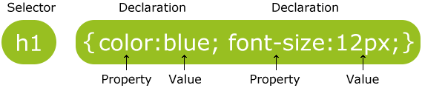
1# CSS Role and Syntax
CSS SYNTAX

Slide 7
1# CSS Role and Syntax
Cascading Order !!!
What style will be used when there is more than one style specified for an HTML element ?
Inline style (inside an HTML element)
External and internal style sheets (in the head section)
Browser default

Slide 8
2# CSS Selectors
CSS selectors are used to "find" (or select) HTML elements based on their element name, id, class, attribute, and more.

Slide 9
2# CSS Selectors
Examples via practical approach

Slide 10
2# Common CSS Concepts
Examples via practical approach

Slide 11
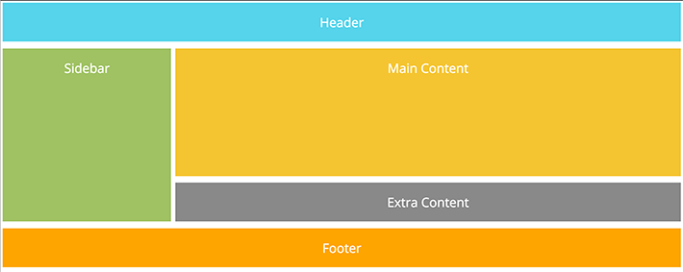
3# CSS Layouts

Slide 12

3# CSS Responsive Design

Slide 13

3# CSS Animation

