Slide 1
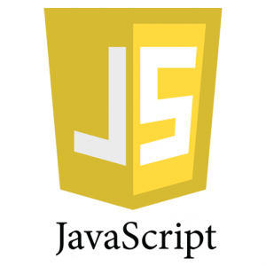
FRONT END WEB DEVELOPEMENT
BATTACH YAHIA
Senior full stack developer at glaxiom

Slide 2
# Course Content
1# JavaScript Introduction
2# JavaScript Basics
3# JavaScript Functions & Objects
4# DOM
5# Events
6# Ajax calls
7# The NodeJS Meth

Slide 3
1# JavaScript Introduction

Slide 4
2# JavaScript Basics
JS Where To …
The <script> Tag
In the head or in the body
External Javascript
Writing into the browser console, using console.log().

Slide 5
2# JavaScript Basics
JS OutPuting
Writing into an HTML element, using innerHTML.
Writing into the HTML output using document.write().
Writing into an alert box, using window.alert().
Writing into the browser console, using console.log().

Slide 6
2# JavaScript Basics
JS Variables
Var keyword is used to declare variables in JS
Variables has data types
JS types are dynamic

Slide 7
2# JavaScript Basics
JS Data Types
Var keyword is used to declare variables in JS
Variables has data types
JS types are dynamic

Slide 8
3# JavaScript Functions & Objects
Practical Examples

Slide 9
4# DOM
Practical Examples

Slide 10
5# Events
Practical Examples

Slide 11
6# AJAX Calls
Practical Examples

Slide 12
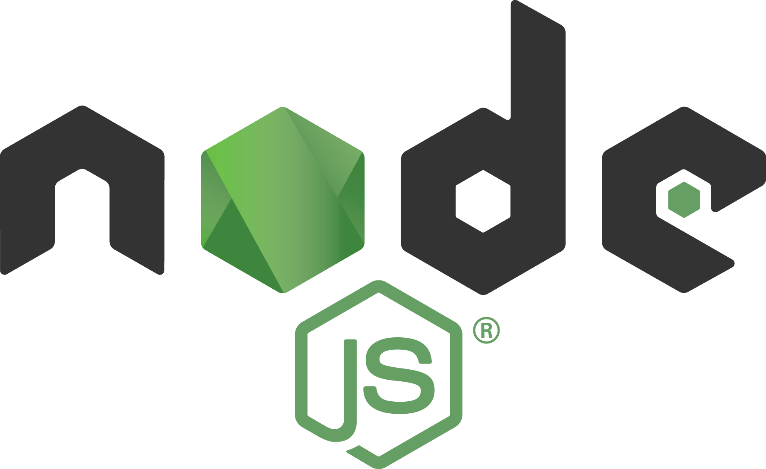
6# The NodeJS Meth

