Slide 1
SCENE DESCRIPTION FOR VISUALLY IMPARED PEOPLE USING DEEP LEARNING

Slide 2
Group 6
Abhijith Kalari Thothathil (C0812709)
Aleesha Shan (C0812687)
Muhammed Shakhil (C0813605)
Sachin Tomy (C0809647)

Slide 3
Introduction
Model leans to recognize the content of an image and generates a caption out of it.
Integrate Computer Vision and Natural Language Processing
Model include RNN for text synthesis and feature extraction.

Slide 4
Dataset
Flicker 8k
It is realistic and small hence easy to work with.
Labelled correctly.
Available for free.
contains 8092 JPEG photos in various sizes and shapes.

Slide 5
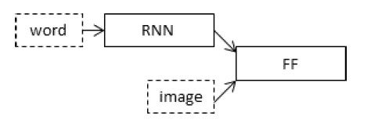
Model
We will describe the model in three parts:
Photo Feature Extractor
Sequence Processor
Decoder

Slide 6
Photo feature Extraction
Visual Geometry Group (VGG 16)
Used to extract features from the image.
Use them as inputs to our existing model
Image features are a 1-dimensional 4,096 element vector.

Slide 7
Preparing Text Data
The dataset contains multiple descriptions for each photograph
First, we will load the file containing all of the descriptions
Each photo has a unique identifier. This identifier is used on the photo filename and in the text file of descriptions.

Slide 8

Preparing Text Data
We will clean the text in the following ways
Convert all words to lowercase
Remove all punctuation.
Remove all words that are one character or less in length (e.g. ‘a’).
Remove all words with numbers in them.
Size of cleaned Vocabulary is 8763 words

Slide 9
Sequence Processor
This is a word embedding layer for handling the text input.
followed by a Long Short-Term Memory (LSTM) recurrent neural network layer with 256 memory units.

Slide 10
Decoder
The Decoder model merges the vectors from both input models using an addition operation
This is then fed to a Dense 256 neuron layer and then to a final output Dense layer.
Output dense layer makes a softmax prediction over the entire output vocabulary for the next word in the sequence.

Slide 11
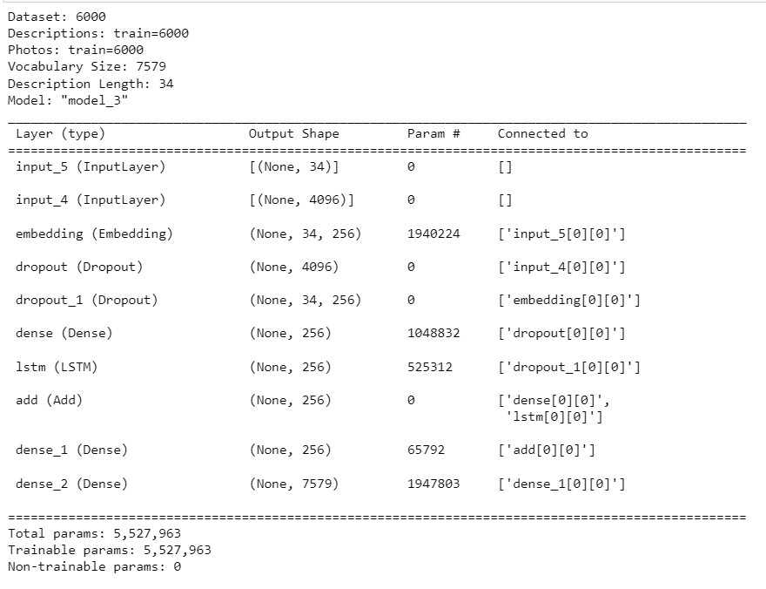
Model Summary

Slide 12
Fitting the Model
We define a Model Checkpoint in Keras and specifying it to monitor the minimum loss on the validation dataset.
Then save the model to a file that has both the training and validation loss.

Slide 13
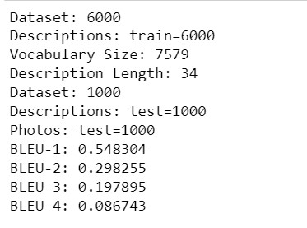
Evaluate the Model
First, we need to be able to generate a description for a photo using a trained model.
We use BLEU score to evaluate the model.
Score = 1 for perfect match
Score = 0 for perfect mismatch

Slide 14
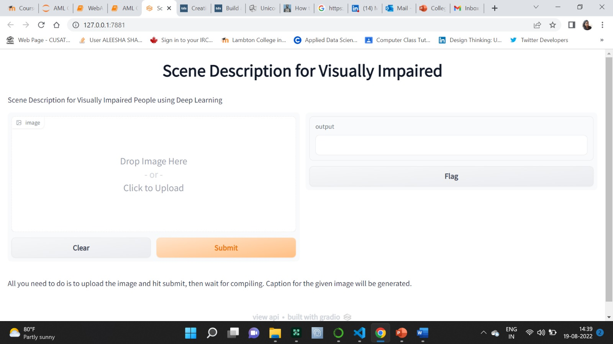
Results

Slide 15
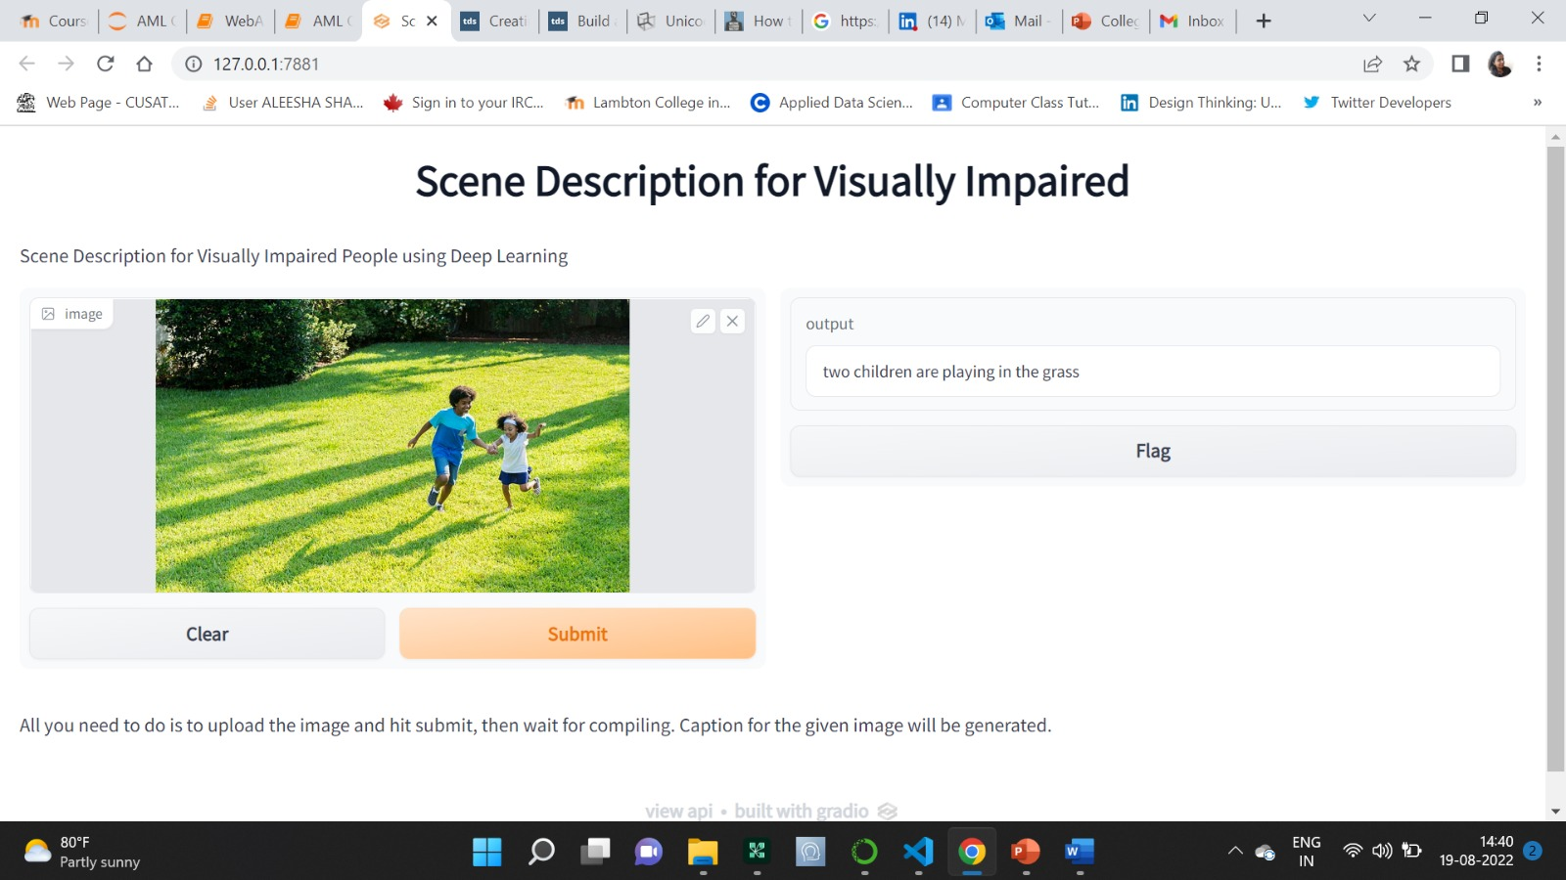
Results

Slide 16
Conclusion
We have introduced a deep learning model that automatically produce image captions.
This helps the visually impaired people to understand the surroundings.
Used Computer vision and RNN for feature extraction and caption generation.

Slide 17
References
[1]. Amritkar, C., & Jabade, V. (2018). Image Caption Generation Using Deep Learning Technique. 2018 Fourth International Conference on Computing Communication Control and Automation (ICCUBEA). https://doi.org/10.1109/iccubea.2018.8697360
[2]. Julakanti, V. (2021). Image Caption Generator using CNN-LSTM Deep Neural Network. International Journal for Research in Applied Science and Engineering Technology, 9(VI), 2968–2974. https://doi.org/10.22214/ijraset.2021.35663
[3]. Sharma, G., Kalena, P., Malde, N., Nair, A., & Parkar, S. (2019). Visual Image Caption Generator Using Deep Learning. SSRN Electronic Journal. https://doi.org/10.2139/ssrn.3368837

Slide 18
THANKS!
Any questions?

